Slide 1
"Exercising our Freedom"

Slide 2
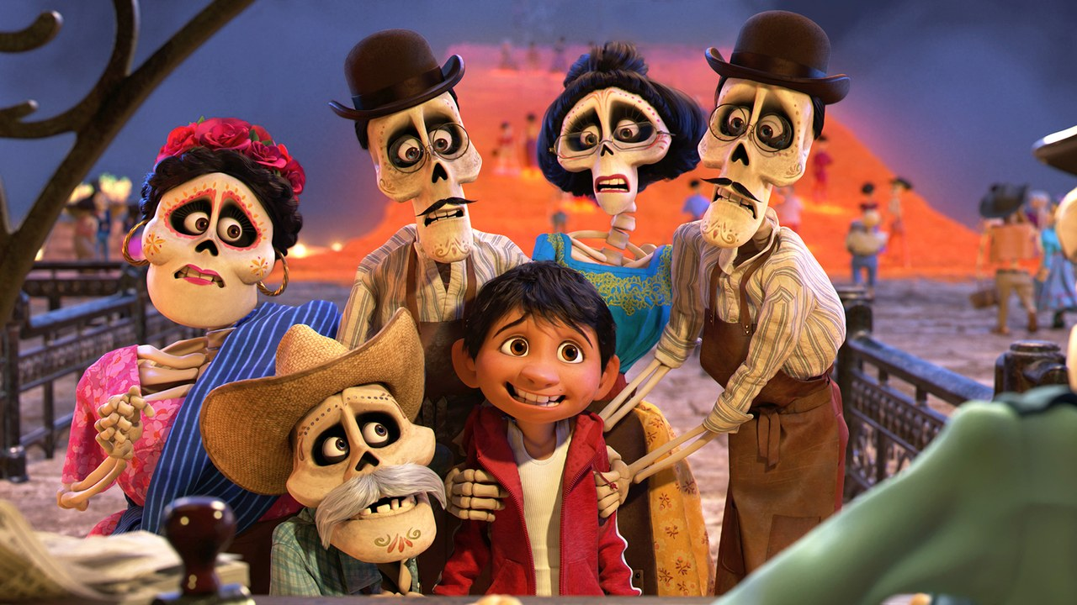
Coco
Notes:
Emma’s friend posted on FB about the movie, Coco. In which a young boy passes over to the realm of the dead on Mexico’s Day of the Dead. She was critical of the idea that having pictures and other objects of dead relatives and making offerings to them could allow them to go on existing in the afterlife and even come for a visit.
Pretty understandable! This is clearly not Christian teaching about the afterlife!
When she saw the post, Emma’s friend, Alana, messaged her, because she had actually seen Coco at the Wharf. She said, “If ever you feel uncomfortable about something, talk to us.” It turns out she was also concerned about a fantasy video game that had dragons in it. She thought dragons are a symbol for Satan. She also thought the game quite violent. It brought up things from her past that she’d already overcome.
And when some people played the game, they would occasionally swear in their enthusiasm. Had coffee last Sunday …
Alana was planning to discuss this at the next Wharf meeting about how to manage different convictions that Christians have about what is OK to watch or play, etc.

Slide 3
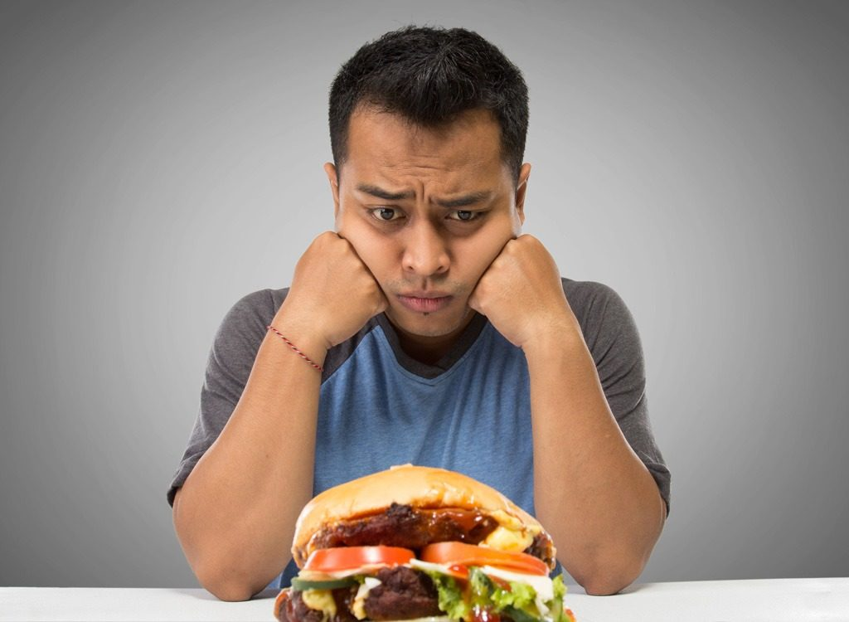
Meat sacrificed to idols
Notes:
So what happens when people have different convictions about what is OK to watch, listen to, eat, wear or buy?
That’s the subject of 1 Cor 8.
Most meat sold in the town marketplace came from sacrificial animals that had been slaughtered at pagan temple ceremonies. Part of the meat of each sacrificial animal was burned on the temple altar, part was eaten in temple ceremonies, and part was sold in the Corinthian marketplace for consumption at home.
Did these rituals somehow automatically taint the food? Could Christians buy it? Could they eat it if it was offered to them at friends’ homes?
People who has recently been converted from paganism were especially sensitive to this issue.
This the question they posed to Paul …

Slide 4
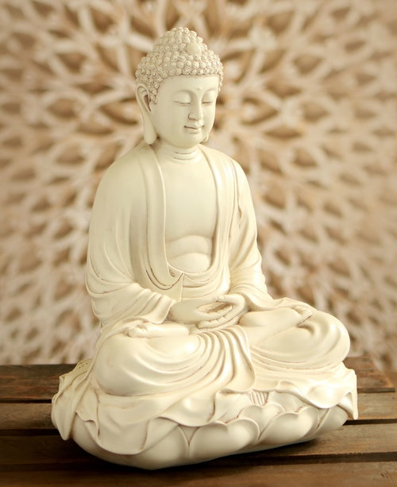
Go for it!
So then, about eating food sacrificed to idols: we know that ‘An idol is nothing at all in the world’ and that ‘There is no God but one.’ 5 For even if there are so-called gods, whether in heaven or on earth (as indeed there are many ‘gods’ and many ‘lords’), yet for us there is but one God, the Father, from whom all things came and for whom we live; and there is but one Lord, Jesus Christ, through whom all things came and through whom we live.
Verses 4-6
Notes:
His response? Bascially, go for it! The meat is sacrificed to an imaginary “god”. We serve the real God – the one God. He is not threatened by idols because their gods do not exist. So neither are his children. Eat and enjoy with a clear conscience.

Slide 5
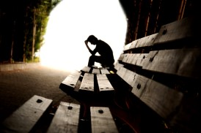
But …
But not everyone possesses this knowledge. Some people are still so accustomed to idols that when they eat sacrificial food they think of it as having been sacrificed to a god, and since their conscience is weak, it is defiled.
Verse 7

Slide 6
So …
Be careful, however, that the exercise of your rights does not become a stumbling-block to the weak.
Verse 9
‘I have the right to do anything,’ you say – but not everything is beneficial. ‘I have the right to do anything’– but not everything is constructive. No one should seek their own good, but the good of others.
10:23-24
Notes:
Sound familiar? See 6:12: ‘I have the right to do anything,’ you say – but not everything is beneficial.
This is the principle. It’s OK but is it helpful? They were will within their rights and freedom to partake of such meat but if in doing so they harmed the faith of those for whom is wasn’t OK, or even put non-Christians off the gospel because it seemed too outrageous for them, then Paul offers his example to them.

Slide 7
Therefore …
Therefore, if what I eat causes my brother or sister to fall into sin, I will never eat meat again, so that I will not cause them to fall.
Verse 13
So whether you eat or drink or whatever you do, do it all for the glory of God. Do not cause anyone to stumble, whether Jews, Greeks or the church of God – even as I try to please everyone in every way. For I am not seeking my own good but the good of many, so that they may be saved. Follow my example, as I follow the example of Christ.
10:31-11:1
Notes:
This is the supreme law of love, which puts the rights of the others before ourselves.

Slide 8
Examples today
NB: We’re not talking about core gospel beliefs but matters of conscience
Drinking alcohol and other legal drugs
Types of clothing / tattoos / piercing / make-up / hairstyles
Movies, music and literature
Swearing
Various forms of gambling
Physical boundaries in dating
What we can do on a Sabbath / Sunday
Notes:
We will have different opinions about these things! Some we see as sin, others as a matter of conscience.

Slide 9
Cross-cultural examples
Notes:
Many of the traditions we once thought were biblical are not, but we should take care not to mock others’ convictions.
In many parts of the world, discomfort with alcohol is almost unintelligible.
Yet in the former Soviet Union, it is scandalous to most evangelicals for women to wear makeup or jewelry and common for men to insist on greeting one another with holy kisses—on the lips!
In some parts of Africa and India, thanks to Western missionaries, it is considered sinful for a preacher to appear in church, even on sweltering days, without a white shirt and tie.
In cultures where polygamy is still practised, debates rage among missionaries about how to deal with a man who has several wives and then becomes a Christian.

Slide 10
Applying the lesson today
We should exercise our freedom with wisdom and love
Will it shake the faith of younger or “weaker” believers?
Will it cause them to sin against their conscience?
Will it hinder people’s acceptance of the gospel?
When appropriate, we should help them understand their freedom in Christ more fully
In the meantime, we give others the grace and the time to build their convictions
Holier than thou?
Living sacrifices
Notes:
shake the faith: If we go against their conviction in one area, it is highly possible that their faith in other more fundamental areas will be shaken.
Help them understand their freedom in Christ: Is there a place for teaching and guiding people into a better understanding of the freedom we have in Christ? Of course! But we accept one another and give each other the grace and the time to build our convictions.
[Eg. Alcohol] Have you every changed your mind about something? I certainly have! I grew up in a household where alcohol was a big part of my father’s life. He spent many hours each week down at the local workingman’s club after work and on Saturdays and I didn’t see a whole lot of him growing up. As a result, I decided I wasn’t going to drink at all. But then, over the years I realised that I was free to drink the odd glass of wine or beer. So sometimes it’s helpful to burst that legalistic image in people’s minds.
Holier than thou? Sometimes people have the view that Christians are “holier than thou” and they have a long list of things they’re not allowed to do. Actually … [Christian freedom]
Now, that’s no excuse for doing whatever you feel like doing. “Everything is permissible but not everything is …”
No, in view of God’s mercy, offer your bodies as living sacrifices, this is your whole-life worship to God.

Slide 11
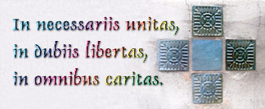
A good rule of thumb …
"in essentials, unity; in doubtful matters, liberty; in all things, charity.“
The Jesus way: surrendering our rights.
Notes:
Society bombards us with a myriad of signals urging us to demand rather than to relinquish our rights. The Jesus way is to surrender our rights so that others would not be hindered in any way from coming to Jesus and discovering the true freedom that only He can give.

