Slide 1
Was Paul a Sexist?
1 Corinthians 11: 1-17

Slide 2
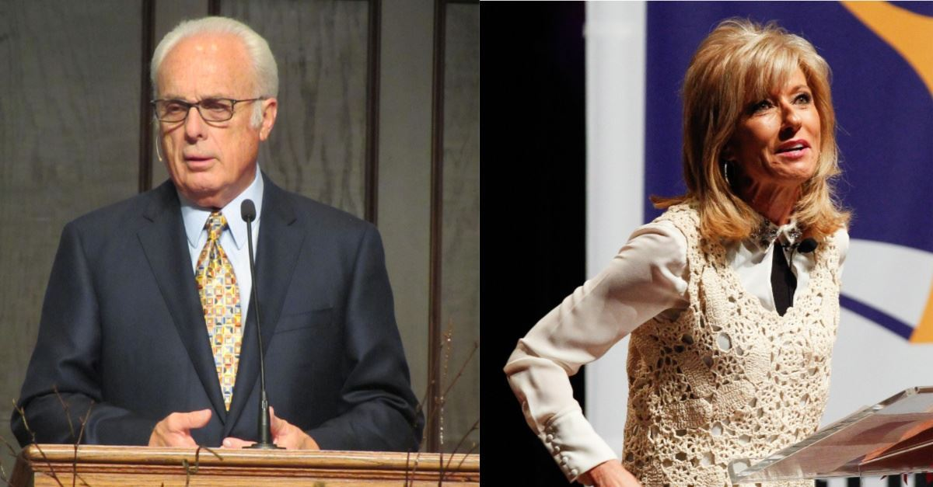
John MacArthur
Beth Moore
“Go home … There’s no case that can be made biblically for a woman preacher, period, paragraph, end of discussion.”
Notes:
Last week, well known Bible teacher, John MacArthur, was speaking at a conference, “Truth Matters”. He was asked to describe another Bible teacher, Beth Moore, in two words. He said, “Go home”. He followed it up with this: “There’s no case that can be made biblically for a woman preacher, period, paragraph, end of discussion.”
And there was rapturous applause.

Slide 3
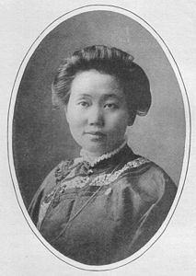
What is the role of women in the church?
Women teachers today
The missionary movement of the 19th century
The house church movements of China and Iran
So what’s the problem?
Three prickly passages from Paul!
Notes:
What is the role of women in the church?
Just serve cups of tea or maybe lead Sunday School?
What about leadership? Preaching? Ordination?
Why is this such a big issue anyway?
[Women teachers today] Thousands of men and women have been blessed by the teaching of Beth Moore, Joyce Meyer and countless others.
In the great missionary movement of the 19th century, two thirds of missionaries were women.
The great house church movements of China and now Iran are largely led my women.
So what’s the problem?
Three prickly passages from Paul! And 1 Cor 11 is the first.

Slide 4
What the Bible says about women
So God created mankind in his own image, in the image of God he created them; male and female he created them.
Genesis 1:27
¹⁸ The Lord God said, ‘It is not good for the man to be alone. I will make a helper suitable for him.’
Genesis 2:18
Notes:
But before we grapple with the Greek etc, we need to take a step back and see what the Bible says about women
Genesis 1:27
Men and women both made in God’s image, reflecting his glory.
Chapter 2 separates the forming of the man and the woman. God introduces the women this way:
Genesis 2:18
This word, “helper”, is used of God himself e.g. Ps 27:9 “Do not hide your face from me, do not turn away your servant in anger; you have been my helper …” So the word clearly means “one who helps”. It does not imply subordination.

Slide 5
What the Bible says about women
‘This is now bone of my bones and flesh of my flesh; she shall be called “woman”, for she was taken out of man.’
Genesis 2:23
Theologically, the man is the source or origin of the women
Notes:
The man embraces this precious gift from God (literally!):
Genesis 2:23
So theologically, the man is the source or origin of the women. He came first. Practically speaking, I’m not sure how that works (!) but the distinction is important in this passage.

Slide 6
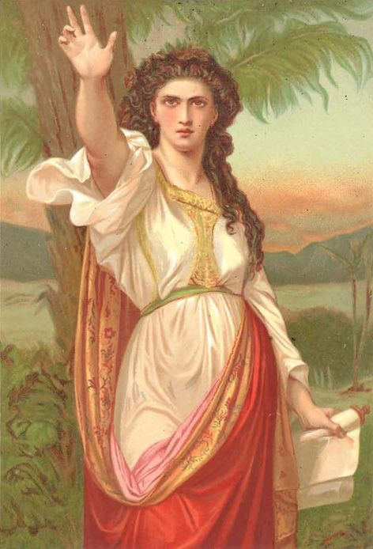
What the Bible says about women
The Fall
“Your desire will be for your husband and he will rule over you.”
Genesis 3:16
The rest of the Old Testament
Deborah the prophet and military leader
Huldah, a prophet
Notes:
After the Fall, things go pear-shaped in gender relationships - or should I say apple-shaped?
The man blames the women, the women blames the snake. The man gets sweat and thorns. The woman gets pain in childbirth and this interesting warning:
Genesis 3:16
What does “your desire will be for your husband” mean? Sounds kind of nice! Maybe, but in a twisted kind of way - there’s a sense that the mutuality that God designed is damaged and replaced by rivalry and dominance.
Sounds like the battle of the sexes that continues to this very day!
So what about the rest of the Bible? Well, this was a very patriarchal society. There is no doubt who wore the pants - metaphorically speaking - in the ancient world! But there are some fascinating exceptions: For instance, Deborah the prophet and military leader during the time of the Judges and Huldah, a prophet who served during the time of King Josiah.

Slide 7
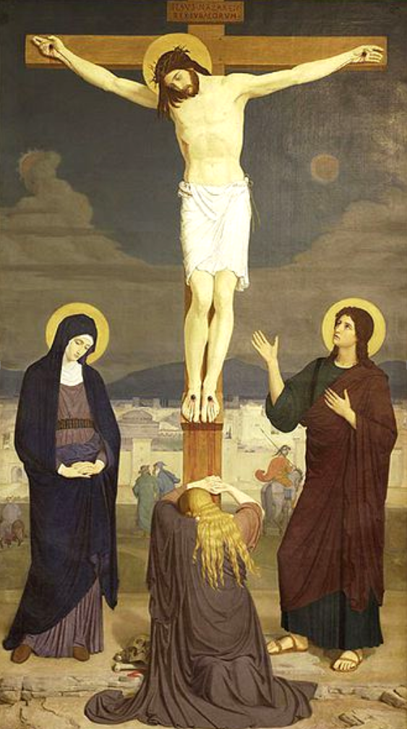
Jesus’ view of women
Women followed Jesus and supported his ministry
He allowed Mary to sit at his feet and learn
He defended a woman caught in adultery against the accusations of men
He went through Samaria and stopped to talk with a women …
Women were the last at the cross and the first at the tomb
Notes:
But the example par excellence is Jesus.
His attitude was counter-cultural
Women almost never studied with rabbis - they couldn’t be disciples alongside men. But women followed …
He allowed …
He defended …
When he wanted to get from Judea to Galilee, he didn’t go around Samaria like well-behaved Jews did. He went through it and stopped to talk with a women - who was sinful and a Samaritan.
He broke every social rule in the book.
Women were the …
In fact, if you wanted to found a religion, you wouldn’t base it on the testimony of women because it wasn’t deemed to be worth much in those days. This fact lends further credibility to the resurrection actually being true.
Well, we know Jesus was a friend of women. He was a friend of everybody, except maybe hypocritical religious leaders!

Slide 8
Paul’s view of women
?
Were there woman teachers in Paul’s ministry?
Priscilla was clearly the leader of the church that met in her home
Junia is listed as an Apostle in Romans 16
Paul mentions many other woman by name who helped him in his ministry
Notes:
But what about Paul? He was a typical sexist Jewish male, wasn’t he?
Well, yes, maybe - and no.
The Greek and Roman world was every bit as patriarchal as the Jewish one. For instance, woman might get a basic education ,but advanced training was for men. After all, who needs a PhD to look after the kids, right? Actually, come to think of it …
So teachers would almost always be men.
Were there woman teachers in Paul’s ministry? Definitely.
Priscilla was clearly … Aquilla was probably not as involved due to his business interests.
Junia - not someone most people have heard of - is listed as an Apostle in Romans 16. The interesting thing about Junia is that her name was changed to Junius - the male equivalent - in older translations. Why? Because there was better textual evidence for it? No, there’s none at all. Because the translators thought it must be man! It couldn’t be a woman! Could it? But Junius is only a woman’s name.
And what does an Apostle do? Teach. Pray. Plant churches.
And Paul mentions …

Slide 9
Paul’s Big Idea
28 There is neither Jew nor Gentile, neither slave nor free, nor is there male and female, for you are all one in Christ Jesus.
Galatians 3:28
“That’s just about salvation. That’s not talking about people’s position in the church!”
What did the gospel do to the status of Jews and Gentiles in the church?
What did the gospel do to slaves and slave owners?
What did the gospel do for “women’s rights”?
Paul didn’t push for them in the church but he laid the groundwork for it
Notes:
Galatians 3:28 is a powerful expression of what the gospel does to divisions of race, gender and social status…
People who argue for male seniority say, …
But hang on a minute. What did the gospel do to the status of Jews and Gentiles in the church? It made them equal - no second class citizens allowed.
What did the gospel do to slaves and slave owners? It brought them together in the one church - as brothers and sisters. That was their primary relationship - not as slave and non-slave. Paul didn’t push for the abolition of slavery - but in the case of Onesimus, he strongly hinted at it.
And what did the gospel do for “women’s rights” in the church? Well, Paul didn’t push but he laid the groundwork for us who live in society which is trying to remove the barriers to participation of women at all levels.
So the Gentile / Jewish division was tackled head-on in the first century. The slave / free and male / female divisions would have to wait until a another time. But the theological basis is right there in Galatians 3:28.

Slide 10
Three prickly passages of Paul
1 Cor. 11, 1 Cor. 14 and 1 Tim 2
Notes:
So we come to the three prickly passages of Paul: 1 Cor. 11, 1 Cor. 14 and 1 Tim 2. We’ll look at the first today and the other two in four weeks time.
It’s these passages which have kept women in a subordinate position to men in the church for centuries. But many people now see them in a new light, because of a better understanding of the context in which they were written.

Slide 11
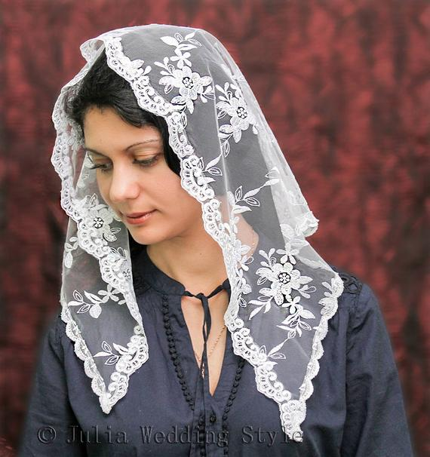
1 Corinthians 11:1-17
The context of 1 Corinthians
Head coverings in worship
In most cultures, the outer garb is still important
Some woman were abandoning wearing head coverings because they thought it stifled their experience of the Holy Spirit
Most churches today see woman’s head-coverings as a cultural issue
Notes:
The context of 1 Corinthians, as we have seen, is a very enthusiastic church. Spiritual gifts are operating freely. The more spectacular the gift the better. And so they had fell into a bit of a celebrity trap where the powerful and important people were given the most respect. This is why Paul is at pains to explain what a pathetic man he is - that it’s only by God’s power that lives are changed. And that they need to be careful to study Scripture and learn from it - as we saw two weeks ago. The Christian faith is not froth and bubble. It’s a long obedience in the same direction. But it’s wonderful!
In chapter 11, Paul is talking about head coverings in worship. The next four chapters are all about order in worship. He starts with clothing.
We might say, “Who cares about what we wear? We just need to get back to the “heart of worship.” True enough.
But in most cultures, the outer garb is still important - it communicates things like respect and modesty. In that culture, it was expected that a woman - particularly a married woman - cover her head in worship.
Some woman were abandoning this practise because they thought it stifled their experience of the Holy Spirit. But that communicated something not so good about the woman’s character and damaged the witness of the church.
The vast majority of churches today see woman’s head-coverings as a cultural issue not one we have to apply in contexts where it’s “no big deal”.

Slide 12
What is meant by the word “head”?
3 But I want you to realise that the head of every man is Christ, and the head of the woman is man, and the head of Christ is God.
1 Corinthians 11:3
Head means head
Head means source or origin
But would we say that the origin of Christ is God?
Head means authority
But it doesn’t fit that well when applied to Christ
Head means a position of prominence
Seems to have the least amount of problems. Culturally, men were more prominent
Notes:
The bigger issue is around the use of the word, “head”.
3 But I want you to realise that the head of every man is Christ, and the head of the woman is man,[a] and the head of Christ is God.
Wow. That seems pretty straight forward, or does it? What actually does head mean? Four options according to language experts:
Head means head - that thing on your shoulders - where you face, throat, brain and hair reside!
That’s clearly not in view in this verse. The head of every woman is man? No thanks! It’s a metaphor.
Secondly, Head means source or origin. This fits quite well with the creation example in verses 8-9. As I said, before, woman was taken out of man. The origin of woman is man, spiritually speaking. Except, would we say that the origin of Christ is God? He who is before all things and in him all things hold together (Colossians 1)? No. We would much prefer to say, the very nature of Christ is the same as God (Philippians 2).
So source fits OK in some ways, but scores badly in describing the trinity.
Thirdly, head means authority. This is the traditional view. Male authority is the natural order of things. This is still a popular view among many. But again, it doesn’t fit that comfortably when applied to Christ. Perhaps, Christ’s earthly life is in view where he willingly submitted himself to the Father’s will.
Fourthly, head means a position of prominence since the head is the most prominent part of the body. This is the most common use of the word in the Greek version of the OT. It doesn’t necessarily denote authority. It’s simply the obvious, the noticeable part.
This fourth meaning seems to have the least amount of problems. Men and woman are different. This should not be a controversial statement! But culturally, men were more prominent.

Slide 13
So …
Woman are not to distract men
Men should not dress as women
The principle is, as always, love
But …
What about Paul’s references to creation?
We must interpret unclear passages in light of the clear
What is certain
“Permission with occasional restriction”
Notes:
So Paul clearly has in mind differences between the sexes. Woman are not to distract men by having their head uncovered in worship.
Nor are men supposed to dress as women or have their hair long. They might feel free to do so, but they must remember they live in a real society with certain social norms and they are not to put stumbling blocks in front of others. The principle is, as always, love.
But what about Paul’s references to creation in this section and in 1 Timothy where he tells women to “learn in quietness”?
The biggest principle is this: we must interpret unclear passages in light of the clear. It is not at all certain exactly what Paul is getting at here!
But what is certain. He permitted women to prophecy - verse 5 - and he worked with them to plant and nurture first century churches.
Yes, he restricted some of what they could do for the sake of the culture. But he saw the gospel eventually breaking down social taboos and he modelled a team approach to ministry - comprising of both men and women, just as Jesus did.
There is more to this story of course! We will tackle part two of the topic of women in ministry when we come to chapter 14 and also look at 1 Timothy 2.

Slide 14
SO WHAT?
“Because many churches are established by female Christians, their reputation and authority make male Christians feel humble. In general, the female leadership does not feel threatened by the capable and gifted male Christian. Instead, they are quite happy about their arrival, for they are longing for male leadership to be established in the church. Once I talked to a female pastor of a huge church: she told me that she prayed and longed for male Christian leadership taking place in the church.
Notes:
But now we need to ask that favourite question of congregations: SO WHAT?
Listen to one Chinese church leader …

Slide 15
That does not mean that the female church leaders think they are not qualified to be church leaders or male leadership would be better, but that they think that a balance of male-female leadership will make the church system stronger and healthier. Both women and men are called to have dominion together (Gen. 1:28). As male church leaders in China, we admire and respect those female church leaders, and their faithfulness, humbleness, and willingness to sacrifice for God’s kingdom. They have encouraged us so much. For the Lord has used what the world calls “weak” to shame the “strong”: us men.

Slide 16
From my experience of working with female leadership, I have found that women have many virtues. For example, they are very faithful to the Lord without fear in the face of evil and danger. They are just like those women who visited Jesus’ tomb on Sunday, in contrast to the men who hid behind a locked door (John 20:19). Christian women seem more interested in ministry while men seem very interested in power and authority. The women are willing to share the leadership with men and do not view men as rivals.

Slide 17
Gradually, the balance of male-female leadership in the churches will come, and it is already coming. With different virtues and gifts from both men and women, the church will begin to function fully in China.”
A Chinese Christian leader (CBE International)

Slide 18
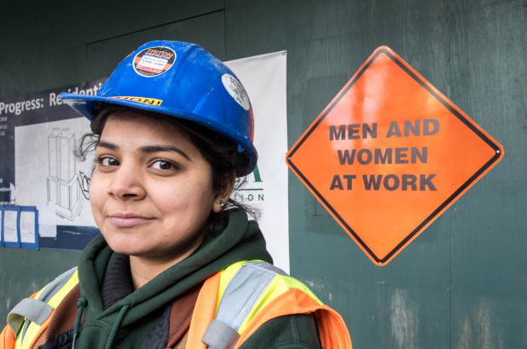
So what?
Men: don’t be threatened by female leadership
Women: be willing to lead!
Both: follow God’s call, and work together for the advancement of God’s kingdom
Notes:
So men, …
Women, be willing to lead - and preach and disciple others and serve as God gifts you and calls you.
To both men and women - follow God’s call, and work together for the advancement of God’s kingdom. When others are more gifted than you. Be humble and let them use their gifts. But don’t hide your light! Fan into flame the gifts that God gives you.

Slide 19
Follow God’s call
“I did not surrender to a calling of man when I was 18 years old. I surrendered to a calling of God. It never occurs to me for a second to not fulfil it. I will follow Jesus—and Jesus alone—all the way home. And I will see His beautiful face and proclaim, Worthy is the Lamb!”
Beth Moore
As we enter a new season at ACPC, we cannot afford to be shy about service. Let us wholeheartedly follow Jesus. Let us work together - men and women - to make Jesus known in Auckland City!
Notes:
After the criticism she received last week, Beth Moore wrote on Twitter …
That’s what it’s about. That’s who it’s about. As we enter a new season ….

