Slide 1
Rhythms of Renewal
Part 2: Connect and Create
Notes:
Last week we looked at the first two rhythms—Rest and Restore. As you begin to experience the rewards of practicing the rhythms of rest and restoration, your heart, mind, and soul will come back to life. In that new life, you’ll find you have something to offer the world around you.
These first two rhythms are input rhythms. Connect and Create are output rhythms. They help us reach out to bless and help others.

Slide 2
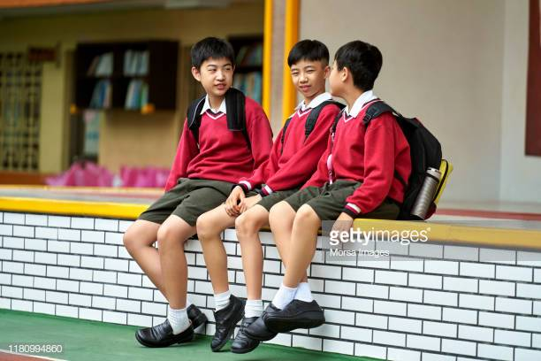
CONNECT
Be the friend you wish to have: Initiate Friendship

Slide 3
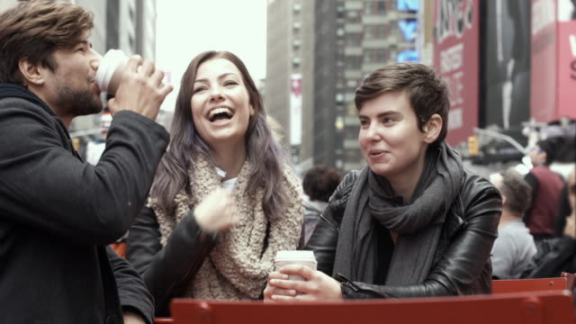
15. Be the friend you wish to have: Initiate Friendship
Three types of friendships: those based on utility, pleasure and virtue.
What are the qualities of your ideal friend? How could you be this friend to another?
Notes:
Aristotle defined three different types of friends who tend to make their way into our lives …
The first two kinds of friendships last as long as there is something useful or pleasurable to be gained from the relationship. Those based in virtue go deeper than convenience and encourage us in our shared commitments.
Key principle: BE THE FRIEND YOU WISH TO HAVE.
What are the qualities …
The classic example of friendship in the Bible is David and Jonathan. Jonathan recognised a kindred spirit in David from the beginning. They were both excellent fighters and men of integrity and common sense. So Jonathan made a covenant with David because he loved him as himself. Jonathan cared about David’s welfare. And even though his father become David’s sworn enemy, Jonathan remained loyal. In Samuel 23, David was at Horesh in the Desert of Ziph and learned that Saul had come out to take his life.
16 And Saul’s son Jonathan went to David at Horesh and helped him find strength in God. (1 Samuel 23:15-16).
We will be looking at David’s some more next week as we begin our 2020 vision series.
Question to ponder: Do I …

Slide 4
Proverbs 27:5-17
⁵ Better is open rebuke than hidden love.
⁶ Wounds from a friend can be trusted, but an enemy multiplies kisses…
⁹ Perfume and incense bring joy to the heart, and the pleasantness of a friend springs from their heartfelt advice.
¹⁰ Do not forsake your friend or a friend of your family, and do not go to your relative’s house when disaster strikes you – better a neighbour nearby than a relative far away…
¹⁷ As iron sharpens iron, so one person sharpens another.

Slide 5
15. Be the friend you wish to have: Initiate Friendship
Three types of friendships: those based on utility, pleasure and virtue.
What are the qualities of your ideal friend? How could you be this friend to another?
David and Jonathan
Do I have meaningful connections in my life, connections that help me maintain spiritual and mental health?
Notes:
Aristotle defined three different types of friends who tend to make their way into our lives …
The first two kinds of friendships last as long as there is something useful or pleasurable to be gained from the relationship. Those based in virtue go deeper than convenience and encourage us in our shared commitments.
Key principle: BE THE FRIEND YOU WISH TO HAVE.
What are the qualities …
The classic example of friendship in the Bible is David and Jonathan. Jonathan recognised a kindred spirit in David from the beginning. They were both excellent fighters and men of integrity and common sense. So Jonathan made a covenant with David because he loved him as himself. Jonathan cared about David’s welfare. And even though his father become David’s sworn enemy, Jonathan remained loyal. In Samuel 23, David was at Horesh in the Desert of Ziph and learned that Saul had come out to take his life.
16 And Saul’s son Jonathan went to David at Horesh and helped him find strength in God. (1 Samuel 23:15-16).
We will be looking at David’s some more next week as we begin our 2020 vision series.
Question to ponder: Do I …

Slide 6
CONNECT
Be the friend you wish to have: Initiate friendship
Lead with vulnerability: Better together

Slide 7
16. Lead with vulnerability: Better together
“Vulnerability is the birthplace of love, belonging, joy, courage, empathy, and creativity. It is the source of hope, empathy, accountability, and authenticity. If we want greater clarity in our purpose or deeper and more meaningful spiritual lives, vulnerability is the path.”
Brené Brown
Is there someone you can you share your deepest thoughts with? Is it with your spouse, your child, your parents, a friend? Pick up the phone and make a call. Connect—really connect in true vulnerability—with those you love.
Notes:
As I shared last year, Rachael and lost our firstborn son in the mid-90’s. After our daughter Emma was born a year and a half later, we wanted to say that we had two kids. We wanted to share our story. But we couldn’t share with the same degree of honesty with everybody. Some people wanted to hear more, some changed the subject and some people ran for the hills. We learned to choose our moment and choose our audience. But it was vital that we could share with someone!
Vulnerability, appropriately expressed, is essential to our mental and spiritual health.
Brené Brown writes, …
Is there someone … Your courage to bring your whole, beautiful self out into the open just might inspire them to do the same.

Slide 8
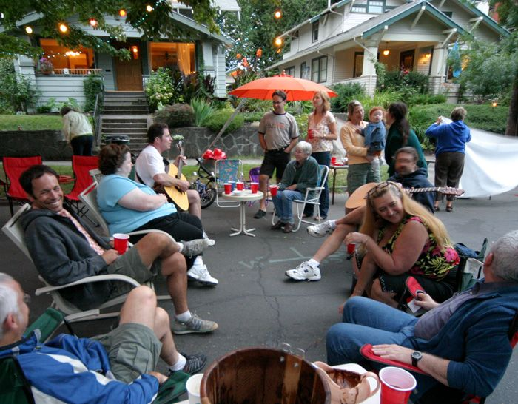
CONNECT
Be the friend you wish to have: Initiate friendship
Lead with vulnerability: Better together
Open-porch policy: Potluck over perfect

Slide 9
17. Open-porch policy: Potluck over perfect
“Come on over and bring the whole family - we can’t wait to see you!”
“Casual frequency” - getting together often, coming as you are, hosting as you are.
A recent survey conducted by the YMCA found that 1/3 of kiwis would like to know their neighbours more.
Who is the most hospitable person you know? What characteristics of hospitality do they exude?
Notes:
“Come on over …Three phrases which RL found wonderful to hear (with four kids – two with Downs Syndrome).
Often we think we have to have everything perfect to offer hospitality. But it doesn’t require an elaborate meal with your best china or making sure every nook and cranny is clean. RL talks about “casual frequency” …
When it comes to hospitality, we tend to think of inviting the people we know already – family, friends, people from church. But Jesus talked a lot about inviting people you don’t know. A recent survey …
What an opportunity to “break the ice” and build community! Our new location will have hundreds of new neighbours right on our doorstep!
Who is … the most hospitable person you know? What characteristics of hospitality do they exude?

Slide 10
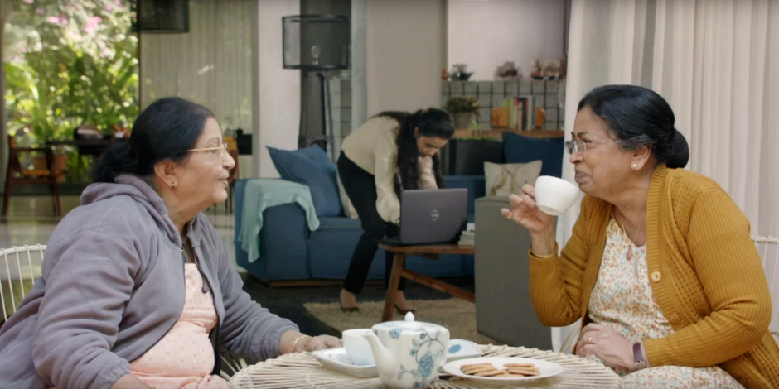
CONNECT
Be the friend you wish to have: Initiate friendship
Lead with vulnerability: Better together
Open-porch policy: Potluck over perfect
Bear each other’s burdens: Carry the load

Slide 11
18. Bear each other’s burdens: Carry the load
Crying not only mentally cleanses us, it can cleanse our body, too. Tears help the body get rid of chemicals that raise cortisol, the stress hormone.
“Carry each other’s burdens, and in this way obey the law of Christ.”
Galatians 6:2
Think of the people in your life. Who has a burden you can help shoulder? Write their name down and commit to reaching out to them this week.
Notes:
[Sam’s last day: “I love you guys!”]
I wish I cried more. I tend to sigh more than cry.
But crying is very healing. “Crying not only …
But we don’t have to cry alone! We weren’t designed to bear our fears, our anxieties, and our worries on our own.
Galatians 6:2 tells us, …
We were meant to encourage one another in darker seasons, to be the church of healing to one another.
Think of …

Slide 12
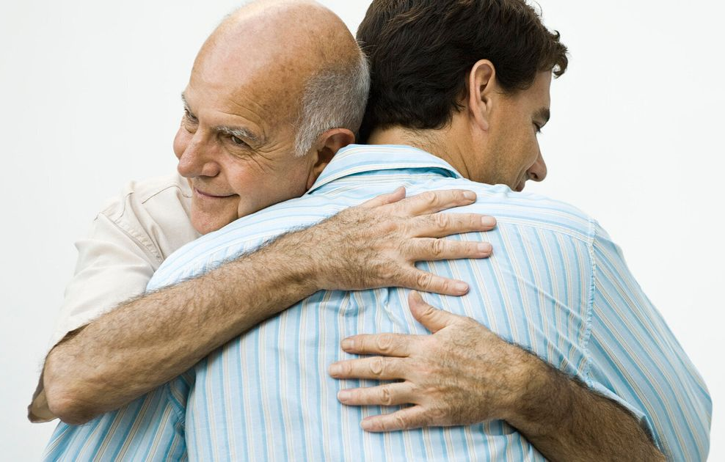
CONNECT
Be the friend you wish to have: Initiate friendship
Lead with vulnerability: Better together
Open-porch policy: Potluck over perfect
Bear each other’s burdens: Carry the load
Hugs all around: The power of physical touch

Slide 13
19. Hugs all around: The power of physical touch
When we hug, our brain releases the neurotransmitter, oxytocin, which promotes feelings of contentment and reduces anxiety and stress. In addition, hugging stimulates dopamine and serotonin production in the body and keeps depression at bay.
“In effect, the body interprets a supportive touch as ‘I’ll share the load.’” - Benedict Carey, science reporter for The New York Times
“A man with leprosy came to him and begged him on his knees, ‘If you are willing, you can make me clean.’ ⁴¹ Jesus was indignant / filled with compassion. He reached out his hand and touched the man. ‘I am willing,’ he said. ‘Be clean!’ ⁴² Immediately the leprosy left him and he was cleansed.”
Mark 1:40-42: 40
Notes:
When we hug, …
In other words, hugs can be an antidote to our stress and anxiety, and in the long run can stem the threat of depression.
Benedict Carey, a science reporter for The New York Times wrote, …
Throughout the Gospels, Jesus displayed his healing power through touch. For example,
A man with leprosy …

Slide 14
CONNECT
Be the friend you wish to have: Initiate friendship
Lead with vulnerability: Better together
Open-porch policy: Potluck over perfect
Bear each other’s burdens: Carry the load
Hugs all around: The power of physical touch
Marriage retreat: Love the one you’re with

Slide 15
20. Marriage retreat: Love the one you’re with
In his book, Love and Respect, Emerson Eggerichs teaches that, basically, men need respect and women need love.
Notes:
If you are married, your spouse plays an outsized role in contributing to or inhibiting your emotional health.
In his book, Love and Respect, Emerson Eggerichs teaches that, basically, men need respect and women need love. RL and Gabe met with the author himself and had some counselling sessions. She shared that she would express big feelings on a number of topics, and Gabe would dismiss them. He loved her but he didn’t understand that he needed to allow Rebekah to express her fears and anxieties. Often that was enough.
When a wife respects a husband, she recognises his role and responsibilities. Take a look at couples that work well together – where each excels in their area of gifting and they mentor younger people simply by their lives. You will see mutual submission, love and respect. They value each other. They’re not in competition. Each sees part of their “job” as helping their spouse blossom.
Do we need those sort of marriages today? Loving our Neighbour begins at home.

Slide 16
CONNECT
Be the friend you wish to have: Initiate friendship
Lead with vulnerability: Better together
Open-porch policy: Potluck over perfect
Bear each other’s burdens: Carry the load
Hugs all around: The power of physical touch
Marriage retreat: Love the one you’re with
Apologise first: Time is short

Slide 17
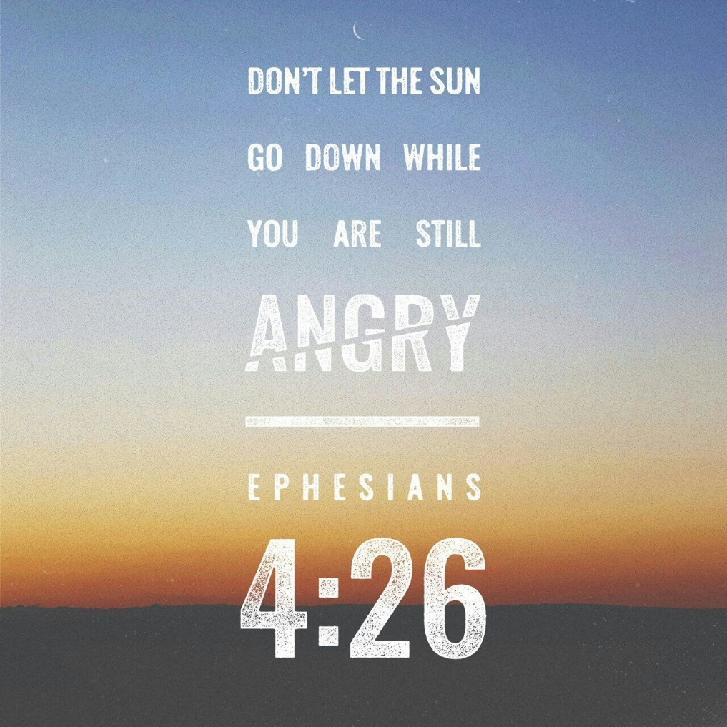
21. Apologise first: Time is short
“Never forget the nine most important words of any family—I love you. You are beautiful. Please forgive me.”
H. Jackson Brown Jr.
“Do not let the sun go down while you are still angry, and do not give the devil a foothold.”
Ephesians 4:26
Notes:
Never forget …
“Do not let
A foothold means a “strong first position from which further progress can be made.” An intruder doesn’t need our whole heart, just a crack wide enough to get a foot in the door. That’s what the devil wants! Don’t let him. Apologies first!

Slide 18
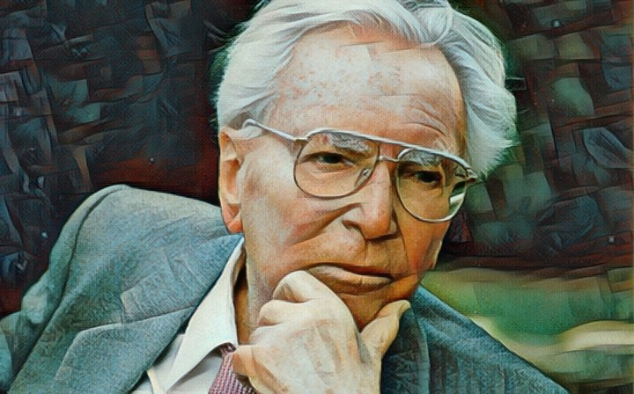
CREATE
Dream again: The road to meaning
Notes:
When RL says create, she doesn’t necessarily mean painting, quilting, or composing a song (though it can mean any of those things). Instead, it’s about using your specific talents, skills, and callings to live deeper into your God-given purpose, to create something that blesses him and the world around you.
As Pauls writes, “We are God’s handiwork – his masterpiece - created in Christ Jesus to do good works, which God prepared in advance for us to do.” Ephesians 2:10
Firstly, Dream again …

Slide 19
22. Dream again: The road to meaning
In his famous book, “Man’s search for meaning”, Viktor Frankl asserted that anxiety flows from a life without meaning and purpose.
Neil Postman’s “Amusing ourselves to death”
If we have too much time on our hands, too little responsibility, and not enough entertainment, we’re headed into a crisis of identity and anxiety.
Consider taking a break from your go-to form of escape.
Ask yourself, what do you want your life to look like in five or ten years? Who am I meant to be? What am I meant to do? Remember what you loved to do most when you were 8, 9, 10, 11 or 12? What talents were obvious to those around you? Why did you stop?
Notes:
Viktor Frankl wrote a famous book, “Man’s search for meaning”, He asserted that …
When we lose meaning, we live with a sense of unfulfilled responsibility, rooted in anxiety. With meaning, anxiety lessens.
In another classic, “Amusing ourselves to death” Neil Postman argued that of two famous dystopian versions of the future, Aldus Huxley’s “Brave New World” and George Orwell’s “!984”, it was Huxley’s vision of control of the population through recreation and consumption and not the “Big Brother” of Orwell’s vision. Today, we live in a society where we can spend hours on devices entertaining ourselves. Where social media giants tailor goods and services to our specific tastes, and where entertainment, “likes” and “shares” are far more important than truth, we amuse ourselves to death.
RL concludes that if we have too much time on our hands, too little responsibility, and not enough entertainment, we’re headed into a crisis of identity and anxiety and boredom.
Her advice: Consider taking a break from your go-to form of escape. Seek to live out of your dreams and passions.
Ask yourself …
Oliver Wendell Holmes said, "Most of us go to our graves with our music still inside us, unplayed."
How tragic. Dare to dream again!

Slide 20
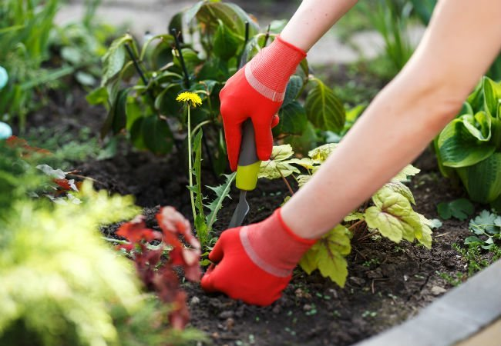
CREATE
Dream again: The road to meaning
Recover your passion: Pulling weeds

Slide 21
23. Recover your passion: Pulling weeds
What things do you need to pull from your life so you have the energy to partner with God in his creative purpose for you?
Notes:
Who’s done some gardening over the summer? Pulling weeds or zapping with with Round-Up is a necessary part of every gardener’s program.
There are also weeds that choke your passion and drain your creative energy.
Are there things that you need to pull from your life? Identify those things and get rid of them: unfulfilling tasks, distracting obligations, social media or whatever. Pull the weeds. Get them at the root so they don’t grow back! Then, with renewed passion, use your passion to create something beautiful with God.

Slide 22
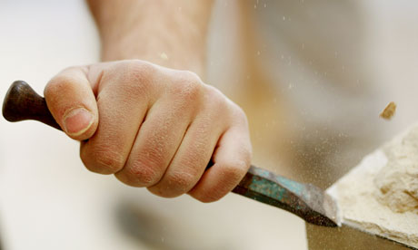
CREATE
Dream again: The road to meaning
Recover your passion: Pulling weeds
Work with your hands: A pattern and a plan

Slide 23
24. Work with your hands: A pattern and a plan
“Research has shown that hand activity from knitting to woodworking to growing vegetables or chopping them are useful for decreasing stress, relieving anxiety, and modifying depression . . . Functioning hands also foster a flow in the mind that leads to spontaneous joyful, creative thought. Peak moments occur as one putters, ponders and daydreams.”
Psychology Today
When is the last time you made something with your hands?
Notes:
According to Psychology Today, …
In this ultra-busy, highly-automated, computer-oriented world, we work with our hands less and less.
What would you like to create, fix or do? Once you identify what you want to create, you might need to find a pattern or download a set of instructions or find a DIY video on YouTube.
When is the last time you made something with your hands?

Slide 24
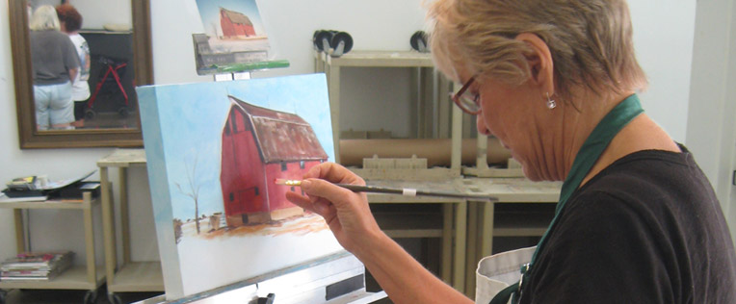
CREATE
Dream again: The road to meaning
Recover your passion: Pulling weeds
Work with your hands: A pattern and a plan
Learn something new: Take a class

Slide 25
25. Learn something: New take a class
Author Julia Cameron recommends “The Artist Date” as a festive, solo expedition to explore something that interests you.
Neuroplasticity: the understanding that “intelligence is not fixed in our brains from birth. Rather, it’s forming and developing throughout our lives.
When we give ourselves new experiences, new electrochemical pathways are formed to connect past experiences and knowledge to new ones.
When people stop practicing new things, the brain will eventually eliminate, or ‘prune,’ these connecting cells.
Plan an artist date in the next month. What will it be? Journal your idea.
Notes:
I mentioned last week about a guy who learned a new skill every year.
Author Julia Cameron recommends “The Artist Date.” The Artist Date is a festive, solo expedition to explore something that interests you. The Artist Date need not be overtly “artistic”—think mischief more than mastery. Artist Dates fire up the imagination. They spark whimsy. They encourage play. Since art is about the play of ideas, they feed our creative work by replenishing our inner well of images and inspiration.
Our brains benefit when we put ourselves in new environments. The scientific term for it is neuroplasticity …
When we give ourselves new experiences …,
But the opposite is true as well. “When people stop …
Plan an artist date in the next month. What will it be? Journal your idea.

Slide 26
CREATE
Dream again: The road to meaning
Recover your passion: Pulling weeds
Work with your hands: A pattern and a plan
Learn something: New take a class
Make a memory: Imaginative play

Slide 27
26. Make a memory: Imaginative play
What are some of the creative things you have done with family or friends that have become lasting memories? What about those experiences made them so memorable?
Notes:
Let’s face it, being highly imaginative isn’t what you always feel like at the end of a busy week. More like blobbing and escaping! Now, part of this is personality. But we can all make a memory. Even simple things like making a pizza together or dressing up to go to latest Marvel or Star Wars movie!
What are some …

Slide 28
CREATE
Dream again: The road to meaning
Recover your passion: Pulling weeds
Work with your hands: A pattern and a plan
Learn something: New take a class
Make a memory: Imaginative play
Take care of something: Be responsible

Slide 29
27. Take care of something: Be responsible
Among school leavers, there is a steep decline in behaviours that we might call “adult” over the last 25 years: 55 percent worked for pay, down from 76 percent; and 73 percent have drivers’ licenses, down from 88 percent.
When I take on responsibilities, when I get out of bed and out the door and show up, it makes me feel needed and useful. When I succeed, I am filled with new confidence.
What new areas of responsibility can you push into, areas that might give you a sense of accomplishment, confidence, and joy?
Notes:
Viktor Frankl argued that unfulfilled responsibility leads to feelings of anxiety. Could this be why so many young people are floundering with their feelings? Among U.S. school leavers … The figures are similar here I’m sure.
When I take …
What new areas …

Slide 30
CREATE
Dream again: The road to meaning
Recover your passion: Pulling weeds
Work with your hands: A pattern and a plan
Learn something: New take a class
Make a memory: Imaginative play
Take care of something: Be responsible
Say yes: Take a risk

Slide 31
28. Say yes: Take a risk
“Life is either a daring adventure or nothing.” - Helen Keller
God can do far more through people completely yielded to him than we might think or imagine.
List the ways you might take a risk to partner with God. Is there a risk you know you need to act on immediately?
Notes:
“Life is …
Research shows that as we get older, our dopamine levels decrease, making us more adverse to risky behaviour. This can be a good thing … but it might also mean remaining on the sidelines when adventure awaits. Think Bilbo Baggins before he met the dwarfs!
The God factor is HUGE. God is blessing the world through people. The blind are seeing, the deaf are hearing, the lame are walking and good news is being preached to the por. And we are a part of it! How is this possible through ordinary men and women like you and I? God can do …
[Earl Roberts: “IMPOSSIBLE, POSSIBLE, PROBABLE, DONE.”]
So what ways …

Slide 32
REST | RESTORE | CONNECT | CREATE
1. Take an inventory: Reflect and Journal | 8. Permission to Play - giving up control | 15. Be the friend you wish to have: Initiate Friendship | 22. Dream again: The road to meaning
2. Tech Detox: Silence the noise | 9. Eat smart brain food | 16. Lead with vulnerability: Better together | 23. Recover your passion: Pulling weeds
3. Get quiet create space and listen | 10. Know your identity - labels don’t define you | 17. Open-porch policy: Potluck over perfect | 24. Work with your hands: A pattern and a plan
4. Do the heart work: Examine and Confess | 11. Take a walk - clear the brain fog | 18. Bear each other’s burdens: Carry the load | 25. Learn something new: Take a class
5. Routines for deep sleep | 12. Seek Adventure - take a trip | 19. Hugs all around: The power of physical touch | 26. Make a memory: Imaginative play
6. Morning Routine - coffee, candle and a pen | 13. Break a sweat - use the workout pants | 20. Marriage retreat: Love the one you’re with | 27. Take care of something: Be responsible
7. Stop the work: Practise Sabbath | 14. Push yourself beyond your comfort zone | 21. Apologise first: Time is short | 28. Say yes: Take a risk

Slide 33
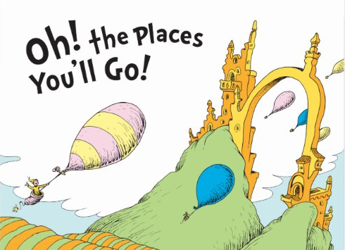
“O the places you’ll go” - Dr Seuss
When you're in a Slump, you're not in for much fun.
Un-slumping yourself is not easily done.
You’re off to Great Places! Today is your day!
Your mountain is waiting, So … get on your way!
Notes:
….. So true. But Dr Seuss’ advice is to get moving and see what happens….

Slide 34
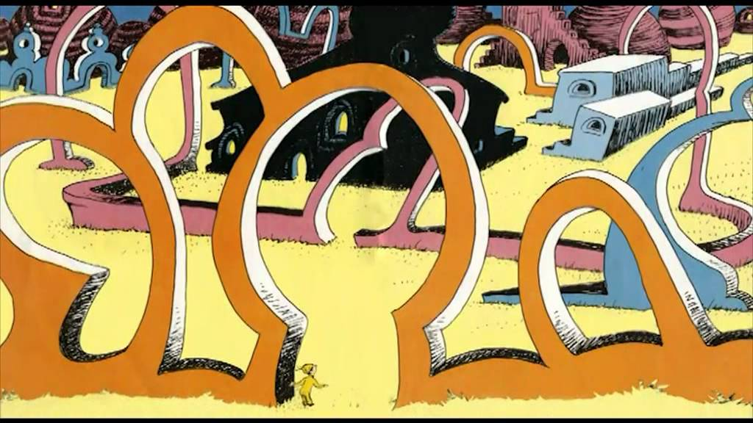
You will come to a place where the streets are not marked.
Some windows are lighted. but mostly they're darked.
A place you could sprain both your elbow and chin!
Do you dare to stay out? Do you dare to go in?
How much can you lose? How much can you win?

Slide 35
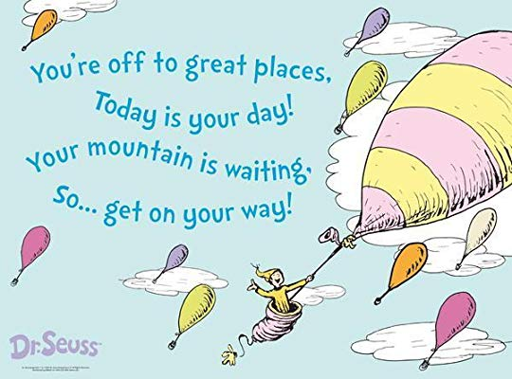
So ... be your name Buxbaum or Bixby or Bray or Mordecai Ali Van Allen O'Shea,
you're off to Great Places! Today is your day!
Your mountain is waiting. So...get on your way!

