Slide 1

Being a 3D Witness
Discover Stories

Slide 2


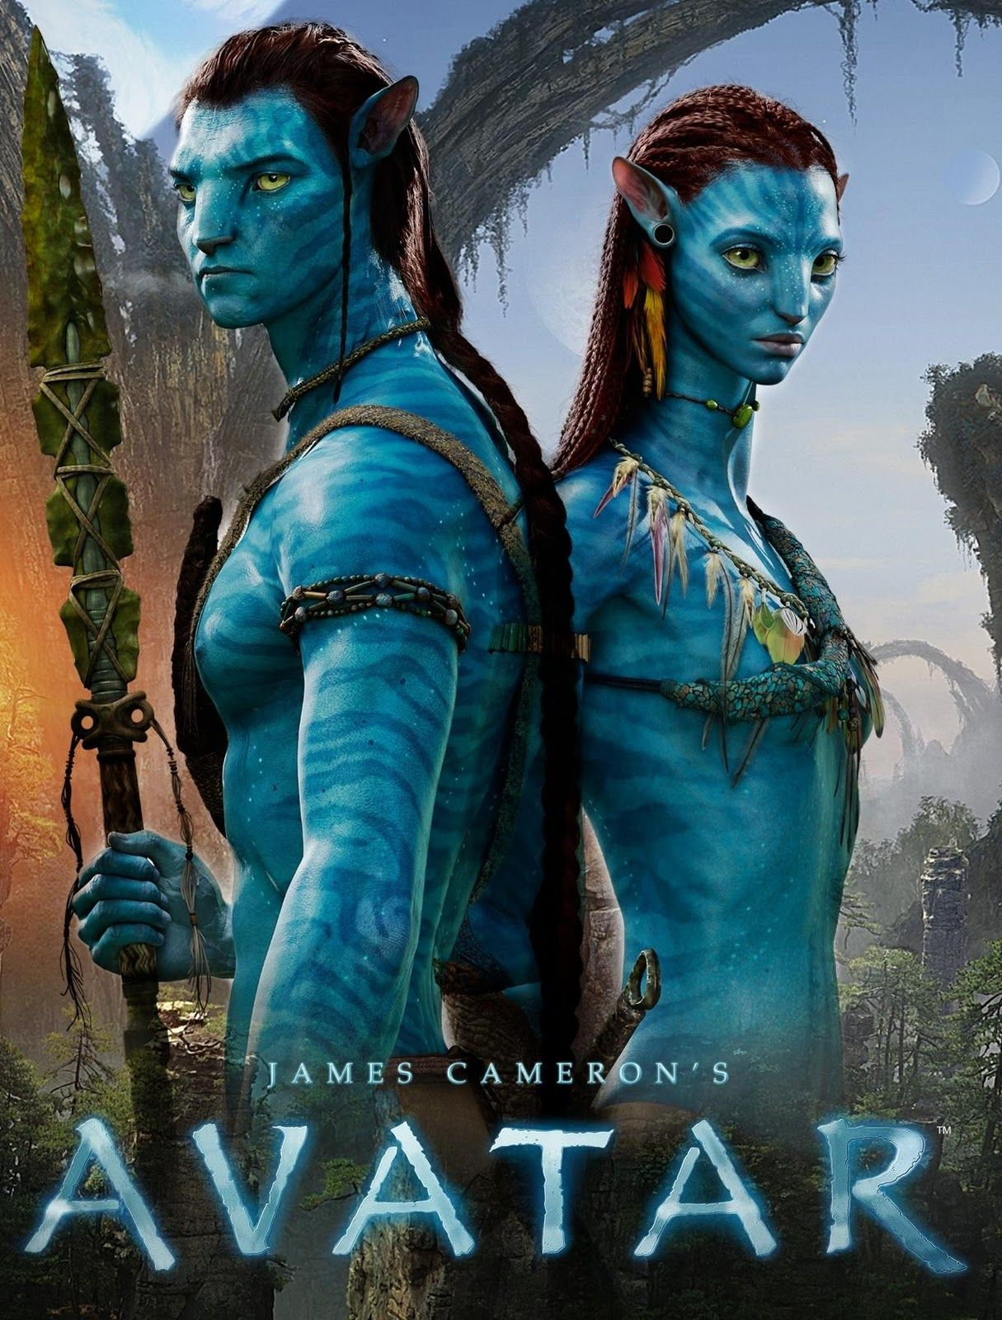
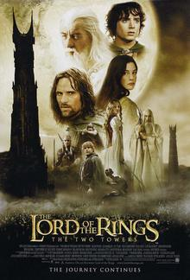

Slide 3
The transformational gospel plus a vivid 3D portrayal is a powerful combination

Slide 4

7D, 2D, 1D
7D
  True Life, Shared Life, Pure Life, Deep Life, Full Life, Serving Life and Bold Life
2D
  2 or 3 disciples meeting regularly to encourage each other in the Word, their Walk and their Witness for Christ
1D
  Having a goal of raising your personal “evangelistic temperature” by one degree

Slide 5

So what is 3D?
DEVELOP FRIENDSHIPS
DISCOVER STORIES
DISCERN NEXT STEPS

Slide 6
Outline
25/10 2. Discover Stories - Andrew
1/11 3. Discern next steps - Andrew
8/11 1. Develop friendships I - Rob
15/11 1. Develop friendships II - Andrew
22/11 1-2-3. Redemptive Family - Howard Webb

Slide 7
Overview
Dear children, let us not love with words or speech but with actions and in truth.
  1 John 3:18
Jesus of Nazareth … went around doing good and healing all who were under the power of the devil …
  Acts 10:38
³⁶ God announced the Good News of peace through Jesus Christ.
⁴² He commanded us to preach to the people and to testify that he is the one whom God appointed as judge of the living and the dead.

Slide 8
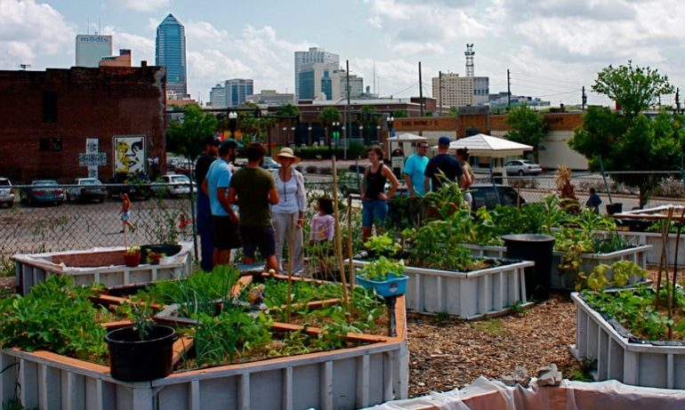
Overview
A 3D Witness gets to know people, goes beyond the surface level, learns about that person’s life, sharing something of their life too and is sensitive to the Holy Spirit for opportunities to invite them to things, talk about their faith etc.
Step 2: Discover Stories

Slide 9
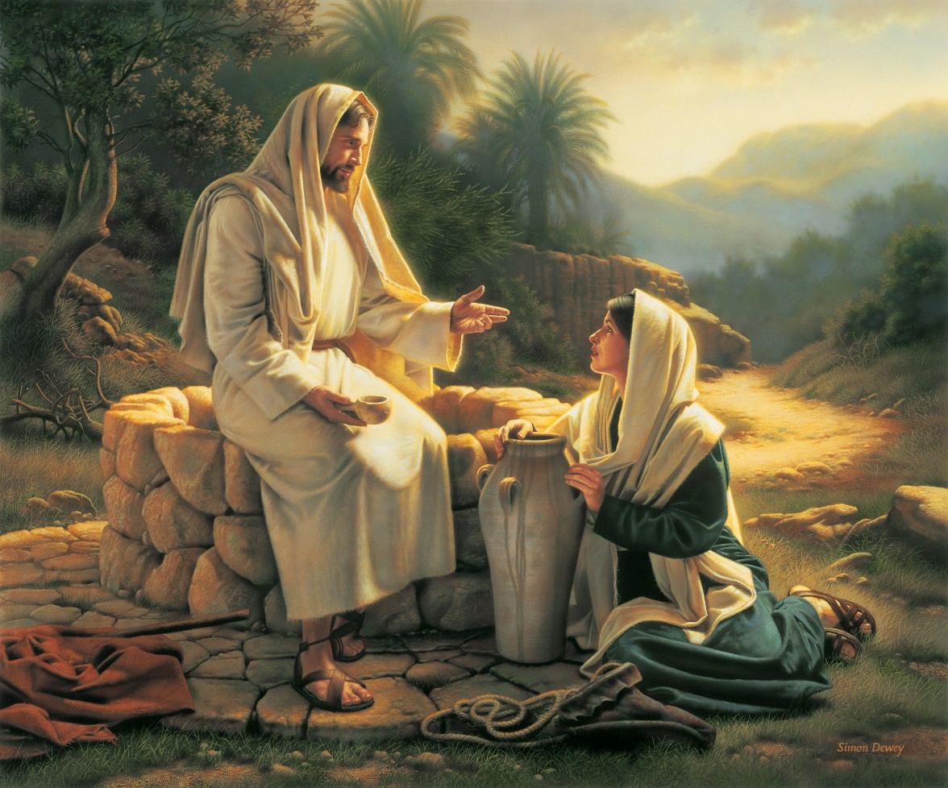
Lessons from Jesus (John 3 & 4)
Talk Life
Love
Listen
Ask the hard questions
Speak the hard truth
See the felt need and address the real need

Slide 10
B. Successful Conversations
Some folks believe that a conversation has been unsuccessful unless the plan of salvation has been clearly explained.

Slide 11
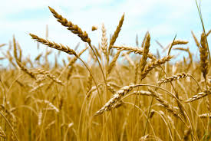
B. Successful Conversations
Some folks believe that a conversation has been unsuccessful unless the plan of salvation has been clearly explained.

Slide 12
The Sower – John 4:31-38
³¹ Meanwhile his disciples urged him, ‘Rabbi, eat something.’ ³² But he said to them, ‘I have food to eat that you know nothing about.’ ³³ Then his disciples said to each other, ‘Could someone have brought him food?’ ³⁴ ‘My food,’ said Jesus, ‘is to do the will of him who sent me and to finish his work. ³⁵ Don’t you have a saying, “It’s still four months until harvest”? I tell you, open your eyes and look at the fields! They are ripe for harvest. ³⁶ Even now the one who reaps draws a wage and harvests a crop for eternal life, so that the sower and the reaper may be glad together. ³⁷ Thus the saying “One sows and another reaps” is true. ³⁸ I sent you to reap what you have not worked for. Others have done the hard work, and you have reaped the benefits of their labour.

Slide 13

The Faith Scale
The faith scale:
 | Pre-Christian |  |  | Christian
ATHEIST | GOD-ACKNOWLEDGER | SEEKER | CONVERSION | FOLLOWER | OWNER | REPRODUCER

Slide 14
C. Getting to know people
Where did you grow up? Where have you lived?
What was your family background like for you?
What is your current family situation? (Married, single, children, etc.)
Where do you work? What do you like about your work? What do you dislike?
What do you do for fun?

Slide 15
Questions about their spiritual journey
I'd be interested in hearing about your spiritual journey.
May I ask you about your religious background?
I'd like to hear where you are in your journey toward God.
Follow Up questions:
"How did your religious training affect you?"
"What level of importance do you place on your religious beliefs?"

Slide 16
D. Principles for Good Listening
Tune in – look at them, show visual and verbal approval
Use conversation expanders - WWWWWH
Find common ground – not your pet hobby horse
Pick up on the big issues – What are their dreams, concerns, needs?
Ask wondering questions

Slide 17
D. Principles for Good Listening
Tune in – look at them, show visual and verbal approval
Use conversation expanders - WWWWWH
Find common ground – not your pet hobby horse
Pick up on the big issues – What are their dreams, concerns, needs?
Ask wondering questions,
  e.g. WORLD EVENTS
  How has 2020 affected the way you look at life?
  What conclusions have you drawn about the nature of humanity?
  Do you believe there is a solution to problems of racism, injustice, sexual abuse and even pandemics?

Slide 18
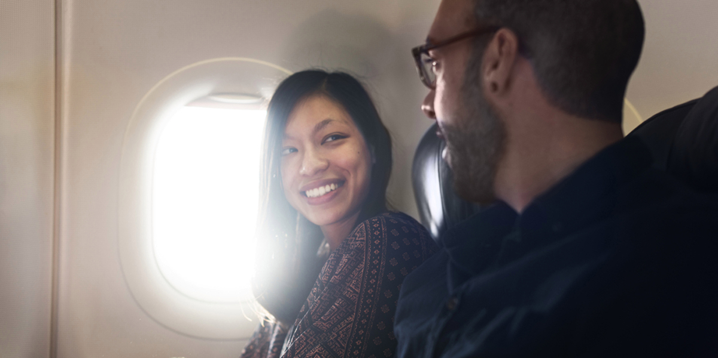
E. Getting Permission
Open-ended answers often causes a sceptic to ask more questions and share more about themselves.

Slide 19
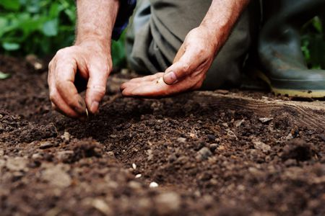
Next week
Discerning Next Steps - this is where things can go in any direction - and that’s OK. God is in charge. He is at work. As Paul says in
I planted the seed, Apollos watered it, but God has been making it grow.
1 Cor 3:6

