Slide 1

Redemptive Family
Week 1: FAMILY
Romans 12:3-16

Slide 2
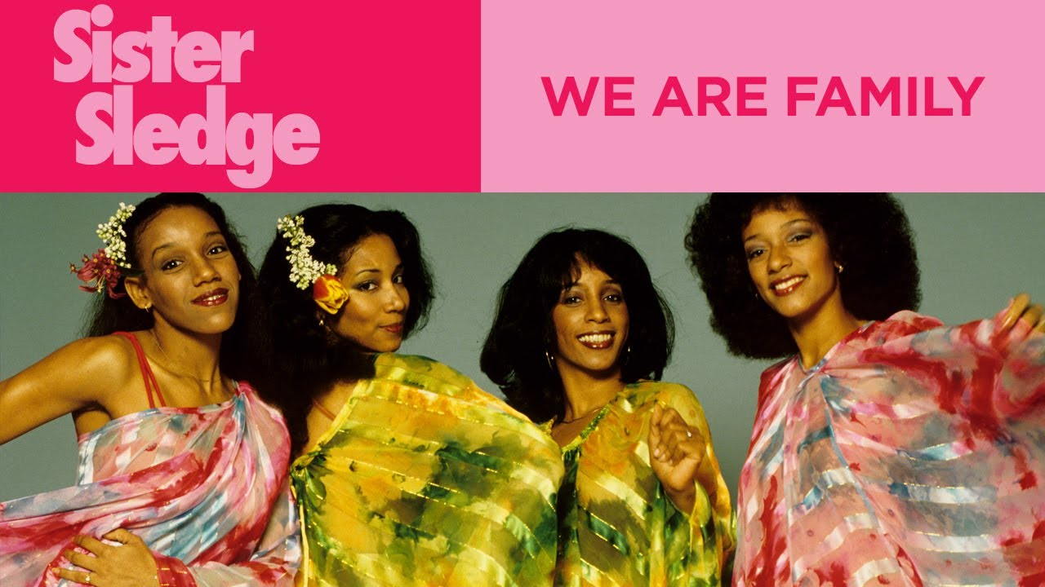
Notes:
[Intro story?]
“We are family - I’ve got all my sisters with me!” Sister Sledge sang back in 1979. A catchy tune but an even more profound truth.

Slide 3
We are Family
‘Who is my mother, and who are my brothers?^{’49} Pointing to his disciples, he said, ‘Here are my mother and my brothers. ⁵⁰ For whoever does the will of my Father in heaven is my brother and sister and mother.’
  Matthew 12:48-50
⁴ For just as each of us has one body with many members, and these members do not all have the same function, ⁵ so in Christ we, though many, form one body, and each member belongs to all the others.
  Romans 12:4-5
Notes:
When Jesus was told that his mother and brothers were outside, he didn’t stop teaching, he just used it as opportunity to make an important point:
[Verses]
Pretty incredible - imagine doing that to your closest relatives! We know that he loved his mum - he specifically made plans for where she was going to live while he hung on the cross. But our relationships with our brothers and sisters in Christ are CLOSE. I belong to you and you belong to me. And we both belong to Christ.
[Verses]

Slide 4
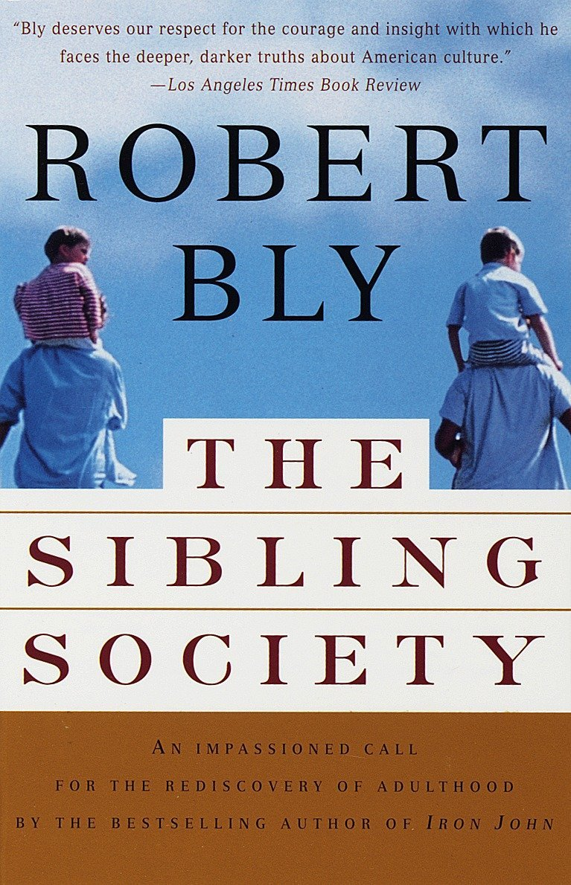
We are Family
“Eternal adolescents”
Families not eating together, talking together and reading together
Young people need stability, presence, attention and advice
“The deepening rage of the unparented”
The results?
Filling the vacuum
Notes:
How we need a rediscovery of family or whanau today!
In his insightful book, The Sibling Society, Robert Bly argues that adults (especially men) have become eternal adolescents. They aren’t growing up. The seeds of this were sown in families where eating together, talking together and reading together were seldom practised. What young people need, he claims, is stability, presence, attention and advice. This phenomenon leads to what he calls “the deepening rage of the unparented.”
What are the results? We see it every day in our mental health and crime statistics.
People are desperately trying to fill this vacuum with friendship groups, dating and relationships. They are searching for someone / somewhere to belong.

Slide 5
We are Family
“The church must be a community (a true family). It must be a place of welcome to desperate pilgrims and the family that people long for. It must be a village in the city where people can find place and home.”
  Nigel Dixon, Village without walls
Notes:
The church must speak into our isolated culture! As Nigel Dixon writes …,
So what is the church? A club? A not-for-profit organisation? Itʹs a family.

Slide 6
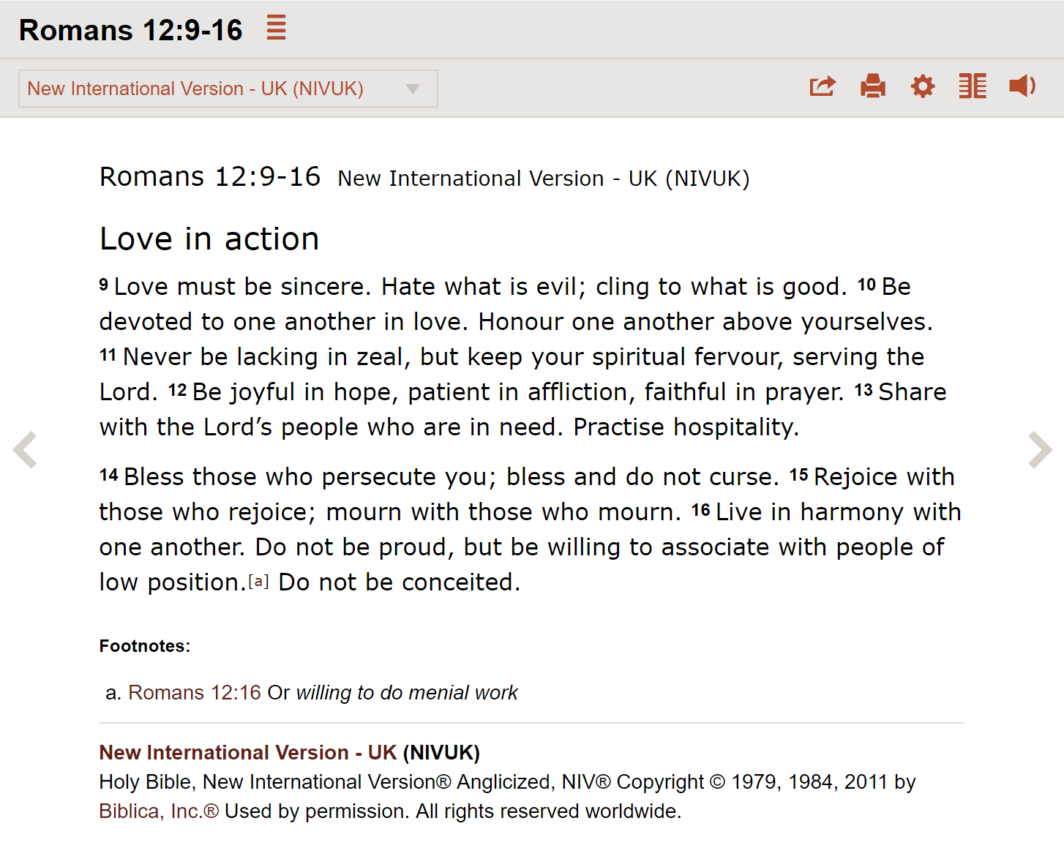
Notes:
[Go though highlights]
Wow! Thereʹs a lot there!

Slide 7

What do we want to be known for?
¹² Live such good lives among the pagans that, though they accuse you of doing wrong, they may see your good deeds and glorify God on the day he visits us.
  1 Peter 2:!2
³⁵ By this everyone will know that you are my disciples, if you love one another.’
  John 13:35
https://www.chooselife.org.nz/lovethemboth/
Notes:
n NZ, we are looking at legislation around euthanasia, abortion law reform and cannabis. Many Christians have strong opinions about these issues and rightly so. I urge you to make a submission on the abortion law reform. Thereʹs an excellent site, lovethemboth.nz.
But there is a risk, isn’t there? That Christians become known more for what they are against than what they are for.
Here’s two big principles from Scripture: [verses]
May we be known by our our good deeds and our love for one another. We can’t avoid people misunderstanding our worldview, but we can build a relationship with people so they might say, those Christians a bit weird, but Nathan’s OK - or Quin or Michelle or …!

Slide 8

Notes:
Here are just a few highlights from this passage:
Practise hospitality

Slide 9
Practise hospitality
“Hospitality is always an act that benefits the host even more than the guest. The concept of hospitality arose in ancient times when the reciprocity [exchanging things with others for mutual benefit] was easier to see: … in nomadic cultures, the food and shelter one gave to a stranger yesterday is the food and shelter one hopes to receive from a stranger tomorrow. By offering hospitality, one participates in the endless re-weaving of a social fabric on which all can depend-thus the gift of sustenance for the guest becomes a gift of hope for the host.”
Parker J. Palmer
Notes:
Parker J. Palmer explains the importance of hospitality in the ancient world: [quote]

Slide 10
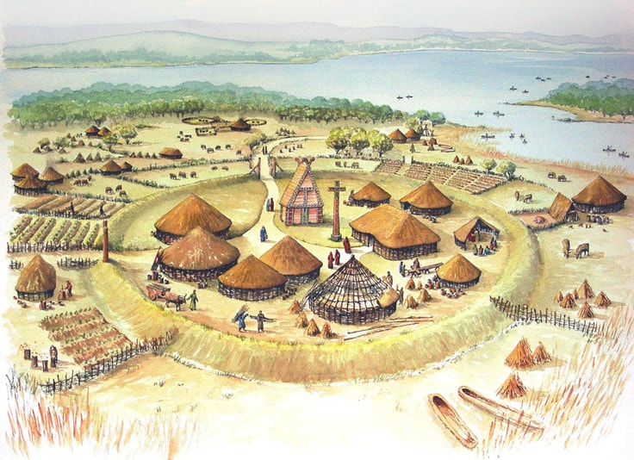
Practise hospitality
Patrick of Ireland
Notes:
One of the most powerful examples of hospitality is Patrick of Ireland. Patrick was called by God to go to the “barbarians” over in Ireland – the very same barbarians who had kidnapped him from England when he was 16 years old!
By the time of his death, the gospel had spread throughout the land. How? Did he travel all over the place preaching? Not so much. He did it through hospitality.
Travellers and seekers would be invited to be guests of the community. They would meet someone at the entrance who would welcome them and introduce them to the rest of the community.
Everyone would welcome the person wholeheartedly. The abbot (the leader of the monastery) would gently ask the person what had led them to the community, he would read a scripture, offer a prayer for the person and wash their feet.
After that they stayed in the guest house and ate at the abbot’s table for meals. Soon they would be given a “soul friend”, a small group and a place for periods of silence.
They would learn some scripture and would worship with the community. One or more people would share the ministry of conversation and pray with them daily.
After a few weeks they would find themselves believing what the Christians believe and they would be invited to commit their life to Christ and his will for their lives.
The gospel spread among the Irish as people's experience of Christian fellowship brought them to a saving faith in Christ himself.
Christian fellowship is still a very powerful thing! My own experience of being invited to be a part of a group of young people talking about real issues of life, praying together, eating and worshipping together attracted me to Jesus.
One night, after a few months of attending youth group and night church, the pastor preached about the resurrection of Jesus and I gave my life to him. I had seen him in the lives of my friends, now I had met him for myself.
Friends, what a joy to be involved in a fellowship like that!

Slide 11
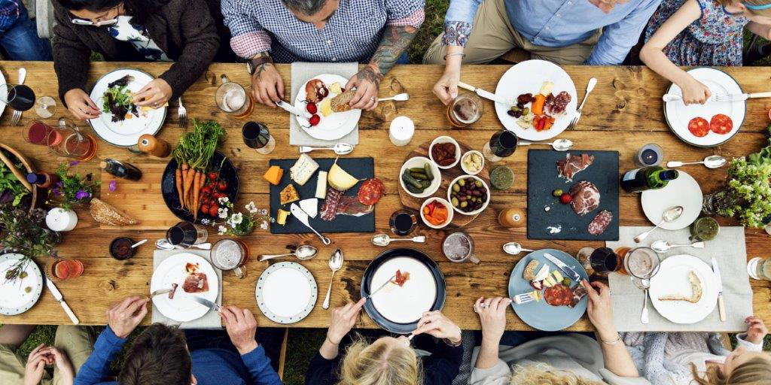
How will outsiders be able to experience our church family?
The answer lies in hospitality. The family that wants to grow needs empty seats at the family table they are longing to fill. As guests experience a loving family and return again and again, they may become family too.
  Howard Webb, Love Your Neighbour NZ

Slide 12
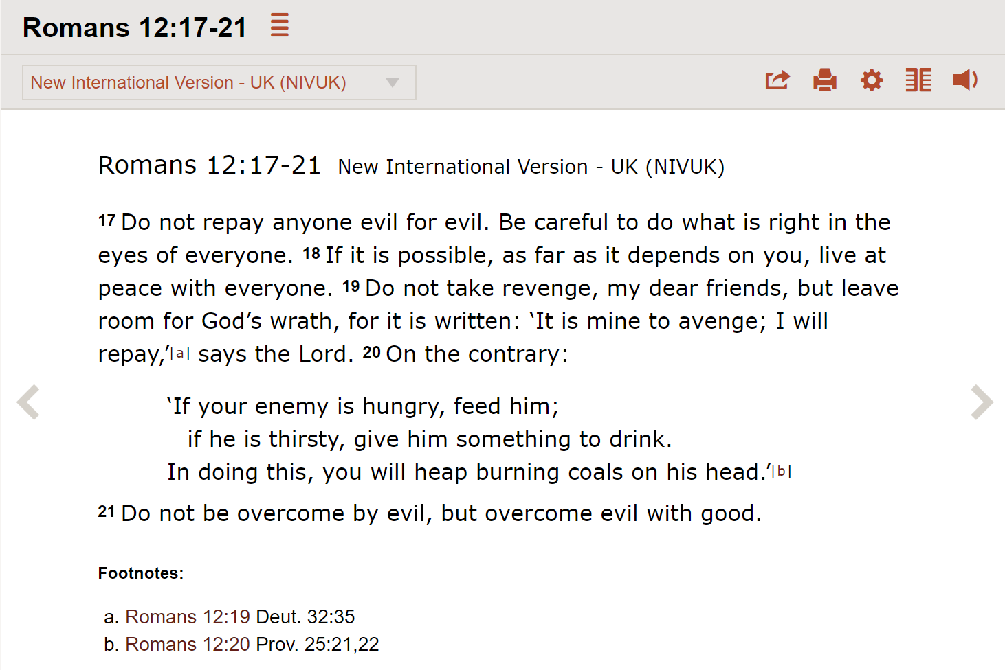
Notes:
I’m not very qualified to talk on this topic, so I thought it would be good to hear from someone who is learning to practise this in a place of conflict and division.
[Show Love Your Enemy video]

Slide 13



Notes:
¹⁵ Rejoice with those who rejoice; mourn with those who mourn.
The best counselling advice ever given: We mourn and rejoice with people like Job’s friends before they said anything! But we are not professionals mourners or cheerleaders, but people who have real practical compassion for each other.

Slide 14
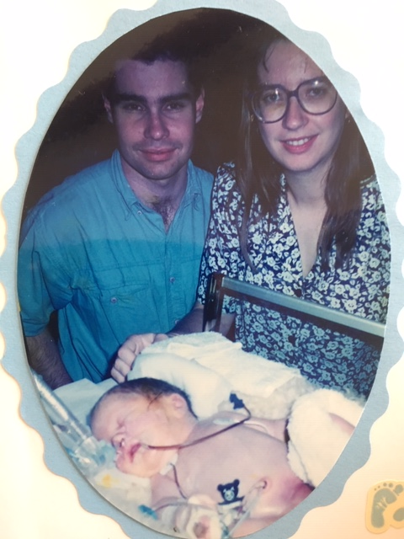
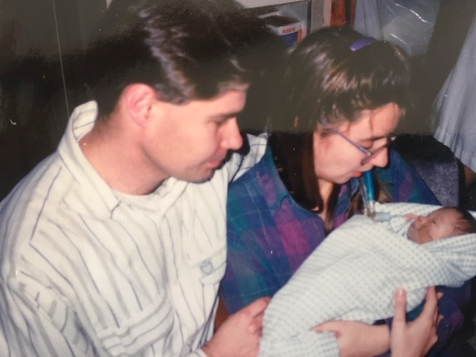
The Family of God in action
Notes:
When Rachael came out of the doctor's clinic on the 9th of January 1995, grinning ear to ear, I knew what she was going to say: "I'm going to have a baby!" We were delighted with the news, but Rachael soon became very sick — so much so that she was hospitalised twice with severe dehydration. This was particularly difficult because we had just moved to Hamilton and we were pioneering a new ministry at Waikato University. Finally by 17 weeks the morning sickness had subsided. We were slowly getting back to “normal” when inexplicably, Rachael’s membranes ruptured - at 19 weeks! She was leaking amniotic fluid but the pregnancy continued.
Amniotic fluid plays an essential role in lung development. The pediatrician was pretty bleak in his prognosis but the obstetrician was more optimistic. If the baby could hang on a few more weeks, there might be a chance, he said. Well, he hung on to 24 weeks, so it was time to begin giving Rachael steroids to help the lungs along. He hung on for another 8 weeks after that, then Samuel John was born on July 29th, 1995.
I won't go into all the drama of that night. He came feet first. And he was beautiful. He gave a little cry, then his chest caved in and he tried to use his little lungs for the first time. Rachael had a brief hold then our Sam was whisked up to the new born intensive care unit. The next 12 days were a real roller coaster ride. One minute: "He's going to make it". The next minute, "He's not going to make it." Every piece of news would send our emotions into a tailspin.
Rachael describes the scene in her tribute: "You had a bandage on your eyes and earmuffs on your ears. There was little I could do for you but sit beside you and hold your hand. Yet as I sat there, I took in so many details about you and loved you." On day 10, Samuel took a turn for the worse. By day 12, there was nothing more the doctors could do. They stopped administering the paralysing drug they had been giving him to stop him fighting against the ventilator. Soon afterwards, he opened his eyes and looked at us for the first time since he was born. Rachael wrote later, "Now the bandage and the earmuffs are off. I can see your face, and you are so beautiful." We held him that afternoon and took pictures. He kept on opening his eyes, as if he sensed our love for him. At 3:30 pm on the 8th of August, Sam's ventilator was turned off and he died a few minutes later, peacefully in Rachael's arms, of what was described as persistent pulmonary hypertension. Rachael bathed and dressed him and took him home.
Those events took place 24 years ago. God has since given us three beautiful daughters. But we will never forget our Sam, or the love shown to us by God’s people.
John Henderson coming down from Auckland in the middle of the night when Sam was born
Our homegroup keeping vigil in the hospital
Our small staff team was amazing - I remember on the day we decided to swtich off the ventilator throwing my arms around them, weeping and saying, “I love you guys!”
Heaps of casseroles and lasagne, including a frozen dinner couriered from Wellsford!
People prayed, sent cards and gathered for Sam’s funeral.
We felt so loved and supported - at least during the crisis of Sam’s short life. I don’t think people knew quite what to do after that - neither did we!
The church is a family. And a family goes through highs and lows. Let’s stick together, lets work at relationships and let’s welcome those who need a family too.

Slide 15
Redemptive Family
Sunday messages 18 August to 22 Sept
Small Group Discussions
Daily Devotion Weekly Survey
Facilitated Workshop 4-5 October
5 weeks
Notes:
DURING THIS COMING WEEK we’ll explore this topic in more depth in our devotionals.
[Revisit the analogy of training for a marathon and suggest that tomorrow Monday 26 August is the first day of the training…]
And do the survey too …

Slide 16
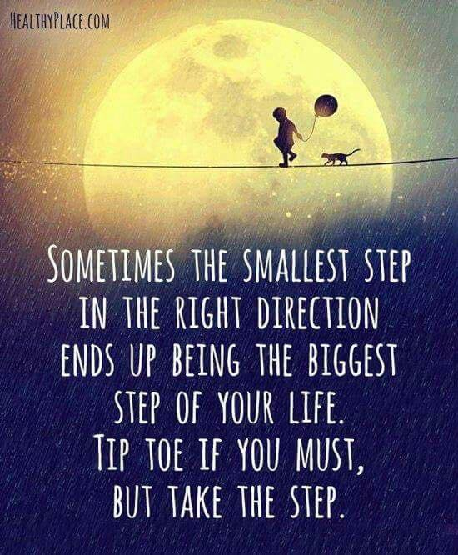
Notes:
[Quote]
[Pray]

