Slide 1
“Guard your Heart”
The transformational power of our attitude and attentions
Philippians 4:1-9

Slide 2
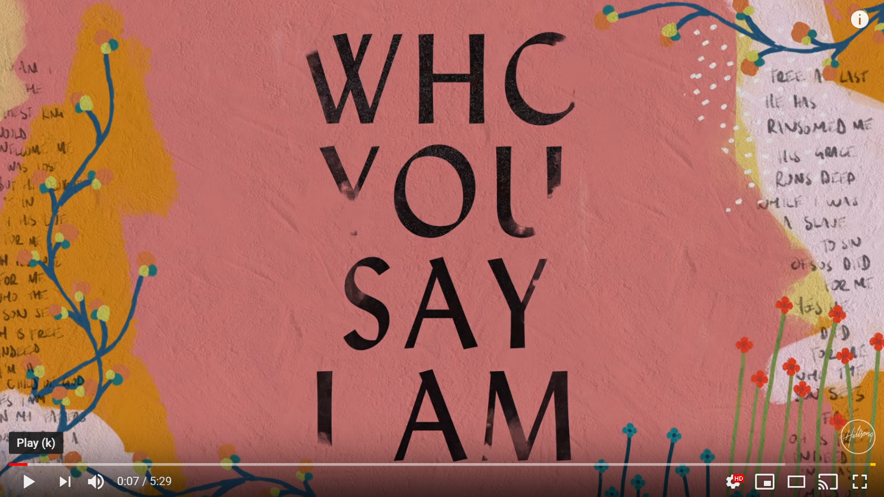
Review of last week
“Let us live up to what we have already attained.”
Our position: blameless (Phil. 3:15-16)
Our progress: relentless (17-19)
Our prospects: glorious (20-21)
“I don’t do it to make him like me, I do it because I am like him.”

Slide 3
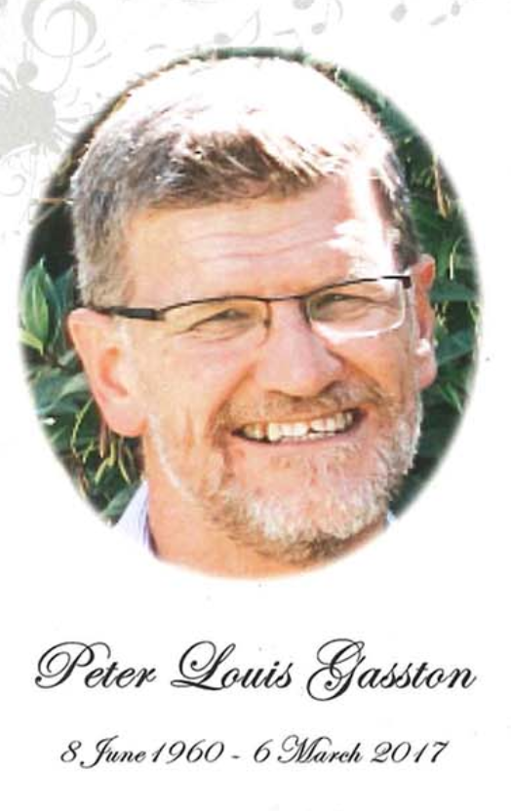
How’s your Heart?
The Bible …
The ruling centre of the whole person, the spring of all desires.
The seat of the will, intellect and feelings.
"Character", "personality" and "mind" are approximate modern terms for the Bible's meaning of heart.
Notes:
Our hearts: precious

Slide 4
Above all else …
Above all else, guard your heart, for everything you do flows from it.
  Proverbs 4:23
“Love the Lord your God with all your heart and with all your soul and with all your strength.”
  Deuteronomy 6:5
“For the eyes of the Lord range throughout the earth to strengthen those whose hearts are fully committed to him.”
  2 Chronicles 16:9
“... But in your hearts revere Christ as Lord.”
  1 Peter 3:15
Notes:
That’s God’s desire for us – hearts that are full of Him!
But our hearts are prone to become proud and stubborn.

Slide 5
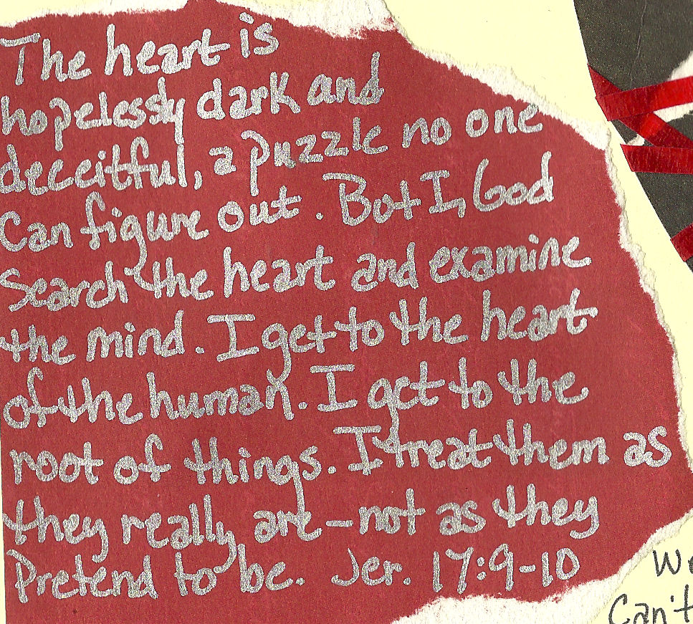
Notes:
The evil we do are symptoms of deeper sickness of the heart …
The shooter put his worldview into action. This is the source of evil actions - our evil hearts - our motives and beliefs. We may not act out so dramatically, but are our hearts are not innocent!
As the previous verses showed, we are called to guard our hearts from becoming hardened and depraved and to allow God free reign.
How do we do that?

Slide 6

Guard your Heart
Attitude (Philippians 4:4-7)
Attention (8-9)
Notes:
Having reached the climax of his argument in chapter 3, Paul concludes his letter with some further instructions, starting with two women …

Slide 7
Attitude (4-7)
⁴ Rejoice in the Lord always. I will say it again: rejoice! ⁵ Let your gentleness be evident to all. The Lord is near. ⁶ Do not be anxious about anything, but in every situation, by prayer and petition, with thanksgiving, present your requests to God. ⁷ And the peace of God, which transcends all understanding, will guard your hearts and your minds in Christ Jesus.

Slide 8
Attitude (4-7)
⁴ Rejoice in the Lord always. I will say it again: rejoice! ⁵ Let your gentleness be evident to all. The Lord is near. ⁶ Do not be anxious about anything, but in every situation, by prayer and petition, with thanksgiving, present your requests to God. ⁷ And the peace of God, which transcends all understanding, will guard your hearts and your minds in Christ Jesus.
Notes:
Four commands (highlighted).
I will focus on 3 and 4: Don’t be anxious about anything, but pray about everything.

Slide 9
Don’t be anxious about anything, but pray about everything
“Anxious” can refer to being unduly concerned about anything, but it is often used in contexts where persecution is the issue.
E.g., Nehemiah …
  Mourned and fasted and prayed when he heard of the situation of the returnees in Jerusalem (ch. 1)
  Prayed an “arrow prayer” when the king asked him what he wanted (ch. 2)
  Prayed to God an posted a guard day and night when their enemies, including Sanballat and Tobiah, plotted to fight against them (ch. 4)
  Prayed that God would strengthen his hands when their enemies tried toi frighten them (ch. 6)
Notes:
Time and again, when faced with problems, Nehemiah prayed. Was he stressed, probably. But he went FIRST to God then made sensible plans.
He exemplified the principle - don't be anxious but pray. Simple! Or is it? How often have we wallowed in our anxiety - we’ve gazed at our problems and glanced at God instead of the other way round! Kadesh banea- we were like grasshoppers... these guys were freaks of nature! It showed a lack of faith - and without faith it is impossible to (do what?) Please God.

Slide 10
What about Anxiety Disorder?
One in four kiwis will suffer some sort of anxiety disorder in their lifetimes. This is when “being anxious” becomes much harder to stop doing.
Some unhelpful advice Christians have received:
‘Give your worries to God.’
  “I sure try. But they just keep coming. I recently asked my doctor for something to fight the anxiety [and it] is working wonderfully.” — Trisha S.
“Have you prayed about it?”
  “I do all the time, [and it] doesn’t change a thing… People seem to automatically think because I have mental health, I am turning away from God in some way.” — Stephanie R.

Slide 11
Unhelpful Advice (continued)
“You wouldn’t need a therapist/medication if you really trusted in God.”
  “This one upsets me most because I felt as if He has sent me on my way to therapy so I could become closer to Him. I was down a dark path before I started therapy and I’m now seeing clearer and loving God as I should have before.” — Barbara L.
“God doesn’t give you more than you can handle.”
  “Implication: you should be able to handle this. You’re probably just not praying hard enough, or you’ve let other things come between you and God. Or, you don’t trust God enough. Once you put those things aside you’ll be fine.” — Rebecca H.

Slide 12
Unhelpful Advice (continued)
Silence.
  “Any physical ailment is prayed over and cared for, but as soon as you mention something being wrong with your mind, the help evaporates. It needs to be addressed. Pastors and church leaders need to understand how to care for those in their congregation that suffer from mental illness, and how they can be of help. Jesus loves those with mental illness, and the greatest comfort can come from Christ. But if no one knows how to find it, that comfort never comes.” — Sarah G.
  Source: themighty.com – digital health community
Notes:
There is hope! I have worked with someone who suffered from anxiety and we also have it in our own family. It is wonderful to see how my friend and family member have been working through it – but it takes time and they still have to keep an eye on their mental health.

Slide 13
Helpful advice from Alice Boyes, The Anxiety Toolkit
Try to consider the worst thing that can happen, the best thing and the most realistic thing.
Eliminate micro-decisions about things such as what to wear or eat by sticking to the same choices.
  “People call me Chairman Mao. I have a uniform I wear every day and two outfits I put on if I have to go out. I was like that even as a kid – I’d wear my school uniform on mufti day. I’ve been teased mercilessly for it, but now there’s actual research to back me up.”
Try exposure (carefully!) Bring the worst case scenario to mind and hold it there, keeping the vivid images until the anxiety level drops. Repeat it until you can bring it to mind with only low levels of anxiety (it’s a bit like an inoculation.)
Don’t avoid! Avoidance of situations or courses of action that make us anxious is the most common strategy people use. It’s a terrible one!
  “It’ll eat you alive psychologically if you don’t work on it.”
Notes:
That last point is worth repeating. The worst thing you can do it nothing. Paul’s advice, sensitively given, is still outstanding.

Slide 14
Prayer
Includes:
  Petition – specific requests
    “Women with advanced breast cancer ask health select committee for Pharmac review” NZ Herald, 13 March
    Shopping list?
      Our loving Father delights in answering our prayers (Luke 11:11-13)
  Thanksgiving
    Question: Why is thanksgiving so important?
  Sometimes the answer is no, but we are promised something wonderful …

Slide 15
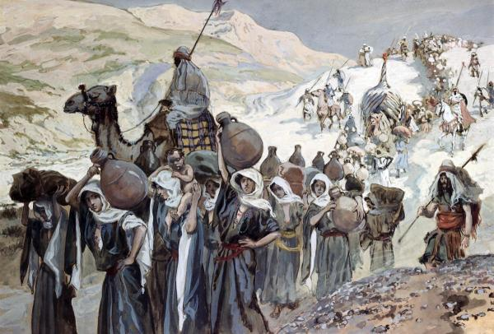
“David found strength in the LORD ...” 1 Sam 30
Notes:
30 David and his men reached Ziklag on the third day. Now the Amalekites had raided the Negev and Ziklag. They had attacked Ziklag and burned it, 2 and had taken captive the women and everyone else in it, both young and old. They killed none of them, but carried them off as they went on their way.
3 When David and his men reached Ziklag, they found it destroyed by fire and their wives and sons and daughters taken captive. 4 So David and his men wept aloud until they had no strength left to weep. 5 David’s two wives had been captured – Ahinoam of Jezreel and Abigail, the widow of Nabal of Carmel. 6 David was greatly distressed because the men were talking of stoning him; each one was bitter in spirit because of his sons and daughters. But David found strength in the Lord his God.
7 Then David said to Abiathar the priest, the son of Ahimelek, ‘Bring me the ephod.’ Abiathar brought it to him, 8 and David enquired of the Lord, ‘Shall I pursue this raiding party? Will I overtake them?’
‘Pursue them,’ he answered. ‘You will certainly overtake them and succeed in the rescue.’
9 David and the six hundred men with him came to the Besor Valley, where some stayed behind. 10 Two hundred of them were too exhausted to cross the valley, but David and the other four hundred continued the pursuit.
11 They found an Egyptian in a field and brought him to David. They gave him water to drink and food to eat – 12 part of a cake of pressed figs and two cakes of raisins. He ate and was revived, for he had not eaten any food or drunk any water for three days and three nights.
13 David asked him, ‘Who do you belong to? Where do you come from?’
He said, ‘I am an Egyptian, the slave of an Amalekite. My master abandoned me when I became ill three days ago. 14 We raided the Negev of the Kerethites, some territory belonging to Judah and the Negev of Caleb. And we burned Ziklag.’
15 David asked him, ‘Can you lead me down to this raiding party?’
He answered, ‘Swear to me before God that you will not kill me or hand me over to my master, and I will take you down to them.’
16 He led David down, and there they were, scattered over the countryside, eating, drinking and revelling because of the great amount of plunder they had taken from the land of the Philistines and from Judah. 17 David fought them from dusk until the evening of the next day, and none of them got away, except four hundred young men who rode off on camels and fled. 18 David recovered everything the Amalekites had taken, including his two wives. 19 Nothing was missing: young or old, boy or girl, plunder or anything else they had taken. David brought everything back. 20 He took all the flocks and herds, and his men drove them ahead of the other livestock, saying, ‘This is David’s plunder.’
21 Then David came to the two hundred men who had been too exhausted to follow him and who were left behind at the Besor Valley. They came out to meet David and the men with him. As David and his men approached, he asked them how they were. 22 But all the evil men and troublemakers among David’s followers said, ‘Because they did not go out with us, we will not share with them the plunder we recovered. However, each man may take his wife and children and go.’
23 David replied, ‘No, my brothers, you must not do that with what the Lord has given us. He has protected us and delivered into our hands the raiding party that came against us. 24 Who will listen to what you say? The share of the man who stayed with the supplies is to be the same as that of him who went down to the battle. All shall share alike.’ 25 David made this a statute and ordinance for Israel from that day to this.
26 When David reached Ziklag, he sent some of the plunder to the elders of Judah, who were his friends, saying, ‘Here is a gift for you from the plunder of the Lord’s enemies.’
27 David sent it to those who were in Bethel, Ramoth Negev and Jattir; 28 to those in Aroer, Siphmoth, Eshtemoa 29 and Rakal; to those in the towns of the Jerahmeelites and the Kenites; 30 to those in Hormah, Bor Ashan, Athak 31 and Hebron; and to those in all the other places where he and his men had roamed.

Slide 16
Attention (8-9)
⁸ Finally, brothers and sisters, whatever is true, whatever is noble, whatever is right, whatever is pure, whatever is lovely, whatever is admirable – if anything is excellent or praiseworthy – think about such things. ⁹ Whatever you have learned or received or heard from me, or seen in me – put it into practice. And the God of peace will be with you.

Slide 17
Attention (8-9)
⁸ Finally, brothers and sisters, whatever is true, whatever is noble, whatever is right, whatever is pure, whatever is lovely, whatever is admirable – if anything is excellent or praiseworthy – think about such things. ⁹ Whatever you have learned or received or heard from me, or seen in me – put it into practice. And the God of peace will be with you.

Slide 18
The Mind
Bible: Sometimes used synonymously with “heart” but usually as the organ of intellectual understanding, practical wisdom and decision-making
Very powerful! “What you think about you become”
So … what do you think about?

Slide 19
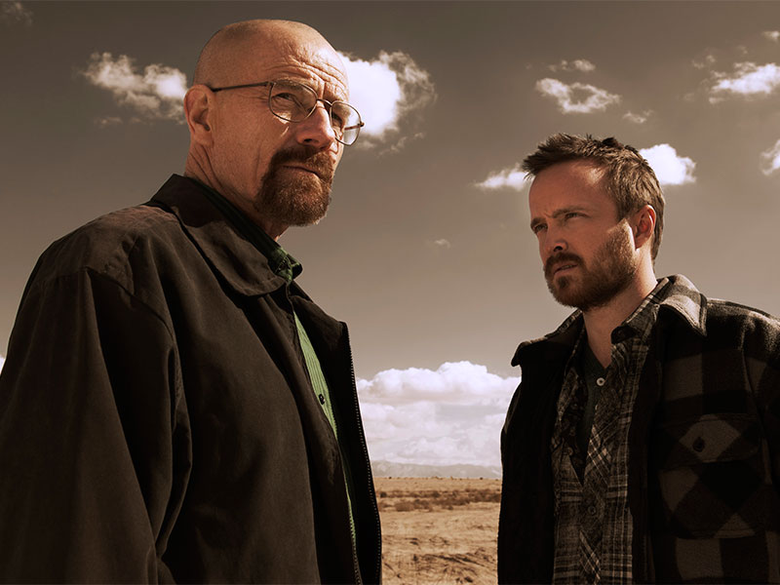
Breaking Bad
Notes:
I first got curious about “Breaking Bad” (a 5 series show on Lightbox) after listening to a Christian podcast. They said that it was actually a brilliant morality tale with a fascinating insight into human sin and redemption. And so it proved to be. Walter White, mild mannered highschool teacher, becomes Mr Big in the Methamphetamine business and does some terrible things along the way. Meth head, is a total loser but his is ultimately a story of redemption while Walter’s story goes the other way. I’m glad I watched Breaking Bad, because of how it told this universal story of the human condition.

Slide 20
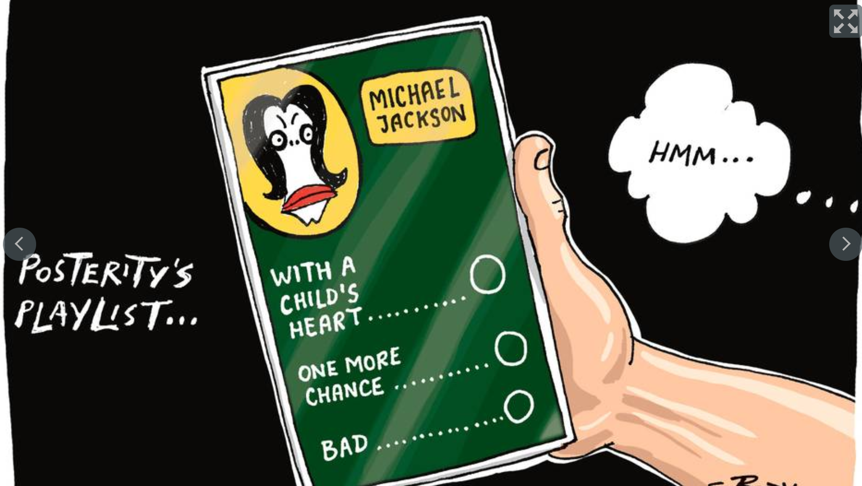
Leaving Neverland
Notes:
Leaving Neverland is a documentary from Dan Reed (centre). It focuses on two men, Wade Robson and James Safechuck, who allege they were sexually abused as children by the singer Michael Jackson. It also examines the effects on their families. While I’ve only watched half the four hour documentary so far, I found it hugely helpful in understanding how abusers groom their targets. The testimony of the two men is pretty compelling but everyone must make up their own mind, as this cartoon shows.
So why do I mention these two shows? Because sometimes we have this view that Christians are forbidden any entertainment beyond Radio Rhema and Shine TV! Yes, we need to be discerning with that we watch. But shows that show us the darker side of life can be important in helping us understand the world we live in and be more compassionate to people who are suffering.
But, it’s a question of balance …

Slide 21
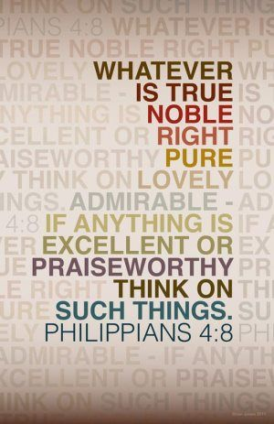
I need …
Beautiful music
Fresh air
Redemptive stories
To drink deeply of God’s Word
(We are all different!)
Question: What feeds your mind and soul?

Slide 22
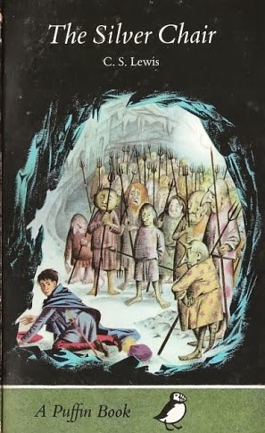
Why this matters a lot!
Competing stories of reality
  “This is all there is”; OR
  God’s story
Phil. 4:9-10 takes on a great degree of urgency. It’s nothing less than a battle for our hearts.
Notes:
In The Silver Chair, Puddleglum, Jill, and Eustace are captured in a sunless underground world by an evil witch who calls herself the queen of the underworld. The witch claims that her prisoners' memories of the overworld, Narnia, are but figments of their imagination. She laughs condescendingly at their child's game of "pretending" that there's a world above and a great ruler of that world. The sun she says is just their imagination based in the lamps they see in the underworld. Aslan the king of Narnia is merely their projection from the cats they have seen in the underworld.
She says to them, hypnotically, "There never was any world but mine” and they, who are under her spell. parrot it after her. Finally, when it appears they've succumbed to the queen's lies, Puddleglum is able to say that their “imaginary” world beats her pathetic so-called “real” world hands down and the spell is broken.
The prince of this world wants us to believe that this is all there is. As John Lennon sang, “No hell below us, above us only sky.” There is no God to whom we are accountable. We are merely a collection of atoms – the product of time plus change plus random variations and have no intrinsic value. There no God-given guidelines for sex and relationships so do what you like as long as you don’t hurt anyone else. We are masters of our own destiny. “So “let us eat, drink and be merry for tomorrow we die!” This is the story we are bombarded with from entertainment, the media, our politicians and educators.
But there is another story – of a God who loves us and has gone to the most extreme lengths imaginable to win us back to himself. Love, beauty, truth – all of these find their source and meaning in our Creator God. Hope? We have it in abundance because of the death and resurrection of Jesus. This is the story our world pretends it doesn’t need. It’s the true story.
So Phil. 4:9-10 takes on a great degree of urgency. It’s nothing less than a battle for our hearts. Which god will we serve – the god of the independent self or the one true God?

Slide 23
So …
Guard your heart by developing good attitudes (e.g. prayer with thanksgiving) and attentions (on what is noble, right, pure, lovely, etc.)
Avoid “pat answers” to those with mental health issues
God will give you his peace as you pray and trust in Him
And, finally, put it into practise! (v.9)
Notes:
⁹ Whatever you have learned or received or heard from me, or seen in me – put it into practice. And the God of peace will be with you.
And I would add, you will have a heart that beats in time with the Holy Spirit, overflowing with love and good deeds.

