Slide 1
World Class Leadership!
1 Corinthians 4:1-23
Notes:
What is the most critical factor in the success of an organisation? Many business gurus would agree - it’s leadership. Companies, SOE’s and NGO’s will pay millions (if they can afford it) to get the right CEO, and often millions again to get rid of them!
Simon Sinek is one of those gurus who has been very influential - especially through his famous Ted Talk on “Starting with the Why”. Here’s a taste.
[Simon Sinek video on world class organisations]

Slide 2
How can I be a world class leader?
¹ This, then, is how you ought to regard us: as servants of Christ and as those entrusted with the mysteries God has revealed. ² Now it is required that those who have been given a trust must prove faithful.
1 Corinthians 4:1-2
Notes:
We’ve been studying 1 Corinthians (messy, theology, love). First four chapters’ focus: divisions. He’s argued that unity is the only logical expression of the gospel and Christian maturity. In chapter 4, he sites his own example as one to follow
[Verse]

Slide 3
A proven servant of Christ
A good servant leader is not out for him or herself.
“I have the right temperament. I have the right leadership. I've built an incredible company. I went to a great school. I came out - I built an incredible company. I wrote the number one selling business book of all time ..”
Donald J. Trump
Notes:
A good servant leader is not out for him or herself. He or she is not aiming to be the best or boasting about their accomplishments. They serve the goal of the mission.
[Quote]

Slide 4
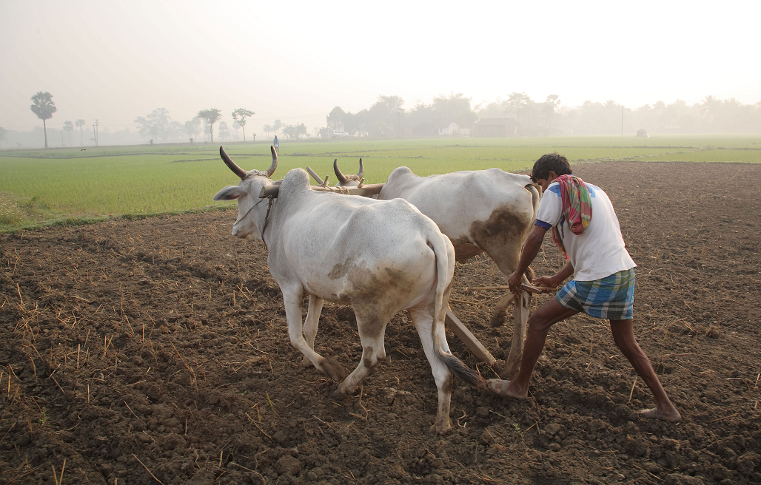
A proven servant of Christ
⁷ ‘Suppose one of you has a servant ploughing or looking after the sheep. Will he say to the servant when he comes in from the field, “Come along now and sit down to eat”? ⁸ Won’t he rather say, “Prepare my supper, get yourself ready and wait on me while I eat and drink; after that you may eat and drink”? ⁹ Will he thank the servant because he did what he was told to do? ¹⁰ So you also, when you have done everything you were told to do, should say, “We are unworthy servants; we have only done our duty.”’
Luke 17:7-10
Notes:
Jesus told many parables about servant / master relationships, including Luke 17:
[Verse]
A world class leader is one who performs their duty to the organisation or mission to their very best ability because that’s what servants do.
Great example: Baruch. Have you heard of Baruch?

Slide 5
E.g. Baruch
Jeremiah’s assistant
Jeremiah’s career spanned five Judean kings
Key period: the fall of Jerusalem to the Babylonians
They had a close relationship
Jeremiah dictated to him God ‘s Words over a period of 22 years
He brought God’s Word to King Jehoiakim
How did he respond?
What did Jeremiah do?
Flight to Egypt
Notes:
Baruch was Jeremiah the prophet’s scribe or secretary. Jeremiah’s career spanned five Judean kings starting with Josiah in 639 BCE and ending with Zedekiah in 586 BCE. Baruch worked with Jeremiah during the difficult years preceding the fall of Jerusalem to the Babylonians in 587 BCE. They had a close relationship. Jeremiah trusted and relied on Baruch. He witnessed a land transaction and stored it in a clay jar from safe keeping. In fact archaeologists have discovered one with an inscription on it that closely resembles Baruch’s name and title: Baruch, the son of Neriayahu, the scribe, dating to about the same period.
Jeremiah also dictated to him all the words that God had spoken to him over a period of 22 years. Baruch carefully wrote down every word and then read from the scroll to the people gathered near the temple on a national fast day as it was too dangerous for Jeremiah to do it himself. The king’s officials then sent for Baruch to come to bring the scroll with them. How did king Jehoiakim respond?
As it was read to him, the king would cut off what had been read and throw the pieces into the fire. The scribes protested, but ultimately, the whole document was burned.
What did Jeremiah do? He dictated the entire thing to Baruch again, adding a few choice warnings at the end for Jehoiakim!
Later on, Jeremiah and Baruch were forced to flee with the people to Egypt, even though Jeremiah had explicitly warned them not to go there. It was there that Baruch himself had a Word (or Oracle) from the Lord.

Slide 6
E.g. Baruch
² ‘This is what the Lord, the God of Israel, says to you, Baruch: ³ You said, “Woe to me! The Lord has added sorrow to my pain; I am worn out with groaning and find no rest.”
Jeremiah 45:2-3
⁴ But the Lord has told me to say to you, “This is what the Lord says: I will overthrow what I have built and uproot what I have planted, throughout the earth. ⁵ Should you then seek great things for yourself? Do not seek them. For I will bring disaster on all people, declares the Lord, but wherever you go I will let you escape with your life.”’
Notes:
[Verse]
Baruch had worked so hard for Jeremiah and what was the result? People refused to listen. They had lost everything. They were taken by force down to Egypt. Then the oracle continued:
[Verse]
We can only speculate what “great things” Baruch might have been seeking for himself, but one possibility is that he was seeking to be a prophet like Jeremiah.
According to God, this would not be his role. Instead he would survive, literally, his life would be a prize of war.” Once all the turmoil was over, Baruch would remain alive to help his people to submit to the Babylonians, as Jeremiah said,
Baruch is a great example of a world class servant. In a turbulent time with often no obvious success, Jeremiah faithfully did what God told him to do, and Baruch did what Jeremiah told him to do. Clearly, he had his struggle and frustrations, but heeded the maxim, “Should you then seek great things for yourself? Do not seek them.”

Slide 7
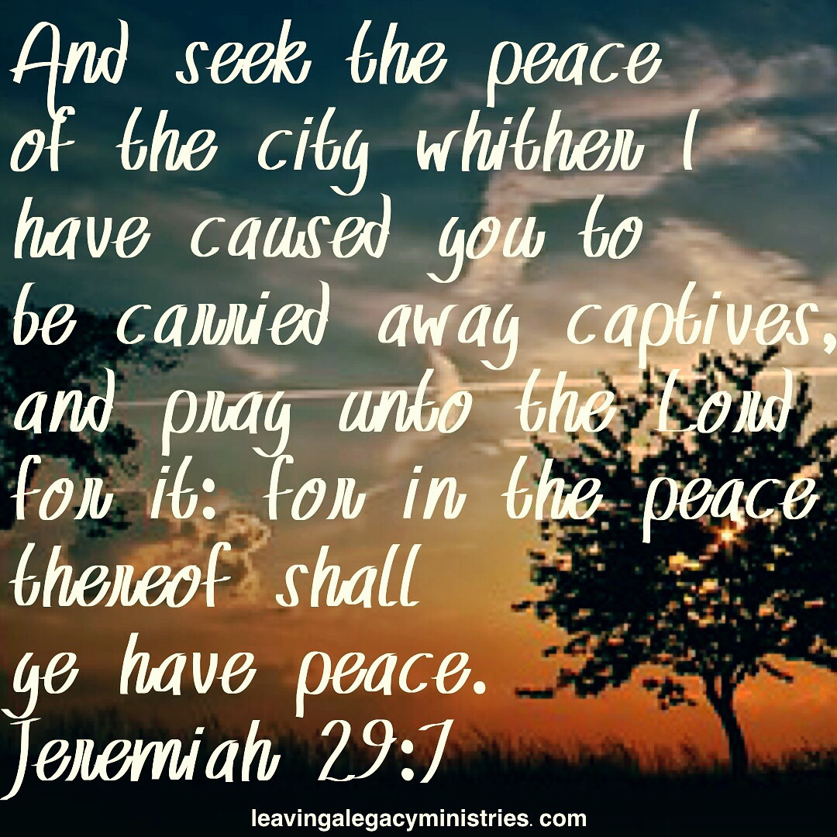
Jeremiah 29:7
Notes:
Baruch is a great example of a world class servant. In a turbulent time with often no obvious success, Jeremiah faithfully did what God told him to do, and Baruch did what Jeremiah told him to do. Clearly, he had his struggle and frustrations, but heeded the maxim, “Should you then seek great things for yourself? Do not seek them.”

Slide 8
Pays the price
⁸ Already you have all you want! Already you have become rich! You have begun to reign – and that without us! How I wish that you really had begun to reign so that we also might reign with you!
“You have all you want” = “satiated”
“You have begun to reign” = “overly realised eschatology”
Notes:
[Verse]
“You have all you want” translates a verb which means“satiated”. (Like a birthday feast!)
“You have begun to reign” exposes their “overly realized eschatology” (the idea that all of the blessings of the messianic age had already arrived). Paul’s response: that would be GREAT! If you’ve already begun to reign, I can reign with you! Let’s have a game of thrones! But before we put on our crowns, there’s the little mater of reality. We’re not there yet.

Slide 9
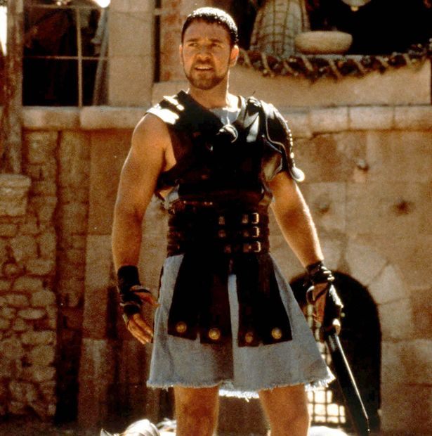
Pays the price
⁹ For it seems to me that God has put us apostles on display at the end of the procession, like those condemned to die in the arena. We have been made a spectacle to the whole universe, to angels as well as to human beings.
Notes:
The move Gladiator depicts the way men were sent into the arena to fight against an adversary or wild animal. Corinth’s theatre seated eighteen thousand. If the Emperor himself was present, he could decide to let the vanquished man live to fight another day but it was usually considered best practise for him to die. Paul and the other apostles were at the end of the procession - an honour normally reserved for the most wretched criminals. What a brutal, hopeless picture! Not exactly “begun to reign”!
Paul’s words in verse 10 are delightfully sarcastic!

Slide 10
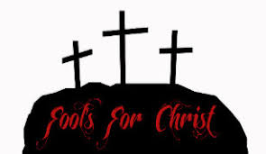
Pays the price
¹⁰ We are fools for Christ, but you are so wise in Christ! We are weak, but you are strong! You are honoured, we are dishonoured!
¹² We work hard with our own hands. When we are cursed, we bless; when we are persecuted, we endure it; ¹³ when we are slandered, we answer kindly.
Notes:
[Verses]
This is exactly how the church grew in its first three hundred years.

Slide 11
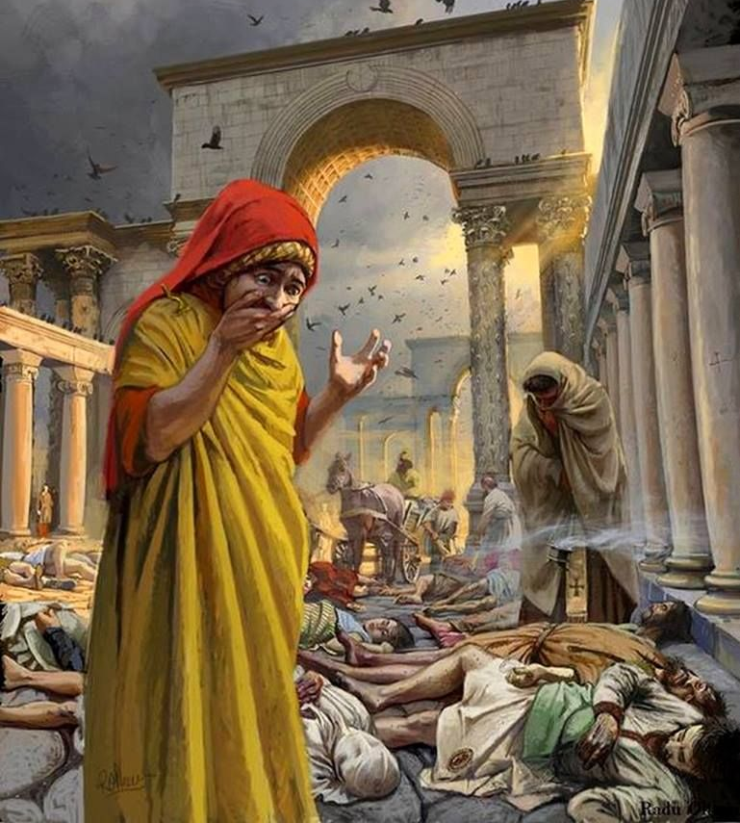
Pays the price
The plague of 250 AD
“Many, in nursing and curing others, transferred their death to themselves and died in their stead. The heathen behaved in the very opposite way. At the first onset of the disease, they pushed the sufferers away and fled from their dearest, throwing them into the roads before they were dead and treated unburied corpses as dirt…”
Dionysius, Bishop of Alexandria
Notes:
For example, in the year 250 a great plague wreaked havoc across the Roman empire. Christians cared for the sick at great risk to themselves. Dionysius, Bishop of Alexandria wrote
[Quote]

Slide 12
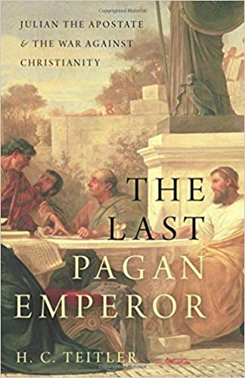
Pays the price
“The recent Christian growth was caused by their ‘moral character, even if pretended,’ and by their ‘benevolence toward strangers and care for the graves of the dead.”
Emperor Julian, 362 AD
The early church was willing to pay the price to live out their faith. Are we?
Notes:
In 362 AD, Julian (the last non-Christian Emperor of the Roman Empire) observed that
[Quote]
So Julian launched a campaign to institute pagan charities - he urged pagan priests to match Christian practices, but there was little or no response because there were no doctrinal basis or traditional practices for them to build upon.
The early church was willing to pay the price to live out their faith.
Are we?
Why is it that we’ll pay heaps to attend a performance of some kind but won’t make it to a church prayer meeting that’s free?
Because we like our comforts and if we are honest our desires so often revolve around what’s fun, what’s tasty, what’s attractive. I’m speaking to myself here!
“Lord, help me to have such a clear picture of your purposes for me and the world that I am willing to pay to price in prayer and giving and service to bring on your kingdom reign ASAP.”

Slide 13
Passes it on
¹⁴ I am writing this not to shame you but to warn you as my dear children. ¹⁵ Even if you had ten thousand guardians in Christ, you do not have many fathers, for in Christ Jesus I became your father through the gospel. ¹⁶ Therefore I urge you to imitate me. ¹⁷ For this reason I have sent to you Timothy, my son whom I love, who is faithful in the Lord. He will remind you of my way of life in Christ Jesus, which agrees with what I teach everywhere in every church.
1Corinthians 4:14-17

Slide 14
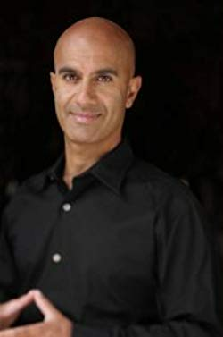
Passes it on
“Leadership is not about a title or a designation. It's about impact, influence and inspiration. Impact involves getting results, influence is about spreading the passion you have for your work, and you have to inspire team-mates and customers.”
Robin S. Sharma
Notes:
Paul understood the power of influence. His life was part of his message. And like Jesus before him, he focused his time on a few team members who were then able to continue the work. (2 Timothy 2:2)

Slide 15
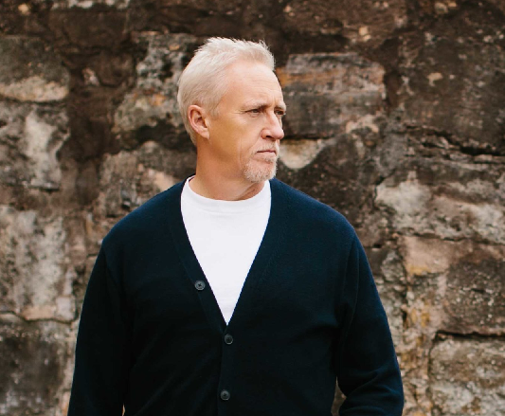
Passes it on
“We have a friend who is a creative at an ad agency and had to go to film school out in Los Angeles. The way he learned to shoot and edit video well was by working with someone who already knew how. Sure, he could have holed up in a room with Final Cut Pro, a case of Red Bull and an instruction manual for six months, but ultimately, the best way for him to learn how to do it was to apprentice himself to someone else.”
Mike Breen, Building a Culture of Discipleship
Notes:
I like that. A case of Red Bull and an instruction manual. We might add a whole bunch of “How To” videos on YouTube! Helpful but they can’t replace a real person modelling, explaining, observing you, giving feedback, etc. Life on life. It’s still the best way to learn.
Ever experienced this type of apprenticeship? Perhaps it was a job or hobby or some kind of skill someone passed on to you. They took time to show you the ropes rather than just tossed a manual on your general direction.

Slide 16
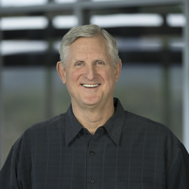
Passes it on
John Henderson
Notes:
One of the men who had a big impact in my life and that of many others was John Henderson. He was a tall good-natured American who worked with Uni students in Auckland through the 1990s. Several of us had just returned from staff training in Brisbane where we spent a year preparing to share the gospel and disciple Uni students back in NZ. I think we all had a bit of a chip on our shoulder. We’d had all this input and done all this stuff. What did this American have to teach us?
Very wisely, John sat down with me and listened to my story and we got to know each other. As we talked he realised that I had missed out on many of the basics of ministry training. He didn’t say, that certificate isn’t worth the paper it’s written on! But he patiently, graciously took me on appointments with students and showed me what he did. I learnt so much that year and I’ve never forgotten it. For instance, before he took a new Christian through a basic study on assurance of salvation – something he had probably done hundreds of times – he would pray over the study and the student and think about how he could make his points as clear as possible. Because for him it wasn’t about getting through the material, it was helping someone discover the unsearchable riches of Christ.

Slide 17
Passes it on
One of the greatest needs of the church today is for men and women who will invest their lives in others
“Timothy will remind you of my way of life, which agrees with everything I teach…”
We don’t have to be a CEO to be a leader. All of us can be people of influence.
Notes:
One of the greatest needs of the church today is for men and women who will invest their lives in others - to show what a Christian family looks like or how to share our faith in a natural way or how to do business with integrity – where belief and practise are intertwined, not kept separate.
I’m so challenged by Paul’s words here: “Timothy will remind you of my way of life, which agrees with everything I teach…” Does my life and my teaching fit comfortably together? I hope so! But it’s easy for pastors and Christian leaders to talk big and act, well, not-so-big. Get close to me, see my life. Then you’ll really learn what I have to say. That’s the way to pass on the faith.
Today I’ve argued that a world class leader is proven faithful, pays the price and passes it on. We don’t have to be a CEO to be a leader. All of us can be people of influence.

Slide 18
A world class leader
is Proven faithful
Pays the price
Passes it on

Slide 19
It's worth it!
"For what is our hope, our joy, or the crown in which we will glory in the presence of our Lord Jesus when he comes? Is it not you? Indeed, you are our glory and joy."
1 Thessalonians 2:19-20
Notes:
When Rachael and I went down to Hamilton to start up Student Life at Waikato University in 1995, we were full of hopes and dreams of what we would accomplish. Five years later, we returned to Auckland leaving behind our firstborn son buried at Newstead cemetery and a small but promising ministry. During the events surrounding our son’s short life, our home group gave us a garden voucher. So we bought a tree – a Robinia Mop Top - which were all the rage at the time. We had a lot of concrete in our place and we had to cut a hole in the concrete to plant it. It was growing nicely by the time we left Hamilton. Five years on, we staying at a caravan park for few days, and it happened to be right next door to our old place, which was on a back section. I went to have a look over the fence and I gasped in amazement. There was our tree. So green! So big! So strong! And God spoke to me through it.
“The ministry you started in people’s lives, even in the pain and the disappointment, has borne fruit and is growing. It may start small, but I am making it into something beautiful.”
Paul wrote to the new believers in another church: [Verse]
If we can help even one person grow in their faith, we will experience that same joy, and we will be world class leaders!
[Pray]

