Slide 1
“Let us Begin!”
Psalm 127

Slide 2
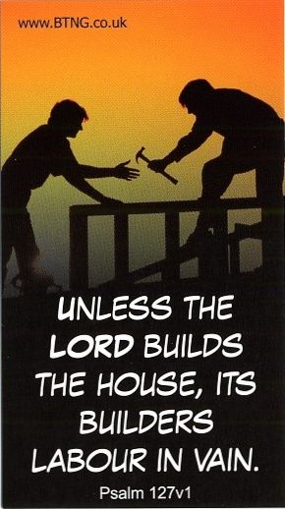
Psalm 127
A song of ascents. Of Solomon.
¹ Unless the Lord builds the house, the builders labour in vain. Unless the Lord watches over the city, the guards stand watch in vain. ² In vain you rise early and stay up late, toiling for food to eat – for he grants sleep to[a] those he loves.
Notes:
Song of Ascents is a title given to fifteen of the Psalms, 120–134 Many scholars believe the title indicates that these psalms were sung by worshippers as they ascended the road to Jerusalem to attend the three pilgrim festivals (Deuteronomy 16:16). Others think they were sung by the Levite singers as they ascended the fifteen steps to minister at the Temple in Jerusalem.

Slide 3
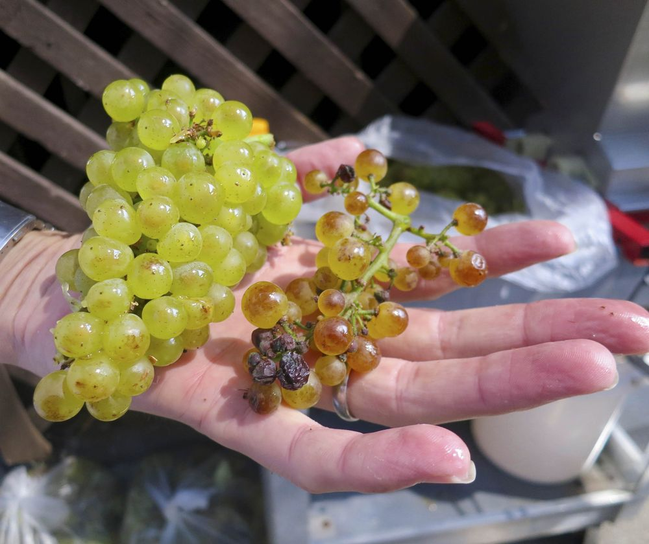
Work
Unless the Lord builds the house …
Futility
Work is God’s idea – e.g.: ³ Children are a heritage from the Lord, offspring a reward from him.”
The curse of some people’s lives is not work itself, but senseless work, vain work, futile work, work that takes place apart from God.
Notes:
Unless the Lord builds …
You can get to the job site early. Have all the council approvals, the architects’ plans, the engineers’ plans, the labour hired and the materials procured, but you might as well sleep in if the Lord isn’t in it!
Futility
We talked last week about the futility of working for little gain, like some South Australian wine growers who have lost most or all of their crop of grapes because they taste of smoke following the devastating bush fires. That’s what happens in our lives when we leave God out of our plans.
Work is God’s idea and it’s what God is himself doing. Children are a great example of the way God actually does most of the work. Making children is relatively easy - although it’s not called” labour” for nothing! They are are a gift from God.
The curse of some people’s lives …

Slide 4
Work
Two extremes: “It’s all up to me!” vs. “Flop on God”
Meaningful and productive work is work done in cooperation with God
Notes:
There are two extremes we can fall into: “It’s all up to me!” VS. “Flop on God”
Technology, structures, bureaucracies and organisations represent our quest to control our lives and become more and more efficient. Contrast this with the Buddhist idea that “All trouble comes from doing too much therefore do nothing.”
Meaningful and productive work … That is what we have been talking about over the past few weeks.

Slide 5
Key verses from the 2020 Vision series
The people rejoiced at the willing response of their leaders, for they had given freely and wholeheartedly to the Lord. David the king also rejoiced greatly.
1 Chronicles 29:9

Slide 6
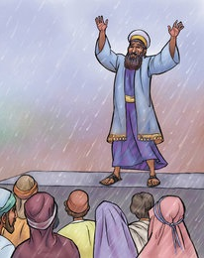
Key verses from the 2020 Vision series
I also told them about the gracious hand of my God on me and what the king had said to me. They replied, ‘Let us start rebuilding.’ So they began this good work.
Nehemiah 2:18

Slide 7
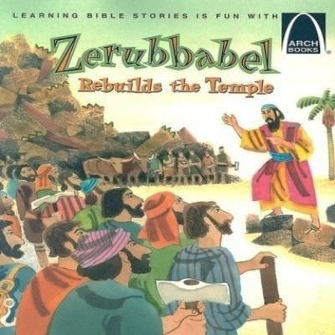
Key verses from the 2020 Vision series
Then [the leaders] and the whole remnant of the people obeyed the voice of the Lord their God and the message of the prophet Haggai, because the Lord their God had sent him. And the people feared the Lord.
Haggai 1:12

Slide 8
Notes:
¹⁴ ‘You are the light of the world. A town built on a hill cannot be hidden. ¹⁵ Neither do people light a lamp and put it under a bowl. Instead they put it on its stand, and it gives light to everyone in the house. ¹⁶ In the same way, let your light shine before others, that they may see your good deeds and glorify your Father in heaven.
Matthew 5:14-16

Slide 11
After the woman poured very expensive perfume on Jesus' head, he said that what she had done would be told wherever the gospel is preached, in memory of her. (Mark 14:3-9). A commemorative donation is one made to remember someone for their good deeds inspired by their faith. It is not meant to exalt that person, but to give glory to God for their life.

Slide 13
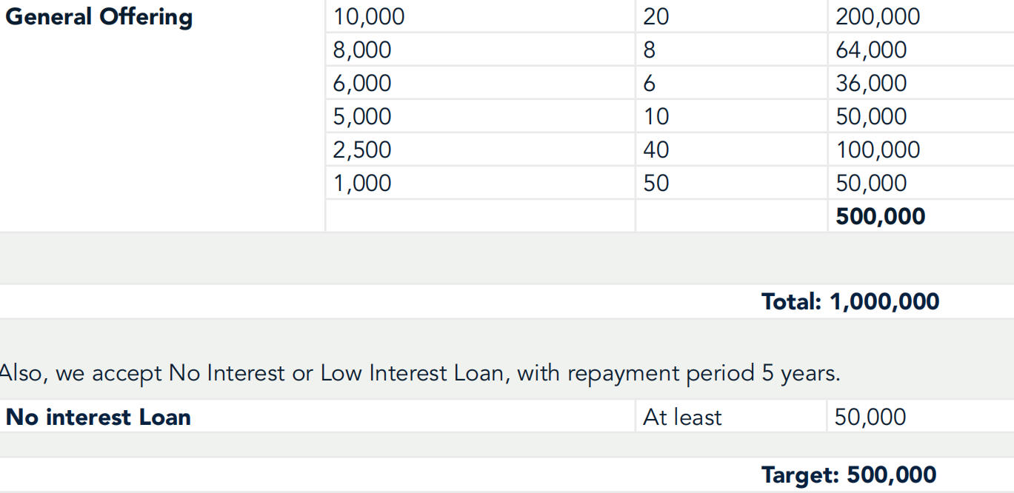

Slide 14
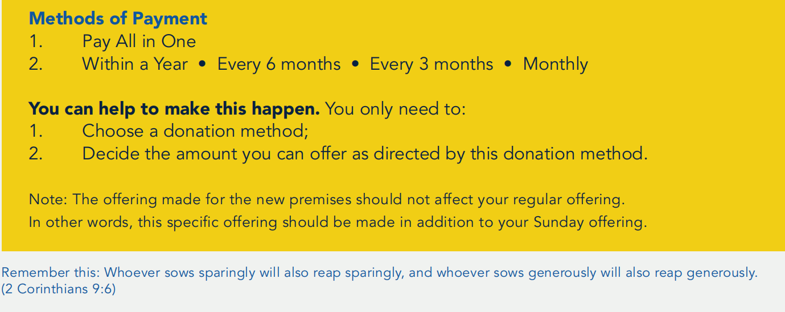

Slide 15
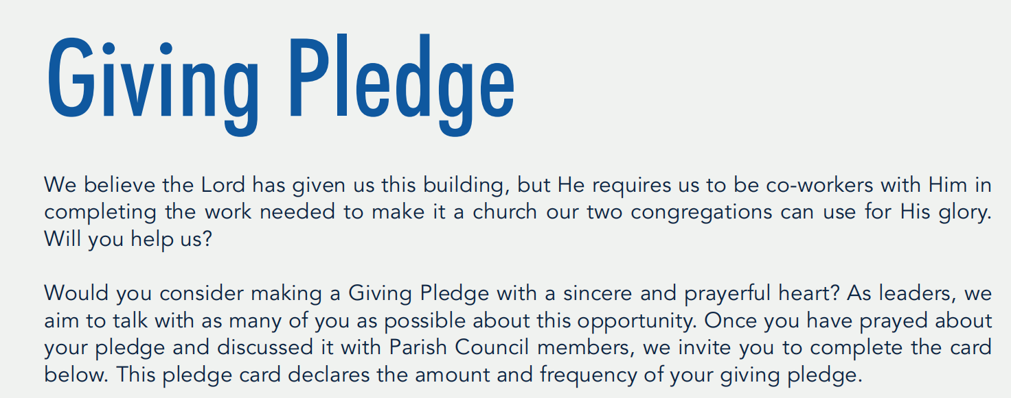

Slide 16
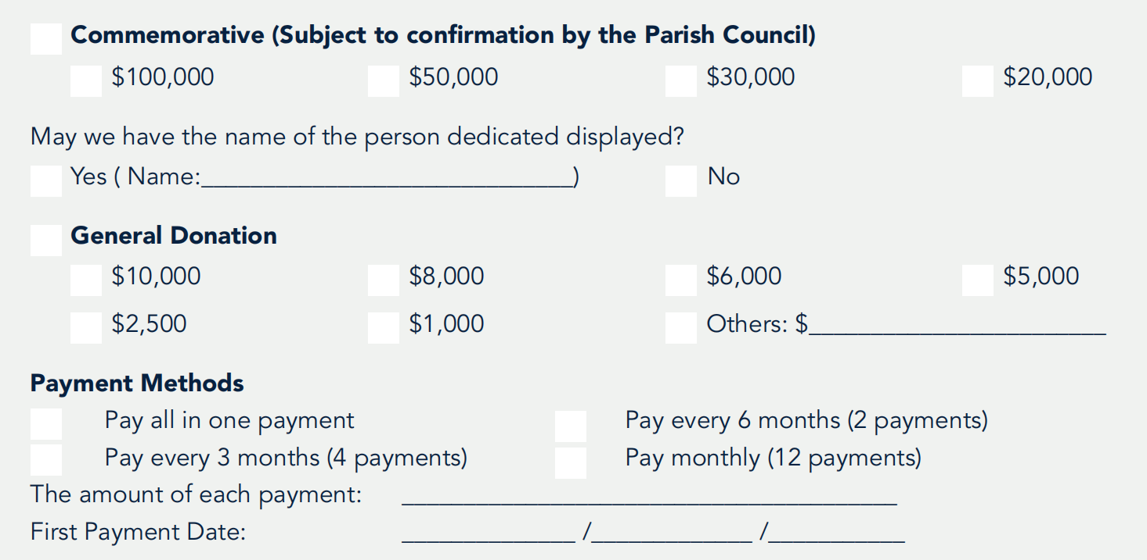

Slide 17
Unless the Lord builds the house, the builders labour in vain. Unless the Lord watches over the city, the guards stand watch in vain.
Psalm 127:1
Have I not commanded you? Be strong and courageous. Do not be afraid; do not be discouraged, for the Lord your God will be with you wherever you go.
Joshua 1:9

Slide 18
“Let us begin!”
Read the Campaign booklet and prayerfully consider how you could be involved
We will be planning some other fund-raising strategies and events. [Committee members]. We would welcome your input and ideas. Please come and talk to us!
Notes:
¹⁴ ‘You are the light of the world. A town built on a hill cannot be hidden. ¹⁵ Neither do people light a lamp and put it under a bowl. Instead they put it on its stand, and it gives light to everyone in the house. ¹⁶ In the same way, let your light shine before others, that they may see your good deeds and glorify your Father in heaven. ¹⁴ ‘You are the light of the world. A town built on a hill cannot be hidden. ¹⁵ Neither do people light a lamp and put it under a bowl. Instead they put it on its stand, and it gives light to everyone in the house. ¹⁶ In the same way, let your light shine before others, that they may see your good deeds and glorify your Father in heaven. Remember

