Slide 1
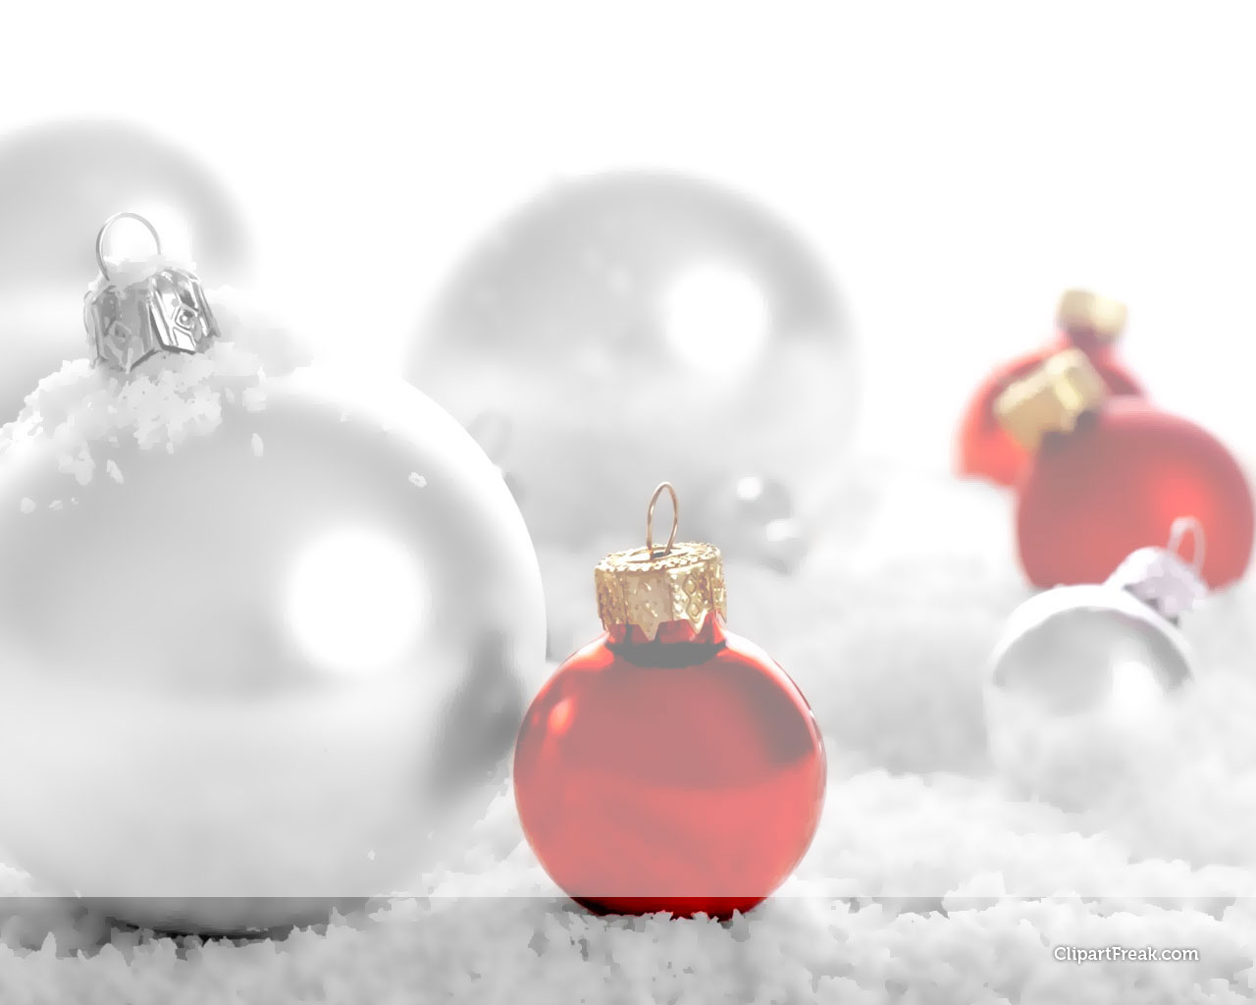
如何慶祝聖誕節？
How To Celebrate Christmas?

Slide 2
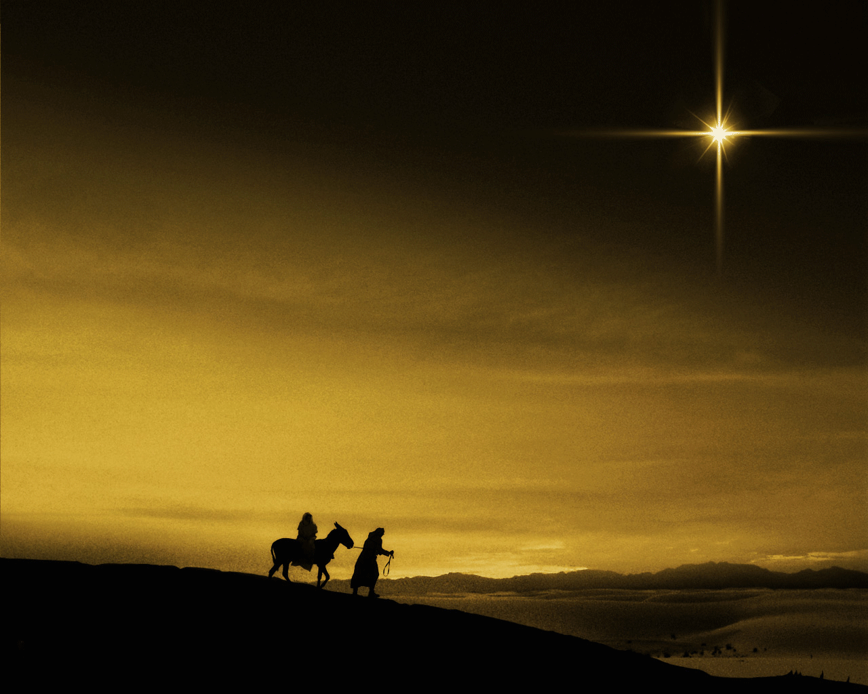
1. 我們可以見證基督
By Witnessing About Christ

Slide 3
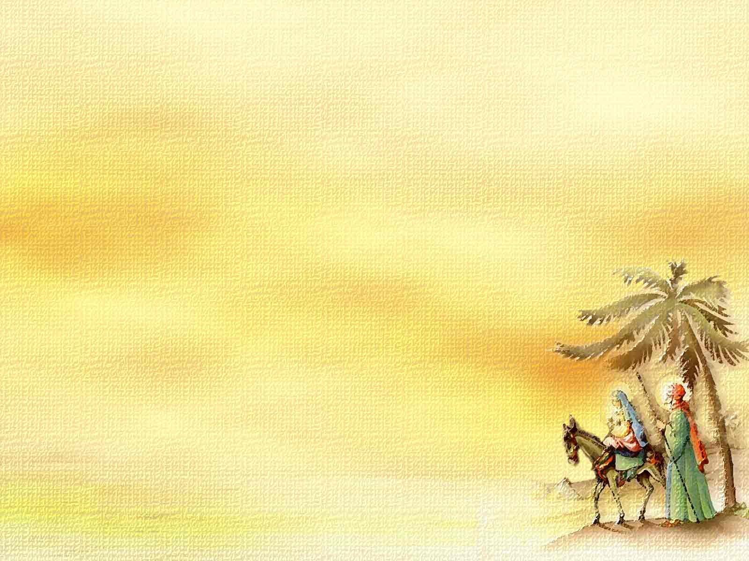
17 他們見過以後，就把天使對他們論這孩子的話傳開了。
17 When they had seen him, they spread the word concerning what had been told them about this child

Slide 4
2. 我們可以默想基督
By Meditating About Christ

Slide 5
18 聽見的人，都希奇牧人所說的事。19 馬利亞把這一切放在心裡，反覆思想。
18 and all who heard it were amazed at what the shepherds said to them. 19 But Mary treasured up all these things and pondered them in her heart.

Slide 6
「面對這樣的神聖奇蹟，人類不能有任何理性的解釋，唯有單純地接受，而無需嘗試去解釋。」
G. Campbell Morgan “In the presence of such a holy miracle, there can be no fitting attitude of the human intellect save that of acceptance of the truth without any attempt to explain the mystery.”

Slide 7
3. 我們可以敬拜基督
By Worshiping Christ

Slide 8
20 牧人因為聽見的和看見的，正像天使對他們所說的一樣，就回去了，把榮耀讚美歸與 神。
20 The shepherds returned, glorifying and praising God for all the things they had heard and seen, which were just as they had been told.

