Slide 1
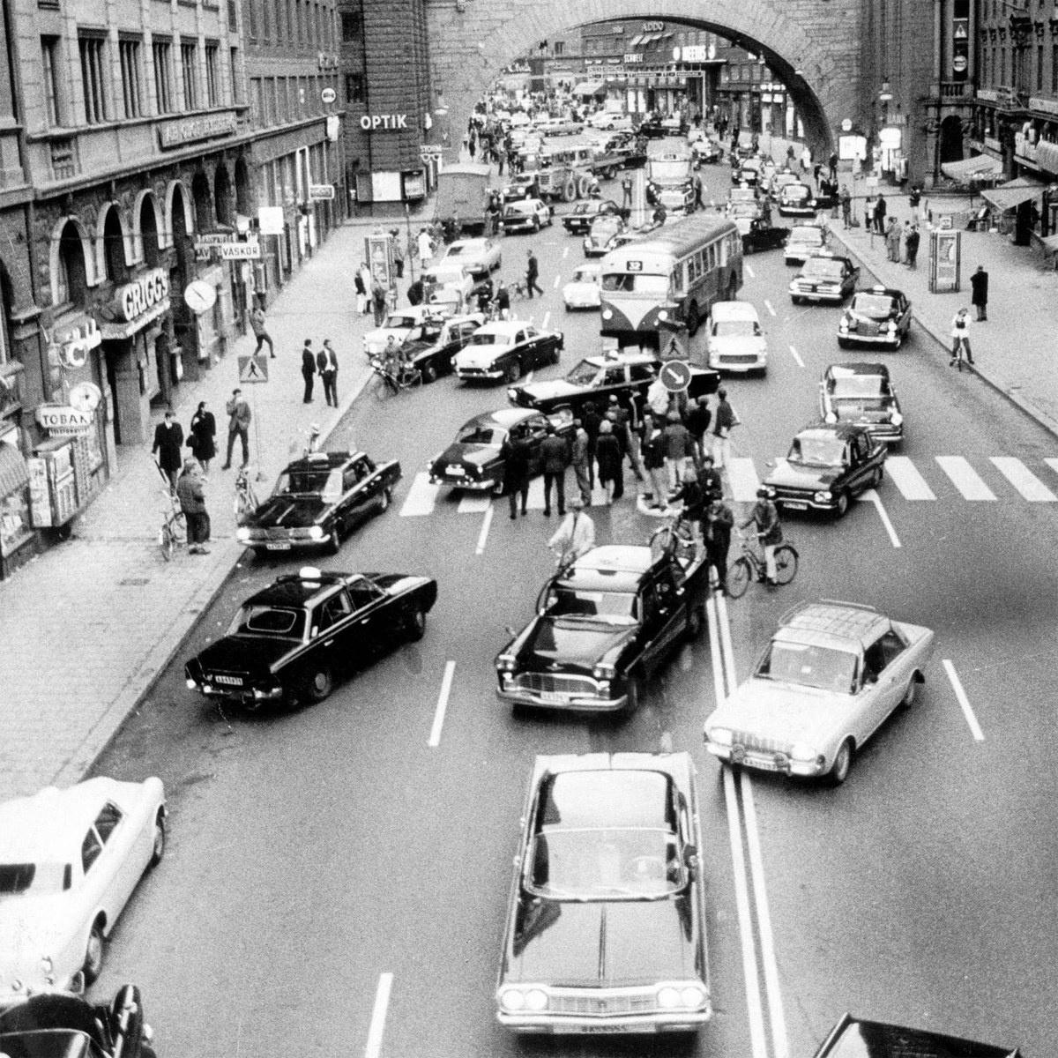
Redemptive Family # 5
Change
Hebrews 10:11-25

Slide 2
Review: Week 4: Team
Jesus intended His mission to be undertaken by His church, not as a collection of individuals, but together as family with everyone playing their part
God has provided gifts to His people for the building up of the Body - we disciple one another through supporting, encouraging and praying for each other (Eph 4:8-15)
Just where He needs me, my Lord has placed me; Just where He needs me, there would I be! And since He found me, by love He’s bound me - to serve Him joyfully! - Miriam Richards
Do the Survey for week 4
Notes:
FAMILY – PLACE – FRIENDS - TEAM
[Allow time to do the survey]

Slide 3

“H Day”
Notes:
On Sunday, September 3, 1967, Sweden changed from driving on the left-hand side of the road to driving on the right. In 1955, a popular referendum showed that 83 percent of the Swedish population was opposed to the change. However, in May 1963 the Swedish Parliament voted overwhelmingly in favour of implementing the switch to right-side driving. With all of Sweden’s neighbouring countries driving on the right, it made sense for Sweden to do the same. Also, despite the left-hand driving rule, cars in Sweden typically had the steering wheel on the left, leading to many accidents, especially on narrow roads.
Preparing the country for the change was a costly and complicated endeavour. Traffic lights had to be reversed, road signs changed, intersections redesigned, lines on the road repainted, buses modified, and bus stops moved. A massive PR campaign was conducted to reconcile the public to the change and educate them about how it would be implemented. Dagen H even got its own logo, which appeared on everything from milk cartons to underwear, and a song contest (the winning tune was “Håll dig till höger, Svensson” — “Keep to the right, Svensson” — by The Telestars).
Finally, everything was ready. At 4:50 a.m. on September 3, 1967, as crowds of people gathered to watch, all vehicles on the road were instructed to come to a halt. They were then directed to move carefully from the left side of the road to the right, and wait. At the stroke of 5:00, following a radio countdown, an announcement was made — “Sweden now has right-hand driving” — and traffic was allowed to resume. Time Magazine called the event “a brief but monumental traffic jam.”

Slide 4
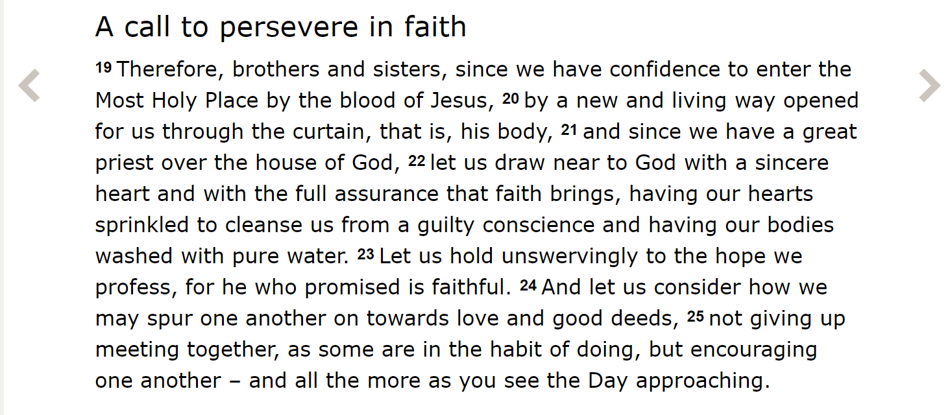
Hebrews 10:19-25
Notes:
Hebrews 10 – a massive change!
Hebrews is all about how Christ fulfils the OT ceremonial law. Salvation comes through Christ plus … nothing. Not law-keeping, sacrifices or Sabbaths. It is in Christ alone our hope is found.
Discoveries
Curtain = Jesus’ body!
9 11 But when Christ came as high priest of the good things that are now already here,[a] he went through the greater and more perfect tabernacle that is not made with human hands, that is to say, is not a part of this creation. 12 He did not enter by means of the blood of goats and calves; but he entered the Most Holy Place once for all by his own blood, so obtaining[b] eternal redemption.
The old covenant system is shown up as defunct by the ministry of Jesus.
A rabbinic tradition: three signs that the animal sacrifices the high priest offered had been accepted by God. In the years when the signs would come up negative, the people would be ashamed and mourn, because God had not accepted their sacrifice. What happened between AD 30 and 70? All three signs were negative each and every time. So from the time of his death to the time of the destruction of the temple —a period of forty years—God signalled that he no longer accepted the sacrifices and offerings of the Jewish people. Why? Because final atonement had been made through Yeshua, just as he had prophesied.
Questions
Hearts sprinkled and bodies washed
The blood of goats and bulls and the ashes of a heifer sprinkled on those who are ceremonially unclean sanctify them so that they are outwardly clean. Hebrews 9:13
Very likely both "hearts sprinkled" and "bodies washed" allude to Christian baptism and the cleansing from sin through the sacrificial death of Christ that it signifies.

Slide 5
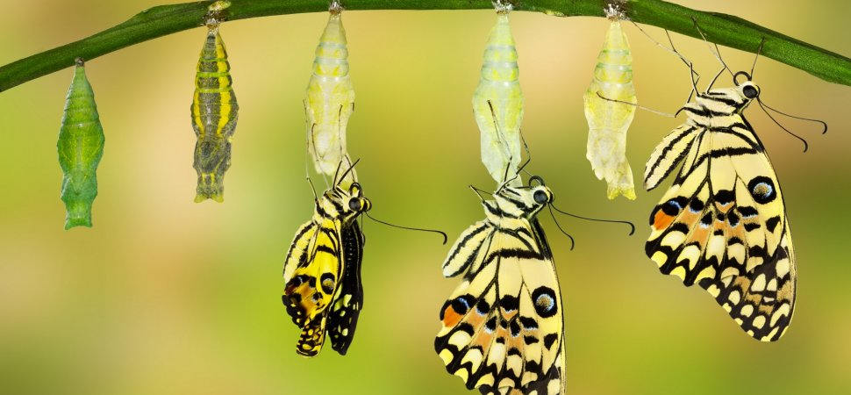
Change is hard!
It involves letting go of what we think we believe
It involves looking crazy – or worse
It can be tempting to go back
It involves choosing to no longer do things we used to do and/or doing new things we have never done before
It involves moving from good things to better things
Notes:
The change from relying on a system of sacrifices to relying on Christ, the once and for all sacrifice for sins. It involved letting go of everything they thought they believed – what they thought was the real thing was only a shadow of the real thing to come. They were pointing to Christ, the ultimate sacrifice. They were temporary. Christ is eternal!
Think for a moment how difficult it would be for the Hebrews to leave the religious practices and cultural norms behind that had shaped their understanding of God and their very existence as a nation. To stop offering sacrifices. To no longer follow dietary laws. To no longer follow ceremonial purification rituals.
To their friends and families they would look like apostates and they would have to wrestle with false guilt brought on by a lifetime of conditioning that they were doing something ‘wrong’. How much easier if they could just keep on with the old traditions and practices and just ‘baptise’ them with the new understanding of the work of Jesus!
It was hard and many were tempted to go back to the safety of what they knew. So are we!
Change can only happen if enough of us share a vision for what could be different. Change means choosing to no longer do things we used to do and/or doing new things we have never done before. Some of the things we might have to leave behind have been good things which we have to replace with better things that move us closer to our clearer vision of the future.

Slide 6
Hebrews 10:19-25
Notes:
Actions
Draw near
Hold on
Spur on
Keep meeting
Encourage
We cannot be a redemptive family on our own – obviously we need each other, which is why God put us in a church family in the first place.
Let us consider how we may spur one another on toward love and good deeds (v.24). Love and good deeds have their limits when we are left to be our natural selfish selves. Left alone, our enthusiasm leaks. We get distracted and become self-protective. We need to be reminded (and in turn remind others) of our mission, which requires that we be selflessly focused on the needs of others.
Not giving up meeting together, as some are in the habit of doing (v.25) We are not just part of some universal scattered church, but we belong to a family of flesh-and-blood people who gather in a particular place to worship and be church for each other. I cannot prioritise the Kingdom without prioritising meeting with the family that supports me and encourages me in my walk and mission. That is how God intended it and that is the only way we can successfully live our Christian life.
Encouraging one another all the more as we see the Day approaching (v.25) We don’t have forever to do God’s work here on earth. If we want to be God’s redemptive family in this place where He has planted us, we need to start now. There is urgency. When Jesus comes back the clock stops, and everything undone will remain undone.

Slide 7

Love and Good Deeds
When asked to explain her min­istry's mission, Mary said, "To save the women of Atlanta."
There was a follow-up question: "You mean the strippers and the pros­titutes?"
"No," she answered, "the women who are sitting in the pews of Atlanta every Sunday morning!"
Notes:
Mary is a gifted Bible study leader at Peachtree Baptist Church in Atlanta. Many women attended small groups at her church, and they were shocked when she told them that all small-group Bible studies for women were disbanded and could only recon­stitute if they had a community ministry component.
So, according to Mary, the women went to the "highways and hedges" of Atlanta to begin ministries to women no one else was reaching—cashiers, food service employees, hairdressers, single mums, women at the women's shelter, strippers, and prostitutes. When asked to explain her min­istry's mission, she said, "To save the women of Atlanta."
[Click] There was a follow-up question: "You mean the strippers and the pros­titutes?"
[Click] "No," she answered, "the women who are sitting in the pews of Atlanta every Sunday morning!"
Do we need to be “saved” – in the sense of being saved from a life of mediocrity – so we can be unleashed to be all God wants us to be?

Slide 8
Where do I / we need to CHANGE to be a more redemptive community?
Do we really love each other as a family?
Do we invest time and care here in the place where God has planted us?
Are we organised around being on the mission God gave us or meeting our own needs?
Are we on the same page regarding reaching out to the lost and lonely?
When we bring our friends to this church, would they be embraced and encouraged and adopted by my church family?

Slide 9
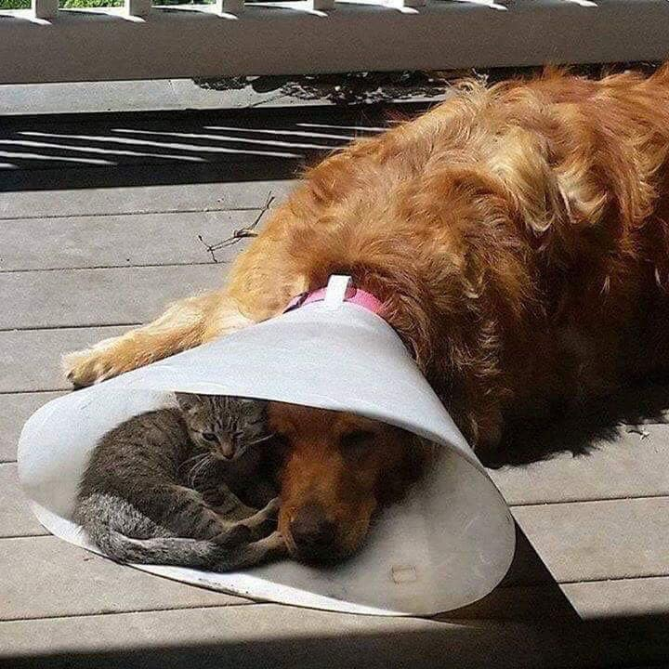
Such as …
When someone is going through a difficult time.... sit with him. No sermon, no advice. Be there.

Slide 10

Big change: redemptive relationships!
One degree shifts:
  Read John’s gospel and see how Jesus interacted with people
  Begin praying for a friend(s)
  Share this prayer with someone else
  Seek to get to know your friend better
  Invite them to lunch
  Invite them to an ACPC social event
  Ask them about their spiritual beliefs
  Share some of your testimony
  Share the gospel message
  Etc.!
Notes:
What might happen at ACPC if we all had this focus on redemptive relationships?
So what has God been saying to you? What changes do you need to make?

Slide 11
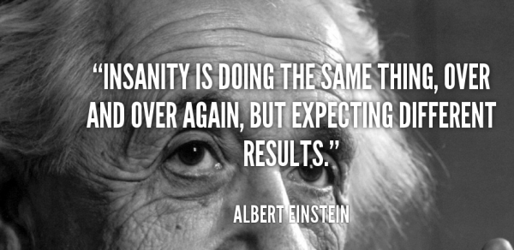

Slide 12
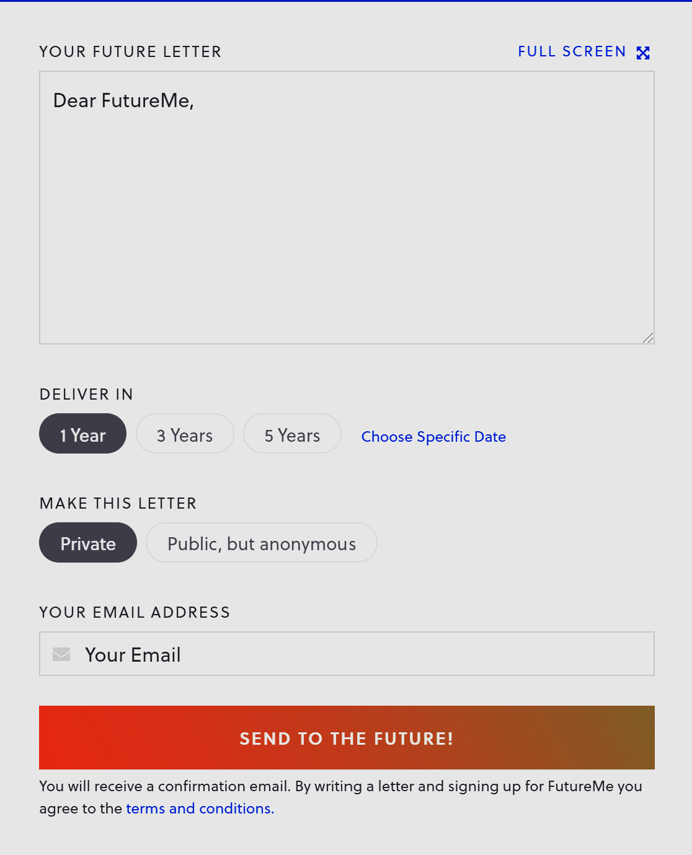
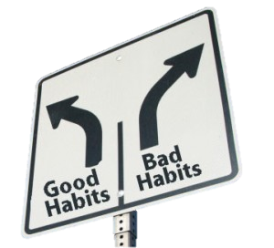
Building Habits
Notes:
Once we decide to make a change too our lives, we need to have some sort of plan. It’s one thing to say I’ll pray for my friend, but another to actually make it a regular prayer habit. We need to get specific. When will we pray? How will I remember?
How will I remember? Well, there are many ways – from notes in your mirror to apps on your phone.
[Click] One fun idea is the website, futureme.org. You can write yourself an email to be delivered to yourself at some future date.
Dear Andrew, how is going praying for _______ regularly? Have you invited them to anything? Etc. You can make it public or private. Some people like telling their goals to their friends – the accountability makes it harder to give up. E.g. I will train for the AKL marathon!
Habits by definition don’t take root in our lives unless there are repeated. Many psychologists agree that if we can do something for 21 consecutive days, it becomes a habit. So take time to build a new habit and/or support the people around you as they build new ones too.

Slide 13
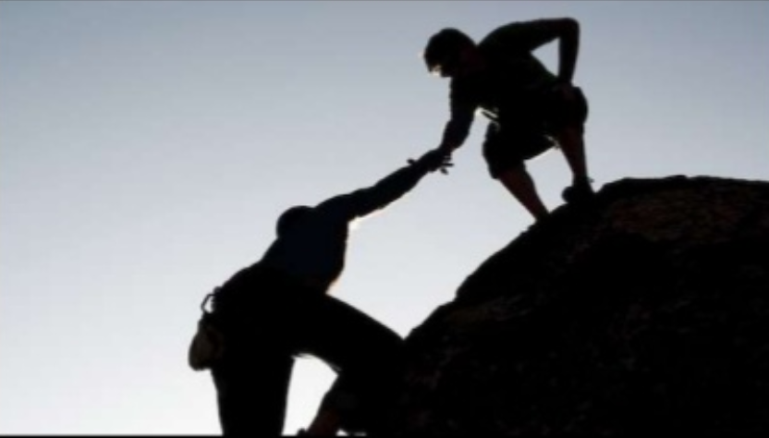
And remember …
²⁴ And let us consider how we may spur one another on towards love and good deeds, ²⁵ not giving up meeting together, as some are in the habit of doing, but encouraging one another – and all the more as you see the Day approaching.
  Hebrews 10:24-25
Notes:
What is the next step?
Having been stirred up through the devotional readings, the surveys, the Sunday messages and the small group studies during this series, it is important that we now listen to each other and capture what God has been placing in our hearts…

Slide 14

The Redemptive Family Workshop
St Peter’s Presbyterian, 4-5 October
Over Friday evening and Saturday morning we will hear each other’s heart and together arrive at a plan for how we can conserve the best of what we have been challenged with this past 6 weeks moving forward.
Register today!
Notes:
We have planned a whole-church workshop that will do exactly this. Over a Friday evening and Saturday morning we will hear each other’s heart and together arrive at a plan for how we can conserve the best of what we have been challenged with this past 6 weeks moving forward. The LYN guys will guide us through this process. They have been freshly inspired by their trip to the UK, so don’t miss this opportunity!!
[Workshop details]
Here’s a video about the most important changes people can make – choosing to move from isolation to community …
[Play video]

