Slide 1
Pure Life :
Addressing Sin and Repentance
18 March 2020

Slide 2
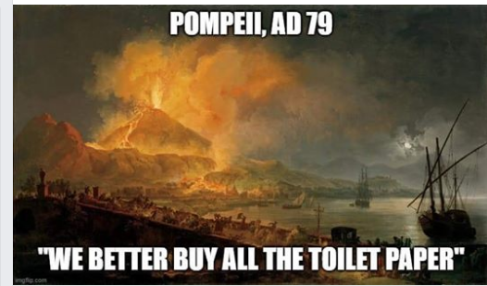

Slide 3
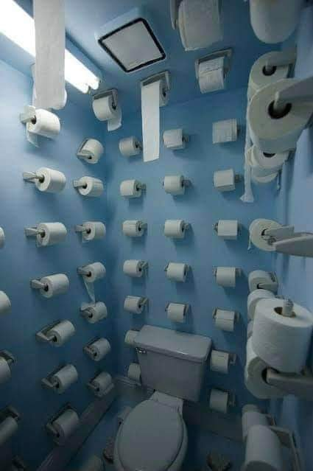
My Panic Room

Slide 4
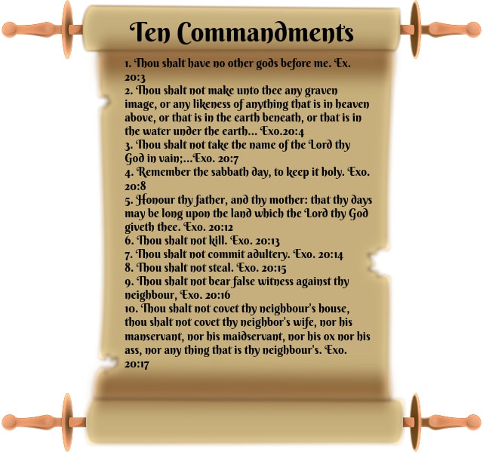

Slide 5
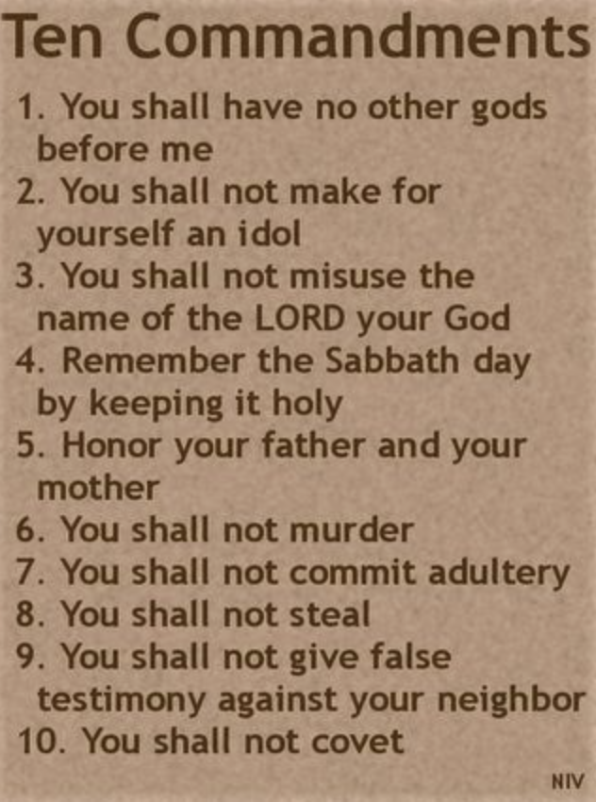
That is what true love for God looks like.
“‘Love the Lord your God with all your heart and with all your soul and with all your mind.’[a] 38 This is the first and greatest commandment.
That is what true love for Neighbour looks like.
Love your neighbor as yourself.’

Slide 6
NT Wright
Humans were made to be ‘image-bearers’, to reflect the praises of creation back to the Creator and to reflect the Creator’s wise and loving stewardship into the world.

Slide 7
NT Wright
Sin is a failure of worship.
Sin is fundamentally being against God and a failure to live as the image of God

Slide 8
Søren Kierkegaard
Deﬁned Sin as:
Building your identity on anything besides God.

Slide 9
Sin
It’s Displacing God as the centre of your worship

Slide 11
Ways to detect your idols
What are you daydreams?
Where do your uncontrollable emotions show up
What do you spend your money on most effortlessly?
What are your nightmares?
What unanswered prayer has embittered you toward God?

Slide 12
You must learn to say to your idols,
“You are not my life—
You are not my security
You do not justify my existence or give my life it’s meaning.
Only Christ can do that—give that—be that for me.”

Slide 13
Gospel Repentance
We understand that our acts of repentance are not ways of receiving Gods Forgiveness Instead, they are done out of gratitude of what Gods has done
Fear-based repentance makes us hate ourselves. Joy-based repentance makes us hate the sin.
Legalistic remorse says, "I broke God's rules," while real repentance says, "I broke God's heart."

Slide 14
Religion
Gospel
When I’m criticised I’m furious or devastated because its critical for me to think of myself as a good person threats to self image must be destroyed at all costs
When I’m criticised I struggle but its not essential for me to think of myself as a good person My identity is built on Gods love for me not my performance

Slide 15
Religion
Gospel
I can be condescending of others who I feel superior to it make me feel secure and proud
Imago Dei
All my talents , opportunities I receive by sheer Grace
Equally I feel insecure when I find people are more successful than me and I become Jealous and envious
My identity and self worth are centred on the one who died for his enemies including me

Slide 16
Religion
Gospel
My identity and self worth are based mainly on how hard I work or how moral I am, so I must look down on those I perceive as lazy or immoral I disdain and feel superior to others
Only by sheer grace am I what I am so I cant look down on those who believe or practice something different from me I have no inner need to win arguments

Slide 17
Repentance
By Living the Gospel it will reshape your heart, your motivations that you no longer live for yourself but for one who died for you .
We will love others and do good out of gratitude of what God has done for us
With the help of the Holy Spirit, The word, prayer and Fellowship

Slide 18
John Stott
For the essence of sin is man substituting himself for God [Gen. 3:1-7],
while the essence of salvation is God substituting himself for man [2 Cor. 5:21].
Man asserts himself against God and puts himself where only God deserves to be;
God sacrifices himself for man and puts himself where only man deserves to be.

