Slide 1
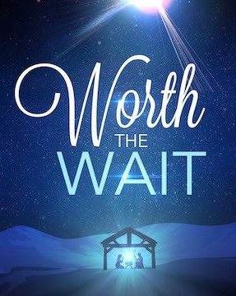
Watching and Waiting: Advent 2020
James 5:7-11

Slide 2
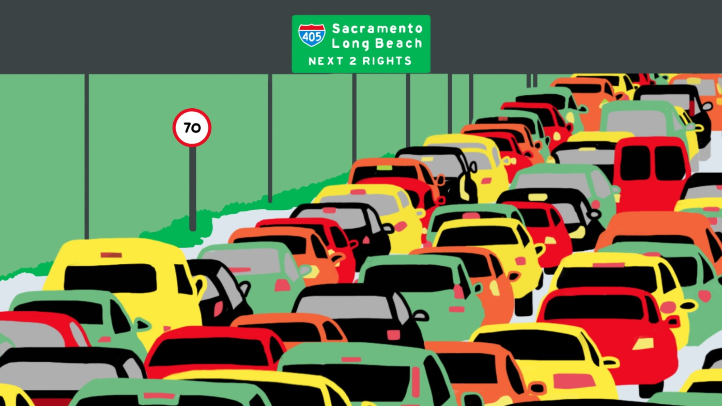
Stuck!
80

Slide 3
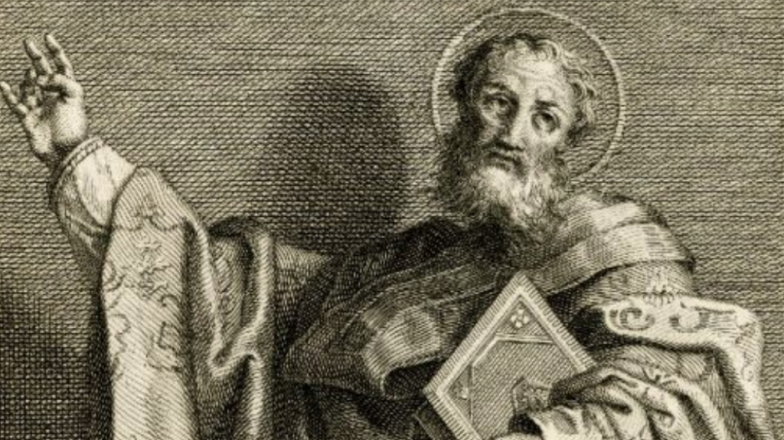
Christmas – ruined!
“I think Christmas has been ruined. It should be about remembering the Nativity of Jesus and trying to be better human beings. Instead, it now seems to be about too much eating, too much drinking and falling out with each other.”
  St Gregory Nazianzus in 384 AD

Slide 4

Advent
“Coming” or” arrival”
Begins on the 4th Sunday before Christmas day
A time of waiting

Slide 5

The Command
Verse 7: Be patient, then, brothers and sisters, until the Lord’s coming.
“patience” = waiting with calm expectancy
The context of patience: suffering (10)
See how the farmer waits for the land to yield its valuable crop, patiently waiting for the autumn and spring rains. 8 You too, be patient and stand firm, because the Lord’s coming is near.

Slide 6
The Promise
The power of STAYING
“I ran away and stayed away; Mother Teresa moved in and stayed. That was the difference. She, a nun, rather slightly built, with a few rupees in her pocket; not particularly clever, or particularly gifted in the arts of persuasion. Just with this Christian love shining about her; in her heart and on her lips… I regret to say that I doubt whether, in any divine accounting, [my efforts] will equal one single quizzical half smile bestowed by Mother Teresa on a street urchin who happened to catch her eye.”
  Malcolm Muggeridge

Slide 7
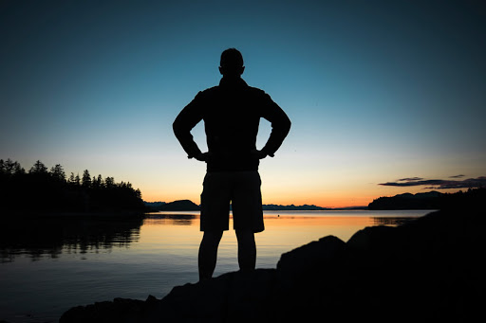
The Promise
Verse 8: You too, be patient and stand firm, because the Lord’s coming is near.
Stand firm
… because the Lord’s coming is near

Slide 8
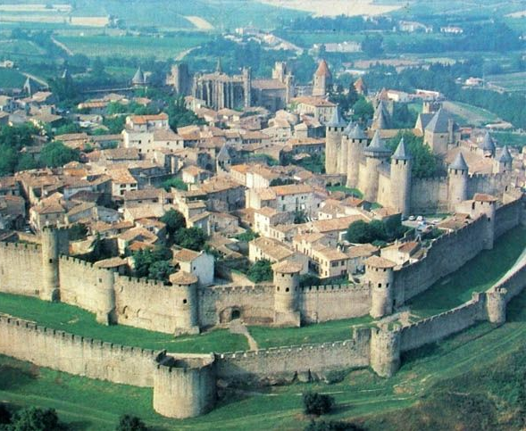
The Example
Jeremiah
“I have made you a fortified city, an iron pillar and a bronze wall to stand against the whole land.” (Jeremiah 1:18)
Job
“I know that my redeemer (or vindicator) lives!” (Job 19:25a)
He didn’t know when or if God would bless him again. He just had to wait.

Slide 10
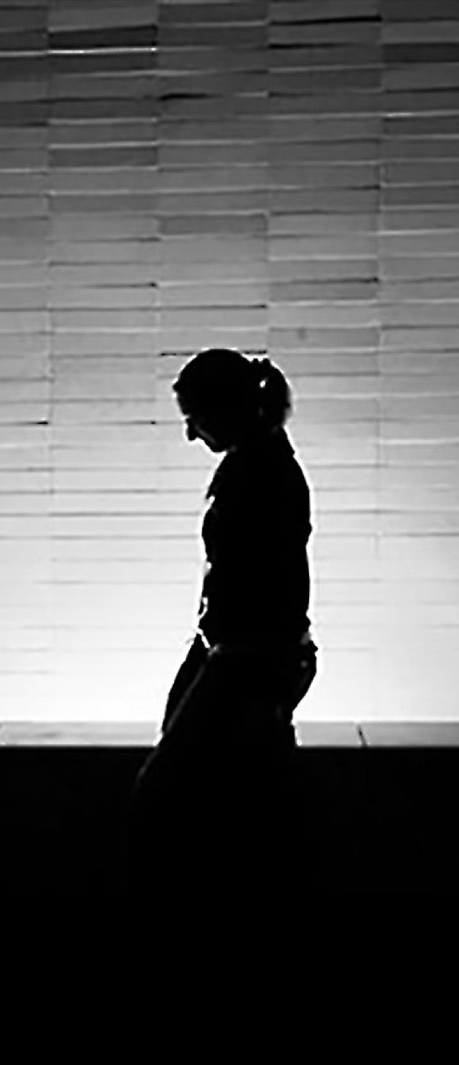
Meanwhile, we wait …
We live in the tension between a suffering world and a redeemed world. The Lord has come! The Lord is coming again!
All shall be well. And all shall be well. And all manner of things shall be well.
  Julian of Norwich
No more let sins and sorrows grow,
Nor thorns infest the ground;
He comes to make His blessings flow
Far as the curse is found.
  Isaac Watts

Slide 11
So, this Advent …
Take time to remember the coming of Jesus to earth
Sing a Christmas carol
Read the Christmas story
Give gifts to others, remembering the greatest gift ever given
Look forward to 2021 - another year of actively waiting and working and looking for our Lord’s return

