Slide 1
20 October 2019, ACPC
The most hated bull market in history

Slide 2
“The views and opinions expressed in today’s sermon are those of the speaker and do not reflect the official policy or position of ACPC or do they? Bible quotes are accurate and are from God. Past performance results indicated are not always a reliable indicator of any future results therefore any action you take upon the information received in this presentation today is at your own risk. But is so worth it if you Trust in the Lord with all your heart and lean not on your own understanding; in all your ways submit to him, and he will make your paths straight."
Disclaimer

Slide 3
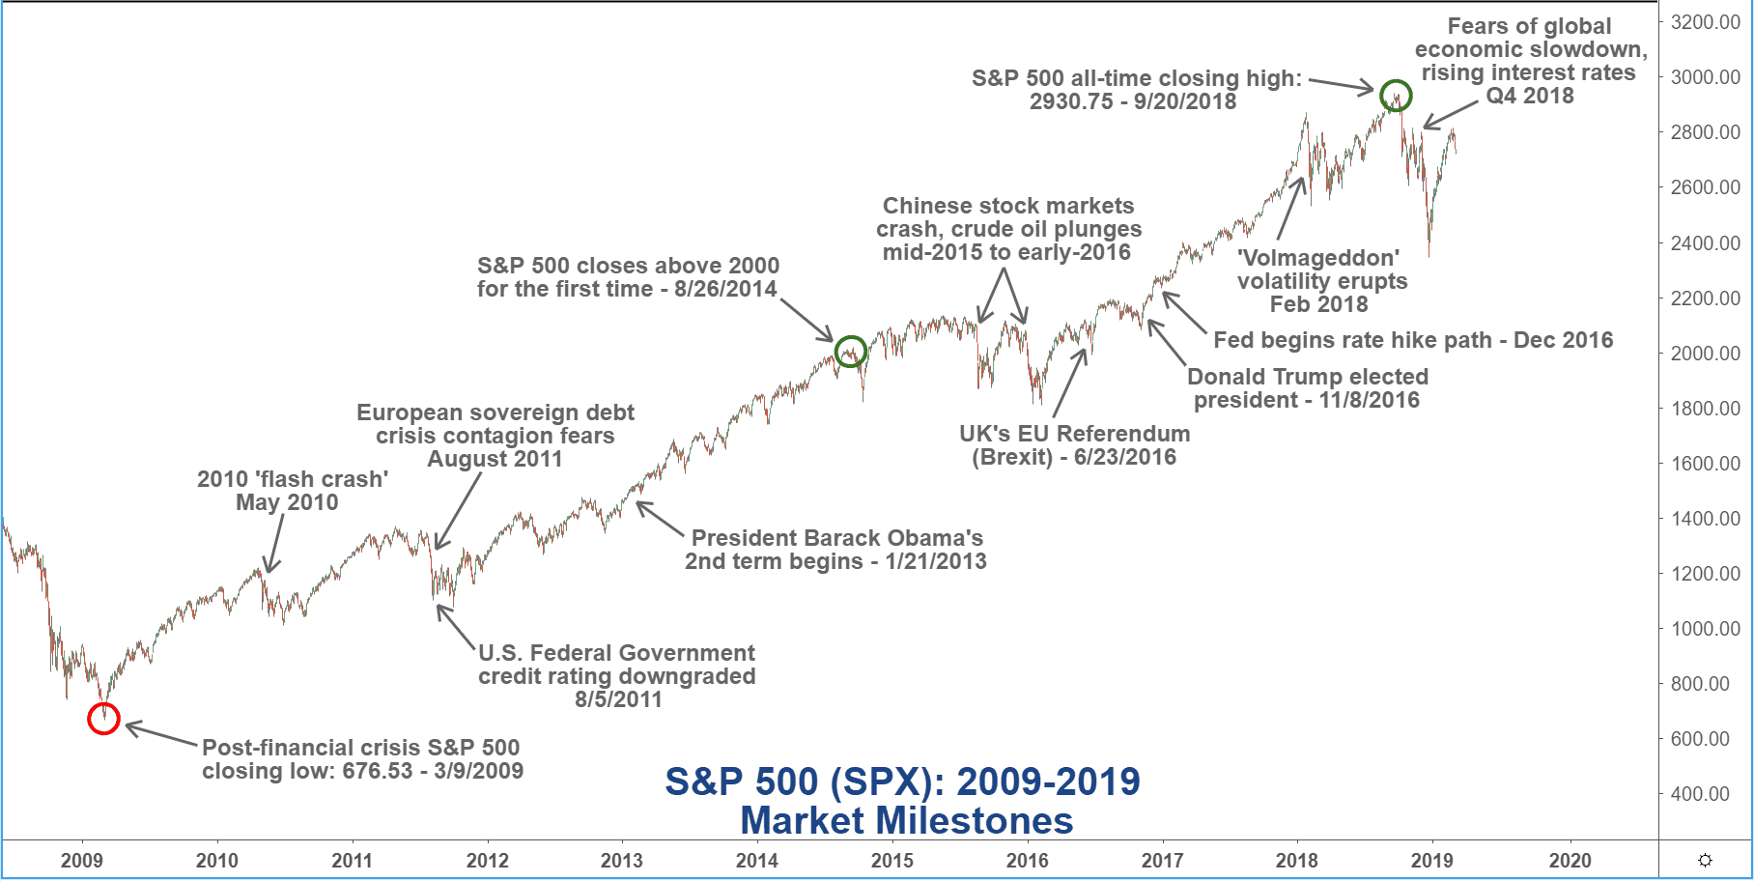

Slide 4
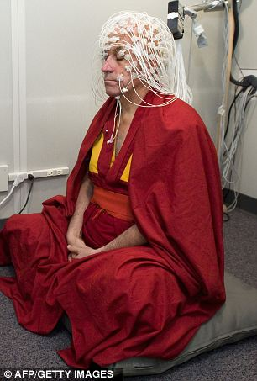

Slide 5
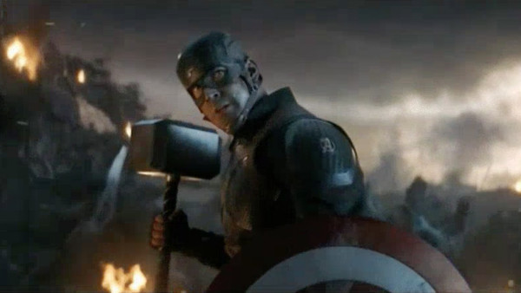
What’s in a life?

Slide 6
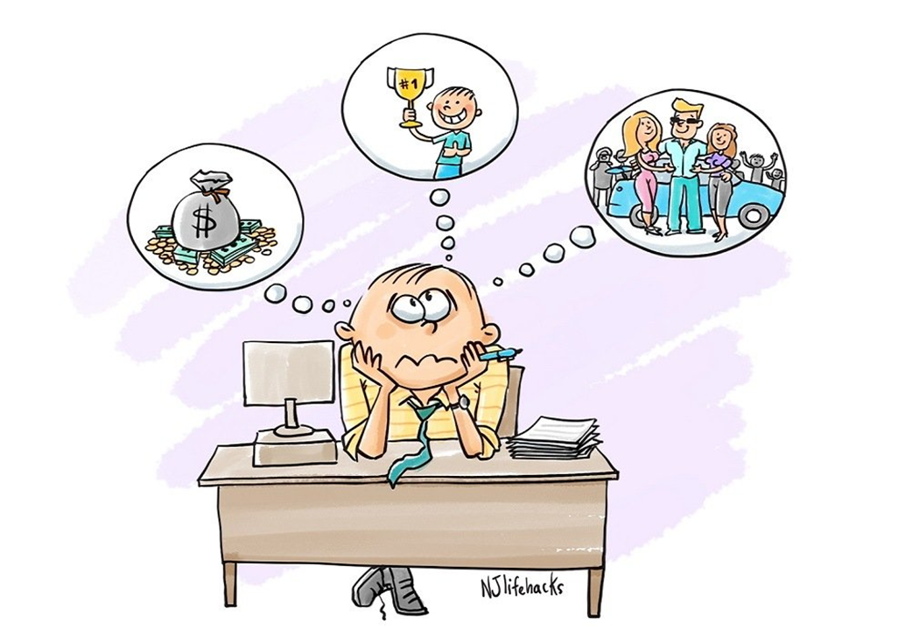
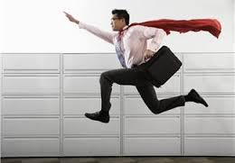
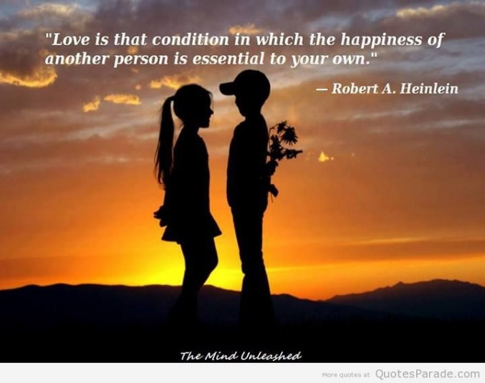
The world see’s happiness being a result of:
- Money
Career success
Love
Other

Slide 7
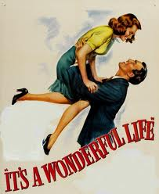
Ecclesiastes 5:18-20
“Well one thing at least is good: It is for a man to eat well, drink a good glass of wine, accept his position in life, and enjoy his work whatever his job may be, for however long the lord may let him live. And of course, it is very good if a man has received wealth from the Lord, and the good health to enjoy it. To enjoy your work and to accept your Lot in Life – that is indeed a gift from God. The person who does that will not need to look back with sorrow on his past for God gives him joy"

Slide 8
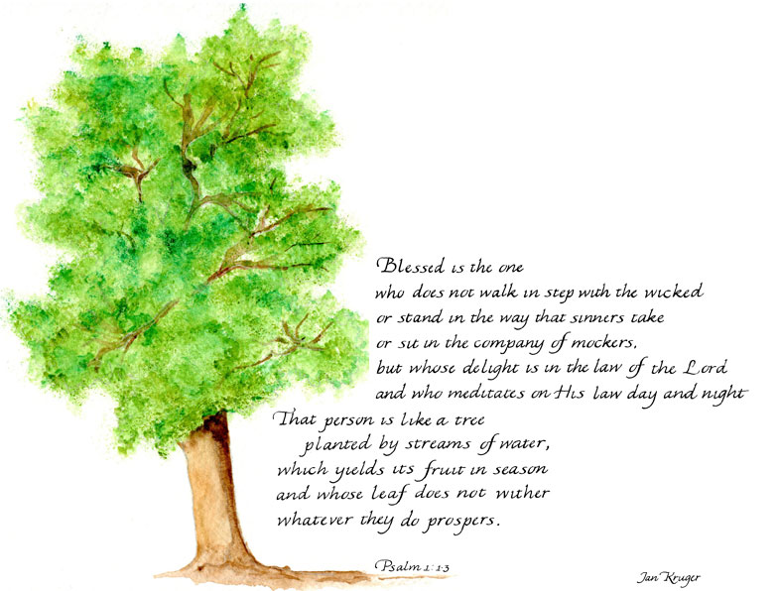

Slide 9
5 Steps to Authentic Happiness
1. Make the best of what you have
Ecclesiastes 5:18-20
Matthew 25:14-30
2. Embrace the Ordinary
Mark 4:26, 27
3. You are Free to be Happy
Psalms 1:1
4. Start with God
Psalms 1:3
Psalms 25:1
5. Choose to Live by the Word
John 8:32
John 13:17

