Slide 1
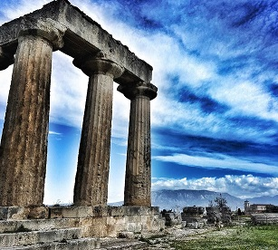
first CORINTHIANS

Slide 2
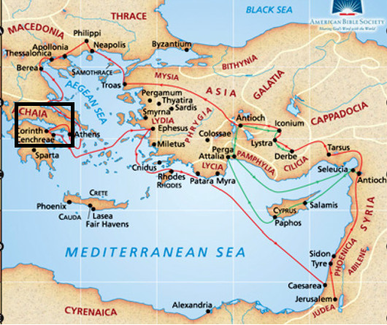
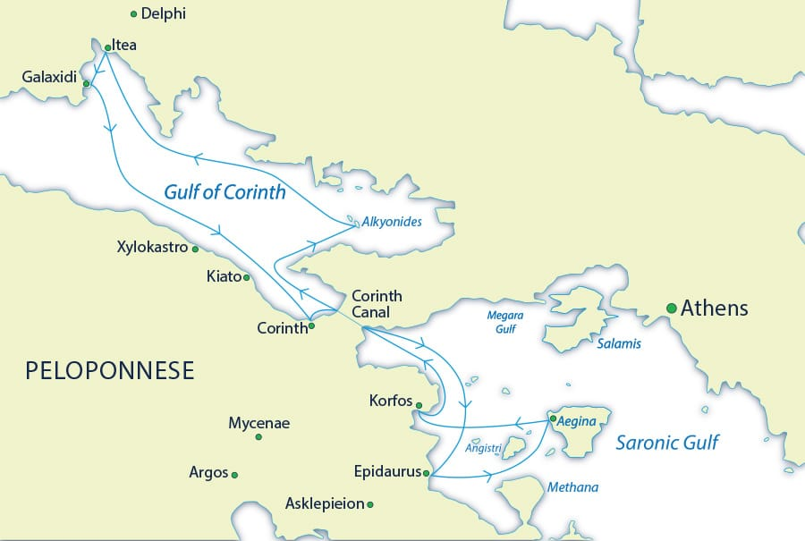
The city of Corinth
Located on an important trade
route
On a narrow isthmus

Slide 3
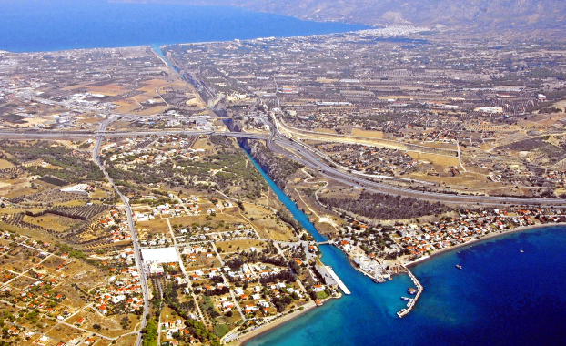
The city of Corinth
Located on an important trade route
On a narrow isthmus
1893: The Corinth Canal

Slide 4
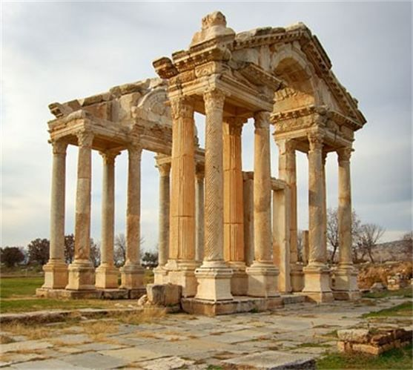
The city of Corinth
Located on an important trade route
On a narrow isthmus
1893: The Corinth Canal
80,000 plus 20,000 people
Eclipsed Athens in political and commercial importance
Lots of temples including the
big one on the hill to Aphrodite, goddess of love
Corruption

Slide 5
The church in Corinth
Acts 18:1-17
There was opposition - but a kind of advocate
God worked: people believed!
Paul was encouraged in a dream to stay longer than planned
He wrote this letter in about AD 55 while in Ephesus

Slide 6
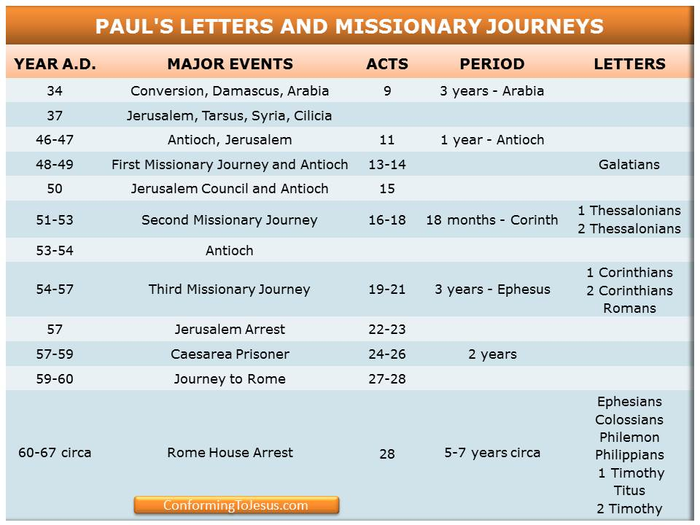

Slide 7
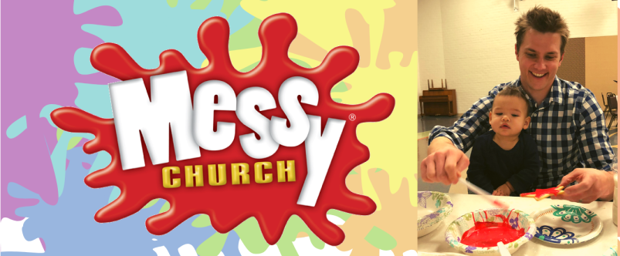
The church is messy
The church is impacted by the culture around it - messy relationships, behaviour and gatherings …

Slide 8
Some issues
Can I still be a Christian and live a worldly life? Why church fights are not a good thing!
What about male and female roles? How are they impacted by the gospel and my culture?
How do we worship God well together? Balancing freedom and form in our gatherings.
What about spiritual gifts? Sometimes we can take our eyes off the giver and on to the gifts.

Slide 9
The church is messy
The church is impacted by the culture around it - messy relationships, behaviour and gatherings …
But it must look for a better way
Messy is OK! But messy because we are IN the world, not OF the world

Slide 10
The church is messy
I prefer a church which is bruised, hurting and dirty because it has been out on the streets, rather than a church which is unhealthy from being confined and from clinging to its own security . . . More than by fear of going astray, my hope is that we will be moved by the fear of remaining shut up within structures which give us a false sense of security, within rules which make us harsh judges, within habits which make us feel safe, while at our door people are starving and Jesus does not tire of saying to us, “Give them something to eat.”
    Pope Francis

Slide 11

Theology is important!
Greek ideas
Confusion about this present age
“Ideas have consequences - bad ideas have victims”
  Creation → Fall → Redemption → Hope
But there IS resurrection

Slide 12
As we go through this study together I will:
Apply
Discuss
Learn
Remember: “We don’t do it to make him like us, we do it because we are like him”

Slide 13
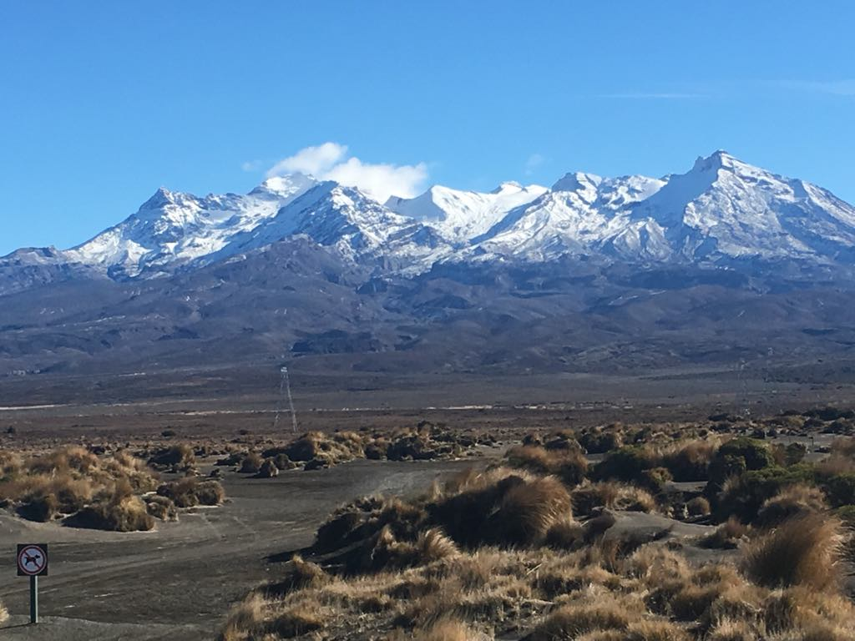
The Law of love is supreme

Slide 14
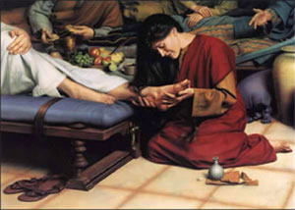
The Law of love is supreme
“The greatest of these is love” (1 Cor. 13:13)
Mary broke her vase! (Mark 14:1-9, c.f. John 12:1-8)
Be honest- we’ve all got problems! When we open up to each other and God, his healing and power will flow …

