Slide 1
Rhythms of Renewal
Part 1: Rest and Restore
Psalm 80
Notes:
The bushfires in Australia have been devastating. People have lost their homes and farms and even their lives. The world has watched in horror as the driest continent on the planet seems to burn and burn. Destruction is an all-too common theme in the Bible. In Psalm 80, Asaph calls on the Lord to restore what has been destroyed.

Slide 2
Psalm 80
For the director of music. To the tune of ‘The Lilies of the Covenant’. Of Asaph. A psalm.
¹ Hear us, Shepherd of Israel,
you who lead Joseph like a flock.
You who sit enthroned between the cherubim,
shine forth 2 before Ephraim, Benjamin and Manasseh.
Awaken your might;
come and save us.
Notes:
Who are all these names? Some of the tribes of Israel’s northern kingdom - notice Judah and Benjamin aren’t mentioned - basically Asaph is calling on the Lord’s help for his people.

Slide 3
Psalm 80
³ Restore us, O God;
make your face shine on us,
that we may be saved.
⁴ How long, Lord God Almighty,
will your anger smoulder
against the prayers of your people?
⁵ You have fed them with the bread of tears;
you have made them drink tears by the bowlful.
⁶ You have made us an object of derision to our neighbours,
and our enemies mock us.
Notes:
Verse 5 reminds us of the blessing Moses taught the people: The Lord bless you keep you… But he doesn’t seem to be doing much blessing at the moment!
Verse 6: Instead of being the envy of the world, they are the joke of the world!]

Slide 4
Psalm 80
⁷ Restore us, God Almighty;
make your face shine on us,
that we may be saved.
⁸ You transplanted a vine from Egypt;
you drove out the nations and planted it.
⁹ You cleared the ground for it,
and it took root and filled the land.
¹⁰ The mountains were covered with its shade,
the mighty cedars with its branches.
¹¹ Its branches reached as far as the Sea,
its shoots as far as the River.
Notes:
This verse reminds us of the blessing Moses taught the people: The Lord bless you keep you… But he doesn’t seem to be doing much blessing at the moment!
Asaph uses the picture of a luxuriant vine, which we can also see in passages like Isaiah 5:1: I will sing for the one I love
a song about his vineyard:
my loved one had a vineyard
on a fertile hillside..”

Slide 5
Psalm 80
¹² Why have you broken down its walls
so that all who pass by pick its grapes?
¹³ Boars from the forest ravage it,
and insects from the fields feed on it.
Notes:
These broken down walls speak powerfully of the devastation wrought by an invading power - Assyria.

Slide 6
Psalm 80
¹⁴ Return to us, God Almighty!
Look down from heaven and see!
Watch over this vine,
¹⁵ the root your right hand has planted,
the son you have raised up for yourself.
¹⁶ Your vine is cut down, it is burned with fire;
at your rebuke your people perish.
¹⁷ Let your hand rest on the man at your right hand,
the son of man you have raised up for yourself.
¹⁸ Then we will not turn away from you;
revive us, and we will call on your name.

Slide 7
Psalm 80
¹⁹ Restore us, Lord God Almighty;
make your face shine on us,
that we may be saved.
Notes:
Return to us, God Almighty! That’s Asaph’s cry. He calls on the Lord to remember the relationship he has with his people, to look at the man at his right hand - the son of man - the righteous and anointed one. Then his people will turn back to the Lord. Really interesting messianic overtones here, aren’t there?

Slide 8
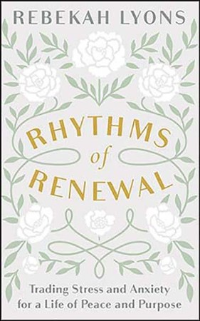
Restoration
Restore: “to bring back to a state of health, soundness, or vigour, to put back to a former place, or to a former position.”
A BIG theme in the Bible!
1 in 6 New Zealand adults had been diagnosed with a common mental disorder at some time in their lives. This includes depression, bipolar disorders and anxiety disorders.
  The 2017/18 New Zealand Health Survey
Rhythms of Renewal by Rebekah Lyons
Notes:
Just like destruction, the theme of restoration is all through the Bible. To restore is [def’n]
The Christchurch rebuild is an example of this, isn’t it? It’s like a brand new city now. Almost nothing is over 5 years old in the city centre.
The Bible promises that our relationship with God can be restored through Jesus Christ. Ultimately we are looking forward to God restoring all things because of his victory over sin and death. Yay!
Today, many people need restoration in their lives. The 2017/18 New Zealand Health Survey found that: …
And the other 5 out of 6 probably face some of these issues too. It’s an epidemic!
Rebekah Lyons talks about her battle with depression and anxiety and how she was able to begin to experience restoration on a daily basis.
In her book, Rhythms of Renewal, she suggests four rhythms to follow: rest, restore, connect and create. We’ll look at the first two today …

Slide 9
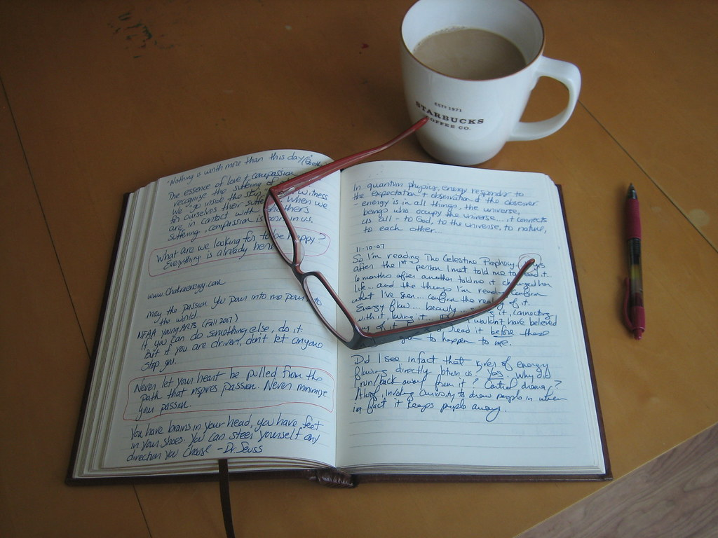
REST
1. Take an inventory: Reflect and Journal
  What’s Right? (Gratitude)
  What’s wrong?
  What’s confused?
  What’s missing?
Notes:
Ah, rest. I hope you have had some of that over the past few weeks. But rest is not simply lying on a hammock. The Hebrew concept of rest is that is precedes work. It fuels the work we do. We rest then we get into it. How good are we at really resting?
Here are RL’s suggestions for REST:
1. Take an inventory: Reflect and Journal
Socrates is credited with saying, "The unexamined life is not worth living". Do you take time to think about your life sometimes? Or you are too busy living it? A really good practise is journaling. I know it’s not for everyone. I like to write a few things down when I have my time with the Lord, to help me process what is going on. Sometimes I need to write more, sometimes less.
RL writes that she takes her journal and asks herself a few questions: [questions]
Reflecting for a few moments every day and maybe more on a quarterly or annual basis, is one of the most powerful ways to identify the anxiety-producing things in our lives and allows us to make corrections

Slide 10
REST
1. Take an inventory: Reflect and journal
2. Tech Detox: Silence the noise
Notes:
2: Who finds themselves checking their device multiple times a day? It is like a leash tying us to the internet and keeping us in a constant state of alertness. What about holidays? I haven’t looked at FB for weeks!
RL argues that resting from technology, from social media or the internet or our smart phones gives us greater capacity to be fully present to the moment right in front of us. To enjoy that view, listen to that friend, etc.
3: Try this sometime. Find a quiet spot and take time to notice the sounds around you – the birds, the water, and look around you at what is going on. Be “in the moment”. It’s incredibly restful.
RL claims that this practise helped her to listen to her own voice so she had something to offer others.
Some other advantages: We gain perspective, we become more emotionally resilient and empathetic to others and we become better listeners.
4: There’s an important statement: “You cannot heal what is hidden.” You have to bring out your brokenness and messiness and let the cruel light of day expose it in all its gory detail. That’s the first step to being free from it: 3 questions: [next slide]

Slide 11
REST
1. Take an inventory: Reflect and journal
2. Tech Detox: Silence the noise
3. Get quiet: Create space and listen
Notes:
2: Who finds themselves checking their device multiple times a day? It is like a leash tying us to the internet and keeping us in a constant state of alertness. What about holidays? I haven’t looked at FB for weeks!
RL argues that resting from technology, from social media or the internet or our smart phones gives us greater capacity to be fully present to the moment right in front of us. To enjoy that view, listen to that friend, etc.
3: Try this sometime. Find a quiet spot and take time to notice the sounds around you – the birds, the water, and look around you at what is going on. Be “in the moment”. It’s incredibly restful.
RL claims that this practise helped her to listen to her own voice so she had something to offer others.
Some other advantages: We gain perspective, we become more emotionally resilient and empathetic to others and we become better listeners.
4: There’s an important statement: “You cannot heal what is hidden.” You have to bring out your brokenness and messiness and let the cruel light of day expose it in all its gory detail. That’s the first step to being free from it: 3 questions: [next slide]

Slide 12
REST
1. Take an inventory: Reflect and journal
2. Tech Detox: Silence the noise
3. Get quiet: Create space and listen
4. Do the heart work: Examine and confess
Notes:
2: Who finds themselves checking their device multiple times a day? It is like a leash tying us to the internet and keeping us in a constant state of alertness. What about holidays? I haven’t looked at FB for weeks!
RL argues that resting from technology, from social media or the internet or our smart phones gives us greater capacity to be fully present to the moment right in front of us. To enjoy that view, listen to that friend, etc.
3: Try this sometime. Find a quiet spot and take time to notice the sounds around you – the birds, the water, and look around you at what is going on. Be “in the moment”. It’s incredibly restful.
RL claims that this practise helped her to listen to her own voice so she had something to offer others.
Some other advantages: We gain perspective, we become more emotionally resilient and empathetic to others and we become better listeners.
4: There’s an important statement: “You cannot heal what is hidden.” You have to bring out your brokenness and messiness and let the cruel light of day expose it in all its gory detail. That’s the first step to being free from it: 3 questions: [next slide]

Slide 13
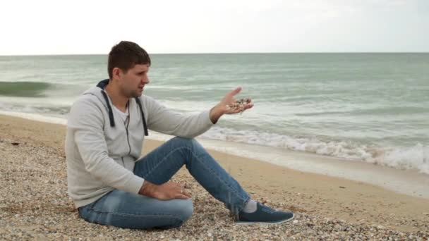
Three questions
What do I need to confess?
What do I need to release?
What do I need to change?

Slide 14
Psalm 32
³ When I kept silent,
my bones wasted away
through my groaning all day long.
⁴ For day and night
your hand was heavy on me;
my strength was sapped
as in the heat of summer. 5 Then I acknowledged my sin to you
and did not cover up my iniquity.
I said, ‘I will confess
my transgressions to the Lord.’
And you forgave
the guilt of my sin.
Notes:
Praise God!
So simple yet so revolutionary!

Slide 15
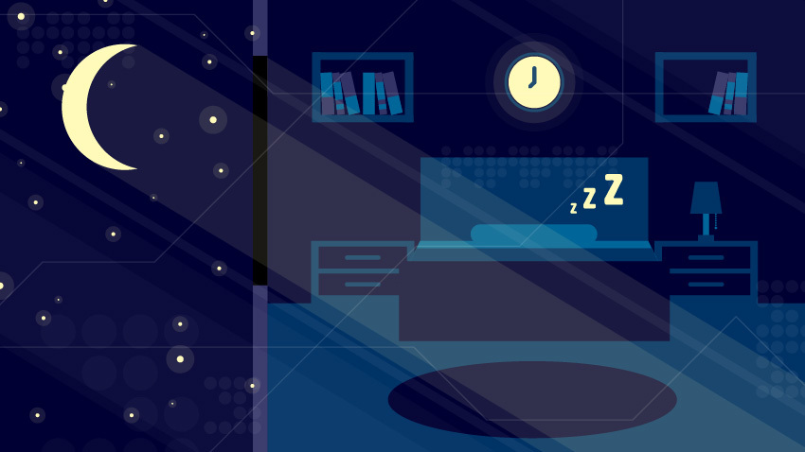
REST
5. Routines for deep sleep
  “When you find depression, even when you find anxiety, when you scratch the surface 80 to 90 percent of the time you find a sleep problem as well.”
  Arianna Huffington
Talk to the person next to you: What is your bedtime routine? How might you create a sense of calm before climbing into bed?
Notes:
5: In her book The Sleep Revolution, Arianna Huffington reports, [quote]
RL discusses her sleep routine.
Talk to the person next to you: [question]

Slide 16
REST
6. Morning Routine: Coffee, candle and a pen
“Meet me, O Christ, in this stillness of morning. Move me, O Spirit, to quiet my heart. Mend me, O Father, from yesterday’s harms. From the discords of yesterday, resurrect my peace. From the discouragement of yesterday, resurrect my hope. From the weariness of yesterday, resurrect my strength. From the doubts of yesterday, resurrect my faith. From the wounds of yesterday, resurrect my love. Let me enter this new day, aware of my need, and awake to your grace, O Lord. Amen.”
  Every Moment Holy by Douglas McKelvey
Notes:
6: Many mornings RL whispers her favourite passage from Douglas McKelvey’s Every Moment Holy, to centre her mind and heart. [quote]
My wife loves to sit on the deck and just taking some time to prepare for the day ahead. She doesn’t madly zoom through a Bible reading plan. Rather, she lets herself soak in a story of Jesus or a Psalm and hear what God is saying to her.
What’s your morning routine? Do you drag yourself out of bed late, slog through a rushed and harried process of getting out the door and entering into the demands of the day? Or do you take it more slowly, settle into God’s rhythm, and let his comfort dictate the pace?

Slide 17
REST
1. Take an inventory: Reflect and Journal
2. Tech Detox: Silence the noise
3. Get quiet: Create space and listen
4. Do the heart work: Examine and Confess
5. Routines for deep sleep
6. Morning Routine: Coffee, candle and a pen
7. Stop the work: Practise Sabbath
Notes:
7: If there is one rhythm we can embrace after learning how to take time for rest, it’s this one. We must Sabbath. This practice is essential for our ability to grow in mental, emotional, and spiritual health. We cannot run if we cannot rest. If we infuse all the other habits into our lives and fail to do this, everything else is at risk.
Jewish people take the Sabbath seriously and plan ahead to make sure they don’t have to work on their Sabbath. What are some of the things you could do to prepare ahead of time to take a Sabbath one day a week?
OK, so those are 7 ideas for RESTING.

Slide 18

RESTORE
I’ll give you a full life in the emptiest of places— firm muscles, strong bones. You’ll be like a well-watered garden, a gurgling spring that never runs dry. You’ll use the old rubble of past lives to build anew, rebuild the foundations from out of your past. You’ll be known as those who can fix anything, restore old ruins, rebuild and renovate, make the community liveable again.
  Isaiah 58:11–12 (The Message)

Slide 19
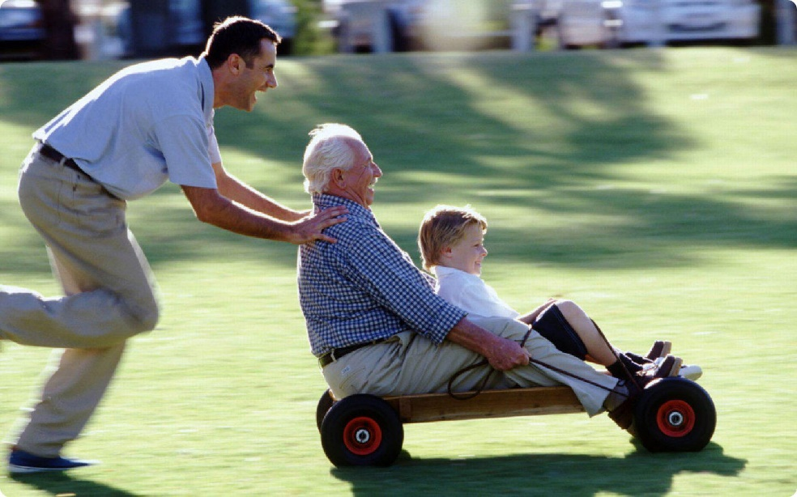
RESTORE
8. Permission to Play: Giving up control
  “Highly playful adults feel the same stressors as anyone else, but they appear to experience and react to them differently, allowing stressors to roll off more easily than those who are less playful.”
    Lynn Barnett, University of Illinois
Talk to the person next you: when was a last time you took an intentional break from work to play something?
Notes:
Lynn Barnett, a researcher and professor at the University of Illinois wrote [quote]
[Question]

Slide 20
RESTORE
8. Permission to Play: Giving up control
9. Eat smart brain food
Notes:
9: I’m sure we could brainstorm some important Do’s and Don’ts for healthy eating. In her book RL emphasises the importance of intentional planning – developing a healthy menu – and have the right kinds of food in the house. This helps avoid snacking and fast food because you know what you’re going to eat.
Everyone has their “danger” points with healthy eating. The key is to work out what yours are and make a plan. For example, a danger point for me is buffets – so I try to avoid them. Another one is snacking after dinner – nice to have something sweet with a cup of tea. Actually I haven’t conquered that one so there’s room for improvement!
Food can be such a controlling thing in our lives. Fasting can be helpful for some people. Both for spiritual formation and weight loss. But we don’t want to fixate on food – either getting more or consuming less. Get support if this is an area of challenge for you.
10: We love to label people don’t we? I was listening to Magic Talk the other day (just flitting through the stations) and Sean Plunket came up with a term: Doomer: People who think the world is going to end because of climate change. Labels enable us to put people in boxes and hence dismiss them. We give ourselves labels too. I’m not good with DIY. I can’t hold a tune. I’m ADD OCD DOI or whatever!
The problem with labels is they keep us from thinking we can change. They act like a ceiling in our psyche.
Here’s a good to help replace those old labels:
As we meditate on these things, we can be defined not by the labels we or others put on ourselves, but on what God thinks of us.

Slide 21
RESTORE
8. Permission to Play: Giving up control
9. Eat smart brain food
10. Know your identity: Labels don’t define you
Notes:
9: I’m sure we could brainstorm some important Do’s and Don’ts for healthy eating. In her book RL emphasises the importance of intentional planning – developing a healthy menu – and have the right kinds of food in the house. This helps avoid snacking and fast food because you know what you’re going to eat.
Everyone has their “danger” points with healthy eating. The key is to work out what yours are and make a plan. For example, a danger point for me is buffets – so I try to avoid them. Another one is snacking after dinner – nice to have something sweet with a cup of tea. Actually I haven’t conquered that one so there’s room for improvement!
Food can be such a controlling thing in our lives. Fasting can be helpful for some people. Both for spiritual formation and weight loss. But we don’t want to fixate on food – either getting more or consuming less. Get support if this is an area of challenge for you.
10: We love to label people don’t we? I was listening to Magic Talk the other day (just flitting through the stations) and Sean Plunket came up with a term: Doomer: People who think the world is going to end because of climate change. Labels enable us to put people in boxes and hence dismiss them. We give ourselves labels too. I’m not good with DIY. I can’t hold a tune. I’m ADD OCD DOI or whatever!
The problem with labels is they keep us from thinking we can change. They act like a ceiling in our psyche.
Here’s a good to help replace those old labels:
As we meditate on these things, we can be defined not by the labels we or others put on ourselves, but on what God thinks of us.

Slide 22
I am …
A child of God (John 1:12)
A new creation (2 Corinthians 5:17)
A friend of Jesus (John 15:15)
Created by God to do good (Ephesians 2:10)
Free in Christ (Galatians 5:1)
Chosen and loved (1 Thessalonians 1:4)
The light of the world (Matthew 5:14)
Not ruled by fear (2 Timothy 1:7)
Forgiven (Colossians 2:13)
God’s possession (Titus 2:14)
Free from the desires of the flesh. (Galatians 5:24)
A light in the world (Matthew 5:14–15)
Secure in him (1 Peter 1:3–5)
Loved by God (1 John 4:10)

Slide 23

RESTORE
11. Take a walk: Clear the brain fog
  “Methinks that the moment my legs begin to move, my thoughts begin to flow.”
    Henry David Thoreau
Notes:
Many clever people walk. Charles Dickens walked 30 km every day to de-stress and free his mind to come back fresh for composition. Google has incorporated “walking meetings” into its workday. Employees can reserve the time they want to meet on the indoor walking track. Sounds like a good idea for our new church premises!

Slide 24
RESTORE
12. Seek Adventure: Take a trip
  “To see things differently than other people, the most effective solution is to bombard the brain with things it has never encountered before. Novelty releases the perceptual process from the shackles of past experience and forces the brain to make new judgments.”
    Gregory Berns, Neuroscientist
Talk to your neighbour: What are some intentional ways you can create an adventure that requires you to face and overcome your fears?
Notes:
12: [quote] I don’t have to convince most of you to take a trip, but you don’t have to go to other side of the world to have an adventure.
Talk to your neighbour …

Slide 25
RESTORE
8. Permission to Play: Giving up control
9. Eat smart brain food
10. Know your identity: Labels don’t define you
11. Take a walk: Clear the brain fog
12. Seek Adventure: Take a trip
13. Break a sweat: Use the workout pants
Notes:
13: I’m not going to say anything about this one – it speaks for itself!

Slide 26

RESTORE
14. Push yourself - move beyond your comfort zone
  “To discover something truly great, one must set sail and leave the shore of comfort.”
    Khang Kijarro Nguyen
Notes:
My wife’s step-mum, Dorothy, has been involved in many things in her life, accountancy, goat farming, weaving, quilting, painting, bushwalking, playing the ukulele, Tai Chi, etc,
Learning a skill, trying a new hobby, meeting new people helps break us out of the rut we might be in. And give us a new outlook on life.

Slide 27
Rhythms of Renewal
REST | RESTORE
1. Take an inventory: Reflect and Journal | 8. Permission to Play - giving up control
2. Tech Detox: Silence the noise | 9. Eat smart brain food
3. Get quiet create space and listen | 10. Know your identity - labels don’t define you
4. Do the heart work: Examine and Confess | 11. Take a walk - clear the brain fog
5. Routines for deep sleep | 12. Seek Adventure - take a trip
6. Morning Routine - coffee, candle and a pen | 13. Break a sweat - use the workout pants
7. Stop the work: Practise Sabbath | 14. Push yourself - move beyond your comfort zone
Notes:
So there you have it. 14 ideas for restoring mental and emotional and physical and spiritual health. Which area resonates the most with you? Do something about it this week. We’ll have another 14 more next week!
God wants you not only to survive, but to thrive. Of course, it’s not all about you – or me – but when we are healthy and growing, we are going to be far for help to others who are need support.

