Slide 1
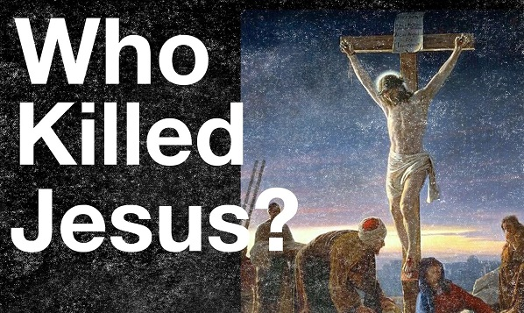
Mark 15:1-20

Slide 2
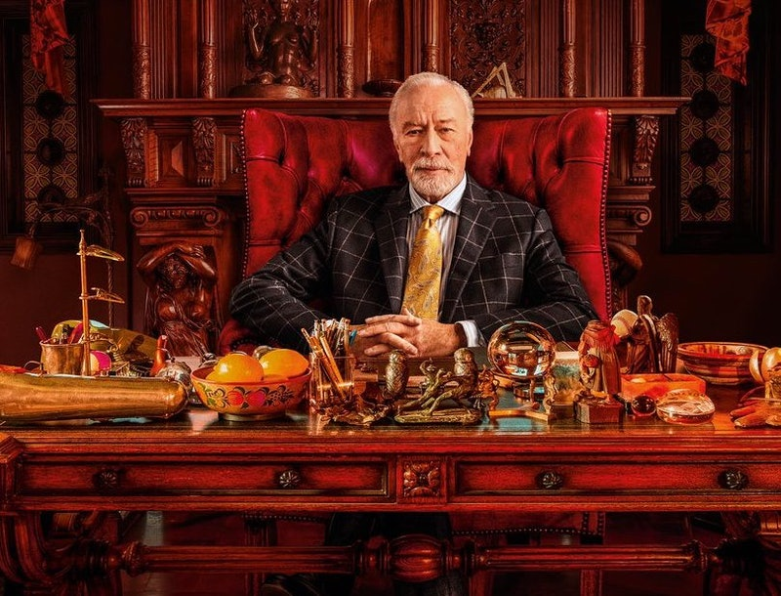
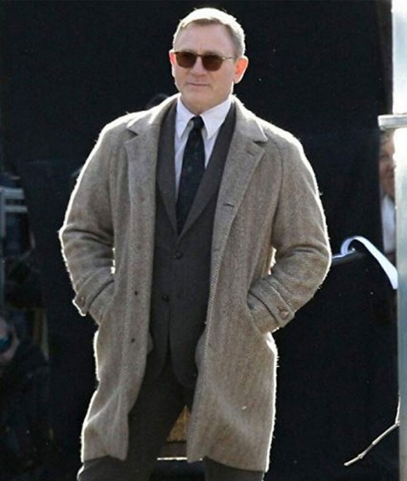
Detective Benoit Blanc
Harlan Thrombey

Slide 3


Slide 4
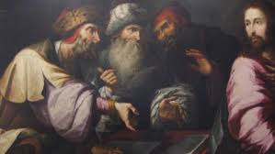
The Murder of Jesus Christ
"Indeed Herod and Pontius Pilate met together with the Gentiles and the people of Israel in this city to conspire against your holy servant Jesus, whom you anointed. They did what your power and will had decided beforehand should happen."
  Acts 4:26

Slide 5
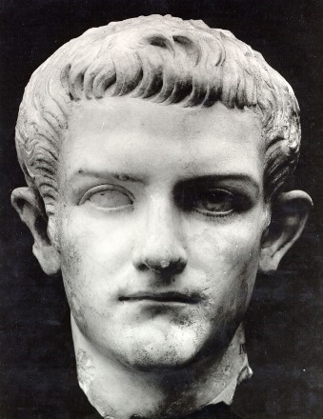
Suspect # 1
Herod Antipas

Slide 6
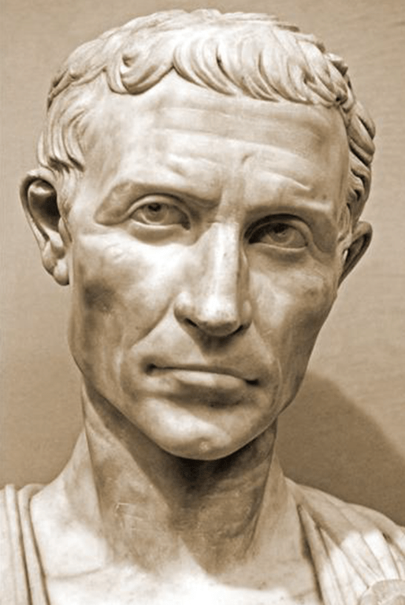
Suspect # 2
Pontius Pilate

Slide 7
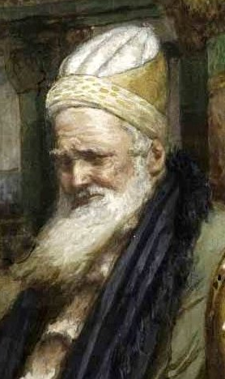
Suspect # 3
The Jewish Leadership

Slide 8

Suspect # 4
The Devil

Slide 9
The one behind the death of Jesus is …
… God himself!
³¹ He then began to teach them that the Son of Man must suffer many things and be rejected by the elders, the chief priests and the teachers of the law, and that he must be killed and after three days rise again.
  Mark 8:31
For even the Son of Man did not come to be served, but to serve, and to give his life as a ransom for many.
  Mark 10:45
"Amazing love, how can it be that thou my God should die for me?“
  Charles Wesley

Slide 10

“That is the God for me”
"I have entered many Buddhist temples in different Asian countries and stood respectfully before the statue of Buddha, his legs crossed, arms folded, eyes closed, the ghost of a smile playing round his mouth, a remote look on his face, detached from the agonies of the world. But each time after a while I have to turn away. And in imagination I have turned instead to that lonely, twisted, tortured …

Slide 11
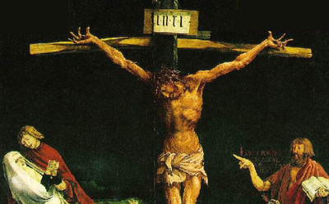
“That is the God for me”
figure on the cross, nails through hands and feet, back lacerated, limbs wrenched, brow bleeding from thorn pricks, mouth dry and intolerably thirsty, plunged in God-forsaken darkness. That is the God for me! He laid aside his immunity from pain. He entered our world of flesh and blood, tears and death. He suffered for us.“
  John Stott

Slide 12
The motive
God -Father, Son and Holy Spirit - agreed that the Son should suffer and die - for us!
Was it all necessary, Lord?
“["The Passion of the Christ“] is a sickening death trip, a grimly unilluminated procession of treachery, beatings, blood and agony. Gibson is thoroughly fixated on the scourging and crushing of Christ and is so meagerly involved in the spiritual meanings of the final hours, that he falls in danger of altering Jesus' message of love into one of hate."
  David Denby of the New York Times

Slide 13
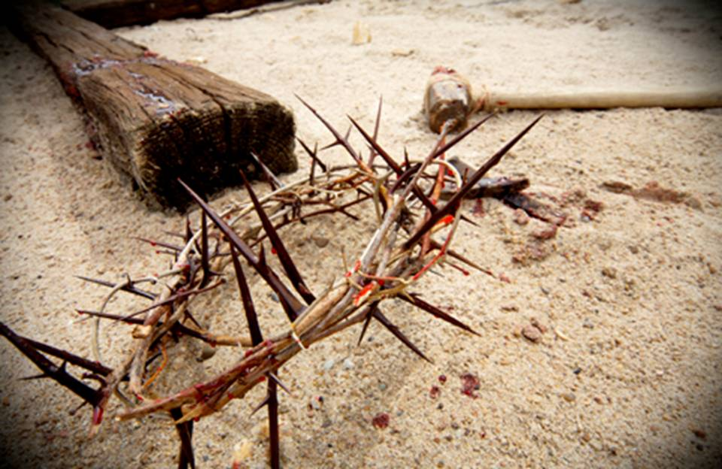
The motive
Why did it have to be a friend
Who chose to betray the Lord?
Why did he use a kiss to show them?
That's not what a kiss is for
Only a friend can betray a friend
A stranger has nothing to gain
And only a friend comes close enough
To ever cause so much pain

Slide 14
The motive
And why did there have to be a thorny
Crown pressed upon His head?
It should have been a royal one
Made of jewels and gold instead
It had to be a crown of thorns
Because in this life that we live
For all who seek to love
A thorn is all the world has to give

Slide 15
The motive
And why did it have to be
A heavy cross He was made to bare
And why did they nail His feet and hands
His love would have held Him there
It was a cross for on a cross
A thief was supposed to pay
And Jesus had come into the world
To steal every heart away

Slide 16
The motive
Yes, Jesus had come into the world
To steal every heart away
  - Michael Card

Slide 17
The motive
Consider him, who endured such opposition from sinful men so you will not grow weary and lose heart.
  Hebrews 12:3
“His appearance was so disfigured beyond that of any man and his form marred beyond human likeness... But after the suffering of his soul he will see the light of life and be satisfied; by his knowledge, my righteous servant will justify many, and he will bear their iniquities. Therefore I will give him a portion among the great, and he will divide the spoils with the strong, because he poured out his life unto death, and was numbered with the transgressors. For he bore the sin of many, and made intercession for the transgressors.”
  Isaiah 52:14, 53:11-12

Slide 18
The motive
For the joy that was set before him he endured the cross, scorning its shame, and sat down at the right hand of the throne of God….
  Hebrews 12:2
"Behold I stand at the door and knock. If anyone hears my voice and opens the door, I will come in and eat with that person, and they with me.“
  Rev 3:20
He suffered at the hands of rulers and priests and soldiers according to the plan and purpose of God so that he might have fellowship with us in the kingdom of God.

Slide 19

The motive
Christ is our Saviour who guarantees our future as we place our faith in Him and he is our example as we endure and eagerly await the salvation of our souls.

Slide 20

Read through the Gospel of Mark again
Pray for your friends and neighbours
Share your struggles with someone

Slide 21

So …
…let us run with perseverance the race marked out for us, ² fixing our eyes on Jesus, the pioneer and perfecter of faith. For the joy that was set before him he endured the cross, scorning its shame, and sat down at the right hand of the throne of God. ³ Consider him who endured such opposition from sinners, so that you will not grow weary and lose heart.
  Hebrews 12:1-3

