Slide 2
Redemptive Family
What kind of church do we want to be?
Notes:
As we focus on the new location, what about the vision to match it?

Slide 3
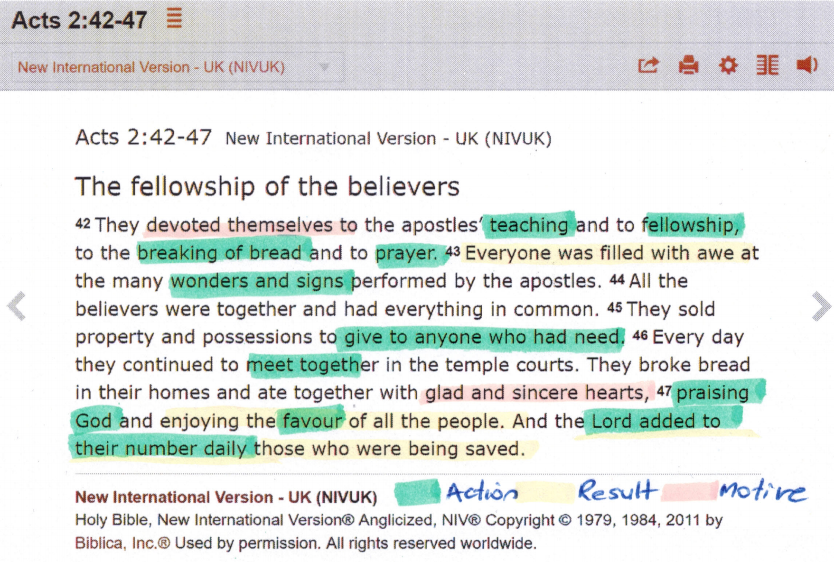
Notes:
Action – result – motive
A real transformation is going on here – even reaching to people’s finances!
There’s a real sense of family in Acts 2, isn’t there. Eating, sharing, gathering in homes ..
It’s pretty informal too not much structure yet.
A natural overflow from the incredible message the Apostles were bringing them and the powerful experience of God’s spirit at work among them.
People wanted to be a part of it!
Wouldn’t you?

Slide 4
Stirred …
“It is impossible to spend several months in close study of the remarkable short book [of Acts]… without being profoundly stirred and, to be honest, disturbed. The reader is stirred because he is seeing Christianity, the real thing, in action for the first time in human history. The newborn Church, as vulnerable as any human child, having neither money, influence nor power in the ordinary sense, is setting forth joyfully and courageously to win the pagan world for God through Christ….”

Slide 5
… but disturbed
“Yet we cannot help feeling disturbed as well as moved, for this surely is the Church as it was meant to be. It is vigorous and flexible, for these are the days before it ever became fat and short of breath through prosperity, or muscle-bound by over-organization. These people did not make ‘acts of faith,’ they believed; they did not ‘say their prayers,’ they really prayed. They did not hold conferences on [healing], they simply healed the sick. But if they were uncomplicated and naive by modern standards, we have ruefully to admit that they were open on the God-ward side in a way that is almost unknown today.”
JB Phillips, The Young Church in Action
Notes:
Are you stirred but disturbed?
What stands in our way of experiencing church like this? Comfort? Entertainment? Busyness? Peer pressure? Secularism? Self-sufficiency?
Yes to all of those – it’s good to name them and shame them as it were.
It’s easy to get depressed, but the good news is that Christ is risen. The Spirit is here. The Gospel is the power of God. When we really believe those things, then we will shout hooray – join us in the new community of God’s people!!
In this new series, we want to rediscover the sense of excitement of being on mission together

Slide 6
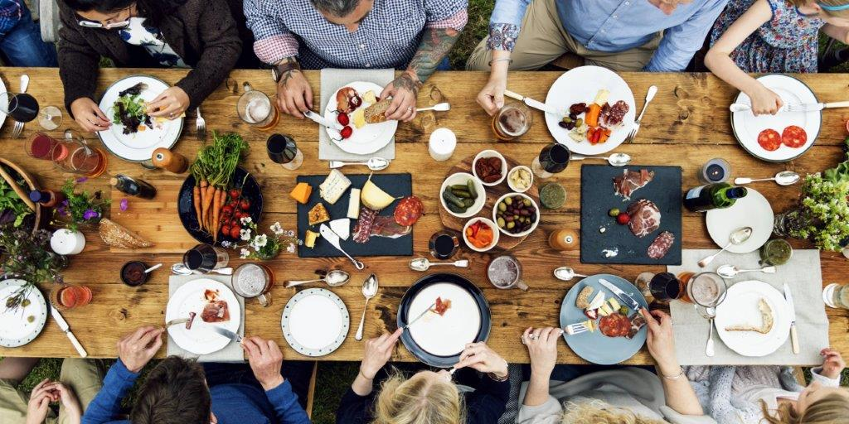
Redemptive Family What is it?
A five part series (plus intro) designed to help us imagine ways of doing simple mission together that are effective and warmly relational.

Slide 7
Redemptive Family
18/8 Week 0 – gear up: get the guide and join a group!
25/8 Week 1 – FAMILY
1/9 Week 2 – PLACE
8/9 Week 3 – FRIENDS
15/9 Week 4 – TEAM
22/9 Week 5 – CHANGE
29/9 Week 6 – (EMLT meets)
4-5/10 Week 7 – Workshop at St Peter’s

Slide 8
# 1 Family
I have a dream of church being family. Of everyone being accepted, loved and valued - where everyone is an uncle and aunty to the youngest and the smallest; where kindness is a lifestyle and forgiveness is always offered. I have a dream that the young will take their place as the church of today and leaders of tomorrow.
Nigel Dixon, Village without Walls

Slide 9
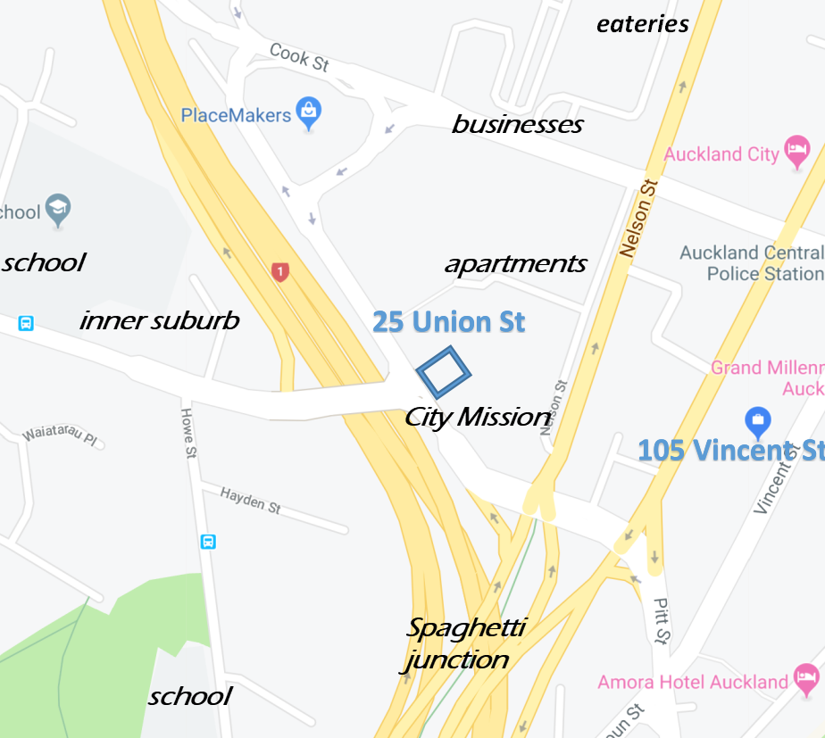
# 2 Place
Notes:
[Story of church in Mafraq]

Slide 10
# 3 Friends
Notes:
We need to hold on to our church family with one hand and on to our not-yet-Christian friends with the other, and do what we can to draw them closer together.

Slide 11
# 4 Team
Notes:
Everyone has a role to play – e.g. pot luck, Christianity Explored, socials, outreach events, services …

Slide 12
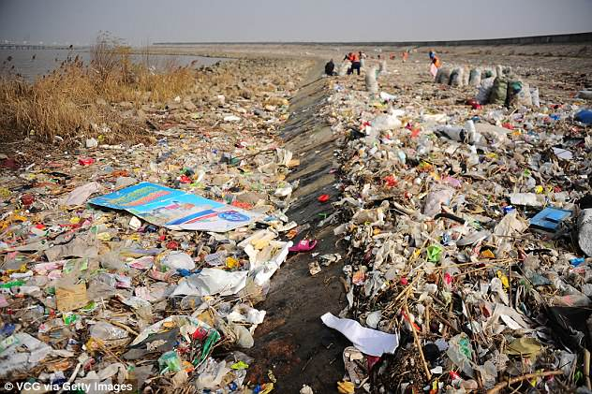
# 5 Change
Notes:
What needs to change in my life and our church? A habit, an attitude, an outmoded practice
Moving locations shakes things up!
Change is often difficult, e.g. Student Life name change

Slide 13
Redemptive Family What Next?
Purchase a Daily Devotional book ($5) and Weekly Survey pad and make a start
Sign up for a small group near you (Group leaders pick up study guides for your members)
Pray for transformation!

Slide 14
Small Groups
Tuesday night at Apt 405, 6a Nugent St (plenty of free parking available) at 7:30 pm CONTACT: Robert Fong 027 274 2570
Wednesday night at church at 6:45 pm. CONTACT: Rob O’Callahan 021 783 289
Thursday fortnightly from 22 August at 2/6 Momona Rd, Greenlane at 8:00 pm CONTACT: George Lowe 021 739 838
Saturday fortnightly from 24 August at 7 Ormonde Rd, Remuera at 10:00 am CONTACT: Ken Cheung 021 431 607 Or perhaps you / we can start another one!

Slide 15
Redemptive Family Bring it On!
⁴² They devoted themselves to the apostles’ teaching and to fellowship, to the breaking of bread and to prayer. ⁴³ Everyone was filled with awe at the many wonders and signs performed by the apostles. ⁴⁴ All the believers were together and had everything in common. ⁴⁵ They sold property and possessions to give to anyone who had need. ⁴⁶ Every day they continued to meet together in the temple courts. They broke bread in their homes and ate together with glad and sincere hearts, ⁴⁷ praising God and enjoying the favour of all the people. And the Lord added to their number daily those who were being saved.
Acts 2:42-47

Slide 16
Theme song?
Notes:
[Play song: No Outsiders, Rend Collective]
Communion
“Anastasis” reprise
Announcements
Benediction
Table after Service:
Devotional Books (with Weekly Survey pads)
Small Group study guides (for leaders)
Small Group sing-up lists

Slide 17
Notes:
Communion on the Moon
50 years ago two human beings changed history by walking on the surface of the moon. But did you know that Buzz Aldrin took communion on the surface of the
Moon?
Aldrin was an elder at his Presbyterian Church in Texas during this period in his life, and knowing that he would soon be doing something unprecedented in human history, he felt he should mark the occasion somehow, and he asked his minister to help him. And so the minister consecrated a communion wafer and a small vial of communion wine. And Buzz Aldrin took them with him out of the Earth’s orbit and on to the surface of the moon.
He and Armstrong had only been on the lunar surface for a few minutes when Aldrin made the following public statement:
“This is the LM pilot. I’d like to take this opportunity to ask every person listening in, whoever and wherever they may be, to pause for a moment and contemplate the events of the past few hours and to give thanks in his or her own way.” He then ended radio communication and there, on the silent surface of the moon. Here is his own account of what happened next:
“In the radio blackout, I opened the little plastic packages which contained the bread and the wine. I poured the wine into the chalice our church had given me. In the one-sixth gravity of the moon, the wine slowly curled and gracefully came up the side of the cup. Then I read the scripture, ‘I am the vine, you are the branches. Whosoever abides in me will bring forth much fruit.. Apart from me you can do nothing.’
“I had intended to read my communion passage back to earth, but at the last minute [they] had requested that I not do this.
“I ate the tiny piece of bread and swallowed the wine. I gave thanks for the intelligence and spirit that had brought two young pilots to the Sea of Tranquility . It was interesting for me to think: the very first liquid ever poured on the moon, and the very first food eaten there, were the communion elements.”
And of course, it’s interesting to think that some of the first words spoken on the moon were the words of Jesus Christ, who made the Earth and the moon – and Who, in the immortal words of Dante, is Himself the “Love that moves the Sun and other stars.”

