Slide 1
“I want Love”
1 Corinthians 13
Notes:
Reginald Dwight’s Father couldn’t express his love for his wife or his son. And the search for love is the theme of the movie about his life. (Who is he?)

Slide 2
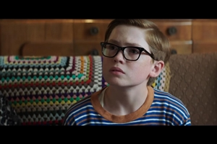
1 Corinthians 13
A universal cry
The greatest passage on love
Context of 1 Corinthians
What is love?
Notes:
“I want love”. It’s a universal cry.
Today we’re looking at possibly the greatest passage on love ever written. It’s been read in millions of weddings, but it’s far more than a Hallmark Card. It’s message is revolutionary.
[Context: The Corinthians valued miraculous gifts and impressive speech. They put some people on a pedestal and the inevitable rivalries that came with that.]
Paul says, you might make a lot of noise, but if you don’t have love, you’re more like instrument time at the local preschool than the NZSO!
So (you ask), what is love?
I’m glad you asked!
Paul fleshes out the concept for them and us - and it’s a love that is gutsy and tough - one with its sleeves rolled up, with scrapes on its knees and dirt in its finger nails. A like Jesus really!

Slide 3
4 Love is patient, love is kind.
“I love you’ means that I accept you for the person that you are, and that I do not wish to change you into someone else. It means that I will love you and stand by you even through the worst of times. It means loving you even when you’re in a bad mood, or too tired to do the things I want to do. It means loving you when you’re down, not just when you’re fun to be with. ‘I love you’ means that I know your deepest secrets and do not judge you for them, asking in return that you do not judge me for mine.”
  Jonathan Safran Foer
Notes:
Ever not felt like loving someone? Of course! We all do. But we love anyway. Rachael and I find it very hard to love our cat when she wakes us up at 4 am to go out or come in. Thankfully we’ve just installed a cat door, so hopefully blissful mornings will ensue. But when we love like Jesus, we love even when we don’t feel like it.

Slide 4
It does not envy, it does not boast, it is not proud.
¹ It was just before the Passover Festival. Jesus knew that the hour had come for him to leave this world and go to the Father. Having loved his own who were in the world, he loved them to the end. ² The evening meal was in progress, and the devil had already prompted Judas, the son of Simon Iscariot, to betray Jesus. ³ Jesus knew that the Father had put all things under his power, and that he had come from God and was returning to God; ⁴ so he got up from the meal, took off his outer clothing, and wrapped a towel round his waist. ⁵ After that, he poured water into a basin and began to wash his disciples’ feet, drying them with the towel that was wrapped round him.
Notes:
This is amazing, isn’t it? Jesus knew he was - that the Father had put all things under his power, and that he had come from God and was returning to God - and still he takes the role of a humble servant to show them how much he loved them.

Slide 5
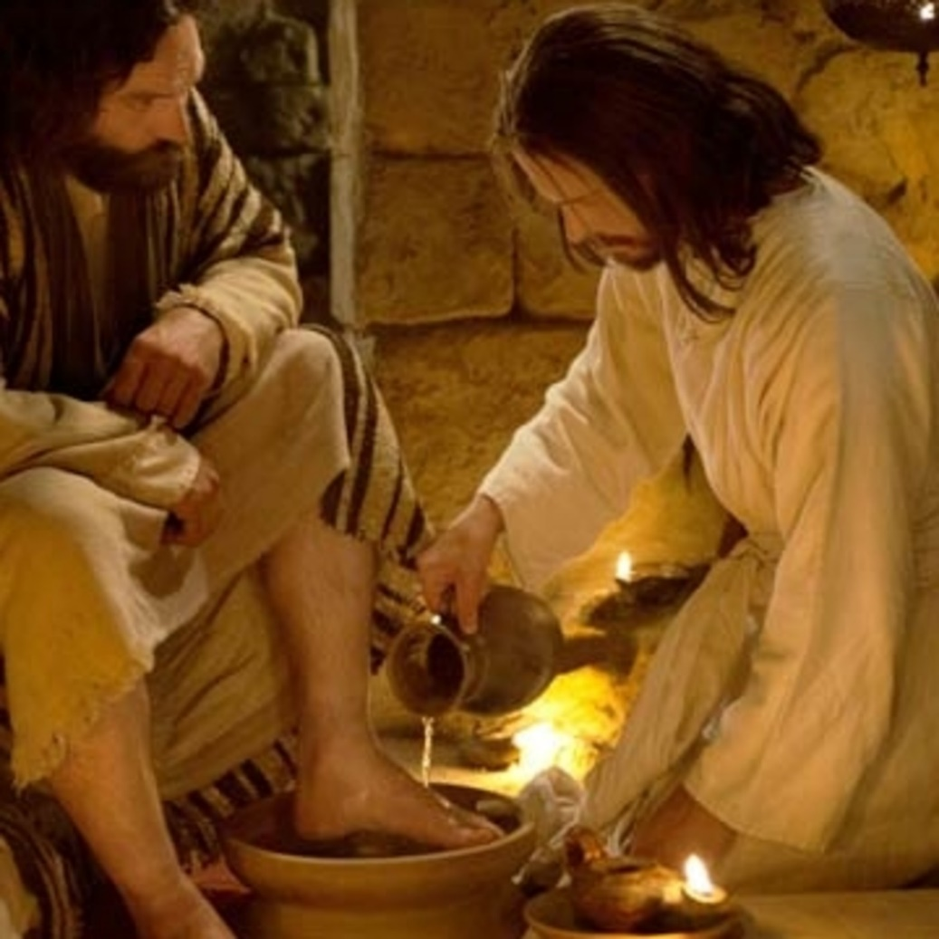
It does not envy, it does not boast, it is not proud.
¹³ ‘You call me “Teacher” and “Lord”, and rightly so, for that is what I am. ¹⁴ Now that I, your Lord and Teacher, have washed your feet, you also should wash one another’s feet. ¹⁵ I have set you an example that you should do as I have done for you.
  John 15:1-5. 13-15
Notes:
Loving like Jesus means we are willing to put aside our rights and serve others.

Slide 6
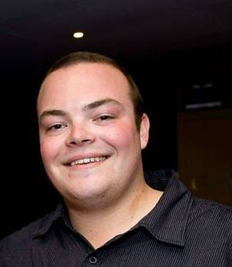
5 It does not dishonour others, it is not self-seeking, it is not easily angered, it keeps no record of wrongs.
February 24, 2014: Luke MacKenzie and Xingyu Shang
Cause of death: "positional asphyxia; being left in his car with no immediate first aid“
But Luke would have died anyway
Restorative justice conference: Tania and Martin MacKenzie
“Father, forgive them, for they know not what they do.”
Notes:
On February 24, 2014, young Luke MacKenzie was driving to his job at Auckland Airport when 27-year-old Xingyu Shang crashed into his car head on while driving under the influence of alcohol. But instead of checking for signs of life or calling the ambulance, he pulled himself from the wreckage, grabbed his phone and flagged down a motorist to get a ride home.
According to court documents, the cause of Luke's death was "positional asphyxia; being left in his car with no immediate first aid". It states Luke's chest and neck were forced into the frame of the door by the impact of the collision, which rendered him unconscious.
But police and the coroner told the family Luke would have died anyway.
Despite their deep grief in the two years since the accident, Luke’s parents, Tania and Martin, made an incredible gesture to the man who left their son to die.
After an emotional restorative justice conference with Shang and his family and a group visit to Purewa Cemetery to pay their respects, the couple were asked to make a recommendation to the court. They knew the judge's decision would be finely balanced: home detention or jail.
The MacKenzies told the court they did not want Shang locked up because they didn’t want the life of another young man ruined as their sons had been. They refused to be consumed by a grudge that would not bring back their son.
Their actions remind me of Jesus who cried out to his Father on the cross, “Father, forgive them, for they know not what they do.”

Slide 7
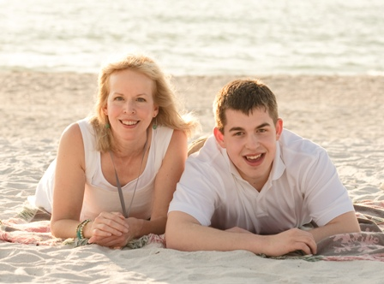
6 Love does not delight in evil but rejoices with the truth. 7 It always protects, always trusts, always hopes, always perseveres.
Emily Colson and her autistic son, Max

