Slide 1
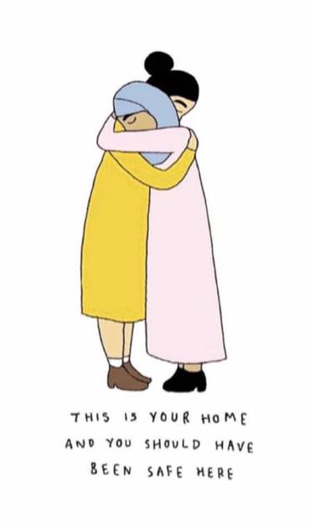
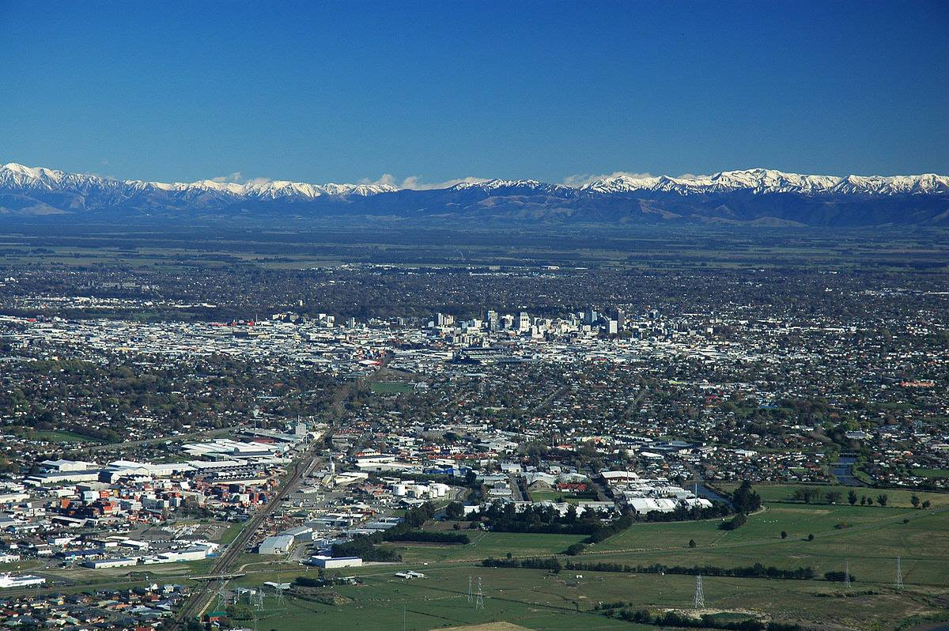
Pray for Christchurch

Slide 2
Psalm 46
¹ God is our refuge and strength,
an ever-present help in trouble.
² Therefore we will not fear, though the earth give way
and the mountains fall into the heart of the sea,
³ though its waters roar and foam
and the mountains quake with their surging.
⁴ There is a river whose streams make glad the city of God,
the holy place where the Most High dwells.
⁵ God is within her, she will not fall;
God will help her at break of day.
⁶ Nations are in uproar, kingdoms fall;
he lifts his voice, the earth melts.

Slide 3
Psalm 46
⁷ The Lord Almighty is with us;
the God of Jacob is our fortress.
⁸ Come and see what the Lord has done,
the desolations he has brought on the earth.
⁹ He makes wars cease
to the ends of the earth.
He breaks the bow and shatters the spear;
he burns the shields^{[d]} with fire.
¹⁰ He says, ‘Be still, and know that I am God;
I will be exalted among the nations,
I will be exalted in the earth.’
¹¹ The Lord Almighty is with us;
the God of Jacob is our fortress.

Slide 4
Romans 12:9-21
⁹ Love must be sincere. Hate what is evil; cling to what is good. ¹⁰ Be devoted to one another in love. Honour one another above yourselves. ¹¹ Never be lacking in zeal, but keep your spiritual fervour, serving the Lord. ¹² Be joyful in hope, patient in affliction, faithful in prayer. ¹³ Share with the Lord’s people who are in need. Practise hospitality.
¹⁴ Bless those who persecute you; bless and do not curse. ¹⁵ Rejoice with those who rejoice; mourn with those who mourn. ¹⁶ Live in harmony with one another. Do not be proud, but be willing to associate with people of low position. Do not be conceited.

Slide 5
Romans 12:9-21 (cont.)
¹⁷ Do not repay anyone evil for evil. Be careful to do what is right in the eyes of everyone. ¹⁸ If it is possible, as far as it depends on you, live at peace with everyone. ¹⁹ Do not take revenge, my dear friends, but leave room for God’s wrath, for it is written: ‘It is mine to avenge; I will repay,’ says the Lord. ²⁰ On the contrary:
‘If your enemy is hungry, feed him;
if he is thirsty, give him something to drink.
In doing this, you will heap burning coals on his head.’
²¹ Do not be overcome by evil, but overcome evil with good.

Slide 6
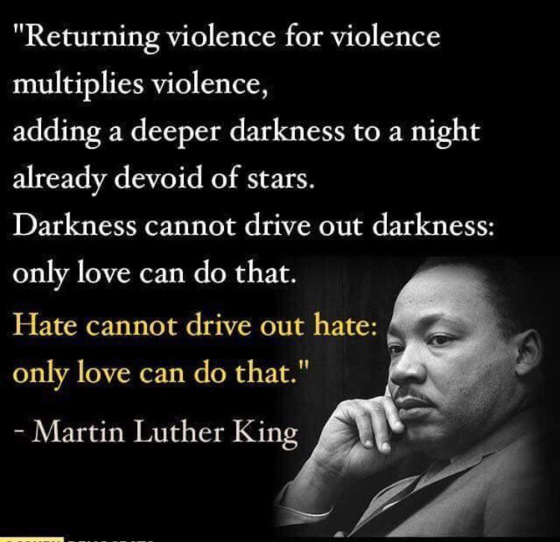

Slide 7
Pray for Christchurch
Those who are injured, some critically
The survivors and victims’ families
For Muslims and other immigrants to NZ not to live in fear
For the perpetrator and his family (now in hiding)
Comfort for the people of Christchurch and others around the world
The New Zealand and Australian governments to lay aside political agendas and provide wise security and other policies
Friendship-making (not hate-peddling) between people of different cultures would become the norm in our nation
That Christians would share the love of Christ and His message of forgiveness and hope with renewed fervour.

Slide 8
Open Mic
There will be many thoughts that have been going round in your minds. If you could like to share something, we want to give you that opportunity now. It may be in the form of questions, obervations, verses, hymns, encouragements, personal stories, prayers or whatever. Do try to be brief and always be edifying. Thank you for sharing.

Slide 9
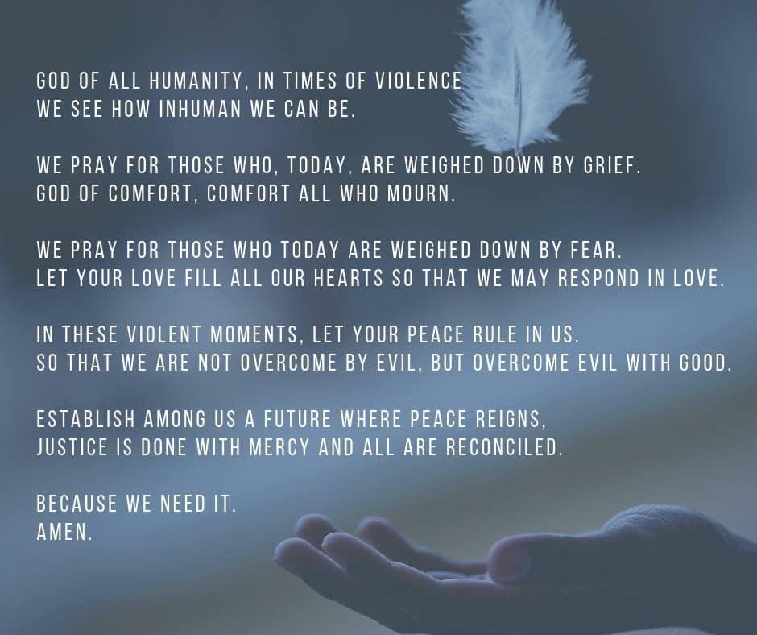

Slide 10
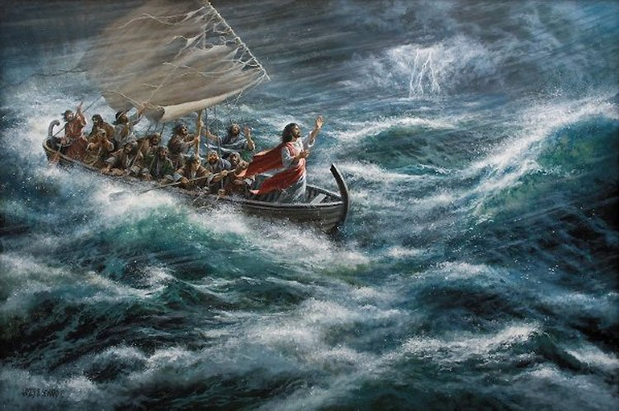
“Don’t you care?”

Slide 11
“Is He Worthy?” By Chris Tomlin
https://www.youtube.com/watch?v=-c6pl6CaiD0

Slide 12
God of Nations (National Anthem)
E Ihowā Atua,
O ngā iwi mātou rā
āta whakarongona;
Me aroha noa
Kia hua ko te pai;
Kia tau tō atawhai;
Manaakitia mai
Aotearoa

Slide 13
God of Nations at Thy feet,
In the bonds of love we meet,
Hear our voices, we entreat,
God defend our free land.
Guard Pacific's triple star
From the shafts of strife and war,
Make her praises heard afar,
God defend New Zealand.

Slide 14
Men of every creed and race,
Gather here before Thy face,
Asking Thee to bless this place,
God defend our free land.
From dissension, envy, hate,
And corruption guard our State,
Make our country good and great,
God defend New Zealand.

Slide 15
Let our love for Thee increase,
May Thy blessings never cease,
Give us plenty, give us peace,
God defend our free land.
From dishonour and from shame,
Guard our country's spotless name,
Crown her with immortal fame,
God defend New Zealand.

