Slide 1
Haggai 1:1-6,12-2:9
Notes:
[Video – Slactivism]
It takes more than clicking “like” to change the world. How true!

Slide 2
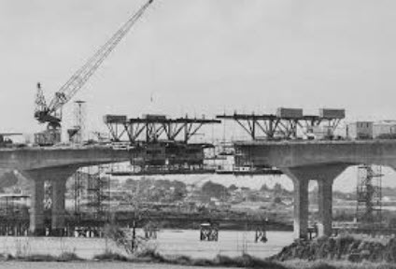
“We’re going home!”
A heart-breaking sight: a levelled city and a destroyed temple
Construction begins on the temple – foundation laid
Opposition
16 years of no work on the temple
Notes:
70 years later …
It had been seventy long years since the captives had seen their homeland. Most of them were too young to remember what it was like, of course, but the older ones among them could not forget–and their enthusiasm quickly spread.
A heart-breaking … Not only had Nebuchadnezzar levelled the city of Jerusalem, but he had also completely destroyed the glorious structure that had once been Solomon’s temple.
Construction begins … But they were back, and they had work to do. So the people began the long, arduous task of constructing a new temple, a house where God’s presence could dwell. The foundation was soon laid and an emotional celebration followed (Ezra 3:10–13).
Opposition But before long the newly returned remnant met with opposition. The surrounding people–who were Samaritans–rose up against them and hampered the work (Ezra 4:1–5). Although the threat passed, the work did not resume.
16 years … he “new” mangere bridge construction was on hold for 2.5 years due to industrial action. This stop-work situation lasted for 16 years! What got them going again? That’s what this little book is about.

Slide 3
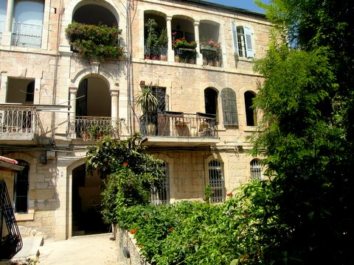
“Now’s not a good time”
520 BC (Before Nehemiah turns up)
‘These people say, “The time has not yet come to rebuild the Lord’s house.”’
‘Is it a time for you yourselves to be living in your panelled houses, while this house remains a ruin?’
Notice the contrast between the timber (v. 8) and their panelled houses
“Panelled” or “roofed”?
So, while the temple lies in ruins, the people are living in nicely decorated homes.
Notes:
“Now’s not a good time” Ever said that? Love to have you over but we’ve got a lot of things on a the moment. How about November? Or – yes, I’d like to join your home group, once the kids have left home. They’re 3 and 5 now so it may be a while.
Now, some excuses are very valid. I’m between jobs at the moment. Can we fix the shared driveway once my situation improves?
But the excuses of this little remnant had run out.
Haggai tells it short and sharp: 520 BC …
If the building industry is such dire straits, why are you somehow able to build your own places?
Notice the contrast … they used their timber supplies for their panelled houses instead of the temple. Oops!
Panelled” or “roofed”? The word translated “panelled” here can also be rendered “roofed.” If the word is “roofed,” the contrast is between completion and incompletion. If the word is “panelled,” the contrast is between luxury and austerity. If you look at the context of the chapter, it seems like the latter is in view.
So, while the temple …

Slide 4
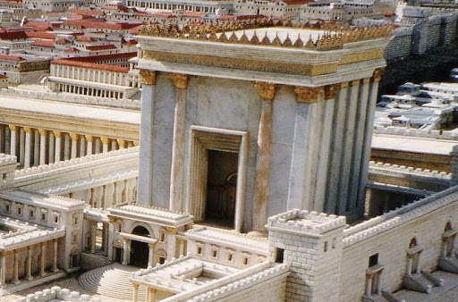
The Temple
What’s so important about the temple?
The centre of public worship
The venue for regular sacrifices for sin
Ezekiel told how God had abandoned his people (Ichabod – the glory has departed) – now he would be with them once more
Reinstatement of the nation and their status as God’s people
Notes:
What’s so important …?
This is hugely important for the nation which was God’s own special possession. The temple was central to the reinstatement of the nation and their status as God’s people

Slide 5
“Give careful thought to your ways”
¹³ Now listen, you who say, ‘Today or tomorrow we will go to this or that city, spend a year there, carry on business and make money.’ ¹⁴ Why, you do not even know what will happen tomorrow. What is your life? You are a mist that appears for a little while and then vanishes.
James 4:13-14
Notes:
Haggai wants to them to think about their priorities. Are they putting God first or serving their own interests?
That resonates for us today, doesn’t it?
James 4:13-14. This is a good perspective to have! My future? My plans? My life? Am I including God in our plans? Do I trust him? Am I submitting my goals to God or following my own desires or the cultural tide? What is my life anyway?
Deep questions!
“Give careful thought to your ways” or “Consider your ways” in the old KJV.

Slide 6
Meagre returns
⁶ You have planted much, but harvested little. You eat, but never have enough. You drink, but never have your fill. You put on clothes, but are not warm. You earn wages, only to put them in a purse with holes in it.’
Haggai 1:6
³⁸ You will sow much seed in the field but you will harvest little, because locusts will devour it. ³⁹ You will plant vineyards and cultivate them but you will not drink the wine or gather the grapes, because worms will eat them…
Deut. 28:38-39
CURSED!
Notes:
What Haggai is saying is that their meagre returns are a direct result of their disobedience. To understand this concept, we need to go all the way back to the 5th book of Moses: Deuteronomy.
After Moses gave the law, he then laid out curses for breaking the law and blessing for keeping it.
³⁸ You will sow …
Sounds familiar? Haggai is bringing people back to those commitment the people made with God way back in Moses’ time.
Obedience – blessing. Disobedience – cursed.

Slide 7
Does God deal with us in the same way?
Prosperity theology: A + B = C (Proverbs)
Problem: sometimes stuff happens! (Job, Ecclesiastes)
Not everyone is healed, wise investors go bankrupt and careful drivers are rear-ended
Discipline and Character formation
¹¹ No discipline seems pleasant at the time, but painful. Later on, however, it produces a harvest of righteousness and peace for those who have been trained by it.
Hebrews 12:11
Notes:
Now, here’s the question for us: Does God deal with us in the same way?
We have to be careful here.
Prosperity theology …
A better way to look at it: Discipline and Character formation
Sometimes God allows things to happen because he has a bigger agenda in mind. Occasionally he gives us a clue what that is!
My own experience of finding myself surplus to requirements in my previous church motivated me to reassess what it was I was designed and called to do … I had to consider my ways and what was important to me. Crusing laong in the same comfy situation would not have prompted as much soul-searching! I know others have had that “jolt” that “halts” you in your tracks.

Slide 8
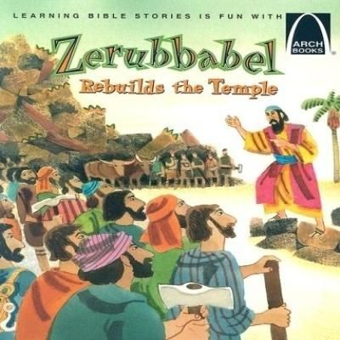
Then they obeyed
¹² Then Zerubbabel son of Shealtiel, Joshua son of Jozadak, the high priest, and the whole remnant of the people obeyed the voice of the Lord their God and the message of the prophet Haggai, because the Lord their God had sent him. And the people feared the Lord.
Haggai 1:12
Notes:
23 days after Haggai delivered his rebuke, they resumed the work.

Slide 9
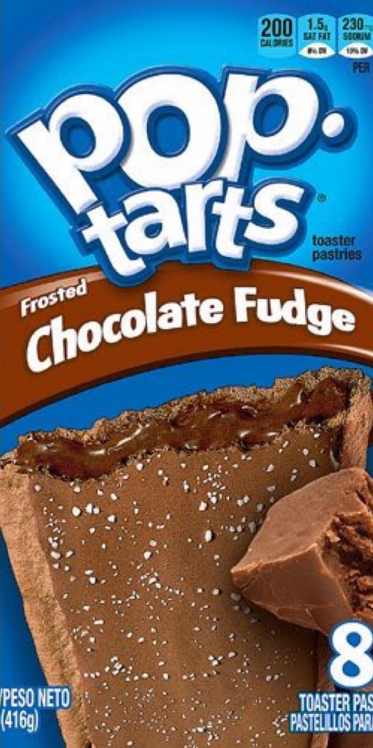
A Heart Response
¹⁴ So the Lord stirred up the spirit of Zerubbabel son of Shealtiel, governor of Judah, and the spirit of Joshua son of Jozadak, the high priest, and the spirit of the whole remnant of the people.
Haggai 1:14
The temple was completed in four years
They were P.O.P.T.A.R.T.s!
Notes:
Recall David and the people as they prepared the materials for the original temple. (The people rejoiced at the willing response of their leaders, for they had given freely and wholeheartedly to the Lord…)
The temple was completed in four years of hard work. Not a lot of cranes and bulldozers available in 520BC! But they did it.
P.O.P.T.A.R.T. (test and prize)

Slide 10
How does this apply to us today?
We have bought into the secular consumerist myth.
If we can just find the right soulmate, meaningful career, enjoyable experiences, material things or the exercise of self-expression, our lives can be filled with pleasure and meaning.
The reality is not living up to the hype
“We have endless opportunities to pursue pleasure and our desires, yet so many of us are miserable and anxious. We can traverse geography, time and space, yet loneliness is growing. Silicon Valley’s promises that a world connected by social media will be a better, more tolerant world now look ridiculous. The assurances that a globalised world will be a fairer, more peaceful and prosperous place seem shaky. These failed promises are fuelling a growing sense of dissatisfaction.”
Mark Sayers, Reappearing Church

Slide 11
How does this apply to us today?
3. We must consider our ways
“The human heart takes good things like a successful career, love, material possessions, even family, and turns them into ultimate things. Our hearts deify them as the centre of our lives, because, we think, they can give us significance and security, safety and fulfilment, if we attain them.”
Tim Keller, Counterfeit Gods
‘My people have committed two sins: They have forsaken me, the spring of living water, and have dug their own cisterns, broken cisterns that cannot hold water.
Jeremiah 2:13
Notes:
Am I looking for significance, security, safety, fulfilment and “the good life” in something other than God himself?

Slide 12
How does this apply to us today?
And recommit ourselves to the Lord
“You’re blessed when you’re at the end of your rope. With less of you there is more of God and his rule.”
Matthew 5:3 (The Message)
Dimensions of Discipleship
True Life
Full Life
Shared Life
Deep Life
Pure Life
Serving Life
Bold Life
Notes:
We build int our lives patterns and habits that shape and form us as followers of Jesus. It’s not slacktivism, but active, vital Christianity! Not simply “This is my desire … Lord I give you my heart” (though that’s a great start(, but we can LIKE and SHARE the idea of a surrendered life and continue doing our own thing! We must hear and respond to the voice of God.

Slide 13
“Today, if you hear his voice, do not harden your hearts …”
Psalm 95:8
“Brothers and sisters, what should we do?”
Acts 2:37
Tune in next week for the answer!
Notes:
Today, …
Rather, say along with those who listened to Peter’s powerful sermon in Acts 2: “Brothers and sisters …”
Tune in next week …

Slide 14
Glory!
Is that all there is? (Ezra 3:12, Haggai 2:3)
“⁹ The glory of this present house will be greater than the glory of the former house …”
⁷ I will shake all nations, and what is desired by all nations will come, and I will fill this house with glory”
² I saw the Holy City, the new Jerusalem, coming down out of heaven from God, prepared as a bride beautifully dressed for her husband. ³ And I heard a loud voice from the throne saying, ‘Look! God’s dwelling-place is now among the people, and he will dwell with them. They will be his people, and God himself will be with them and be their God.
Revelation 21:2-3
Notes:
Ezra tells us that many of the older folks, who had seen the former temple, wept aloud when they saw the foundation of this temple being laid, while many others shouted for joy. No one could distinguish the sound of the shouts of joy from the sound of weeping, because the people made so much noise.
“The glory ...” God is saying, it may look small now, but that’s how my kingdom grows. When someone chooses me over the idols of their lives, and adjusts their lifestyle to give and serve and speak in my name, then my kingdom grows. Don’t despise the day of small beginnings. The journey of a thousand miles begins with a ….” (single step)
“I will shake …” Haggai was actually looking beyond the earthly temple to one not made by human hands. A temple that God’s promised Messiah, the desired of nations, would come and fill with his glorious presence. The temple would be the entire world! Knowing this, the discouraged remnant could take courage and finish their work. And so can we.
² I saw the Holy City …
Amen. Bring it on!

