Slide 1
The Resurrection: Why it Matters
1 Corinthians 15:1-58

Slide 2
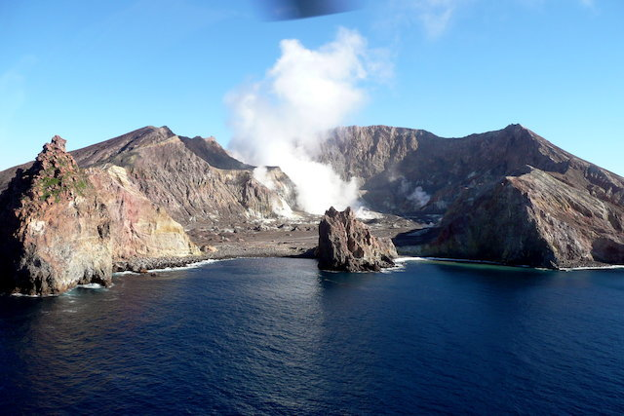
Whakaari - White Island Tragedy

Slide 3
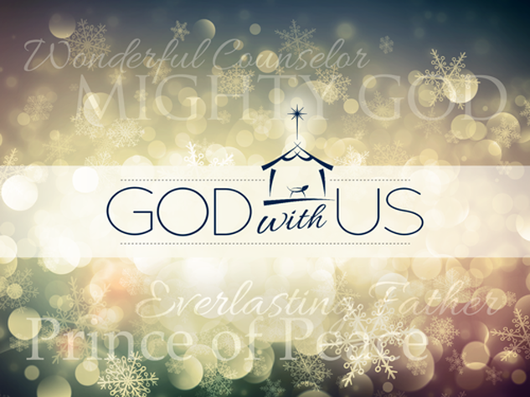
What do we say in the face of natural disasters and suffering?
God cares!
But look at the world around us …
That’s why Christmas is so important
Christmas reminds us that we are not alone
Throughout history, followers of Jesus have provided practical and spiritual support to victims with no strings attached
Notes:
We say (of course) that God cares. He loves us and wants the best for us.
But look at the world around us and it’s easy to conclude the opposite, that God’s got it in for us. That we are mere pieces on a game board subject to the throw of the dice or the whim of the player: God.
That’s why Christmas is so important. God did not remain far off from our plight. He entered our world and became involved personally. He experienced first-hand the pain and injustice of the world and he did something about it.
Christmas reminds us that we are not alone.
And so throughout history, followers of Jesus have been among the first to rush to the scene, providing practical and spiritual support to victims with no strings attached - in most cases. Not - “here’s a care package if you come to our church” but “freely we give because freely we have received.”

Slide 4
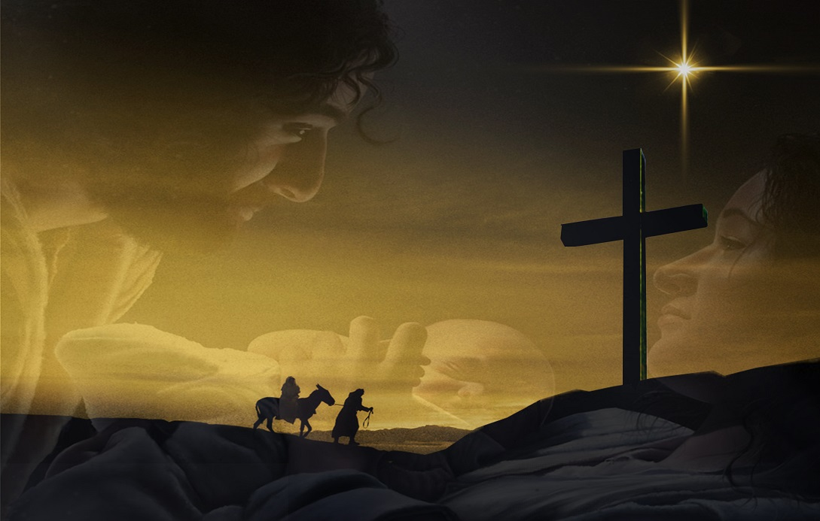
A larger story
Christmas is part of a larger story
Right at the centre of that plan is the birth, life, death and resurrection of Jesus of Nazareth, the Son of God
Notes:
But Christmas is not the whole story, as you know. It’s part of a larger story - a bold plan which God set in motion some 2000 years earlier with the call of Abraham - a plan which will be complete when creation itself is fully redeemed.
Right at the centre of that plan is the birth, life, death and resurrection of Jesus of Nazareth, the Son of God. This picture reminds us that Jesus was born … to die.

Slide 5

No more let sin and sorrow grow
Nor thorns infest the ground:
He comes to make his blessings flow
Far as the curse is found,
Far as the curse is found,
Far as, far as the curse is found.
Notes:
I’ve been doing a lot of singing of late - of Christmas carols - the Bethlehem variety as well as the Jingle Bells variety. Most carols are relentlessly positive - they focus on the birth, the angels, the shepherds and the wise men - but they often hint at Jesus’ bigger mission. For example, Joy to the World:

Slide 6
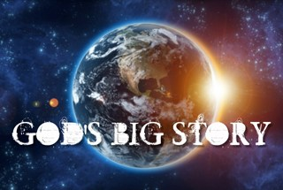
A larger story
Jesus didn’t just come to save us from our sin, but to reverse the effects of the Fall
One day, there will be a new order of life and health and peace which will extend to all people and all creation.
But this message often gets lost
Notes:
Notice that Jesus didn’t just come to save us from our sin, but to reverse the effects of the Fall - that fatal act of disobedience that brought so much death and decay and misery.
One day, there will be a new order of life and health and peace which will extend to all people and all creation. This is the hope of Christmas. This is the hope of the gospel. This is the hope that we can point to in the face of something like last Monday’s volcanic eruption.
But this message often gets lost in all the tinsel and shopping and parties. This is nothing new. Doubts about the truth of Jesus’ life and victory over death had snuck into the church in the first century.

Slide 7
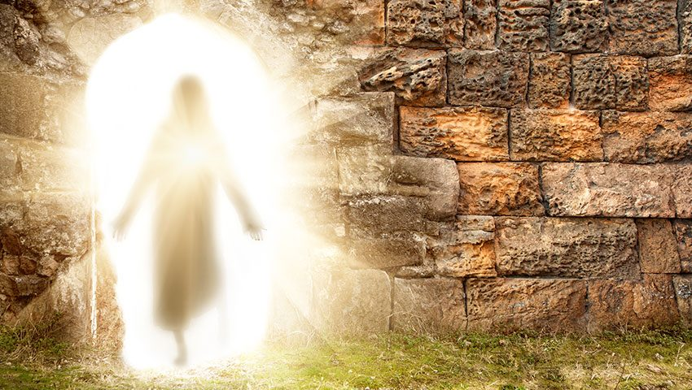
1 Corinthians 15
Does it really matter that Christ rose from the dead?
The resurrection of Christ changes everything!
Notes:
We have been going through the book of Corinthians over the past few months and hopefully we will conclude our series this morning!
The church had a lot going for them - they lacked no spiritual gift, they were enthusiastic - but they had a few problems as well. In chapter 15, Paul addresses the issue of the resurrection.
Does it really matter that Christ rose from the dead?
It seems that some of them were heavily influenced by the Greek idea that spirit is good and matter is evil. Western civilisation has had a problem with this ever since! The Hebrew idea is that both are good but corrupted by sin. If matter is evil, argued some, then Jesus didn’t rise bodily in a flesh and blood form. Because he’s perfect and flesh and blood are not. They favoured the Greek view of the afterlife which was a disembodied existence of the clouds and harps variety. Sound familiar? Yes, it’s a view that persists even in the church today.
So in chapter 15, Paul argues that Jesus rose bodily from the dead and that fact is critical to our faith.
The resurrection of Christ changes everything!
Three key points. Two long ones and one very short one:

Slide 8
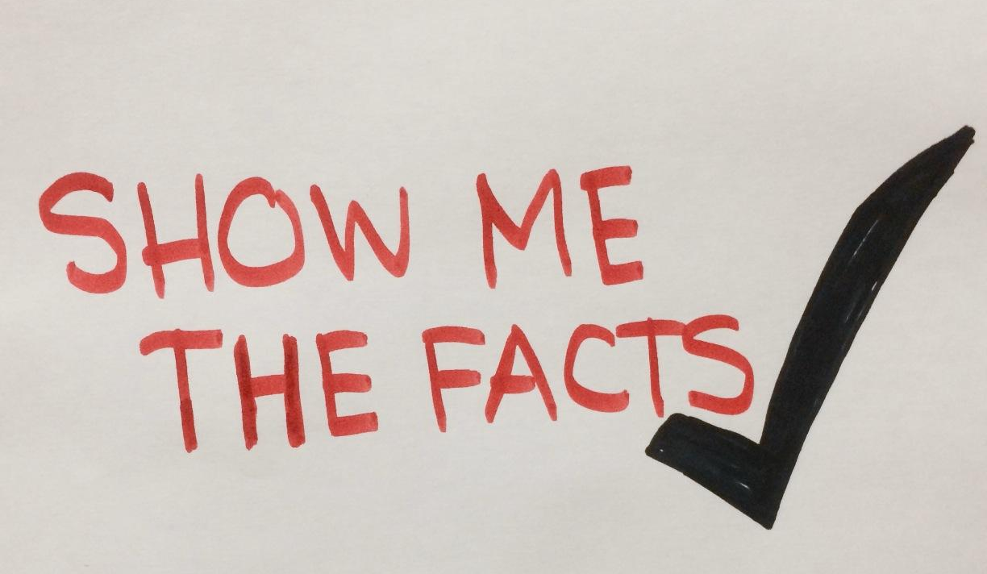
The resurrection vindicates our faith 1-34
The facts
  Christ died
  He was buried
  He rose on the third day
  He appeared to many people
The purpose
  “for our sins”
  “according to the Scriptures”
Notes:
Paul begins by explaining that Jesus died, was buried and rose again, appearing to individuals and groups of up to 500 people and himself last of all.
But these are more than bare facts. He also notes the purpose for Christ’s death. It is “for our sins”. It is “according to the Scriptures”. These are not random events. They are part of God’s plan.

Slide 9
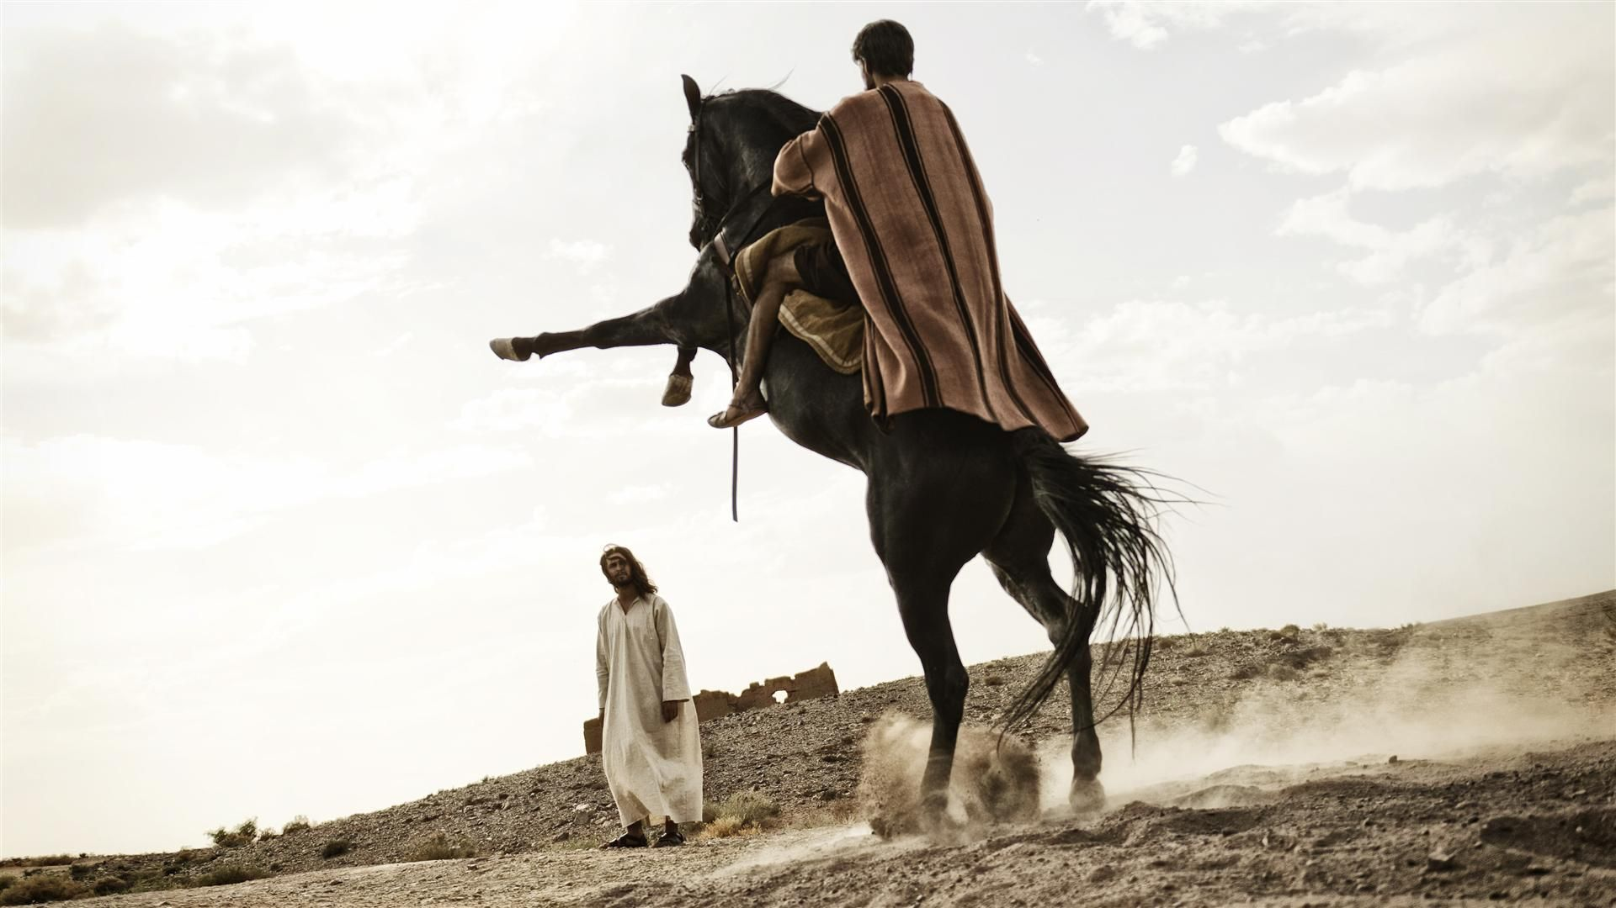
The resurrection vindicates our faith 1-34
500+!
The biggest proof: Paul changed
  “I persecuted the church of God.” (9)
  “By the grace of God, I am what I am.”
  “This is what we preach and this is what you believed.”
Notes:
Now, 500+ is quite a lot of people who claimed to have seen Jesus alive after he died. Most of them would have been still alive at the time this letter was written. You could talk to them! You could talk to Paul!
And the biggest proof that Paul was telling the truth is the fact that he changed.
As he says in verse 9, “I persecuted the church of God.” He was zealous in his efforts to stamp out this new movement. But then he met Jesus. “By the grace of God, I am what I am.”
I love the way God chooses the most unlikely people! Paul was the last man on earth you would expect to become a Christian. Something happened on that road to Damascus. What was it? The resurrection.
Paul sums it up by saying, “This is what we preach and this is what you believed.” This is the Good News. Jesus was not just a great teacher or healer or prophet. He was and is the Saviour of the world.
And the resurrection proves it.

Slide 10
The resurrection vindicates our faith 1-34
If Jesus didn’t rise from the dead, then:
  No one rises from the dead
  Our preaching is useless
  Your faith is useless and futile
  You are still in your sins
  We are false witnesses
  Those who have fallen asleep in Christ are lost
If our hope in Christ is only for this life, then we should be pitied more than anyone.
If the dead are not raised, ‘Let us eat and drink, for tomorrow we die.’ (32)
Notes:
Check out Paul’s argument in 12-19:…
Tell us what you really think, Paul!
In verse 32 he quotes the famous Epicurean school of philosophy, which espoused pleasure as the purpose of life:
If the dead are not raised, ‘Let us eat and drink, for tomorrow we die.’
If this is all there is, we might as well enjoy it. Either that or sink into despair. That sounds to me life today: the pursuit of pleasure and skyrocketing rates of depression.

Slide 11
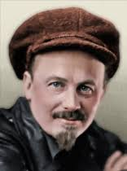
The resurrection vindicates our faith 1-34
But Christ has indeed been raised from the dead, the firstfruits of those who have fallen asleep. (20)
Nikolai Ivanovich Bukharin
Notes:
Nikolai Ivanovich Bukharin was one of the most powerful men on the Soviet Union. The story is told that in 1930, he addressed a huge assembly in Kiev on the subject of atheism and proofs against Christianity. An hour later, he looked out over the crowd. "Are there any questions?" Deafening silence. Then one man approached the platform and stood next to the communist leader. He looked left then he looked right. Finally he said the words that Russians had been saying to each other for centuries: "CHRIST IS RISEN!" The crowd rose to its feet and as one man shouted the traditional response: "HE IS RISEN INDEED!"
That’s what I’m reminded of when I read verse 20:
But Christ has indeed been raised from the dead.
Then Paul explains the implications of this fact.
The firstfruits - that first fruit of the season - that little tomato plant on the vine or lemon on the tree. What does it tell us? There will be more. First Christ, then all believers will rise from the dead.

Slide 12
The resurrection vindicates our faith 1-34
When will this happen?
²² For as in Adam all die, so in Christ all will be made alive. ²³ But each in turn: Christ, the firstfruits; then, when he comes, those who belong to him. ²⁴ Then the end will come, when he hands over the kingdom to God the Father after he has destroyed all dominion, authority and power. ²⁵ For he must reign until he has put all his enemies under his feet. ²⁶ The last enemy to be destroyed is death.
"The kingdom of the world has become the kingdom of our Lord and of His Christ, and He will reign forever and ever."
  Revelation 11:15
Notes:
When will this happen?
Verse 23: …Revelation 11:15
So, point 1 - the resurrection vindicates our faith.

Slide 13
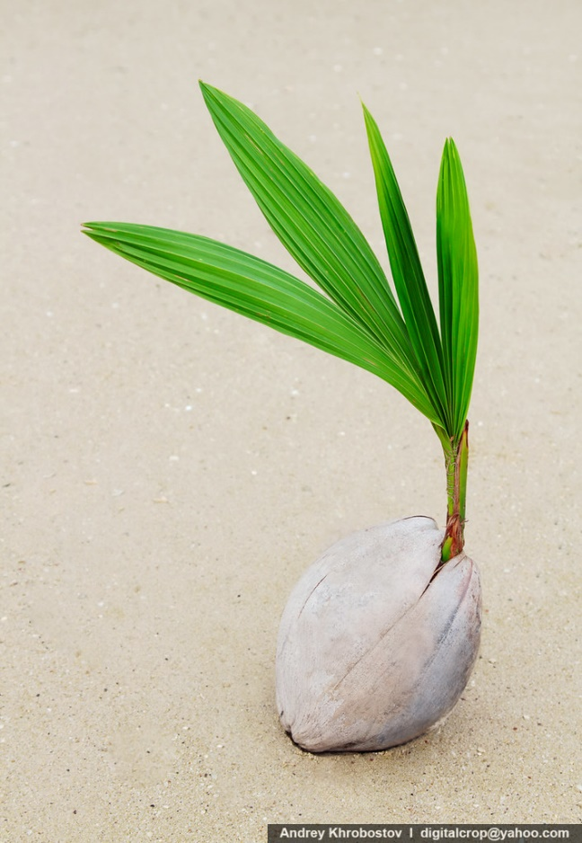
The resurrection anticipates our future 35-57
Two metaphors
The seed
  There is continuity between seed and plant and continuity between new and old. But there are also differences.
  The body that is sown is perishable, it is raised imperishable; ⁴³ it is sown in dishonour, it is raised in glory; it is sown in weakness, it is raised in power; ⁴⁴ it is sown a natural body, it is raised a spiritual body.
  A vast improvement!
Notes:
Paul explains how the resurrection of Jesus gives us insight into what kind of body we will have. He uses two metaphors: the seed and the wardrobe. (No - not the Lion, the Witch and the Wardrobe” but the clothes inside the wardrobe!)
The seed
Our current bodies can be likened to a seed. Only when a seed is planted in the ground, can it grow into the plant it is made to become. In the same way, only when we die, can we receive our new bodies.
There is continuity between seed and plant and continuity between new and old. But there are also differences. Verse 42:
The body that is sown is perishable, it is raised imperishable; ⁴³ it is sown in dishonour, it is raised in glory; it is sown in weakness, it is raised in power; ⁴⁴ it is sown a natural body, it is raised a spiritual body.
These differences amount to a vast improvement! It’s like comparing your self-drawn cartoon in the corner of your notebook - flicking the pages quickly so it appears to move - with seeing Frozen II at the multiplex!
The limitations and failures of our current bodies will be a distant memory, as we enjoy our eternal upgrade.

Slide 14
The resurrection anticipates our future 35-57
The wardrobe
⁵³ For the perishable must clothe itself with the imperishable, and the mortal with immortality. ⁵⁴ When the perishable has been clothed with the imperishable, and the mortal with immortality, then the saying that is written will come true: ‘Death has been swallowed up in victory.’
⁵⁵ ‘Where, O death, is your victory?
Where, O death, is your sting?’
Death has had a hold over our lives which seemed unbreakable
Death does not have the final say
Notes:
Paul emphasises this with his next metaphor:
The wardrobe …
We will clothed with new bodies that are not subject to death.
Death has had a hold over our lives which seemed unbreakable. We have been confronted yet again with death and injury and desperate grief. We say along with the families of the victims and the first responders and the medical staff and the whole nation: this is not right. This is awful. We don’t minimise or rationalise or spiritualise. We grieve and rage and we are tempted to despair.
But we also know that death does not have the final say. Death is not the end. We look forward to a day when death gets it comeuppance - when it is banished forever.
Because Christ is risen. He is risen indeed.
So, the resurrection vindicates our faith, anticipates our future and

Slide 15
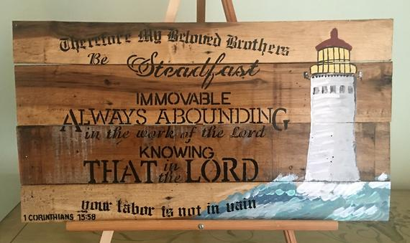
The resurrection motivates our faithfulness
Notes:
So what difference does all this make to our lives right now?
Verse 58: Therefore, my dear brothers and sisters, stand firm. Let nothing move you. Always give yourselves fully to the work of the Lord, because you know that your labour in the Lord is not in vain.
Sounds like a good benediction, right? And it is. But it’s also one of the most encouraging verses in the whole Bible.
Because all this is true, then we can have confidence - as we do the work of the Lord.

Slide 16
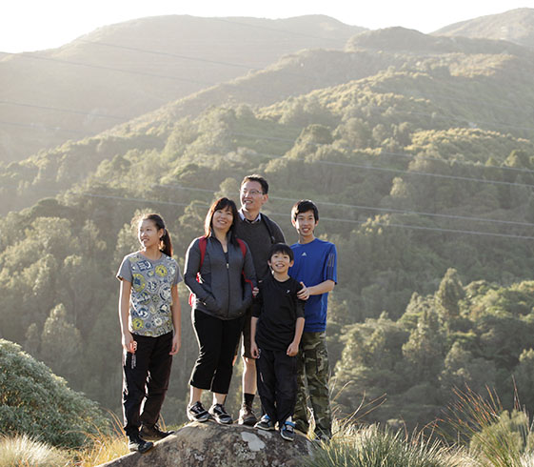
The resurrection motivates our faithfulness
What is the work of the Lord”?
  Keep your promises, turn up on time for work, pay your taxes, take a break once in a while
  Enjoy what God gives you with a thankful heart: tuis in the tree, pavlova on the table, jandals on the beach
  Love God, follow Jesus, help the hurting, empower the forgotten and share the wonderful news of his first and second coming, guaranteed by his resurrection from the dead.
Notes:
What is the work of the Lord”?
Whatever he tells you to do: …
At times it will not be easy. But it is not in vain. It is never a waste. Each act of love has eternal impact.

Slide 17
The resurrection motivates our faithfulness
Too heavenly minded?
"If you read history you will find that the Christians who did most for the present world were precisely those who thought most of the next. It is since Christians have largely ceased to think of the other world that they have become so ineffective in this.“
  C.S. Lewis, Mere Christianity
Which world are we thinking of? Which world are we living for?
Notes:
People sometimes complain that Christians can be so heavenly minded they are no earthy use.
But [quote]
Which world are we thinking of? Which world are we living for?

Slide 18
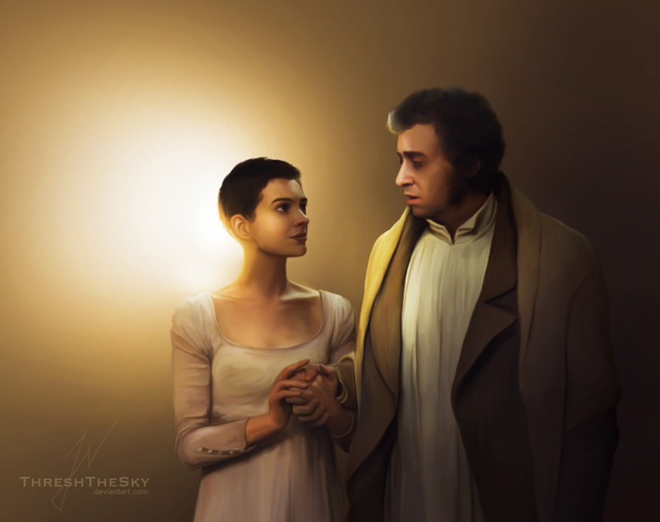
The resurrection motivates our faithfulness
Valjean:
  On this page
  I write my last confession
  Read it well when I, at last, am sleeping
  It's the story
  Of one who turned from hating
  A man who only learned to love
  When you were in his keeping.
Notes:
A couple of weeks ago, Rachael and I were blessed to be able to attend Les Mis the musical for the first time in 28 years.
[Summarise]
The final scene hit me afresh. John Valjean is dying and he is surrounded by those he loves both living and dead.
To his adopted daughter, Cosette he sings,

Slide 19
The resurrection motivates our faithfulness
Fantine:
  Come with me
  Where chains will never bind you
  All your grief
  At last, at last behind you …
  Take my hand
  I'll lead you to salvation
  Take my love
  For love is everlasting
  And remember
  The truth that once was spoken
  To love another person
  Is to see the face of God.
Notes:
Fantine, Cosette’s dead mother, whom Valjean coudn’t save, sings:
When we are ready to depart this earth and prepare for our own resurrection, it is the love that we have given that will last. May we live for that which lasts, and never lose heart, because Christ is risen - he is risen indeed!

