Slide 1
God's plan for marriage and intimacy
1 Corinthians 6:12-20
Notes:
What is the biggest revolution of the 20th century?

Slide 2
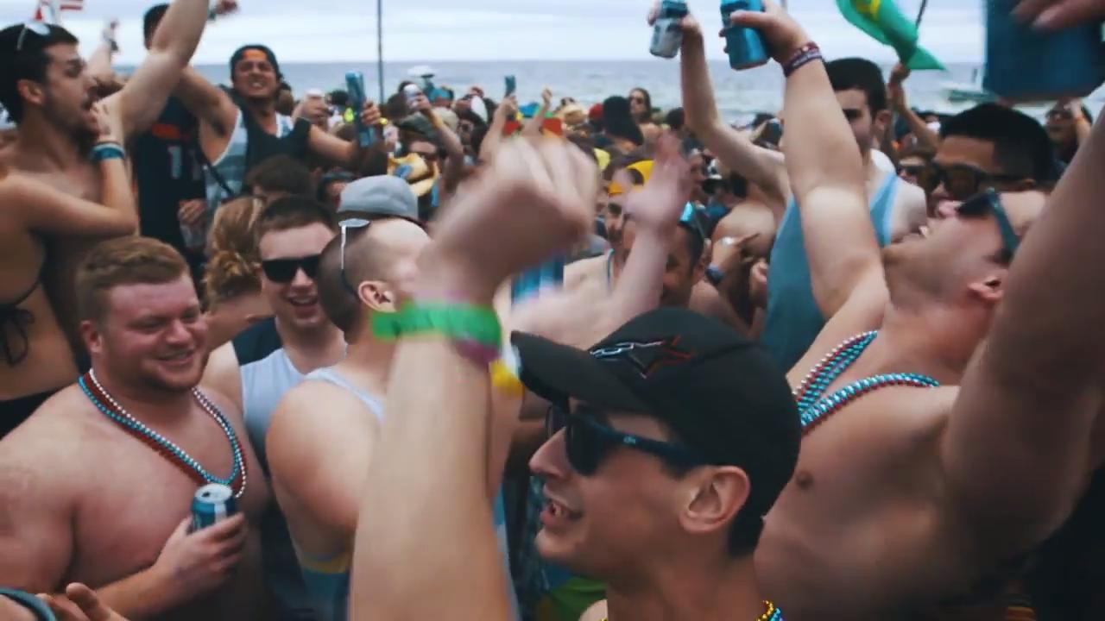
Revolution!
Notes:
Arguably it’s the sexual revolution.
Bolstered by Alfred Kinsey’s research which helped separate sexual behaviour from morality and freed from the constraints of conventional religion, the mantra of our society became: if it feels good (and you’re not hurting anyone), DO IT!
In this worldview, sex is the ultimate pleasure. The message of TV, movies, and music is that there is no greater pleasure available, and that it is the right of every person to enjoy it. In fact, the problem is, we are repressed by our traditional (Christian / Jewish / Muslim) ideas.
How has the church responded to this?

Slide 3
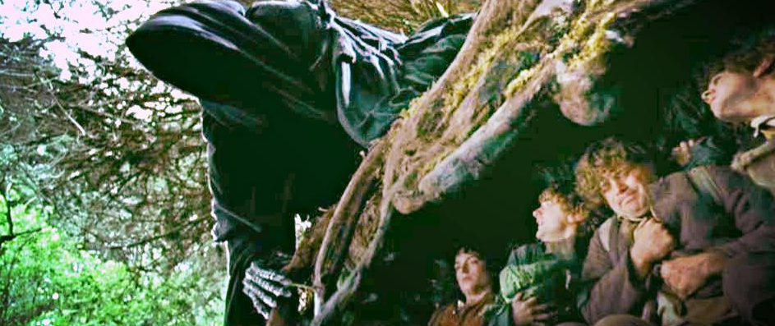
Common responses …
Stay in our bubble and hope it goes away
Notes:
Problem?

Slide 4
Common responses …
Go public
Notes:
[recent Aussie plebiscite on ss marriage)
Problem?

Slide 5
Common responses …
Soak in the culture
Notes:
Problem?

Slide 6
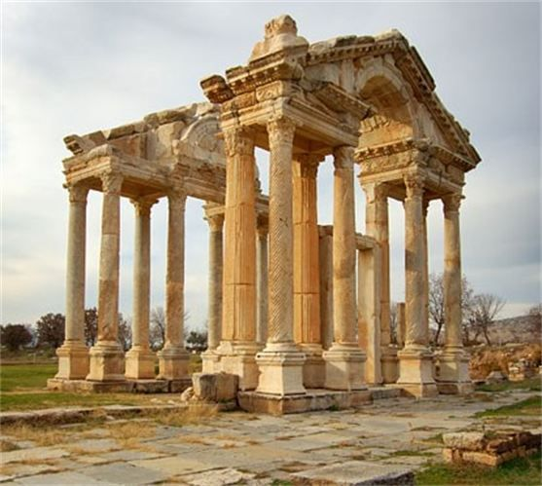
1 Corinthians
Great location - a strategic crossroads
Messy church - Paul addresses issues and questions:
Divisions
Sexual immorality
Etc

Slide 7
Fallacy 1: “I can do what I want”
¹² ‘I have the right to do anything,’ you say – but not everything is beneficial. ‘I have the right to do anything’– but I will not be mastered by anything.
6:12
A misunderstanding of grace
See 5:1-2 “…and you are proud!”
Romans 6:1-2 “May it never be!”
Grace is not licence to sin, but freedom to obey out of love and not fear
Even if it is lawful, is it helpful?
Notes:
Grace is fantastic …
A misunderstanding of grace
“I’m forgiven because you were forsaken … “, so I can do what I like.
See chapter 5
It is actually reported that there is sexual immorality among you, and of a kind that even pagans do not tolerate: a man is sleeping with his father’s wife. ² And you are proud! (5:1-2a)
They were proud of their freedom
How does Paul respond to this question in Romans 6:1-2?
What shall we say, then? Shall we go on sinning, so that grace may increase? ² By no means! [literally, NO WAY, HOSE!] We are those who have died to sin; how can we live in it any longer?
When a person truly experiences grace, they will experience Jesus, and Jesus will change their life from the inside out.
So grace is not licence to sin, but freedom to obey out of love and not fear.
And Paul says here, Even if it is lawful, is it helpful?

Slide 8
Fallacy 2: “It’s just a bodily function”
¹³ You say, ‘Food for the stomach and the stomach for food, and God will destroy them both.’ The body, however, is not meant for sexual immorality but for the Lord, and the Lord for the body.
6:13
A misunderstanding of the body
Greek thinking about the body and the spirit
The body is like a single-use plastic bag
Our bodies ultimately belong to the Lord - Why? We are bought and paid for! (20)
They are dwelling places of the Holy Spirit and they will be resurrected (19 & 14)
Notes:
“the body is for sex and sex is for the body” –it’s just a bodily function, like eating or drinking
A misunderstanding of the body
“…plastic bag” – use it once then throw it away.
Our bodies …

Slide 9
Do these fallacies exist today?
“I can do what I want”
“It’s just a bodily function”
How can we respond?

Slide 10
How can we respond?
The negative impacts of the sexual revolution:
Sexually transmitted diseases
Broken homes
Fatherlessness
Dependency on the State
Abortion
Child abuse
Increasing infertility
Soaring rates of depression
Loss of sexual desire (ironically)
Notes:
[Ask: what have been the negative impacts of the sexual revolution?]
[My list]

Slide 11
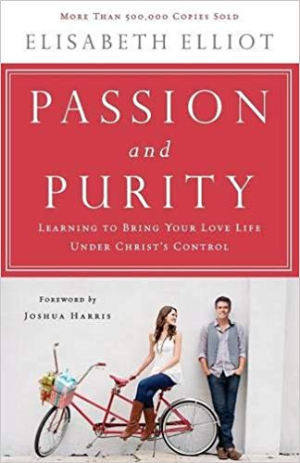
Negative Impacts
“I am convinced that the human heart hungers for constancy. In forfeiting the sanctity of sex by casual, non-discriminatory “making out” and “sleeping around,” we forfeit something we cannot well do without. There is dullness, monotony, sheer boredom in all of life when virginity and purity are no longer protected and prized.”
Elisabeth Elliot

Slide 12
How can we respond?
The negative impacts of the sexual revolution
Sex is God’s idea!
“… a man leaves his father and mother and is united to his wife, and they become one flesh.”
Genesis 2:24
“Eat, friends, and drink; drink your fill of love.”
Song of Songs 5:1
Marriage is best!
Notes:
A lot of people think the Bible says, “Sex is fun and it feels good, so don’t do it.” Nothing could be farther from the truth! Sex was God’s great idea in the first place!
But God’s view of sex as a sacred and private gift to married couples: Gen 2:24
He wants them to enjoy this gift [SoS 5:1]
Marriage is best! He is not a cosmic killjoy, but he has made sexual expression to be a very powerful thing which thrives best in a committed marriage relationship

Slide 13
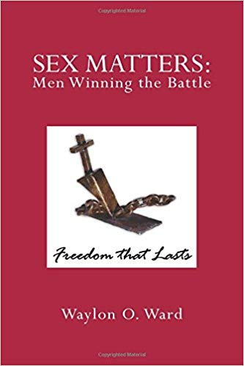
Sexual expression is powerful
“In the counselling office, individuals rarely if ever weep scalding tears about any other sense of loss like they do for a sexual relationship when it ends. There are soul ties that bind two partners together in unseen ways …There is a hole in your soul where the connection was ripped from you.”
Waylon Ward

Slide 14
How can we respond?
The negative impacts of the sexual revolution
Sex is God’s idea!
Sexual intimacy is a profound sharing of body and spirit
Lightning vs electricity
Intimacy = “into-me-see”
Illustration of Christ and the Church
Notes:
The Bible teaches that sex welds two souls together. It is so powerful that it is only safe within a committed, covenant marriage relationship.
Lightning vs electricity - It’s like the difference between the wild energy of lightning compared to the harnessed power of electricity. God wants to protect our hearts and bodies and relationships and families.
Intimacy = “into-me-see”. It is only safe to reveal the fullness of who we are, “warts and all,” to someone who loves us and has committed to be faithful and supportive “till death do us part.”
Illustration - of the unity of Christ and the church, where two very different, very other beings are joined together as one. A vey profound truth!

Slide 15
How can we respond?
The negative impacts of the sexual revolution
Sex is God’s idea!
Sexual intimacy is a profound sharing of body and spirit
So it’s worth waiting for
“Do not arouse or awaken love until it so desires”
Song of Songs 2:7, 3:5, 8:4

Slide 16
Therefore …
Flee from sexual immorality (18)
porneia - premarital, extramarital and unnatural sexual behaviour
Embrace God’s plan for marriage and intimacy
Marriage should be honoured by all, and the marriage bed kept pure …
Hebrews 13:4
Good question to ask: Will this lead to greater intimacy and fruitfulness with my husband /wife now or (if God wills) in the future?
Accept messy people (5:9-13)
Notes:
Embrace - God wants to protect us from images (pornography or past relationships) that will steal away the specialness of the relationship with our spouse
Good question - Will it (this activity) enhance the marriage or take away from the specialness of our relationship?
Accept – Paul actually encourages them to keep associating sinners even while they are to avoid unrepentant Christians – because people are a work in progress …including us. We are all prone to sin. We all fail. Let us extend to people the same grace God extends to us.

Slide 17
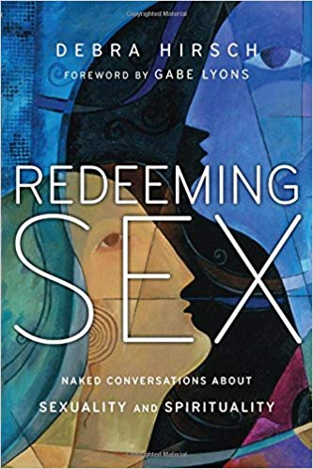
Accept messy people
“The chief role of the church is to create the right environment for all people to be able to encounter Jesus ; everything else that we do is relative to this great cause.”
Debra Hirsch
Notes:
In her fantastic book, Redeeming Sex, Debra Hirsch tells the story of Jasmine …
Jasmine is a transgender woman who “adopted” Debra and her husband, Alan, 25 years ago. She was born a boy but never really felt at home in her biological sex. From an early age she began dressing and identifying as female, culminating years later in her undergoing full sex-reassignment surgery. By all outward appearances Jasmine is now a woman.
Jasmine used to go with Debra every now and again when she would talk at churches and sometimes would share her story of what it was like being a transgender woman. One morning after a service around coffee, a straight up to her wanting to know why Jasmine had not gone back to being a man. Her question was understandable, but as we progressed I sensed it was also about her own discomfort with people like Jasmine. People like Jasmine are outside the box for most people, and we really don’t know what to do with them.
Debra writes, “Did God make a mistake with Jasmine’s biological sex? I don’t think so. I think there are many complex and painful reasons why she now lives as a woman, and for people to suggest that she needs to go back to being a man is simplistic, to say the least. What this lady didn’t know was that two previous churches had tried to insist on this, and on one occasion Jasmine tried to hang herself. To reembrace a masculine identity was for her simply too painful. In many ways Jasmine is further ahead than others in some areas of sanctification. For instance, she is one of the most self-giving servants I have ever met. It is never a problem for her to give up time to clean someone’s house as a gift. She is generous to a fault; she wouldn’t even think twice about giving all her money away to someone in need, and she doesn’t have much to begin with. She really is a remarkable servant. What the [lady who spoke to me] could not see or understand was that there are many areas in Jasmine’s life where there has been remarkable healing. She has forgiven people she didn’t think she could. She is living an independent life that she wasn’t able to before. She hasn’t been admitted to a psych hospital for many years. She doesn’t take drugs, nor does she abuse alcohol or sell her body anymore. All these things are indicators of significant growth. Why didn’t these matter in [that] lady’s assessment of Jasmine? Sometimes we have expectations of people that they just can’t fulfil. And yet God accepts them anyway. This doesn’t let any of us off the hook, for we are all called to press into God, but it does mean we have to be very sensitive to those in our midst that simply can’t “perform” in the ways we want or think they should. Nonetheless we are all headed toward Jesus—we simply hold each other accountable to stay on that journey.”
We are all on the journey. We are all broken, messy people. Let us be a church which such people are accepted and loved and helped along the way. [Quote]

