Slide 1
A Thief in the Night
1 Thessalonians 5:1-11

Slide 2

A Thief in the Night
¹ Now, brothers and sisters, about times and dates we do not need to write to you, ² for you know very well that the day of the Lord will come like a thief in the night.
  1 Thessalonians 5:1-2

Slide 3
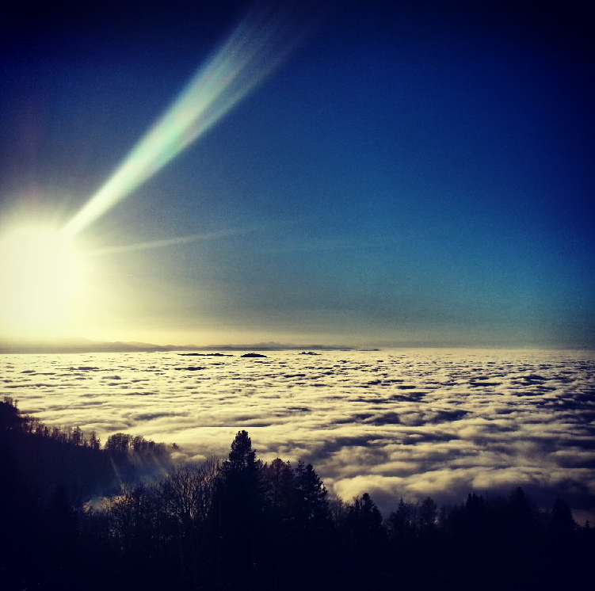
What is the Day of the Lord?
For the Lord himself will come down from heaven, with a loud command, with the voice of the archangel and with the trumpet call of God and the dead in Christ will rise first. ¹⁷ After that, we who are still alive and are left will be caught up together with them in the clouds to meet the Lord in the air.
  1Thessalonians 4:16-17

Slide 4

What is the Day of the Lord?
The Day of the Lord is the second coming of Jesus to earth
The Day of the Lord is a day of judgement
Matthew 25

Slide 5
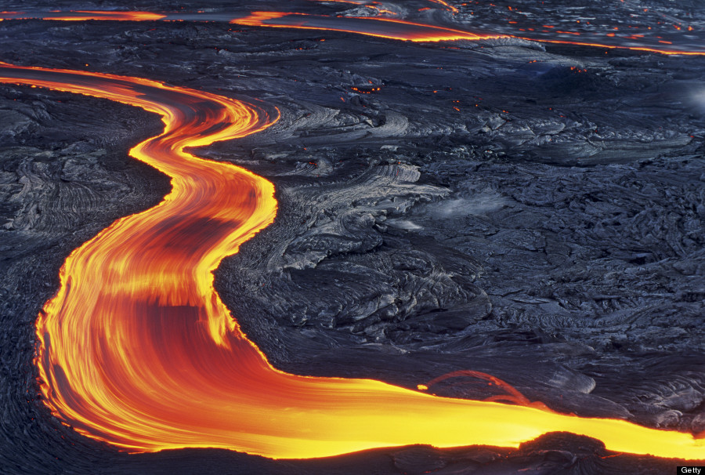
What is the Day of the Lord?
The Day of the Lord is the re-making of all things
That day that will bring about the destruction of the heavens by fire, and the elements will melt in the heat. ¹³ But in keeping with his promise we are looking forward to a new heaven and a new earth, where righteousness dwells.
  2 Peter 3:12b-13

Slide 6
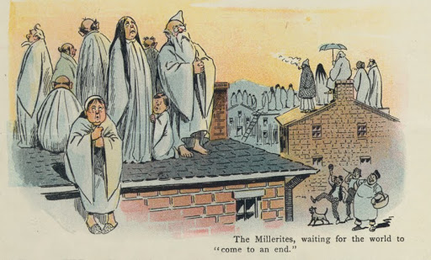
When is the Day of the Lord?
It is unexpected
William Miller(1782-1849)
"At the appointed time the end shall be"

Slide 7

When is the Day of the Lord?
It is sudden
³ While people are saying, ‘Peace and safety’, destruction will come on them suddenly, as labour pains on a pregnant woman, and they will not escape.

Slide 8
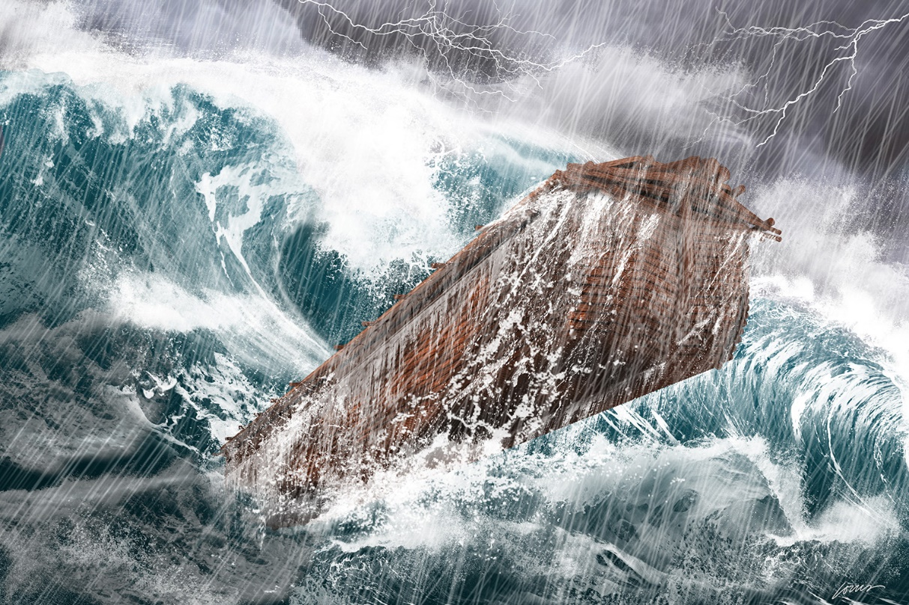
When is the Day of the Lord?
³⁷ As it was in the days of Noah, so it will be at the coming of the Son of Man. ³⁸ For in the days before the flood, people were eating and drinking, marrying and giving in marriage, up to the day Noah entered the ark; ³⁹ and they knew nothing about what would happen until the flood came and took them all away.
  Matthew 24:37-39

Slide 9

Is the Day of the Lord really coming?
³ Above all, you must understand that in the last days scoffers will come, scoffing and following their own evil desires. ⁴ They will say, ‘Where is this “coming” he promised?
  2 Peter 3:3-4a

Slide 10
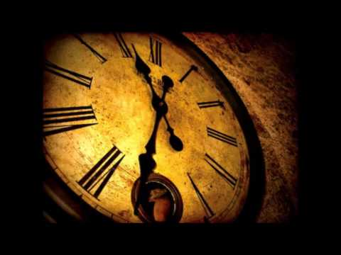
Is the Day of the Lord really coming?
⁸ But do not forget this one thing, dear friends: with the Lord a day is like a thousand years, and a thousand years are like a day.
⁹ The Lord is not slow in keeping his promise, as some understand slowness. Instead he is patient with you, not wanting anyone to perish, but everyone to come to repentance.
  2 Peter 3:8-9
We are in an age of grace

Slide 11
So what?
Children of Light
⁴ But you, brothers and sisters, are not in darkness so that this day should surprise you like a thief. ⁵ You are all children of the light and children of the day. We do not belong to the night or to the darkness.
  1 Thessalonians 5:4-5
¹¹ Since everything will be destroyed in this way, what kind of people ought you to be? You ought to live holy and godly lives ¹² as you look forward to the day of God and speed its coming.
  2 Peter 3:11-12a

Slide 12
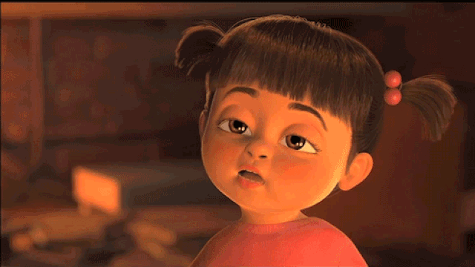
So what?
Stay awake!
⁶ So then, let us not be like others, who are asleep, but let us be awake and sober. ⁷ For those who sleep, sleep at night, and those who get drunk, get drunk at night. 8 But since we belong to the day, let us be sober, putting on faith and love as a breastplate, and the hope of salvation as a helmet.
  1 Thessalonians 5:6-8

Slide 13
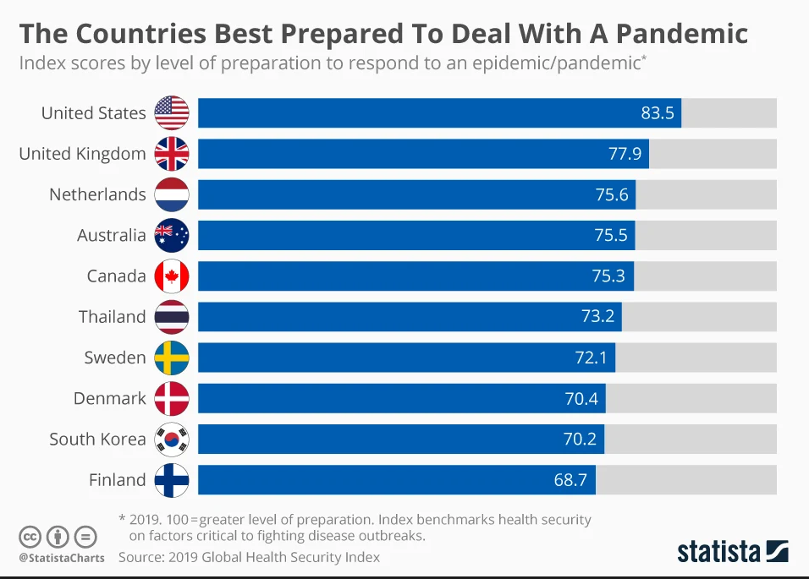
So what?

Slide 14

So what?
⁴² ‘Therefore keep watch, because you do not know on what day your Lord will come. ⁴³ But understand this: if the owner of the house had known at what time of night the thief was coming, he would have kept watch and would not have let his house be broken into. ⁴⁴ So you also must be ready, because the Son of Man will come at an hour when you do not expect him.
  Matthew 24:42-44

Slide 15
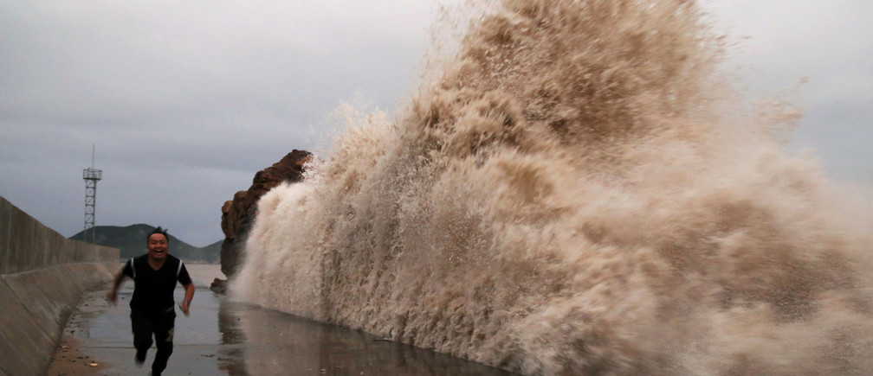
So what?
Matthew 24
  4 Deceivers will come, claiming to be the Messiah.
  5 - 8 Wars and natural disasters will come with destructive force
  9 Persecution will increase
  10 Many will turn away from the faith
  11 False prophets will appear
  12 The love of most will grow cold

Slide 16
Meanwhile …
¹³ but the one who stands firm to the end will be saved. ¹⁴ And this gospel of the kingdom will be preached in the whole world as a testimony to all nations, and then the end will come.
  Matthew 24:13-14
⁹ For God did not appoint us to suffer wrath but to receive salvation through our Lord Jesus Christ. ¹⁰ He died for us so that, whether we are awake or asleep, we may live together with him. ¹¹ Therefore encourage one another and build each other up, just as in fact you are doing.
  1 Thessalonians:5:9-11

Slide 17
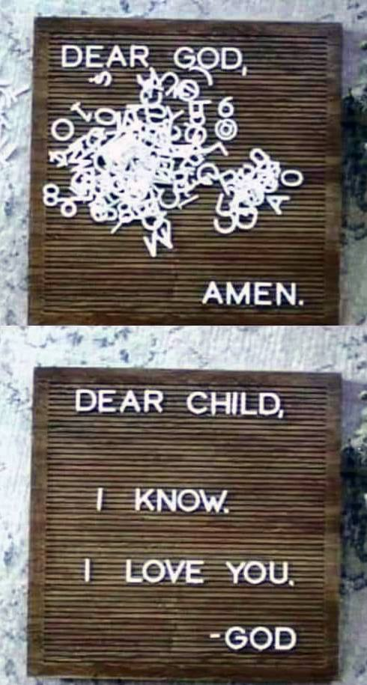

Slide 18
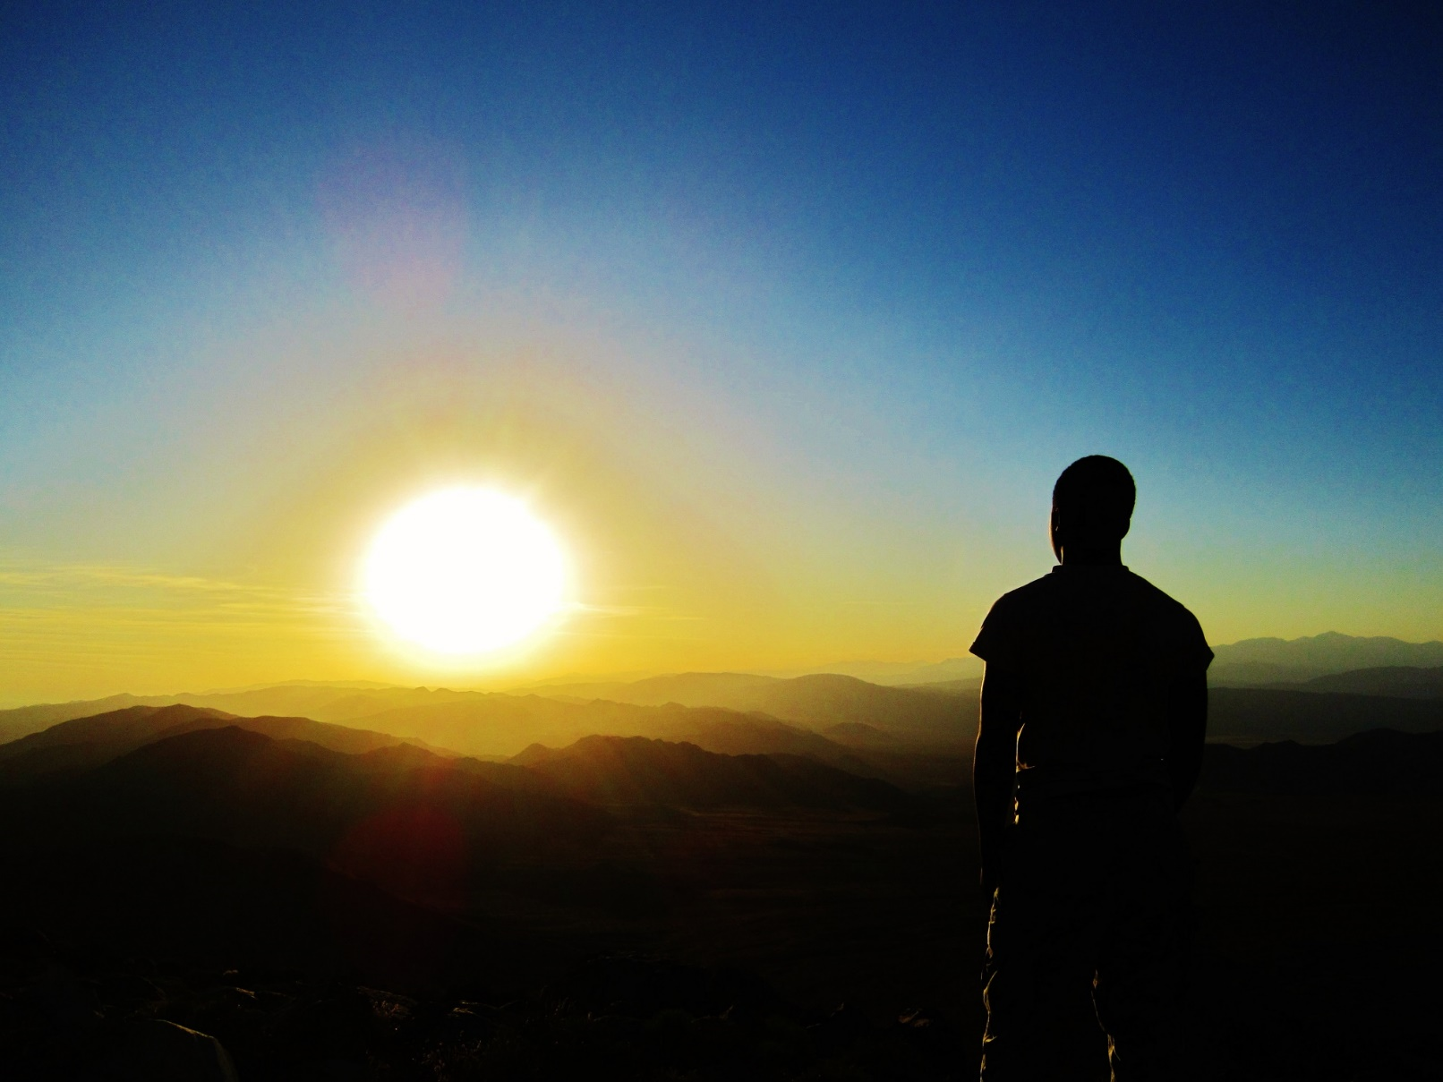
Meanwhile …

