Slide 1
“Who do you say I am?”
Matthew 16:13-28

Slide 2
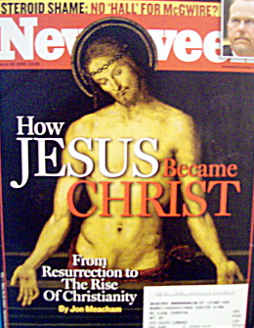
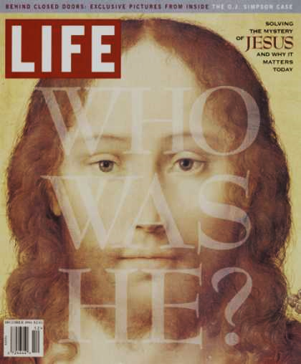
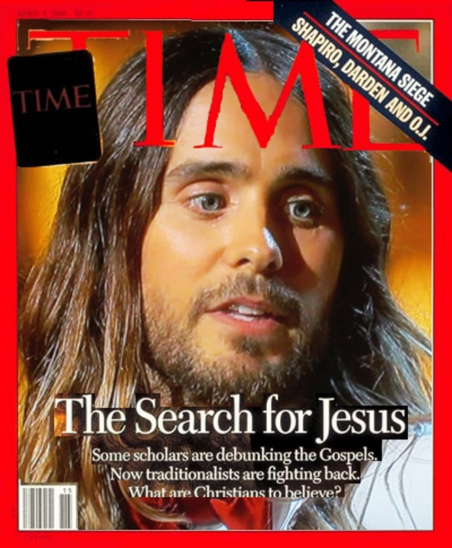
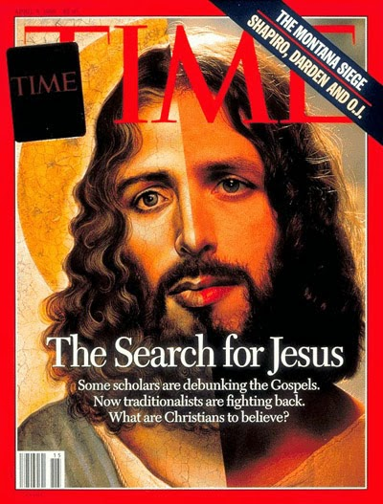
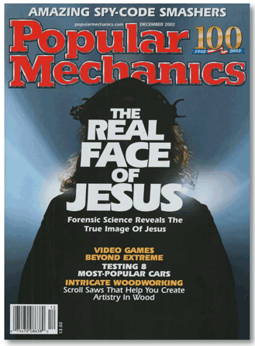
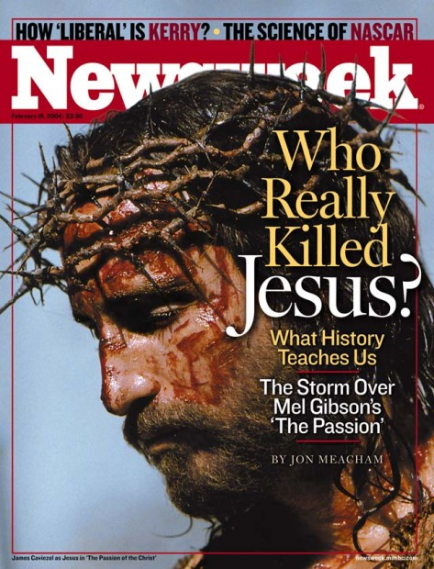

Slide 3
Two Questions:
“Who do people say I am?”
“Who do you say I am?”

Slide 4
Who … ?
There is much more to Jesus that a great title
Jesus’ question calls for a response – not just a statement of faith
Following Jesus is not just a one-time decision
Peter struggled to hear what Jesus was saying
“Facts” Video

Slide 5
Who … ?
There is much more to Jesus that a great title
Jesus’ question calls for a response – not just a statement of faith
Following Jesus is not just a one-time decision.
Peter struggled to hear what Jesus was saying
Why don’t facts convince people?

Slide 6
What areas of our hearts might God want to work on?
A greater compassion for lost people
A love for those that we don't really like that much
Extending Grace to someone who has hurt us
Letting go of resentment towards God when things seem to turn to custard
Living by standard of holiness even our Christian friends don't expect

Slide 7
What areas of our hearts might God want to work on?
Often I am tempted to fill my schedule with activity
At other times, God is calling me to complete a task
What might God be saying to you?
… to us as a church?

Slide 8
ACPC
“We seek first of all to be known as a community who worships Jesus Christ. Through the education and spiritual development of all our people, we seek to grow in him and to grow together in love and grace. As we know Jesus, we seek to make him known in our neighbourhood, beginning in Vincent St. We do this through hospitality, programmes in and with the community, through pastoral care, service to others and through sharing our faith.”
Worship - Grow - Serve

Slide 9
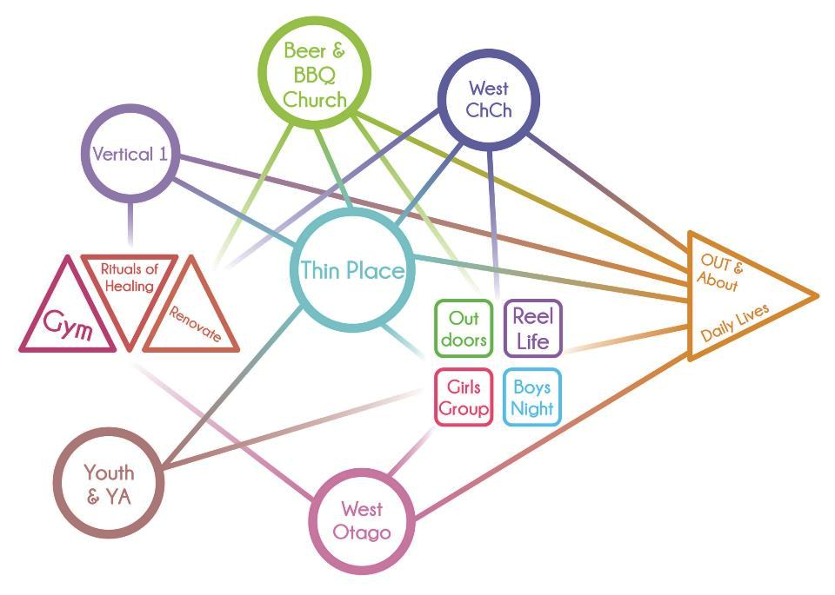
www.kiwichurch.org.nz

Slide 10
Take time to pray
Thursday 18 April 7:30 pm at Glenda’s place
Sunday 28 April downstairs 9:45 to 10:13 am

Slide 11
Follow me!
¹⁸ Very truly I tell you, when you were younger you dressed yourself and went where you wanted; but when you are old you will stretch out your hands, and someone else will dress you and lead you where you do not want to go.’ ¹⁹ Jesus said this to indicate the kind of death by which Peter would glorify God. Then he said to him, ‘Follow me!’
  John 21:18-19

