Slide 1
Get into Acts(ion)!
Acts 1:1-26
Reading: 1-14

Slide 2
Emma, Hannah and Ellie

Slide 3
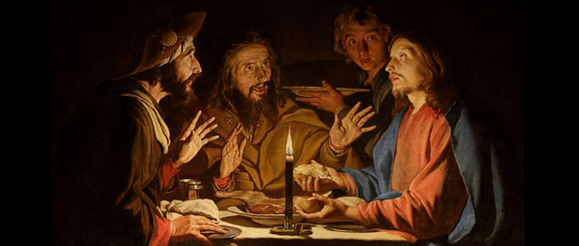
Emmaus evening

Slide 5
In my former book, Theophilus, I wrote about all that Jesus began to do and to teach ² until the day he was taken up to heaven, after giving instructions through the Holy Spirit to the apostles he had chosen.
Acts 1:1-2

Slide 6
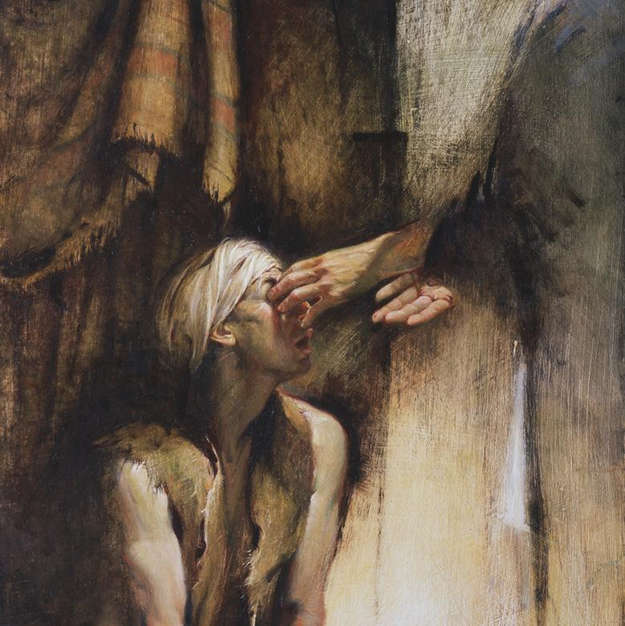
What?
In Acts 1:1-2, Luke refers to his former book (see the prologue in Luke 1:1-4)
John Stott described the Book of Acts as “The Continuing Words and Deeds of Jesus by his Spirit through his Apostles.”

Slide 7
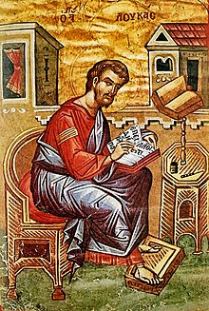
Who?
Luke
The earliest mention of Luke’s authorship of both his gospel and Acts is in the Muratorian Canon (ca. A.D. 170).
The Book itself mentions Luke as a companion of Paul

Slide 8
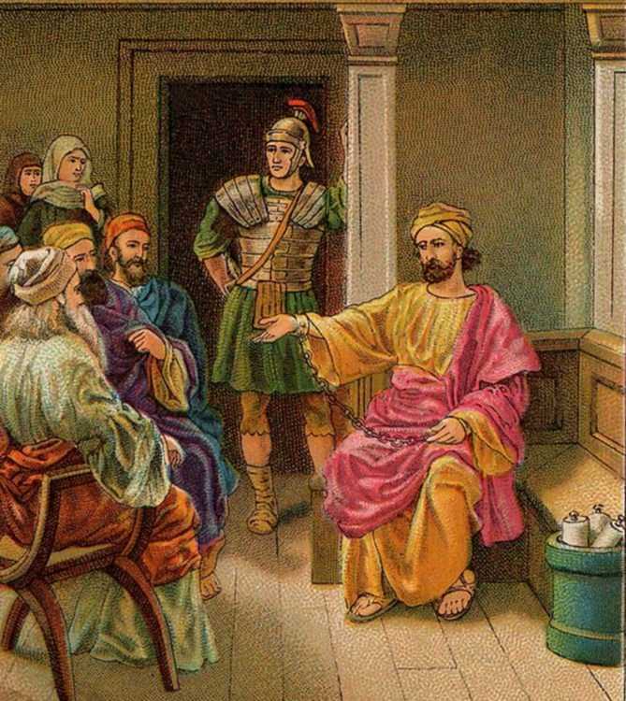
Who to?
Theophilus
Roman - Judge?
Most of the book is about …
… Paul!
²⁵ ‘I am not insane, most excellent Festus,’ Paul replied. ‘What I am saying is true and reasonable. ²⁶ The king is familiar with these things, and I can speak freely to him. I am convinced that none of this has escaped his notice, because it was not done in a corner.
Acts 26:25-26

Slide 9
When?
Early 60’s
Why?
³ …since I myself have carefully investigated everything from the beginning, I too decided to write an orderly account for you, most excellent Theophilus, ⁴ so that you may know the certainty of the things you have been taught.
Luke 1:3-4

Slide 10
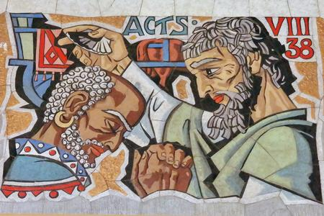
How?
Accurate historical detail
Literary excellence
Dramatic description
Objective account
Effective use of speeches

Slide 11
Disciples’ Blooper
⁴ On one occasion, while he was eating with them, he gave them this command: ‘Do not leave Jerusalem, but wait for the gift my Father promised, which you have heard me speak about. ⁵ For John baptised with / in water, but in a few days you will be baptised with / in the Holy Spirit.’
⁶ Then they gathered round him and asked him, ‘Lord, are you at this time going to restore the kingdom to Israel?’
⁷ He said to them: ‘It is not for you to know the times or dates the Father has set by his own authority.

Slide 12
Jesus’ Blueprint
⁸ But you will receive power when the Holy Spirit comes on you; and you will be my witnesses in Jerusalem, and in all Judea and Samaria, and to the ends of the earth.’
⁹ After he said this, he was taken up before their very eyes, and a cloud hid him from their sight.

Slide 13
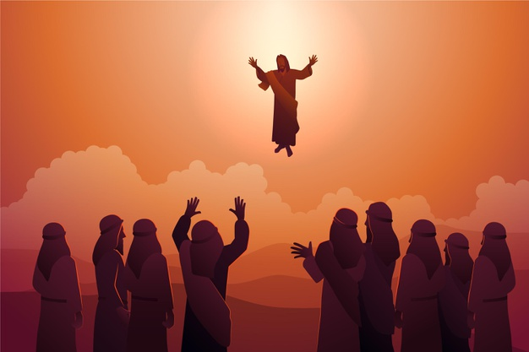
Significance of the Ascension?
A hint of Jesus’ glory
Jesus obviously won’t die again
Jesus had to leave in order for the Holy Spirit to come
A model for the second-coming

Slide 14
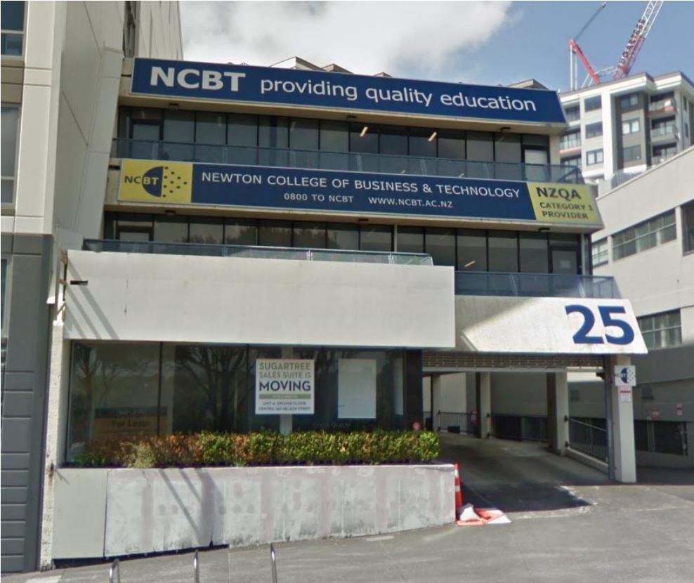
Get into Acts(ion)!
ACPC ‘21: Moving Out – Growing Up
Get ready for this amazing adventure in the book of Acts. Read it, reflect on it, discuss it and allow God’s Spirit to help you get into Acts ….. ion!

