Slide 1
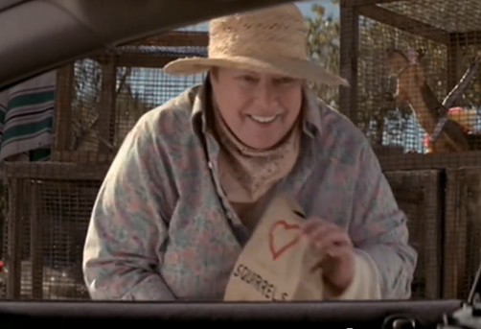
Warning – danger ahead!
1 Corinthians 10:1-13
Notes:
1 Corinthians 10 Danger Ahead!
[You should have brought a squirrel! Scene from “Rat Race”]

Slide 2

“If you think you are standing firm, be careful that you don’t fall!” (v. 12)
Notes:
Paul is sticking up a big “danger” sign in this chapter.
Verse 12: if you think you are standing firm, be careful that you don’t fall!
The Corinthians were confident - they did not lack any spiritual gift but the danger if spiritual gifts is we can focus on the gifts and not the giver. We can start to think it’s our skill, our fantastic programs that bring success, rather than the power of God.
Sometimes we are in the most danger when we think everything is going well - like Whoopi Goldberg and Lanei Chapman in the movie clip. But there’s a car crash around the corner.
Be on your guard, Paul says. Don’t be complacent!

Slide 3
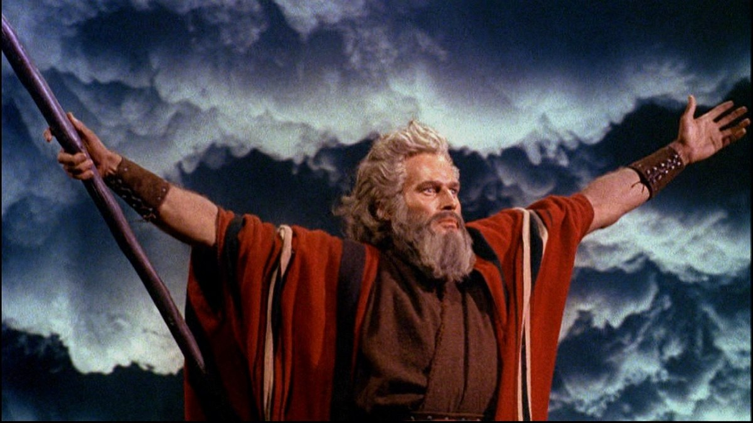
A History Lesson: Moses and the people
¹ For I do not want you to be ignorant of the fact, brothers and sisters, that our ancestors were all under the cloud and that they all passed through the sea. ² They were all baptised into Moses in the cloud and in the sea. ³ They all ate the same spiritual food ⁴ and drank the same spiritual drink; for they drank from the spiritual rock that accompanied them, and that rock was Christ.
Notes:
Most of us have heard these stories for years. The parting of the red sea with Charlton Heston (I mean Moses) brandishing his staff as the waters roar and the sea divides. Manna in the wilderness - water from the rock. Paul claims that these are not just nice Sunday School stories. They have a point. I mean, who knew? :-)
They speak of God’s intervention on behalf of his people - those with whom he made a covenant, beginning with Abraham that they would be a great nation and God’s blessing to them would eventually extend to the whole world. But they’ve been in Egypt a long time. They’ve been surrounded by serpent gods and lion gods and bull gods. They need to be reacquainted afresh with the one true God and it aint gonna be easy!

Slide 4
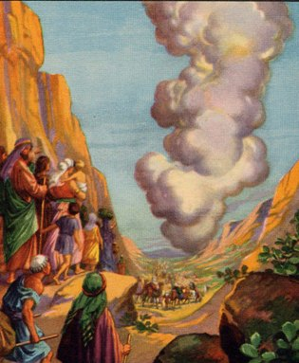
A History Lesson: Moses and the people
‘They were all under the cloud’
  GUIDANCE
They all passed through the sea’
  RESCUE
‘Spiritual’ provision?
  John 6:35: ‘I am the Bread of Life’
  “God has given us eternal life and this life is in his son. Whoever has the Son has life. Whoever does not have the Son of God does not have the life.” 1 John 5:11-12
Notes:
So let’s look at these one by one.
They were all under the cloud. Now, today when someone says, they’re under a bit of a cloud, they mean, “they’re suspect”, their reputation is doubtful. That is not what is meant here. The Israelites were “under the cloud” because god led them by cloud during the day and fire by night. What is view here is GUIDANCE.
I’m mentioned the sea already. What does the sea tell us? God RESCUES his people even when it seems impossible. “Who then can be saved” after Jesus apparently squashed the hopes of rich people entering heaven. “Aha! With human beings, not possible. With God - that’s another story!”
Spiritual food, spiritual food, spiritual rock. Why does a serviceable if uninspiring meal of manna and water (with occasional quail thrown in) get so “spiritual” all of a sudden? Paul takes his cue from Jesus in John 6. “I am the bread of life.” In John 6 Jesus is not so much making a point about the Lord’s Supper as saying, that only through faith in him, only by depending on him alone, can we have eternal life.
So, the Israelites were saved / baptised into Moses. We are saved / baptised into Jesus Christ.

Slide 5
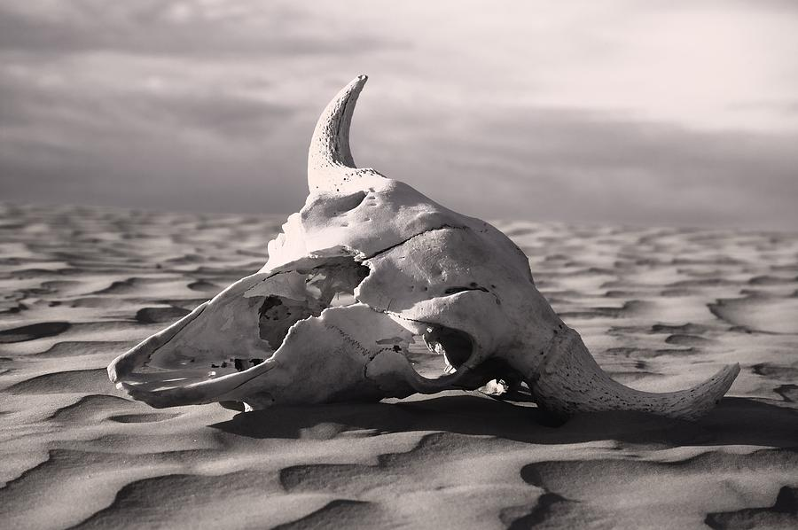
A History Lesson: Moses and the people
⁵ Nevertheless, God was not pleased with most of them; their bodies were scattered in the wilderness.
Notes:
Nevertheless - such a sad word.

Slide 6
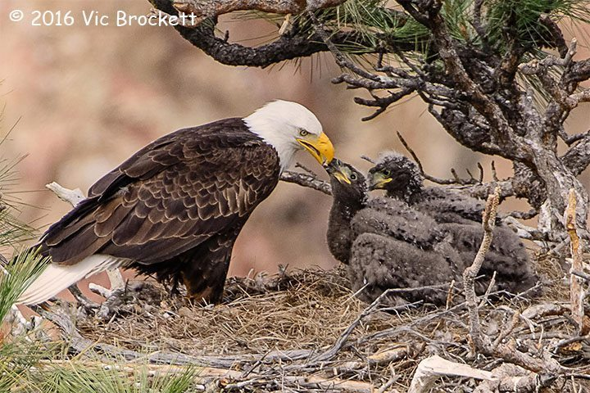
A History Lesson: Moses and the people
¹⁰ In a desert land he found him [his people],
in a barren and howling waste.
He shielded him and cared for him;
he guarded him as the apple of his eye,
¹¹ like an eagle that stirs up its nest
and hovers over its young,
that spreads its wings to catch them
and carries them on its pinions.
  Deuteronomy 32:10-11
Notes:
Moses describes the tenderness of God in Deuteronomy 32. [passage]
God loved them - he provided for them and protected them. That picture of an eagle with its young is a powerful one, isn’t it!
Nevertheless, most of them never reached the promised land. They died in the desert.
How tragic.

Slide 7
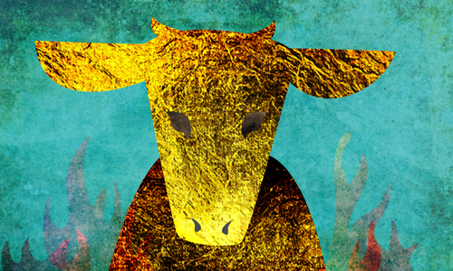
Warning!
Idolatry
Sexual immorality
Testing Christ
Grumbling
Notes:
Paul then goes on to list some of their sins and warns that those very sins can be present today. -4 points]
Let’s focus on the third one, testing Christ. (When I wrote this I misspelt it “texting Christ” but I’m sure this is far more dangerous!)
Let’s go back to the scene:

Slide 8
Testing Christ
¹ The whole Israelite community set out from the Desert of Sin, travelling from place to place as the Lord commanded. They camped at Rephidim, but there was no water for the people to drink. ² So they quarrelled with Moses and said, ‘Give us water to drink.’
Moses replied, ‘Why do you quarrel with me? Why do you put the Lord to the test?’
³ But the people were thirsty for water there, and they grumbled against Moses. They said, ‘Why did you bring us up out of Egypt to make us and our children and livestock die of thirst?’
⁴ Then Moses cried out to the Lord, ‘What am I to do with these people? They are almost ready to stone me.’

Slide 9
Testing Christ
⁵ The Lord answered Moses, ‘Go out in front of the people. Take with you some of the elders of Israel and take in your hand the staff with which you struck the Nile, and go. ⁶ I will stand there before you by the rock at Horeb. Strike the rock, and water will come out of it for the people to drink.’ So Moses did this in the sight of the elders of Israel. ⁷ And he called the place Massah [testing] and Meribah [quarrelling] because the Israelites quarrelled and because they tested the Lord saying, ‘Is the Lord among us or not?’
  Exodus 17:1-7
Notes:
Some context: the Lord has just parted the Red Sea and the all the people have come through on dry land. They have been supplied with manna and quail to eat. So what do they do when they are thirsty? Say, [“Lord, “We know that care for us and that you can do anything. We’re really thirsty. Will you help us?”]? No, they doubt, they fuss, they blame. It seems like they have learned nothing from the previous miracles. But God is gracious to them.
Nevertheless, that attitude continued among that generation, culminating in God’s judgement: they would all die in the desert (except Joshua and Caleb, who trusted the Lord.)

Slide 10
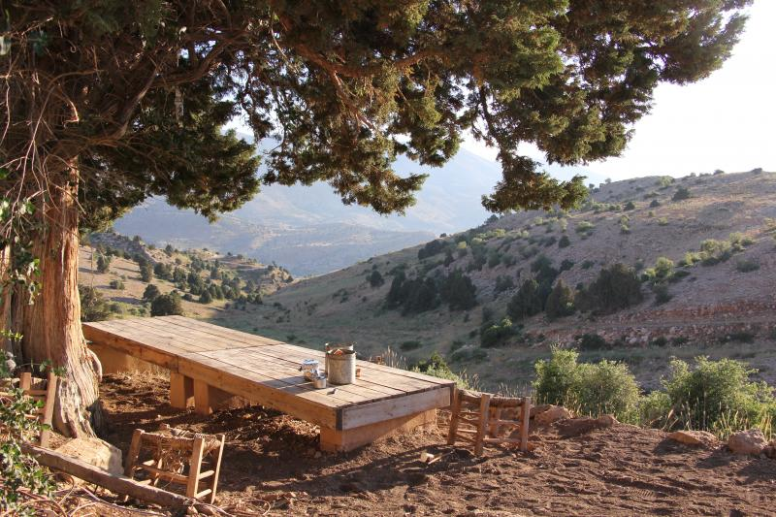
Testing Christ
¹⁶ Do not put the Lord your God to the test as you did at Massah.
  Deut. 6:16
¹⁸ They wilfully put God to the test
by demanding the food they craved.
¹⁹ They spoke against God;
they said, ‘Can God really
spread a table in the wilderness?
  Psalm 78:18-19
Notes:
Can God really …?
They didn’t really believe that he could - or would. They doubted his power and his motives. What did he need to do to convince them?
In the end, he couldn’t. It’s the one thing God can’t do: force someone to believe in Him.
So he worked with their kids instead.

Slide 11
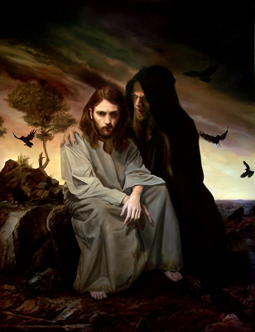
Testing Christ
“Do not put the Lord your God to the test.”
“We must never try to get Christ to serve us instead of us serving him.”
Notes:
Another way of describing testing the Lord is presumption. When Jesus was tempted by the devil, the devil says to him, “Throw yourself down from here and let the angels catch you” (quoting a verse out of context.) Jesus’ answer? “Do not put the Lord your God to the test.” The sin of presumption is trying to to control God or trick him or use him or tame him!
The Message paraphrase captures the essence of testing Christ really well:
“We must never try to get Christ to serve us instead of us serving him.”
He’s not at our beck and call - “Garcon - bring more wine!” He is God. He is Lord. Our God is in heaven. He does what he pleases. Let all the earth be silent.

Slide 12
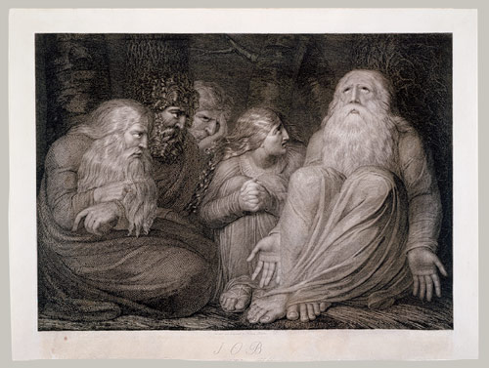
Example: Job
Job lost everything
Job knew that God was good so he didn’t understand what was happening to him
“I know that my Redeemer lives!”
God reveals himself to Job in a new way
Notes:
So should we just do nothing and wait for God to do what God will do?
Consider the example of Job. He was really ticked off at God. He lost everything - his houses, his children, his crops, his cattle. All he had left was his wife and let’s face, it, she wasn’t much help! All this happened … for no particular reason that he could see.
Now, he knew that God wouldn’t punish him for what he didn’t deserve. He knew that God was not some capricious deity - playing dice with the universe! He knew that God was good. That’s why he couldn’t understand what was happening to him.
“I know that my redeemer lives!” He affirmed. Job’s faith in God was so strong that could present his case and demand an answer.
Well, did God give him an answer? Not really! God is not answerable to anybody! But of course what he does is he reveals himself to Job in a powerful new way.
So it’s OK to doubt God. It’s OK to complain to God. To get passionate. To get angry even! But don’t demand answers. God wants to give you much more than that. He wants to give you Himself.
Some people have an A+B=C kind of faith.
If I pray or tithe or follow these biblical principles, God will heal me, give me financial success, supercharge my ministry - whatever. But God is not an equation kind of God. He’s about relationship far more than prosperity.

Slide 13
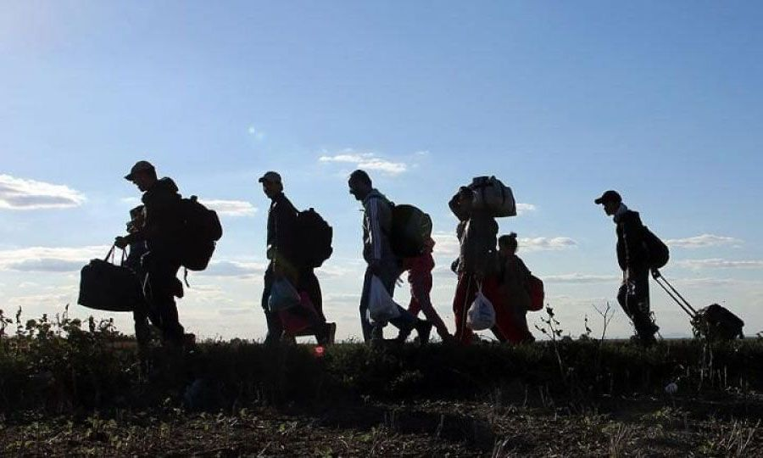
Treasures
One by one He took them from me,
All the things I valued most,
Until I was empty-handed;
Every glittering toy was lost.
And I walked earth's highways, grieving.
In my rags and poverty.
Till I heard His voice inviting,
"Lift your empty hands to Me!"
Notes:
Actually, if we’re talking about tests, it’s actually God who test us, not the other way around! Because he is passionately committed to our spiritual maturity, and that often doesn’t happen when we get everything we want.

Slide 14
So I held my hands toward heaven,
And He filled them with a store
Of His own transcendent riches,
Till they could contain no more.
And at last I comprehended
With my stupid mind and dull,
That God COULD not pour His riches
Into hands already full!
  Martha Snell Nicholson
Notes:
So true!
[Share our house loss and the lessons God is teaching me and I’m slowly learning]

Slide 15
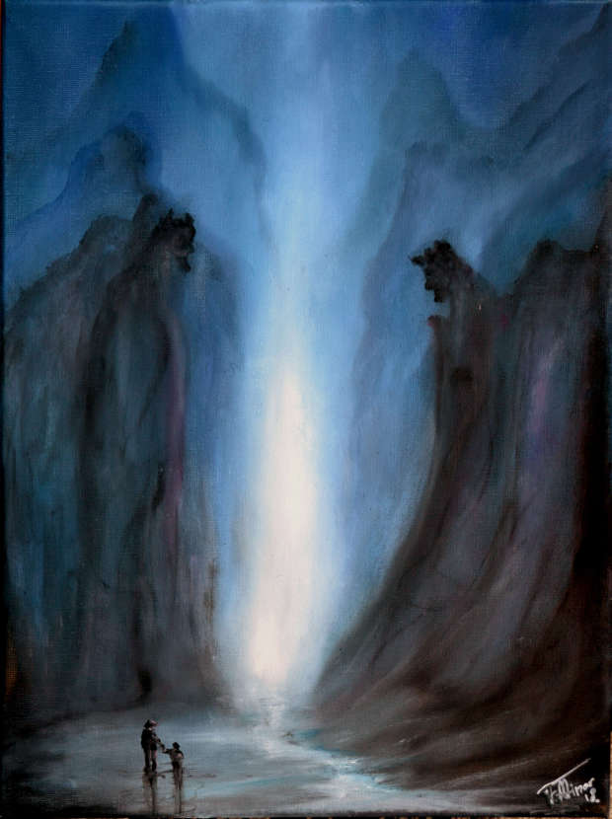
A Way Out
¹³ No temptation has overtaken you except what is common to mankind. And God is faithful; he will not let you be tempted beyond what you can bear. But when you are tempted, he will also provide a way out so that you can endure it.
Even though I walk
through the darkest valley,
I will fear no evil,
for you are with me;
your rod and your staff,
they comfort me. (Psalm 23:4)
Notes:
[Share how I got “Survival Kit for New Christians”]
Verse 13 was one of my first memory verses: [v.13]
We usually take these verses to mean that when we are tempted to sin, God will help us overcome it. This is true. I like the analogy of an off ramp. If we ignore the danger signs and get on the motorway at Greenlane, heading north on the Highway to Hell, God will quickly provide an offramp to Market Rd so that we won’t be swept away in the traffic of sinfulness. Hence the word “Excape” which, by the way, also means “Exodus.” Hmm …
But look at your footnotes. What else can the word translated as temptation mean? Testing. When we are tested in our faith, we have someone who will not allow the testing to completely overwhelm us. He may not spare us from the testing. But he will help us through it.
[Psalm 23]

Slide 16
So …
Read the Bible to learn the lessons of the past
Beware of testing Christ
Seek his face – ask for his help
“You’re blessed when you feel you’ve lost what is most dear to you. [Because] Only then can you be embraced by the One most dear to you.
  Matthew 5:4 (The Message)
Notes:
So …
The Bible is really relevant - read and it and learn the principles from the past - they are more timely than the 6 o’clock news and more true than a million tweets!
Beware of testing Christ – using him as a personal “genie” rather than submitting to this will
God is totally on your side - he wants to see you grow and flourish. He loves you! Trust him! Seek his face. Ask for his help. And remember that
4 “You’re blessed when you feel you’ve lost what is most dear to you. [Because] Only then can you be embraced by the One most dear to you. Matthew 5:4 (The Message)

