Slide 1
Abide and Abound
Philippians Intro and 1:1-11

Slide 2
“The challenge then has been for Beijing to stop even more debt from turning this boom into a bust without stopping the boom in the first place. In other words, to navigate the economy between the Scylla of a bubble and the Charybdis of a severe slowdown.”

Slide 3
"Abound" and "Abide"

Slide 4
ACPC vision for 2016-2018
“We seek first of all to be known as a community who worships Jesus Christ. Through the education and spiritual development of all our people, we seek to grow in him and to grow together in love and grace. As we know Jesus, we seek to make him known in our neighbourhood, beginning in Vincent St. We do this through hospitality, programmes in and with the community, through pastoral care, service to others and through sharing our faith.”

Slide 5
Introduction to Philippians
Acts 16:25-34, 40

Slide 6
Paul's place of writing
¹² Now I want you to know, brothers and sisters,that what has happened to me has actually served to advance the gospel. ¹³ As a result, it has become clear throughout the whole palace guard and to everyone else that I am in chains for Christ.
1:12-13

Slide 7
Theme of the letter
Joy?
Unity?
Finish what you started!

Slide 8
Theme of the letter
... he who began a good work in you will carry it on to completion until the day of Christ Jesus. (1:6)
… continue to work out your salvation with fear and trembling (2:12)
Not that I have already obtained all this, or have already arrived at my goal, but I press on to take hold of that for which Christ Jesus took hold of me. (3:12)
... stand firm in the Lord in this way, dear friends! (4:1)

Slide 9
Chapter 1:1-11
Paul’s prayer
⁹ And this is my prayer: that your love may abound more and more in knowledge and depth of insight, ¹⁰ so that you may be able to discern what is best and may be pure and blameless for the day of Christ, ¹¹ filled with the fruit of righteousness that comes through Jesus Christ – to the glory and praise of God.
Love
God showed his love for us in this: while we were still sinners, Christ died for us.
Romans 5:8

Slide 10
Maturity

Slide 11
Corresponding good traits
Purity
Self control
Contentment
Industriousness
Kindness
Generosity
Humility

Slide 12
Maturity

Slide 13
So how do we abide and abound?
Mark 1
“The more we receive in our silent prayer, the more we can give in our active life.”
Mother Teresa
The Day of Christ

Slide 14
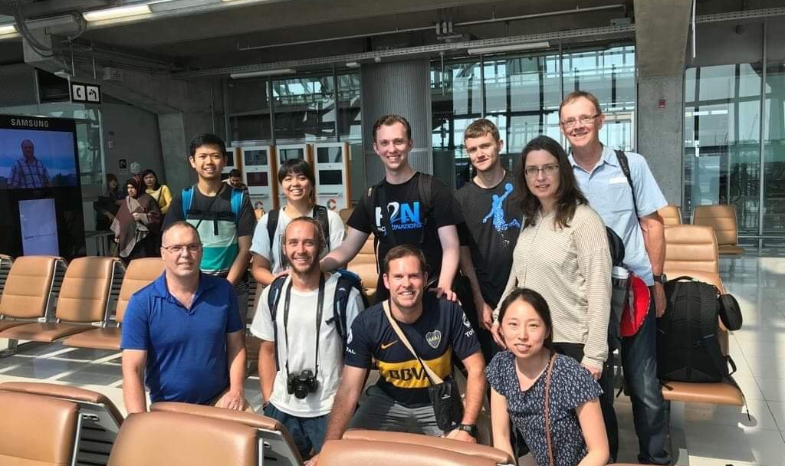
Jordan team

