Slide 1
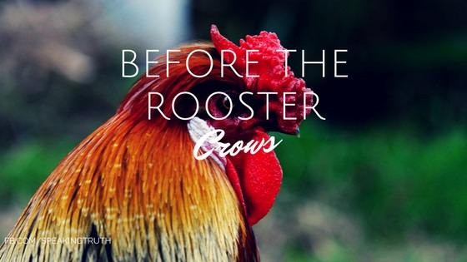
That Infamous Rooster
Mark 14:27-31, 66-72

Slide 2


Slide 3
Jesus predicts Peter’s denial
²⁷ ‘You will all fall away,’ Jesus told them, ‘for it is written:
‘“I will strike the shepherd,
and the sheep will be scattered.”
²⁸ But after I have risen, I will go ahead of you into Galilee.’
²⁹ Peter declared, ‘Even if all fall away, I will not.’
³⁰ ‘Truly I tell you,’ Jesus answered, ‘today – yes, tonight – before the cock crows twice you yourself will disown me three times.’
³¹ But Peter insisted emphatically, ‘Even if I have to die with you, I will never disown you.’ And all the others said the same.

Slide 4
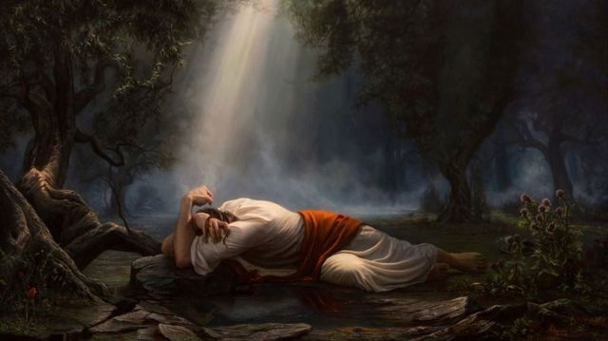
Gethsemane
³⁴ ‘My soul is overwhelmed with sorrow to the point of death …’
Judas led a “large crowd” of people to arrest him

Slide 5
Peter’s Denial
⁶⁶ While Peter was below in the courtyard, one of the servant-girls of the high priest came by. ⁶⁷ When she saw Peter warming himself, she looked closely at him.
‘You also were with that Nazarene, Jesus,’ she said.
⁶⁸ But he denied it. ‘I don’t know or understand what you’re talking about,’ he said, and went out into the entrance.
⁶⁹ When the servant-girl saw him there, she said again to those standing round them, ‘This fellow is one of them.’ ⁷⁰ Again he denied it.

Slide 6
Peter’s Denial
After a little while, those standing near said to Peter, ‘Surely you are one of them, for you are a Galilean.’
⁷¹ He began to call down curses, and he swore to them, ‘I don’t know this man you’re talking about.’
⁷² Immediately the cock crowed the second time. Then Peter remembered the word Jesus had spoken to him: ‘Before the cock crows twice you will disown me three times.’ And he broke down and wept.

Slide 7
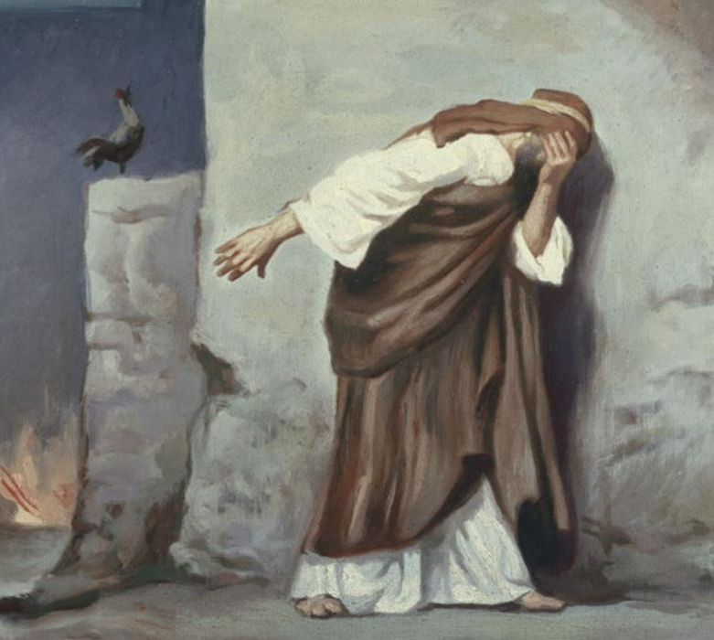
Peter’s Denial
⁶⁹ …‘This fellow is one of them.’ ⁷⁰ Again he denied it.
⁷¹ He began to call down curses, and he swore to them, ‘I don’t know this man you’re talking about.’
He didn’t need to put himself in such a dangerous position!
So Peter felt the threat was real. He responded out of fear and he failed – big time.

Slide 8
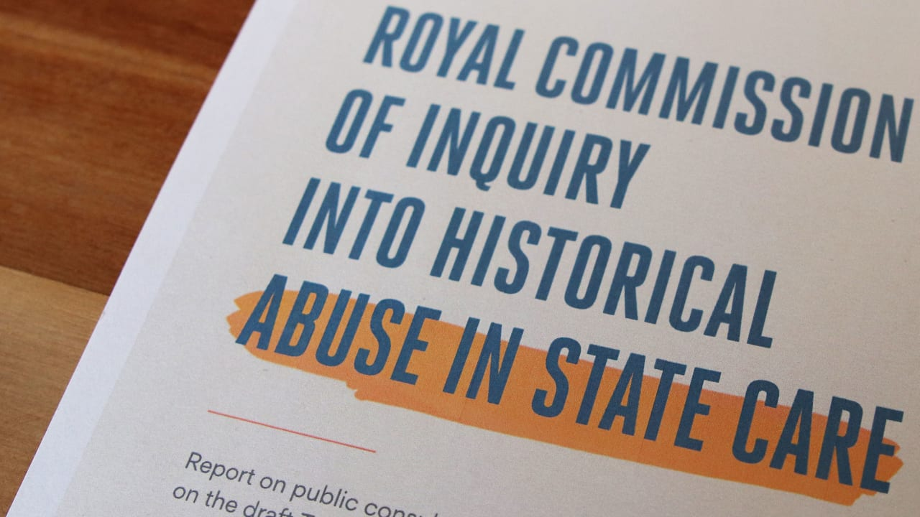
1. Have a realistic assessment of your ability to withstand temptation
We too, need to have an accurate assessment of ourselves
²⁴ The sins of some are obvious, reaching the place of judgment ahead of them; the sins of others trail behind them.
  1 Timothy 5:24
Where are you vulnerable?

Slide 9
1. Have a realistic assessment of your ability to withstand temptation
We are all prone to sin
“The line separating good and evil passes not through states, nor between classes, nor between political parties either – but right through every human heart…”
  Aleksandr Solzhenitsyn
“…do not think of yourself more highly than you ought, but rather think of yourself with sober judgment, in accordance with the faith God has distributed to each of you.”
  Romans 12:3

Slide 10
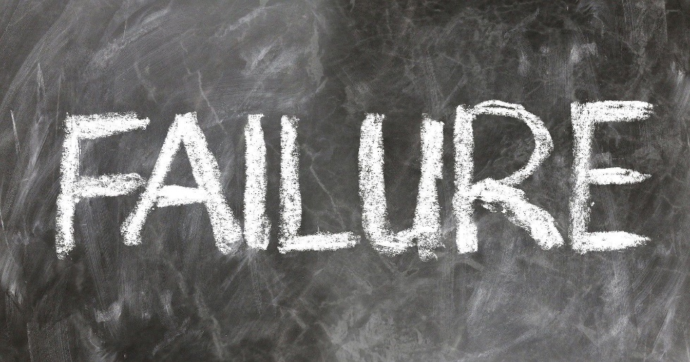
2. When you know you’ve blown it, that’s the beginning of the way back
Peter the rock had hit rock bottom.
Jesus knew that Peter would fail but he also knew that that wouldn’t be the end of the story:
I have prayed for you, Simon, that your faith may not fail. And when you have turned back, strengthen your brothers.’
  Luke 22:32
But Jesus still let Peter fail.

Slide 11
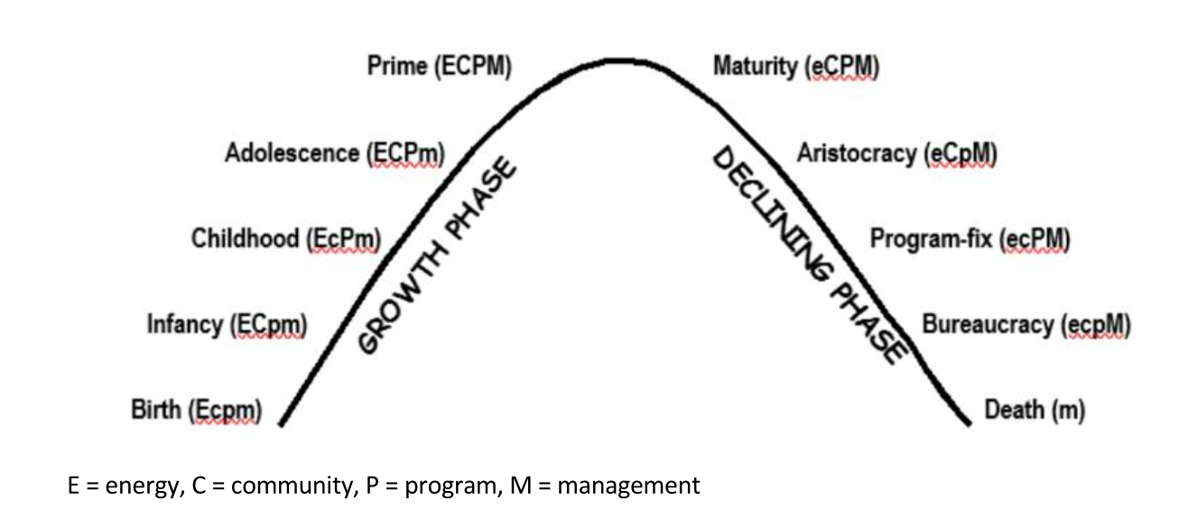
Organisational Life Cycle
Where are we at as a church?

Slide 12
Total Losers!
“Jesus handpicked a group of total losers to be his disciples, and for three years they did nothing but whine, bicker, and squabble, striving pathetically (and futilely) to become winners. Then Jesus died and rose again. That single event made the difference. After that, the disciples finally understood that the whole human story isn’t about us; it’s about Christ. Once they grasped this, they spread the news with such passion that they were willing to give their lives for him, and for those he came to save. And their witness continues today, two millennia after their deaths. Such is the transforming power of accepting our loserness and acknowledging God as the true winner, the star of the story, the Lord of all.”
  Losers Like Us: Redefining Discipleship after Epic Failure

Slide 13

3. There is always grace
“I never saw those heights and depths in grace, and love, and mercy, as I saw after this temptation: great sins draw out great grace; and where guilt is most terrible and fierce, there the mercy of God in Christ, when showed to the soul, appears most high and mighty.”
  John Bunyan, Pilgrim’s Progress
That is not the end of Peter’s story.

Slide 14
3. There is always grace
What does the rooster say?
  Even when you think there’s so way back – when you’ve blown it on an industrial scale, there is always grace.
Grace is not a silver bullet that makes your life perfect. It is the assurance of God’s acceptance of you as his beloved child no matter what you do.

