Slide 1
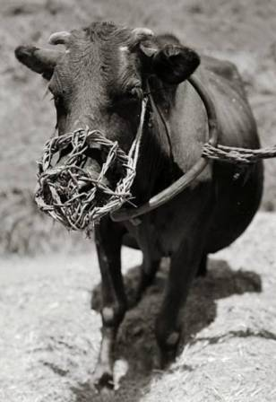
“Don’t Muzzle the Ox”
Funding the Great Commission
1 Corinthians 9:3-14

Slide 2
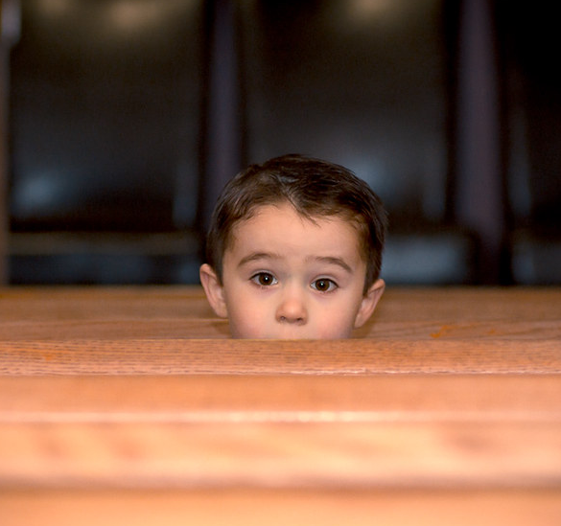
You are a minister!
¹¹ So Christ himself gave the apostles, the prophets, the evangelists, the pastors and teachers, ¹² to equip his people for works of service [ministry], so that the body of Christ may be built up
  Eph 4:11-12
What is the role of the apostles, prophets, evangelists, pastors and teachers?
What is the role of God’s people?

Slide 3
You are a priest!
To him who loves us and has freed us from our sins by his blood, ⁶ and has made us to be a kingdom and priests to serve his God and Father – to him be glory and power for ever and ever! Amen.
  Rev 1:5b-6
But you are a chosen people, a royal priesthood, a holy nation, God’s special possession, that you may declare the praises of him who called you out of darkness into his wonderful light.
  1 Peter 2:9
What is our job as priests?

Slide 4
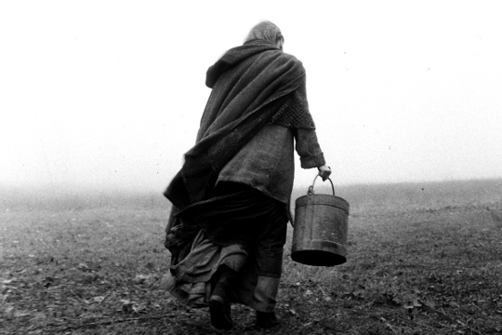
Unfortunately …
We have devalued “secular work” – why?
We don’t have a great view of work in general
  The Cultural Mandate: God blessed them and said to them, Be fruitful and increase in number; fill the earth and subdue it. Rule over the fish in the sea and the birds in the sky and over every living creature that moves on the ground. Genesis 1:28
  The Hard Slog: ‘Cursed is the ground because of you; through painful toil you will eat food from it all the days of your life.’ Genesis 3:17
Notes:
Why?
Sacred / Secular dichotomy
Prayer, bible study and evangelism are where it’s at and everything else is second rate
The Cultural Mandate: We are called to partner with God in his work of looking after the world. We are co-creators.
Work that is creative and constructive is intrinsically human.
The Hard Slog: Work, like everything else, has been affected by the Fall.

Slide 5

So, all work is valuable to God
²² Slaves [today = employees], obey your earthly masters in everything; and do it, not only when their eye is on you and to curry their favour, but with sincerity of heart and reverence for the Lord. ²³ Whatever you do, work at it with all your heart, as working for the Lord, not for human masters, ²⁴ since you know that you will receive an inheritance from the Lord as a reward. It is the Lord Christ you are serving.
  Colossians 3:22-24
Notes:
That sums it up beautifully, doesn’t it?

Slide 6
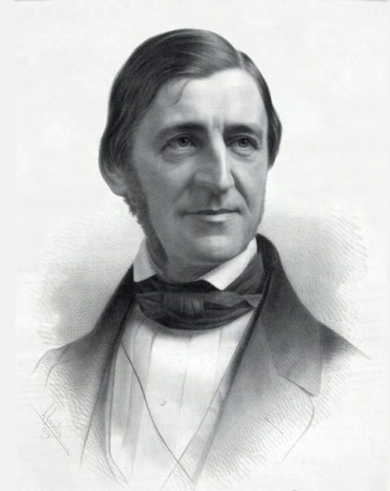
So, all work is valuable to God
“And we are now men … not minors and invalids in a protected corner, not cowards fleeing before a revolution, but guides, redeemers, and benefactors, obeying the Almighty effort, and advancing on Chaos and the Dark.”
  Ralph Waldo Emerson

Slide 7
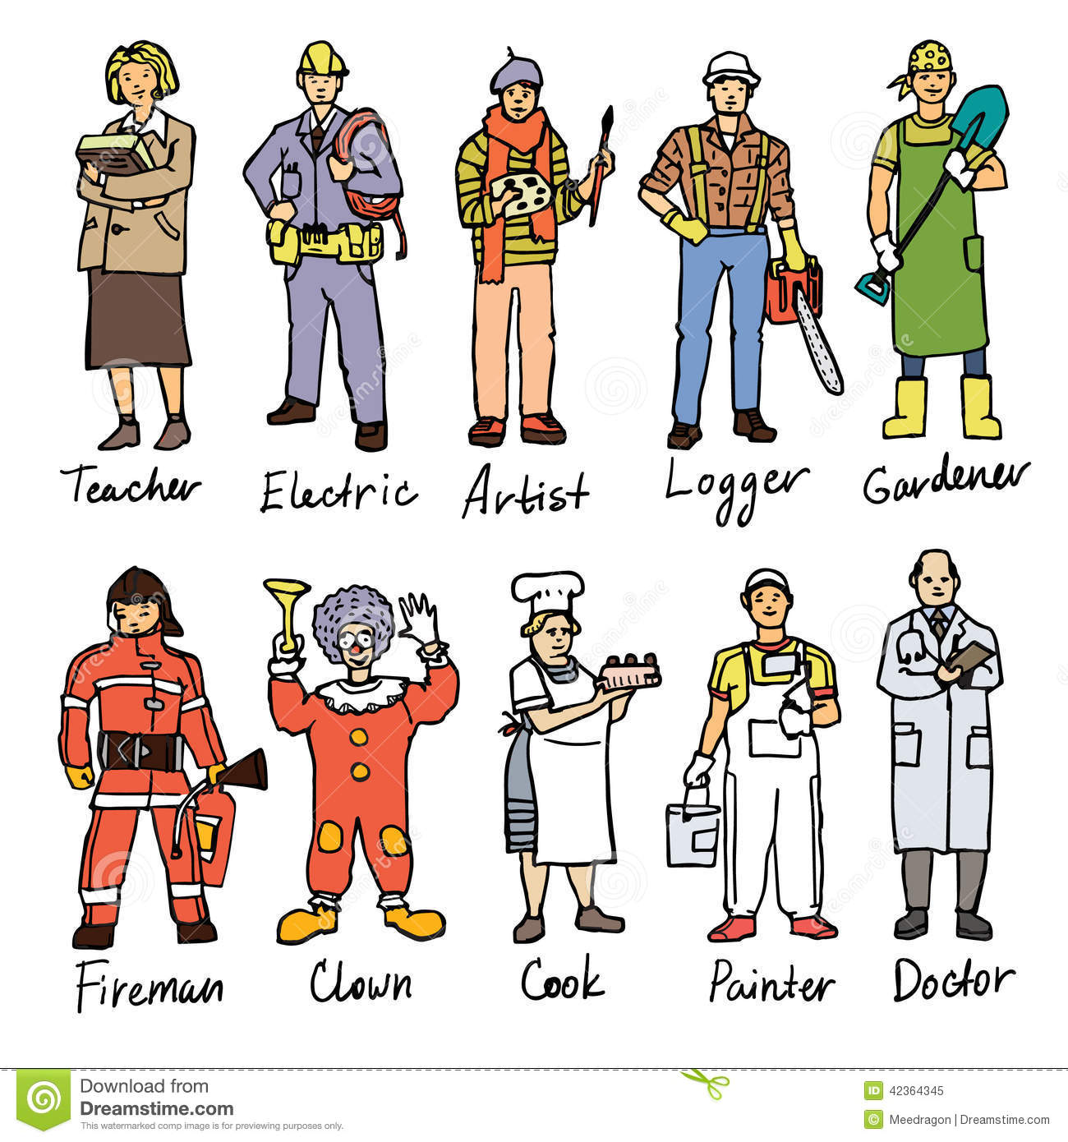
Whether you are a …
Your work matters to God

Slide 8
Identifying Your Passion
If you could snap your fingers and know that you couldn't fail, what would you do that would be most fulfilling personally and be of help to others?
What do you repeatedly see that annoys or angers you, which if changed, would benefit others?
l care about some things more than others. l care most about …
At the end of my life, I'd love to be able to look back and know that I have done something about …

Slide 9

Identifying Your Passion
List your top 3 to 5 most meaningful and positive experiences. Briefly describe what you achieved and why it meant so much to you.
Based on your responses to this exercise, what do think your main career passion might be?
Based on your responses, what do you think your main life passion might be?

Slide 10
Some are called to serve the Lord full time or part time
E.g. Paul: “The God of our ancestors has chosen you to know his will and to see the Righteous One and to hear words from his mouth. ¹⁵ You will be his witness to all people of what you have seen and heard.
  Acts 22:14-15
E.g. me
My life passion: “Seeing people amazed and inspired by the gospel and equipped to be agents of societal transformation.”
Notes:
My calling testimony

Slide 11
They are funded by the Lord’s people, their own work or a combination of the two
‘Do not muzzle an ox while it is treading out the grain.’ (1 Cor. 9:9, quoting Deut. 25:4)
Those who preach the gospel should receive their living from the gospel (14)
Two extremes in talking about giving in the church
We do not have to be embarrassed about asking for money because giving is a good thing and the Lord’s work is a great investment!
“Called to a less blessed life”
“It is more blessed to give than receive” - Jesus
Notes:
The ox: We might also say, don’t take all the honey away from the bees who are making it!
Two extremes: we talk about money too much or not at all. Could we strike a balance?

Slide 12
They are funded by the Lord’s people, their own work or a combination of the two
Paul didn’t fit the mould of the travelling orator because he didn’t ask them for money
He received support: ⁸ I robbed other churches by receiving support from them so as to serve you. ⁹ And when I was with you and needed something, I was not a burden to anyone, for the brothers who came from Macedonia supplied what I needed. I have kept myself from being a burden to you in any way, and will continue to do so. (2 Cor. 11:8-9)
He had his own business: He worked with leather to make tents and preached in the hot part of the day and after work
Notes:
Patronage: So they couldn’t exert any influence over him.
Pay it forward: Paul didn’t want money to be a barrier to people accepting the gospel, so he didn’t seek support from the people he was ministering to.

Slide 13
They are funded by the Lord’s people, their own work or a combination of the two
Tentmaking
Pro’s | Cons
Not vulnerable to manipulation from major donors Relieves the target group of any financial burden esp. new church plants Can get into creative access countries without having “missionary” on their visa Can build relationships in the marketplace Cheaper to fund missionaries

Slide 14
They are funded by the Lord’s people, their own work or a combination of the two
Tentmaking
Pro’s | Cons
Not vulnerable to manipulation from major donors Relieves the target group of any financial burden esp. new church plants Can get into creative access countries without having “missionary” on their visa Can build relationships in the marketplace Cheaper to fund missionaries | Less time to devote to evangelism, discipleship, preaching, teaching, etc. May result in the pastor or missionary “living on the smell of an oily rag”

Slide 15

Who should we give to?
To meet the needs of believers in your own church (Eph 4:28, Gal 6:10, 1 John 3:17)
To meet the needs of believers in other churches (Rom 15:25-26)
To meet the needs of people exercising serving God on a full-time basis (Phil 4:10, 1 Cor 9:1-11)
To meet the needs of non-believers (Gal 6:10)

Slide 16
What has God called you to do?
Paul was called to preach the gospel - when I preach the gospel, I cannot boast, since I am compelled to preach. Woe to me if I do not preach the gospel! (16)
What keeps you up at night – other than the new baby? ☺
Explore full-time ministry by doing some theological study, going on a short-term mission or doing an internship for a year
If God is calling you to full-time ministry, he will supply your needs!
If God is calling you to serve Him in the marketplace, then seek to excel in all you do and seek first the kingdom of God as you spend, save and give the resources he has entrusted you with.

Slide 17

The reward
²⁴ Do you not know that in a race all the runners run, but only one gets the prize? Run in such a way as to get the prize. ²⁵ Everyone who competes in the games goes into strict training. They do it to get a crown that will not last; but we do it to get a crown that will last for ever.
  1 Cor 9:24-25
Notes:
2005 – I was in Hamilton catching up with supporters. Free afternoon – movies. “Millions”. Two boys: Damien and Anthony, find themselves in possession over 250,000 pounds! Anthony wants to invest it, he also wants to buy some cool stuff. But Daniel wants to use the money to help others. It all turns to custard of course! At the end of the film, the family takes an imaginary rocket to Africa and goes to see what happens when you invest in something of enormous value: water…
[Play clip from “Millions”]

