Slide 1

Spiritual Gifts … What Gives?
1 Corinthians 12:1-1 and 14:1-5

Slide 2

Notes:
There we were standing around in a small Vineyard church in Hawaii in 1989. A group of uni students from Auckland. Our wonderful hosts (who had picked us up from our hotel and riven us there in a pick-up truck) were so keen for us to receive a special anointing from God. Maybe we would start to speak in tongues or fall down or have a special words of knowledge. But nothing happened. I did feel a warm glow - kind of - but it was pretty warm in that church. I felt for our hosts - they were clearly disappointed and I wondered, what’s my problem? Am I too intellectual? Probably! It reminded me of the time my friend at Easter Camp tried to get me to speak in tongues. After a few minutes of saying variations on banana to “kick-start” the gift, I gave up.
Have you ever had an experience like that - or should I say, non-experience? The issue if the more “interesting” spiritual gifts has vexed Christians for centuries.

Slide 3
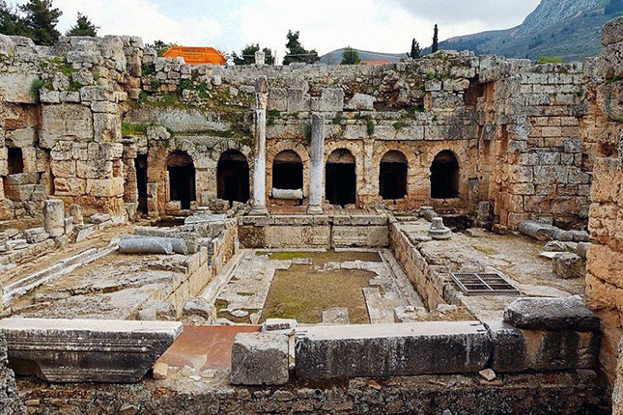
The Context
Now about the gifts of the Spirit, brothers and sisters, I do not want you to be uninformed.
  1 Cor. 12:1
Paul is responding to a question they have asked
Notes:
In these two chapters, Paul says more about spiritual gifts than the rest of the NT combined.
So let’s see what he was getting at and what it might mean for us at ACPC.
[1 Cor. 12:1]
*** We see here that Paul is responding to a question from the church: what about spiritual gifts, Paul? Remember they did not lack any. This was not a church trying to “get the gifts”, they were already flowing!
But in the Corinthian church, spiritual gifts had become symbols of spiritual power. Those with the most impressive gifts - who could prophecy or speak in tongues or had healing gifts, were looked up to. What happens when some people are are put on a pedestal? Jealousy, rivalry and misuse of power.
This is the very antithesis of what the Spirit is about!

Slide 4
We all have the Spirit of God
³ Therefore I want you to know that no one who is speaking by the Spirit of God says, ‘Jesus be cursed,’ and no one can say, ‘Jesus is Lord,’ except by the Holy Spirit.
Name him, Christians, name him,
with love strong as death,
but with awe and wonder,
and with bated breath;
he is God the Saviour,
he is Christ the Lord,
ever to be worshipped,
trusted and adored.
  Caroline Maria Noel, At the Name of Jesus
Notes:
First of all, Paul explains that they all have the Spirit of God, not just an elite few - that is, all who believe in Jesus.
*** ³ Therefore …
It is the Spirit who draws us to Christ, who helps us to call upon the name of Jesus.
*** Name him …

Slide 5
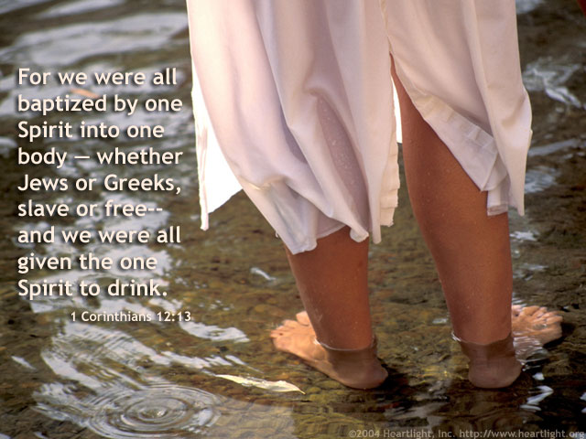
We all have the Spirit of God
This is subversive!
What about the baptism of the Spirit (13)?
  In every case in the book of Acts, they were receiving the Spirit for the first time.
  God was giving the big “thumbs up” to every group
We all have the Spirit if we belong to Christ.
Notes:
To say Jesus is Lord was so subversive in those days. It was to imply that Caesar is not Lord - that there is a power greater than Caesar - there is a love stronger than death.
The Spirit guides us to Christ and invades our lives with his powerful, cleansing presence. Yay!!
*** The baptism of the Spirit mentioned in verse 13 happens at conversion. There is no subsequent Spirit baptism. We are baptised by one spirit into the Body of Christ when we believe in Jesus.
Now, this statement is at odds with what Pentecostals believe!
They point to various passages in the book of Acts where the Spirit came upon people and they spoke in tongues etc. as a result. They argue that we should also seek out this experience. But what they overlook is that …
*** in every case in the book of Acts, including a group who were baptised by John the Baptist, they were receiving the HS for the first time. The coming of the Holy Spirit was a bit like my birthday the other week. There was one actual day and a number of celebrations the rest of the week. It was the same with the HS - as he came Jews at Pentecost and then there were special outpourings of the Spirit to Samaritans and Gentiles as well. *** God was giving the big “thumbs up” to every group and saying, “You also are included in the gospel!”
We all have the Spirit if we belong to Christ.

Slide 6
The Gifts of the Spirit
⁴ There are different kinds of gifts, but the same Spirit distributes them. ⁵ There are different kinds of service, but the same Lord. ⁶ There are different kinds of working, but in all of them and in everyone it is the same God at work.
The Holy Spirit is God
⁷ Now to each one the manifestation of the Spirit is given for the common good.
The purpose is for …
Notes:
Then Paul talks about the gifts of the Spirit.
⁴ There …
*** Notice that the Holy Spirit is God. The phrases, the same Spirit, the same Lord, the same God are all interchangeable. Notice too that it the Spirit who is in charge of the gifts. So the most amazing prophet or the greatest miracle-worker is not in charge of the church, the Spirit is.
*** ⁷ Now …
The purpose is for … what? The common good. Not, to make me look good! But for the whole church to be built up. Everyone contributes what little they have to the blessing of all.

Slide 7
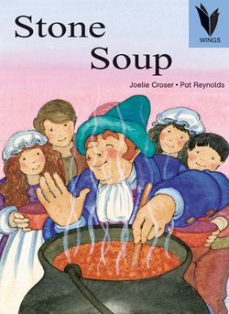
Notes:
A kindly, old stranger was walking through the land when he came upon a village. As he entered, the villagers moved towards their homes locking doors and windows.
The stranger smiled and asked, why are you all so frightened. I am a simple traveller, looking for a soft place to stay for the night and a warm place for a meal.
"There's not a bite to eat in the whole province," he was told. "We are weak and our children are starving. Better keep moving on."
"Oh, I have everything I need," he said. "In fact, I was thinking of making some stone soup to share with all of you." He pulled an iron cauldron from his cloak, filled it with water, and began to build a fire under it.
Then, with great ceremony, he drew an ordinary-looking stone from a silken bag and dropped it into the water.
By now, hearing the rumor of food, most of the villagers had come out of their homes or watched from their windows. As the stranger sniffed the "broth" and licked his lips in anticipation, hunger began to overcome their fear.
"Ahh," the stranger said to himself rather loudly, "I do like a tasty stone soup. Of course, stone soup with cabbage -- that's hard to beat."
Soon a villager approached hesitantly, holding a small cabbage he'd retrieved from its hiding place, and added it to the pot.
"Wonderful!!" cried the stranger. "You know, I once had stone soup with cabbage and a bit of salt beef as well, and it was fit for a king."
The village butcher managed to find some salt beef . . . And so it went, through potatoes, onions, carrots, mushrooms, and so on, until there was indeed a delicious meal for everyone in the village to share.
The villager elder offered the stranger a great deal of money for the magic stone, but he refused to sell it and travelled on the next day.
As he left, the stranger came upon a group of village children standing near the road. He gave the silken bag containing the stone to the youngest child, whispering to a group, "It was not the stone, but the villagers that had performed the magic."

Slide 8
The Gifts of the Spirit
What God-given gifts do we bring to the church?
What is the difference between a talent and a gift?
Notes:
What God-given gifts do we bring to the church? Paul focuses on the miraculous gifts here. Because those were the ones the Corinthians were fixated on. But there are all sorts of gifts mentioned in Scripture. Gifts of serving, of helping, giving, crafts, leadership, even singleness.
*** So what is the difference between a talent and a gift?
Does it really matter? Both can and should be used for the “common good.” I like to think of think of it this way: What is a spiritual talent? What is a spiritual car or bank account or rice cooker or person? Someone or something appointed by God and set apart for his purposes. In this sense, everything we offer to God is spiritual.

Slide 9
Everything we offer to God is spiritual
This is tied up with our view of salvation and heaven
Our works here and now are not all transitory. The good that we have done will not simply disappear and be forgotten. The world is not a passing and futile phase. It will taken up in God's new world. Our good buildings, our great inventions, our acts of healing, our best writings, our creative art, our finest clothes, our greatest treasures will not simply pass away. If they represent the finest works of God's image- bearers, they will adorn the world to come.
  Paul Marshall, Heaven is Not My Home: Learning to Live in God's Creation
Notes:
This is actually tied up with our view of salvation and heaven. We now realise that the view that salvation is going to heaven when we die is sadly lacking. Just as Jesus’ resurrected body had continuity with his earthly body yet was new and incorruptible, so the new earth will have continuity with the old earth and yet be new and incorruptible. And the works and service that we perform in the name of Jesus in this life will be somehow expressed in the world to come.
In his book. Heaven is Not My Home: Learning to Live in God's Creation (Nashville, TN: Thomas Nelson, 1999), Paul Marshall writes the following:
*** Our …
Wow - interesting thought!

Slide 10
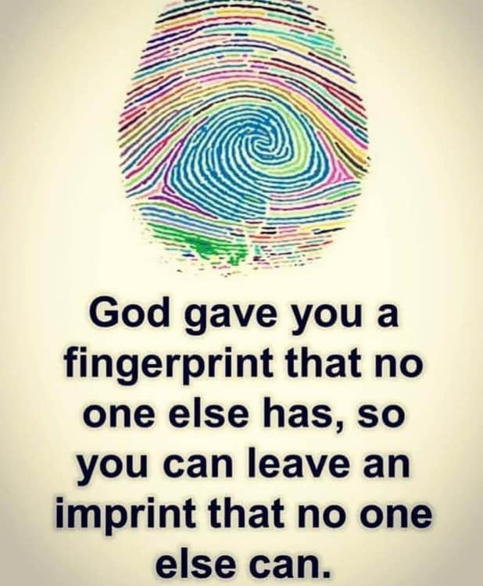
Discovering your Gifts
Refer to the newsletter for some questions to help you work out your spiritual gifts
(My example)
What S.H.A.P.E. has God given you?
  Spiritual Gifts
  Heart or passion
  Abilities
  Personality
  Experience
Notes:
[Refer to newsletter - discovering your gifts …]
You will see there are some questions to help you work out your spiritual gifts.
*** From the very first time I visited a church, I looked at the guy upfront and thought, I could do that! Getting “upfront” involved playing the clarinet in the small worship band - for years - but it was start. My first sermon was in the evening service. I spoke on the topic of “Why does God allow evil and suffering?” The people looked at me like I was speaking Swahili or something! The second sermon was from the Beatitudes and people seemed to enjoy it. So I was encouraged to keep giving it a go. The most challenging part was doing a second sermon and not being so put off by the reception to the first one! But I knew in my heart this was what I wanted to do.
*** What S.H.A.P.E. has God given you? He has a special YOU-shaped assignment that only you can do!

Slide 11
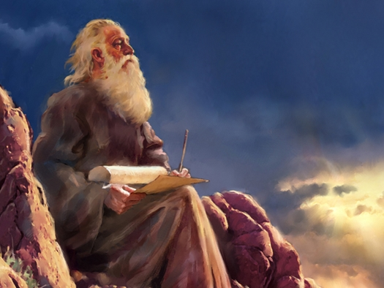
The Gift of Prophecy
¹ Follow the way of love and eagerly desire gifts of the Spirit, especially prophecy. (14:1)
What is the gift of prophecy?
  The prophets of old spoke the word of God to people.
  This office continued in the New Testament.
Notes:
As I mentioned, the list of gifts in chapter 12:7-10 is not comprehensive. I want to focus on just one of them today, because it is specifically discussed in chapter 14.
14 Follow …
*** What is the gift of prophecy?
*** The prophets of old spoke the word of God to people. While God spoke through human agents, the words they spoke could be described as the Word of God.
*** This office continued in the NT.

Slide 12
The Gift of Prophecy
² I want you to recall the words spoken in the past by the holy prophets and the command given by our Lord and Saviour through your apostles.
  2 Peter 3:2
¹⁵ Bear in mind that our Lord’s patience means salvation, just as our dear brother Paul also wrote to you with the wisdom that God gave him. ¹⁶ He writes the same way in all his letters, speaking in them of these matters. His letters contain some things that are hard to understand, which ignorant and unstable people distort, as they do the other Scriptures, to their own destruction.
  2 Peter 3:14-16
Notes:
For instance, both Peter and Paul had a prophetic role in the early church.
[2 Peter 3:2]
[2 Peter 3:14-16]
Notice here that Prophets, Apostles and Scripture are all put on the same level by Peter. There’s an authority there, isn’t there?

Slide 13
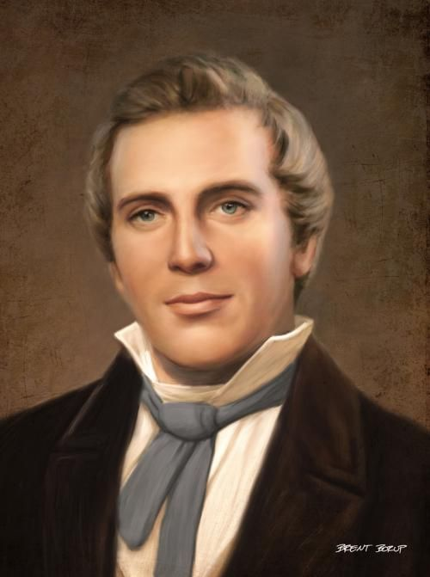
The Gift of Prophecy
Is the New Testament gift of prophecy on the same level as what Peter is talking about here?
No
I do not believe that prophecy today will bring us any new revelation on a par with Scripture. But that doesn’t mean to say God has stopped speaking.
Joseph Smith
Notes:
So here’s the question, is the NT gift of prophecy on the same level as what Peter is talking about here?
*** In a word, no. There have been too many examples in Church history where someone has claimed some sort of new revelation from God.
*** In 1830, a 24 year old named Joseph Smith published the Book of Mormon, claiming it was based on some golden tablets which an angel helped him to translate into English. Smith is widely recognized as a con-artist. He was in imprisoned. In fact, he was killed while in prison by an angry mob who was offended by his doctrine of polygamy. Yet the religion he founded False prophets exist and that they represent a major threat to the church. Both the Old and New Testaments repeatedly warned believers boasts 16 million members today and estimated net worth of $40 billion.
*** I do not …

Slide 14
The Gift of Prophecy
² For anyone who speaks in a tongue does not speak to people but to God. Indeed, no one understands them; they utter mysteries by the Spirit. ³ But the one who prophesies speaks to people for their strengthening, encouraging and comfort.
So what’s the role of the prophetic gift today?
  To strengthen, encourage and comfort God’s people.
  Prophecy is bringing God’s Word to bear on a particular situation.
Timely advice is lovely, like golden apples in a silver basket.
  Proverbs 25:11 (NLT)
Notes:
² For …
*** So what’s the role of the prophetic gift today?
*** To strengthen …
*** Prophecy is …
*** Proverbs 25:11 expresses it beautifully:
Timely advice is lovely, like golden apples in a silver basket. Proverbs 25:11 (NLT)
A word of prophecy is like timely advice.

Slide 15
The Gift of Prophecy
“Prophecy is the living word that compels to constructive action, that rends our hearts and pushes us to deeper connectedness with life, so that we dare to reach out to others with greater love and faith.”
    Carolyn Osiek
Prophecy can be manifested in different ways:
  Inspiration in Preaching
  Incisive conversation
We should always be tentative.
Notes:
“Prophecy is …
So the Spirit takes the words of Scripture and brings those words to life once more in our experience.
*** Prophecy can be manifested in different ways:
*** Ever experienced the moment that the preacher seems to be talking just to you - that his or her words are apt in your situation? The preacher can be inspired on Friday morning preparation or Sunday morning delivery. They don’t need a sudden flash of inspiration at 11 am when God has been speaking all week. But what they yearn for is for the Spirit to apply that text into individual lives. Amen!
*** Some people have a particular gift of bringing God’s word to bear in an incisive way. They might say to you: “I’ve been praying for you and I wonder if the Lord might be using this problem to teach you …” Ever experienced someone saying something like that to you? I have on a few occasions (the guy who prayed Ant and I on the first Sunday I preached …)
Or maybe you’ve said that to someone else?
*** We should always be tentative. Don’t claim “Thus saith the Lord!” Say things like, I wonder, I believe, I sense …

Slide 16

The Gift of Prophecy
God speaks today to strengthen, encourage and comfort his people - through his Word and through sensitive people who are able to see how it applies.
¹⁹ Do not quench the Spirit. ²⁰ Do not treat prophecies with contempt ²¹ but test them all; hold on to what is good, ²² reject every kind of evil.
1 Thessalonians 5:19-22
Notes:
God speaks …
*** But we must test these words.
[1 Thessalonians 5:19-22]
Does it fit with the Word of God? Does it help me honour Christ? Does it actually work? These are good questions to ask.

Slide 17
The Gift of Prophecy
4 main dangers of Pentecostal / Charismatic churches
  Abuses and elitism in prophetic ministry
  The excesses of Word-Faith teachings
  Authoritarianism and hierarchical leadership structures
  An approach to spiritual formation (discipleship) that depends on crisis events
Do we make enough room for God to surprise us?
The fact is that extraordinary healings have convinced millions of people of the truth of the gospel
We want to see God work in power here too!
Notes:
Now, no one church has cornered the market on this kind of thing. Every church tradition has their challenges. People who identify as “post-charismatic” cite four main dangers with more Pentecostal or charismatic churches:
*** Abuses and elitism in prophetic ministry, coupled with a “carrot and stick” approach to holiness that many find legalistic, manipulative, and repressive
*** The excesses of Word-Faith teachings (health and wealth, prosperity doctrine) which clash with the emerging generations’ concern for a biblical approach to justice and ministry with the poor
*** Authoritarianism and hierarchical leadership structures that exist more to control people than to equip the saints for works of service
*** An approach to spiritual formation (discipleship) that depends on crisis events – whether at “the altar” in a church service, or in a large conference setting – but either neglects or deliberately belittles other means of spiritual maturing (I.e. spiritual disciplines)
*** We have a low risk of these things at ACPC! But, like many churches that emphasise biblical teaching and orderly worship, do we make enough room for God to surprise us? To do the unexpected? To even work miracles?
*** Whatever happens locally, the fact is that extraordinary healings have convinced millions of people of the truth of the gospel. For example, a survey from 2000: About half of all new conversions in China were due to faith healing experiences, and the number was closer to 90% in rural areas. Why don’t we see more of this in NZ? I like what theologian Craig Keener concludes: It seems that God wants to lavish his love on those who have never heard the good news of his Son.
*** We may not see as many miracles in NZ, but we want to see God work in power here too, don’t we? Because so many people here have never heard the Good News either - or they think they have and they don’t realise just how good the Good News is.

Slide 18
Make room for God
²⁷ [When] Herod and Pontius Pilate met together with the Gentiles and the people of Israel in this city to conspire against your holy servant Jesus, whom you anointed, ²⁸ they did what your power and will had decided beforehand should happen. ²⁹ Now, Lord, consider their threats and enable your servants to speak your word with great boldness. ³⁰ Stretch out your hand to heal and perform signs and wonders through the name of your holy servant Jesus.’
³¹ After they prayed, the place where they were meeting was shaken. And they were all filled with the Holy Spirit and spoke the word of God boldly.
  Acts 4:27-31
Notes:
So let’s pray like the early disciples did in Acts 4:
[Acts 4:27-31]
Yes Lord, stretch out your hand to perform miracles! Increase out faith! Make us bold to speak your Word!

Slide 19
Make room for God
Paul exhorted the Corinthians to “eagerly desire the greater gifts”
(Example: Seung Seon)
Eagerly desire spiritual gifts - the flash ones and the quiet, helpful ones. And put them to use for the good of others and the glory of God.
God is so generous, and he delights to bless us and give good gifts to us, so that we can in turn bless others. We just need to ask him.
Notes:
Paul exhorted the Corinthians to “eagerly desire the greater gifts”, especially prophecy, bringing God’s Word to bear in a particular situation.
*** One of the students in my previous church was a Korean-born son of missionaries who were working in NZ for several years by the name of Seung Seon. SS had a real passion to disciple others. He was great at gathering people and getting them to study the Bible with him. One of things he really wanted was to experience the HS more deeply. So he started praying that God would speak to him. This went on for years, with much frustration. A few weeks ago, I visited SS where is living in Whangarei and it was great to hear how God has been answering his prayer - giving him the words to speak to non-Christians and in quite prophetic sermons at local churches. It’s not spectacular, but God is answering prayers and bringing people to himself and building a strong home church which is going out to preach the gospel every week.
*** So eagerly …
*** And God is …

Slide 20
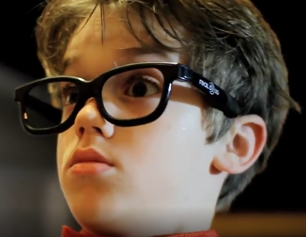
Video: Everyday Gifts
Notes:
[Show video: Everyday Gifts -- Chuck Knows Church]

Slide 21

If I speak in the tongues of men or of angels … If I have the gift of prophecy and can fathom all mysteries and all knowledge, and if I have a faith that can move mountains … If I give all I possess to the poor and give over my body to hardship that I may boast, but I am missing this one crucial ingredient, I am only a resounding gong or a clanging cymbal, I am nothing, I gain nothing.]
Notes:
But remember what Paul goes on to say next:
*** If I …
What is this “must have” recipe, rivalling the colonel’s special blend of herbs and spices?
You’ll have to tune in next week to find out!
Let’s pray.

