Slide 1
That Crazy Cross?!
1 Corinthians 1:18-2:5

Slide 2
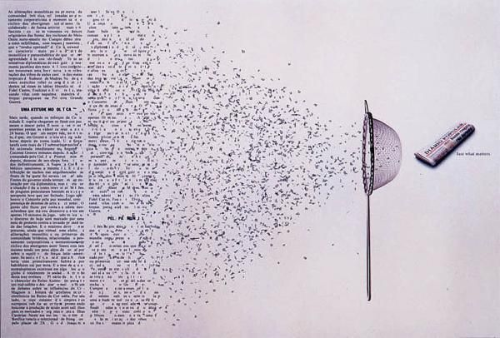
Notes:
What is the one commodity we are never short of in today’s world?
Information!
The amount of data we produce every day: 2.5 quintillion bytes of data created each day (that’s 2.5 with 14 zeroes). But’s that pace is only accelerating. Over the last two years alone 90 percent of the data in the world was generated.
Now how much of that is useful? This is what I had for dinner. Here’s the latest cat video …
Lots of noise / “babble” today: Facebook and Twitter, Instagram and Snapchat, podcasts and talk shows, blogs and apps - and everything at our finger tips, information overload!
You know that they say … “When all is said and done …. there’s a lot more said that done.”
What we need is something to help us make sense of this blast of babble - something that will curate the content that would otherwise overwhelm us. The Bible calls this WISDOM.

Slide 3
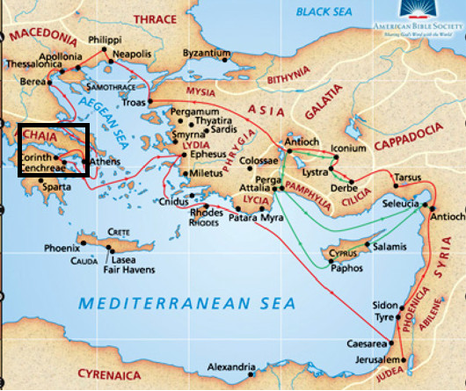
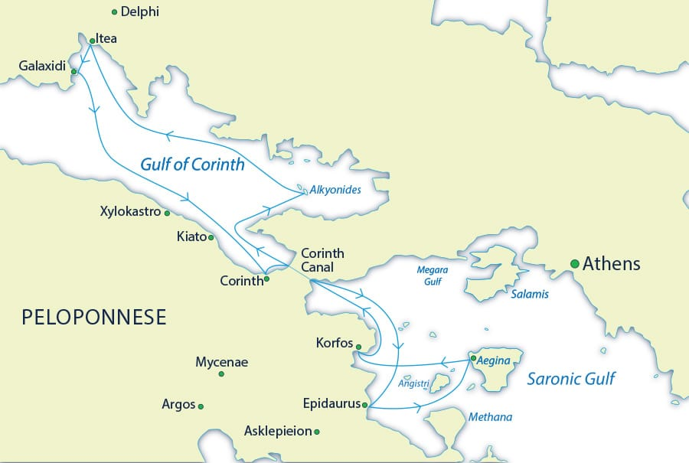
The City of Corinth
Located on an important trade
route
On a narrow isthmus
Notes:
Corinth - geography - a number of issues ..

Slide 4
True / False?
The Corinthians were quite a unified church
The relationships within the Trinity are described as “perichoresis”
Apollos was a powerful and learned speaker
The Corinthians lacked spiritual power
Paul stayed in Corinth for 18 months
He received a report from members of Cleo's household
Many in the Corinthian church were impressed by words and wisdom
The Corinthians were spiritually mature
The Corinthians throught they were already in the “eschalot”
Greeks look for signs and Jews look for wisdom
Notes:
True/ False quiz answers: FTTFTFTFFF

Slide 5

Problem # 1: Divisions
The crazy cross is clearly the cleverest creed ever conceived!
¹⁸ For the message of the cross is foolishness to those who are perishing …
²² Jews demand signs and Greeks look for wisdom, ²³ but we preach Christ crucified: a stumbling-block to Jews and foolishness to Gentiles 1:18, 22-23
Sometimes reading Paul’s letters is like listening to only one side of a phone call
Notes:
Paul’s letters: Like a one-sided phone call - we only get to hear Paul’s side - we glean from his responses what the issues were.
The first big issue was divisions.
Last week: Is Christ divided? No!
This week: it’s not about being the best or the brainiest speaker anyway. The real power lies in the message itself.
Today’s big idea: The crazy cross is clearly the cleverest creed ever conceived!
But not everybody thinks so ...
[verse/quote]

Slide 6
“Wisdom”
“All the Athenians and the foreigners who lived there spent their time doing nothing but talking about and listening to the latest ideas.”
  Acts 17:21
‘The Greeks were intoxicated with fine words.’
  William Barclay
“I think, therefore I am”
  Rene Decartes
The Greeks argued that God is completely removed from human suffering.
So the message of the cross seemed ridiculous
Notes:
Now, signs and wisdom are OK - and Jesus showed them both. But his sign-filled, wise-worded ministry finished on an embarrassing - actually scandalous note - a bloody Roman cross.
Now the Corinthians were mainly Gentile believers. Their culture was Graeco-Roman more than Jewish. And one of the things the Greeks were known for (and still are) is philosophy.
When Paul went to Athens and encountered Greek philosophers, there’s this lovely description of the people in Acts 17:21: [verse/quote]
William Barclay says [verse/quote]
They loved to toss around the big questions - to speculate their way towards God through reasoning and argument.
Does this sounds familiar?
Wasn’t it Decartes who said, [verse/quote]
[verse/quote:] The Greeks argued that God by his very nature is completely removed from human suffering. He cannot feel in the way that we feel. So how did they respond to the preaching of the cross, a suffering God, a criminal Messiah and salvation not based on human speculation but the grace and love of a Holy God who bridges the impossible gap and comes to us?
Now the gospel got a lot of traction among Gaeco-Roman people, but philosophers and wise people of the time really struggled to accept this message.
[verse/quote:] It seemed ridiculous.

Slide 7
“Wisdom”
²⁰ Where is the wise person? Where is the teacher of the law? Where is the philosopher of this age? Has not God made foolish the wisdom of the world? ²¹ For since in the wisdom of God the world through its wisdom did not know him, God was pleased through the foolishness of what was preached to save those who believe.
  1:20-21
Mystery religions:
  special knowledge
  special rituals
  special people
Notes:
Listen to Paul’s words again:
[verse/quote]
The first century was a time of religious upheaval, not just because of the preaching of the early church.
So called mystery religious were popping up everywhere, with their promise of some secret which unravel the mysteries of life.
[verse/quote:] Only special knowledge and special rituals and special people could unlock these mysteries.

Slide 8
“Wisdom”
The Corinthians probably over-valued human ideas and rhetoric and even shunned the message of the cross
All our knowledge brings us nearer to our ignorance,
  All our ignorance brings us nearer to death,
  But nearness to death, no nearer to God.
  Where is the life we have lost in living?
  T. S. Eliot
Notes:
You can see now the Corinthians, who had been enriched with knowledge and speaking (verse 5), might stray into over-valuing human ideas and rhetoric and even shunning the message of the cross because it didn’t make sense.
Can we do that? You bet. But the results are frustrating.
As the poet, T. S. Eliot wrote:
[verse/quote]

Slide 9
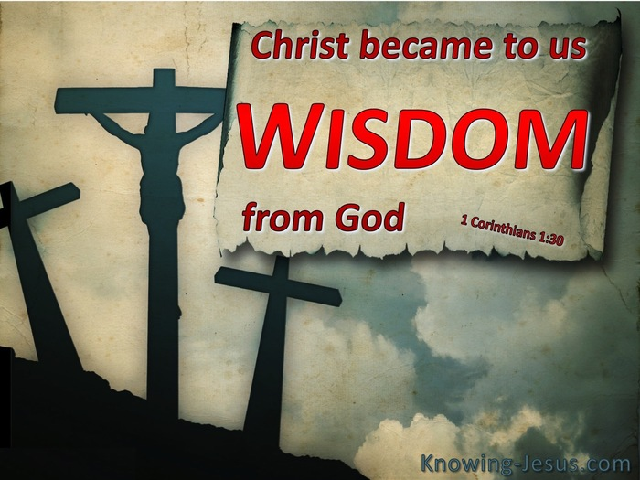
True Wisdom
Christ Jesus … has become for us wisdom from God – that is, our righteousness, holiness and redemption.
  1:30
What are some of the barriers to people accepting the message of the cross today?
Notes:
So what is true wisdom, and what is the real so-called mystery according to Paul?
[verse/quote]
The cross of Jesus Christ - crazy as it seems - is clearly the cleverest creed ever conceived!
[Question:} So what are some of the barriers to people accepting the message of the cross today?

Slide 10

32%
45%
14%
9%
15%
7%
Notes:
[NZ percentages on the left]

Slide 13


THOSE WHO OFTEN OR OCCASIONALLY DISCUSS SPIRITUALITY AND RELGION
69%
Generation Y
50%
Baby Boomers
Notes:
Generational differences
Younger generations are more likely to talk about spirituality and religion, with seven in ten Generation Y (69%) often or occasionally discussing spirituality and religion with friends. Half of Builders (50%), however, never talk about spirituality or religion with friends.

Slide 16
Top 10 perceptions of Christians

Slide 17
Perceptions of jesus

Slide 18
FAITH AND BELIEF SURVEY 2018
A significant decline in adherence to Christianity (but await census figures)
43% of those who state “no religion” prefer a scientific and evidence-based approach
25% would be open to exploring religion to some degree
Gen Y seems comfortable discussing religion and spirituality a lot more than baby boomers
Top 5 issue blockers: teaching on homosexuality, hell and condemnation, suffering, role of women, supernatural aspects.
Top 5 behaviour blockers: church abuse, hypocrisy, religious wars, judging others, issues around money
91% of people know at least one Christian and have generally positive views about them

Slide 19

Responding to people today
Issues e.g. ”I prefer a scientific and evidence-based approach”
Behaviour
  Love: hospitality, acts of generosity and genuine friendship
  Be the church - messy but growing, sound theology that is hopeful but also realistic about life and love that is supreme.
Notes:
And how do we respond to them?
First off, it won’t be easy. There are a lot of people who don’t seem very interested! There are couple of interesting “blockers” that the survey found: Behaviour and Issues.
Issues
If someone will listen, there are some good response we can make - for example, ”I prefer a scientific and evidence-based approach”
They are not in opposition to one another
Not evolution vs faith but scientism or naturalism vs faith
Christianity is falsifiable - “show me the body!”
Faith is not unique to Christianity - scientists weigh up the evidence and postulate a theory - but that theory is not fact - it’s more like faith based on evidence. Just like Christianity!
Behaviour
This one is harder, especially if people have really bad experiences.
“This Little Life” by Hanya Yanagihara - Jude’s abuse at the hands of an ex-Catholic priest and subjected him to years of degrading acts in captivity by him and a long line of willing abusers. What would I say to Jude?
If I got to know him somehow, I would simply “love on him”, as the Americans like to say. Hospitality, acts of generosity and genuine friendship - these are strategies that can heal.
Be the church [verse/quote]
. (Does that sound familiar?)
Eg: The guys who cane to my commissioning - really enjoyed it… our church has a lot to offer!

Slide 20
What I'd emphasise
Behaviour
Good
Prepare
Share
Issues
Many
Few
Prayer
Care
Bad
Notes:
[Diagram of what I’d emphasise - actually it’s much more nuanced than this!]

Slide 21

Responding to people today
Issues
  E.g. ”I prefer a scientific and evidence-based approach”
Behaviour
  Love: hospitality, acts of generosity and genuine friendship
Closed people
  “Even if the word “Yahweh” was written in clouds in the sky, I still would not believe!”
    - Richard Dawkins
Notes:
Some people seem totally closed- Richard Dawkins: “Would anything convince you that Christianity is true?” “Even if Yahweh was written in clouds in the sky, I still would not believe!” [verse/quote] He would just think it’s a psychotic episode.

Slide 22
The mystery revealed!
¹ And so it was with me, brothers and sisters. When I came to you, I did not come with eloquence or human wisdom as I proclaimed to you the testimony about God. ² For I resolved to know nothing while I was with you except Jesus Christ and him crucified. I came to you in weakness with great fear and trembling. ⁴ My message and my preaching were not with wise and persuasive words, but with a demonstration of the Spirit’s power, ⁵ so that your faith might not rest on human wisdom, but on God’s power. 2:1-5
God has chosen to make known among the Gentiles the glorious riches of this mystery, which is Christ in you, the hope of glory. Colossians 1:27
⁶ I planted the seed, Apollos watered it, but God has been making it grow. 3:6
Notes:
This leads me to Mystery # 2
What is today? [Pentecost Sunday.]
Listen to 2:1-5: [verse/quote]
God’s Spirit comes to live inside of us! As Paul writes to the church in Colossae:
[verse/quote]
The Spirit has come to live within us who have received the gospel - to bring us the Word of God, to give us the desire to please Him and to equip us with the power to do His will in the world.
God does the work. We simply join him in it.:
[verse/quote]

Slide 23
What I'd emphasise
Behaviour
Good
Prepare
Share
Issues
The Spirit's work
Many
Few
Prayer
Care
Bad
Notes:
So as we look at my diagram from earlier, the Spirit is actually involved EVERYWHERE!

Slide 24
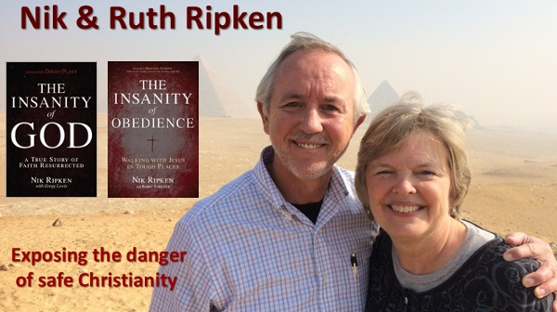
An incredible story
Notes:
Nik Ripken, “The Insanity of God”
On my trip home from China, I took the opportunity to spend a few days in a large, very strict Islamic nation. During my time there, a forty-three-year-old Muslim-background believer somehow heard I was there [to hear people’s stories].
It turns out that Pramana traveled twenty-nine hours to find me. He had been born into a people group with a population of twenty-four million. In his people group, there were only three known followers of Jesus, and no church. The only religion that he had ever practiced or known while growing up had been a sort of folk Islam. Pramana knew the Quran by rote. He couldn’t actually speak Arabic, so (as an oral communicator from an oral culture) he simply memorized the words of the book as if they were part of some sort of magic formula. He knew the story of Mohammad, of course. But he had never heard of anybody called Jesus, he had never met a believer, and he had no idea what a Bible was.
“Five years ago,” he told me, “my life was in ruins. My wife and I were always fighting; I was ready to divorce the woman. My children were disrespectful. My animals were not growing or multiplying. My crops were dying in the fields. “So I went to the imam of the nearest mosque for help,” Pramana continued. The imam, who also functioned as the local spiritualist, told him, “Okay, son, here is what you need to do. Go buy a white chicken. Bring it to me and I will sacrifice it on your behalf. Then, go back to your village to meditate and fast for three days and three nights. On the third day, you will receive the answer to all the problems that you are having with your wife, your children, your animals, and your crops.”
Pramana did exactly as he was told. He went back to his village. He meditated, he fasted, and he waited. Then, as he explained it: “I’ll never forget, on that third night, a voice without a body came to me after midnight. That voice said, ‘Find Jesus, find the gospel.’” This Muslim man had no clue what that even meant. He didn’t know if Jesus might be a fruit or a rock or a tree.
Pramana told me that the voice without a body also said, “Get out of bed, go over the the mountain, and walk down the coast to ______________ (a city where he had never been). When you get to that city at daybreak, you will see two men. When you see those men, ask them where ____________street is. They will show you the way. Walk up and down that street and look for this number. When you find the number, knock on the door. When the door opens, tell the person why you have come.” So he went.
He hiked over the mountain, trekked down the coast, and arrived in the specified city the next morning at daylight. He saw two men who told him where to find the street he wanted. He walked up and down that street until he found a building with the right number on it. He knocked on the door. A moment later, an older gentleman opened the door and asked, “Can I help you?” The younger man declared: “I have come to find Jesus; I have come to find the gospel!” In a flash, the old man’s hand shot out from the darkened doorway. He grabbed Pramana by the shirt, dragged him into the apartment, and slammed the door behind him. The old man released his grip and exclaimed, “You Muslims must think I am a fool to fall for a trap as transparent as this!” The very startled and confused traveler replied, “I don’t know if you are a fool or not, sir. I just met you. But here is why I’ve come.” Then Pramana told the older man the story of how he had come to be there that day.
The Holy Spirit had led this young Muslim man through his dream and vision and his obedience to the home of one of the three believers in his twenty-four million people group. Stunned, the older man explained the gospel to this young Muslim man and led him to Christ. For the next two weeks, the old man discipled this new convert in the faith. That had been five years ago. There had been blessings and trials and tribulations during the last five years, but his life had clearly been changed in startling ways.We marveled that his faith had grown in this hostile world where there had been almost no opportunity for fellowship with other followers of Jesus.

Slide 25
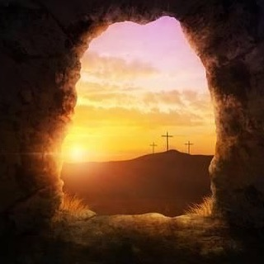
Applications
Realise that real wisdom is found in Christ and the cross
Keep learning to live and share the message
Thank him for sending His Spirit (more next week)
Notes:
Realise …The crazy cross is clearly the cleverest creed ever conceived. Understand the wisdom of the world but know that it is ultimately futile without Christ. Trust in him for your righteousness, holiness and redemption.
And keep …
And thank …
We will talk more about this amazing gift next week!

Slide 26
The Old Rugged Cross
Brad Paisley
On a hill far away, stood an old rugged Cross
The emblem of suffering and shame
And I love that old Cross where the dearest and best
For a world of lost sinners was slain
To the old rugged Cross, I will ever be true
Its shame and reproach gladly bear
And they'll call me some day to my home far away
Where His glory forever I'll share

Slide 27
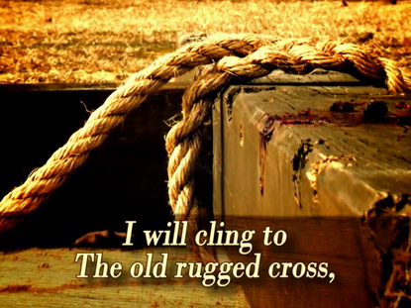
The Old Rugged Cross
Brad Paisley
So I'll cherish the old rugged Cross
Till my trophies at last I lay down
I will cling to the old rugged Cross
And exchange it some day for a crown

