Slide 1

The Three Prickly Passages of Paul
1 Cor. 11, 1 Cor. 14 and 1 Tim 2

Slide 2
1 Corinthians 14:34-25
³⁴ Women should remain silent in the churches. They are not allowed to speak, but must be in submission, as the law says. ³⁵ If they want to inquire about something, they should ask their own husbands at home; for it is disgraceful for a woman to speak in the church.
²⁶ What then shall we say, brothers and sisters? When you come together, each of you has a hymn, or a word of instruction, a revelation, a tongue or an interpretation. Everything must be done so that the church may be built up.
Notes:
Sounds straight forward! A blanket ban on women speaking? But remember what Paul said in chapter 11: “Every woman who prays or prophecies with her head uncovered …
Go up to verse 26: Paul says that everyone contributes a hymn, a word of instruction, a revelation, a tongue or an interpretation (26). This sounds great but there is potential for chaos! Hence Paul instructions about tongues needing an interpretation and limiting the number of people who prophecy.
Then he addresses women since it appears that some of them were disrupting the service by questioning their husbands in public worship. They wanted to understand what was being said and done. That’s great, Paul says, but wait until you get home and ask your husband then.
So in this context about order in worship, women are not to participate in a way which leads to chaos and confusion.

Slide 3
The principle expressed
³³ … God is not a God of disorder but of peace … ⁴⁰ … everything should be done in a fitting and orderly way.
What is order in worship?
  That which strengthens the church (v. 26)
  Where believers show respect for others (see vv. 30-31) and for God (see v. 33) as they exercise their spiritual gifts.
How might that relate to today?
  Take turns, be “visitor-friendly”, involve lots of people …
Notes:
This is the universal principle.
How much you limit the role of women will depend on whether you believe that Paul’s recommendation is universal or a localised, culturally relevant expression of the universal principle of order in worship.
What is order in worship? [slide]
How might that relate to today? E.g. Take turns to speak. Don’t all speak at once. Be aware of visitors. Cut the jargon! Involve lots of people, but with new or younger Christians you might want to check out what they are going to say first. Those with an established track record of speaking truth in a sensitive way, they can go for it, but not take too much over time.

Slide 4

1 Timothy 2:11-15
¹¹ A woman should learn in quietness and full submission. ¹² I do not permit a woman to teach or to assume authority over a man; she must be quiet. ¹³ For Adam was formed first, then Eve.
A “creation principle” or an illustration?
Notes:
Let’s take a look at our third prickly passage!
Paul seems to say that women are not to teach or be in charge of men. But the verb “have authority” often meant “seize authority” - to try to take over or “push in”. Sounds to me like the battle of the sexes described in Genesis 3. Men and women vying for dominance, rather than working in harmony.
Speaking of Genesis, it is to Genesis that Paul turns next. 13 For Adam was formed first, then Eve. This is the most persuasive point for many people. Since Paul invokes a “creation principle”, the idea of woman not teaching or having authority over men is a universal principle. But is it a “creation principle” or simply an illustration Paul uses for his present argument?

Slide 5
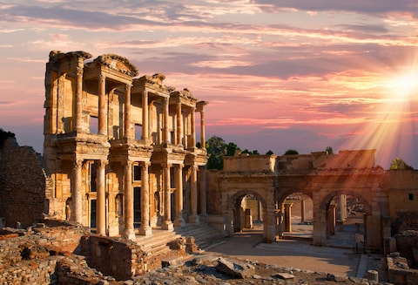
Context in Ephesus
The church was threatened by ‘false doctrines’, ‘myths and endless genealogies’ and ‘controversial speculations’ (1:3-4)
They [the false teachers] are the kind who worm their way into homes and gain control over gullible women … 2 Timothy 3:6
The problem with false teaching
The Positive: Women should learn!
Notes:
This is where an understanding of the context of 1 Timothy is vital. Timothy is the young pastor of the church in Ephesus, which is threatened by … [slide]
Because women received little formal education they were more susceptible to these false teachers, as we read in Paul’s final letter: [verse]
Paul was really upset about false teaching - for good reason. If the church was led astray from the truth, its witness would be destroyed. It would be like having a rocket with the wrong fuel - it wouldn’t get off the ground. So in view of this critical issue, he recommends a very practical solution: Women should learn and not teach. Actually that’s quite positive, isn’t it? Women should learn.

Slide 6
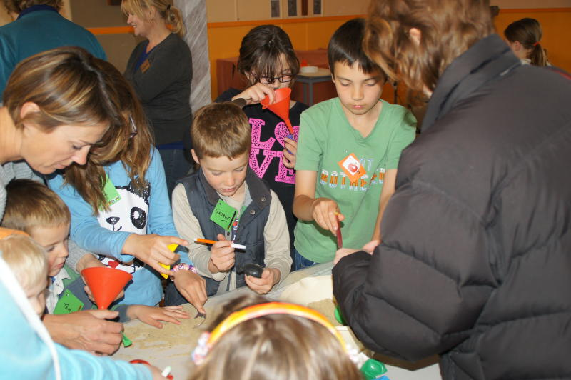
Summary
Paul’s recommendations that women be silent in the church arose out of specific situations of order in worship and the danger of false teaching
But can we at ACPC do more to encourage women elders, teachers and leaders at all levels?
All of us can contribute in some way
May we all, with one mind and one voice glorify the God and Father of our Lord Jesus Christ.” (Romans 15:6)
Notes:
So, in summary, [slide]
Women were starting to sense that the freedom they had in Christ made them able to participate as fully as men. Paul says, in view of the culture, not so fast!
It's an issue that won't be perfectly resolved, I think. But can we at ACPC [slide]
And while I'm at it, let's get away from the idea that just a few people should contribute in the service. All of us can contribute in some way - and not just on a roster. Even being attentive to opportunities to encourage someone else over morning tea is a valuable part of our worship. Last week was a fantastic example of different ages contributing to our worship.
May we all, with one mind and one voice (and many costumes), glorify the God and Father of our Lord Jesus Christ.” (Romans 15:6) Amen!

