Slide 1
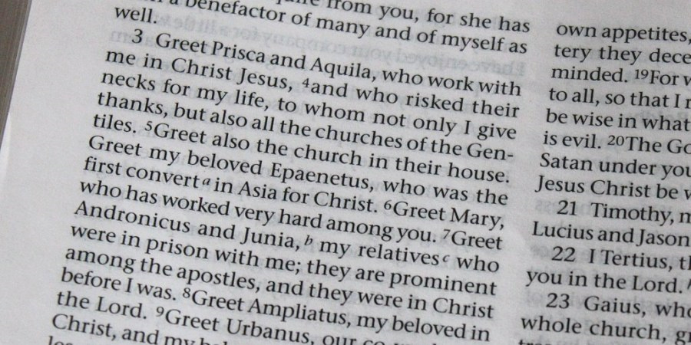
Paul and women
Notes:
Sounds good. But what about Paul. He was a misogynist, wasn’t he? Not at all. At the end of his letter to the Romans, Paul mentions no less than nine women who have helped him in his ministry, including Junia, an apostle. And there are many other examples. Yes, he ministered within a very patriarchal culture, but he worked with and relied on women throughout his ministry.

Slide 2
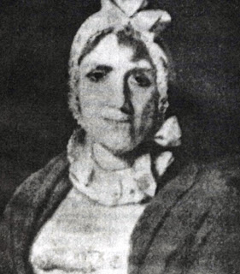
Hannah Marshman
The forgotten 4th member of the Serampore Trio
Considered to be the first women missionary in India
Founded boarding schools
Looked after Carey’s four unruly boys - "The good man saw and lamented the evil but was too mild to apply an effectual remedy.”
“Consecrated her life and property to the promotion of this sacred cause and exhibited an example of humble piety and energetic benevolence for forty-seven years.”
Notes:
Last time I also highlighted the role of women to bring God’s Word throughout history. Have you heard of the Serampore Trio? This group of missionaries founded the mission that William Wilburforce described as one of the chief glories of the British nation. Well, there was actually a fourth no less important member of the group, Hannah Marshman.
Hannah is considered to be the first woman missionary in India. She and her husband Joshua, arrived in Serampore (a few miles north of Calcutta) on 13 October 1799. The next year, they opened two boarding schools. Years later, Hannah herself founded a boarding school for girls.
When William Carey (the father of modern missions) arrived a few months later, Hannah was appalled by the way he neglected his four boys; aged 4, 7, 12 and 15. They were unmannered, undisciplined, and even uneducated. Carey had not spoiled, but rather simply ignored them. Hannah and her husband Joshua shaped the boys as Carey pampered his botanical specimens and performed his many missionary tasks. They offered the boys structure, instruction and companionship. To their credit – and little to Carey's – all four boys went on to useful careers.
At one point, Hannah wrote about Carey, [quote]
Hannah outlived her original group by many years. An inscription in her memory stated that she [quote]
The Forgotten Missionary: Hannah Marshman [video]

