Slide 1
Redemptive Family # 3 FRIENDS
2 Corinthians 5:16-21

Slide 2
Review: Week 2: Place
Seek the peace and prosperity of the city ... Pray to the Lord for it, for if it prospers, you too will prosper – Jer. 29:7
“Embrace our place”: Be “fully present” in the place God has called us
Actively work on His kingdom vision in the places where we live, work, worship and play
Do the Survey for week 2

Slide 3
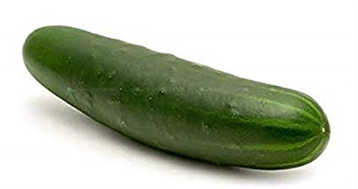
Having a friend for lunch … (video)
Notes:
Friends - sometimes you simply can’t join in! Today, I want to encourage you (and me) to join in - to connect with others, to include others and experience the adventure that is redemptive relationships!

Slide 8
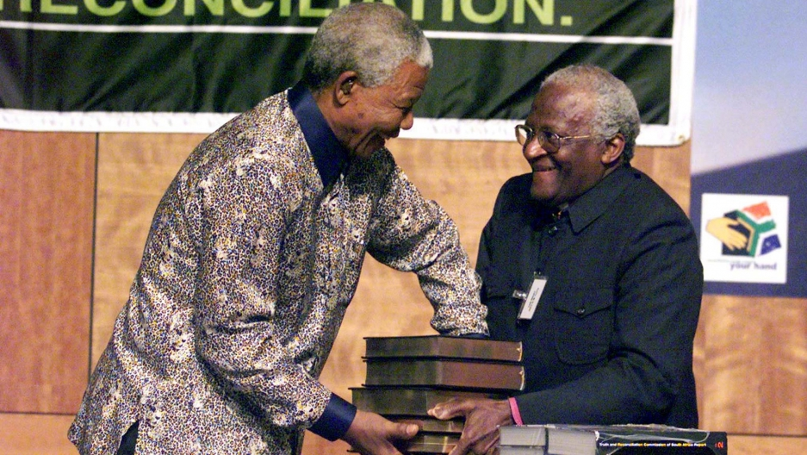
Reconciliation
Notes:
Example: South Africa’s truth and reconciliation commission (TRC) - my visit in 1997
The TRC was a restorative justice body assembled in South Africa after the end of apartheid, a government-imposed system of discrimination and separation based on skin colour. Over seven years, from 1996, some 2,000 people, perpetrators, and victims told their stories of what they’d done or what had been done to them, under apartheid. Over 7,000 perpetrators asked for amnesty; fewer than 1,000 got it. Those who did generally showed contrition, sometimes directly to family members of the people they’d killed. All this testimony was broadcast live, and all around the country, people watched. Some wept. Some scoffed. Some knew these stories all too well. And some were hearing them for the first time. While the process of coming to grips with South Africa’s troubled past continues to this day, the TRC opened up a way to talk about the individual and systemic wrongs committed under 43 years of apartheid.

Slide 9
Reconciliation
¹⁹ For God was pleased to have all his fullness dwell in him, ²⁰ and through him to reconcile to himself all things, whether things on earth or things in heaven, by making peace through his blood, shed on the cross. ²¹ Once you were alienated from God and were enemies in your minds because of your evil behaviour. ²² But now he has reconciled you by Christ’s physical body through death to present you holy in his sight, without blemish and free from accusation.
Col 1:19-21
Notes:
God was not only reconciling us to himself, but the whole of creation (remember last week …)
This passage is rich in gospel truth!

Slide 10
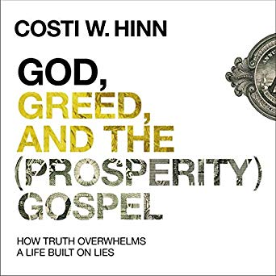
Reconciliation
“I had travelled the world, seen all there was to see, and lived like royalty, but this moment outshone the brightest diamonds we’d ever owned. The words seemed to leap off the page, and the once-blurry picture of who God is and what the gospel is suddenly came into sharp focus…The gospel suddenly made sense. My life existed for the glory of God, not my own glory. God’s highest purpose was not to make me happy, healthy, and wealthy; it was to give him glory! …
Notes:
Recently I read the story of Costi Hinn - God, Greed and the (Prosperity) Gospel. What a story!
Costi is the nephew of Benny Hinn, the famous faith healer. He was born into a family that pedaled a gospel of health, wealth and prosperity. As he interacted with friends and colleagues, he came to doubt what he had been taught. It was when he was studying the healing of the lame man by the pool in John 5, that the Lord opened his eyes fully to the truth.

Slide 11
Reconciliation
Over the course of what seemed to be hours, I repented of my sins, false teachings, and life of hypocrisy. I confessed to God that I had twisted his gospel for greedy gain, and I asked him to forgive me and give me a fresh start.”
Costi Hinn
Notes:
I thoroughly recommend his book.
Notice his words, “The gospel suddenly made sense.” When did the gospel first make sense to you? When did you realise your need of him, and that Christ paid for all of your sins? That you are not simply a prettyy good person who goes to church but a sinner saved by grace!
“If anyone is in Christ, the new creation has come: the old has gone, the new is here!”
When we really understand the good news, we are motivated to share it with others. It’s the best news ever announced. Why keep it to ourselves?

Slide 12
The ministry of reconciliation
Redemptive Relationship
“a relationship of friendship in which I commit to seeking God’s best for the other person and am prayerfully alive to opportunities presented by the Spirit of God over time to woo my friend closer to Jesus through words, deeds and answers to prayer. “
“From now on we regard no one from a worldly point of view …” (v. 16)
Authentic Relationships by Wayne Jacobsen
Notes:
We are called to the ministry of reconciliation
On Day 2 of the devotional guide there’s a definition of a redemptive relationship…

Slide 13
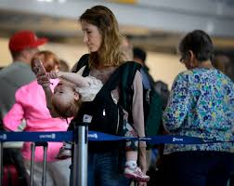
The ministry of reconciliation
“I had ceased to view the crowd as a faceless mass of humanity and instead saw them as individuals with unfolding stories.”
Notes:
In his excellent book on Authentic Relationships, Wayne Jacobsen writes,
“I was en route from my home in California to a speaking engagement in Columbus, Ohio, and my flight arrangements had left me with a three-hour layover in Chicago’s O’Hare Airport. After finding something to eat, I still arrived at my gate more than two hours before my departure. I sat down to read a book that I wanted to finish before my plane boarded. I had barely settled down to read when the noise of a gathering crowd distracted me. This was before the post–September 11 security measures, and friends and family could greet arriving passengers at the gates.
Why can’t they be quieter? I asked myself, foolishly expecting the busy concourse to be like a library. The commotion continued to grow until I found it impossible to concentrate. I looked up in contempt as I prepared to move my things to a quieter gate, and a little girl, no older than five, caught my eye. She gazed longingly out the window and then looked up briefly at her mom and smiled as their eyes met.
A burst of laughter pulled my eyes to a young Japanese family, and behind them a young man stood quietly with a single rose in hand. I found myself captured in the human dramas unfolding around me. Their excitement continued to rise until a jet taxied around the terminal and docked at the gate. In the moments until the passengers finally began deplaning, the crowd grew quieter. It would have been easier to read now, but I had forgotten about my book.
Soon people began to come through the jetway. The little girl being held by her mother above the crowd suddenly screamed, “Daddy!” as a man in military uniform came through the door. As her mom put her down, she barged through the crowd and into his arms. The mother joined them in an embrace, nearly crushing the little girl between them. Tears pooled in my eyes. The Japanese family began to shout greetings in their native language as an elderly couple emerged from the jetway. I wondered if they were the parents of recent immigrants, finally able to see their children’s new homeland. Their joy, expressed in tears, deeply hit me, and I tucked my head lest anyone see mine.
I looked at the young man with the rose. He stared intently up the jetway, and with each passenger emerging his face grew more concerned. When the trickle of people finally stopped, his tension was visible. Had she missed her flight? “Oh no, let her be there, ” I muttered half in prayer. Seconds later she walked out, and his face lit up. He ran to her, and the two lovers embraced. Soon the crowd, more exuberant than ever, moved up the concourse toward the main terminal. I watched them go with a smile on my face. In just a few moments, my contempt for the annoying crowd had been transformed into deep affection. How it happened reveals one of the most powerful characteristics of God’s love.
I had ceased to view the crowd as a faceless mass of humanity and instead saw them as individuals with unfolding stories. That is how Jesus loved too.”
Ever experienced something like that? Where God just changes your attitude and see something in a whole new light? I think we often need that when it comes to redemptive relationships. We need to see people as God’s sees them.

Slide 14
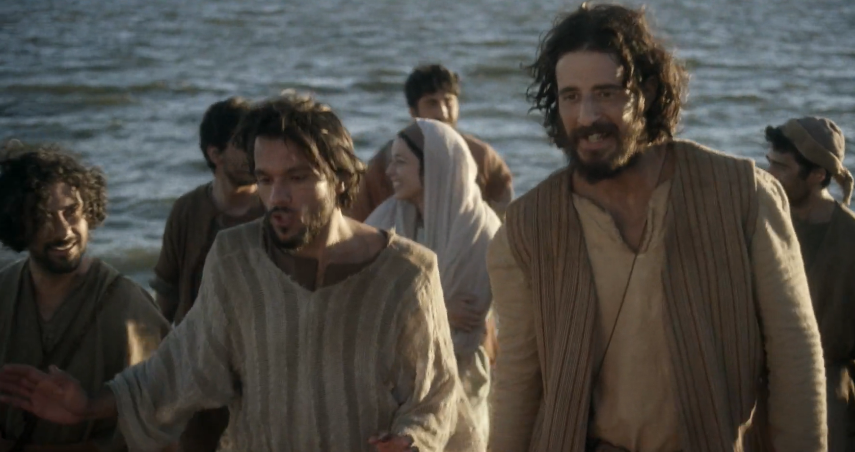
Friendship
Notes:
So how are your friendships? Often when we are young, we get lots of invites and we have lots of energy for relationships. That subsides as we get older. Because friendships take work. Often we have to schedule things weeks in advance. [E.g. the Gillies]
Jesus modelled this beautifully. Do you know, He said very little about the church. You’d think he’d have given us more stuff on how to organize ourselves, run our ministries, and plan our services! But actually, Jesus didn’t talk about it because he was too busy living it!
He was too busy being a friend to a short tax-collector by the name of Zacchaeus, to some fishermen named James, John, Peter and Andrew. He loved calling in on his friends, Mary, Martha and Lazarus on his way to Jerusalem. He even associated with religious guys like Nicodemus and a rejected woman at a well and countless others who came into his orbit.
Look at the ways he engaged them, built relationships with them centred in the Father’s love, and served them with no thought for himself.
With the simple declaration, “I no longer call you servants. . . . I have called you friends” (John 15:15), Jesus identified the nature of the relationship God desires with us —intimate friendship.
So when we come to that Acts 2 passage with which we began the series, we see that the early church simply practised what Jesus had done for them. He taught, fed, served, gathered and sent … and they simply turned around and did likewise!

Slide 15
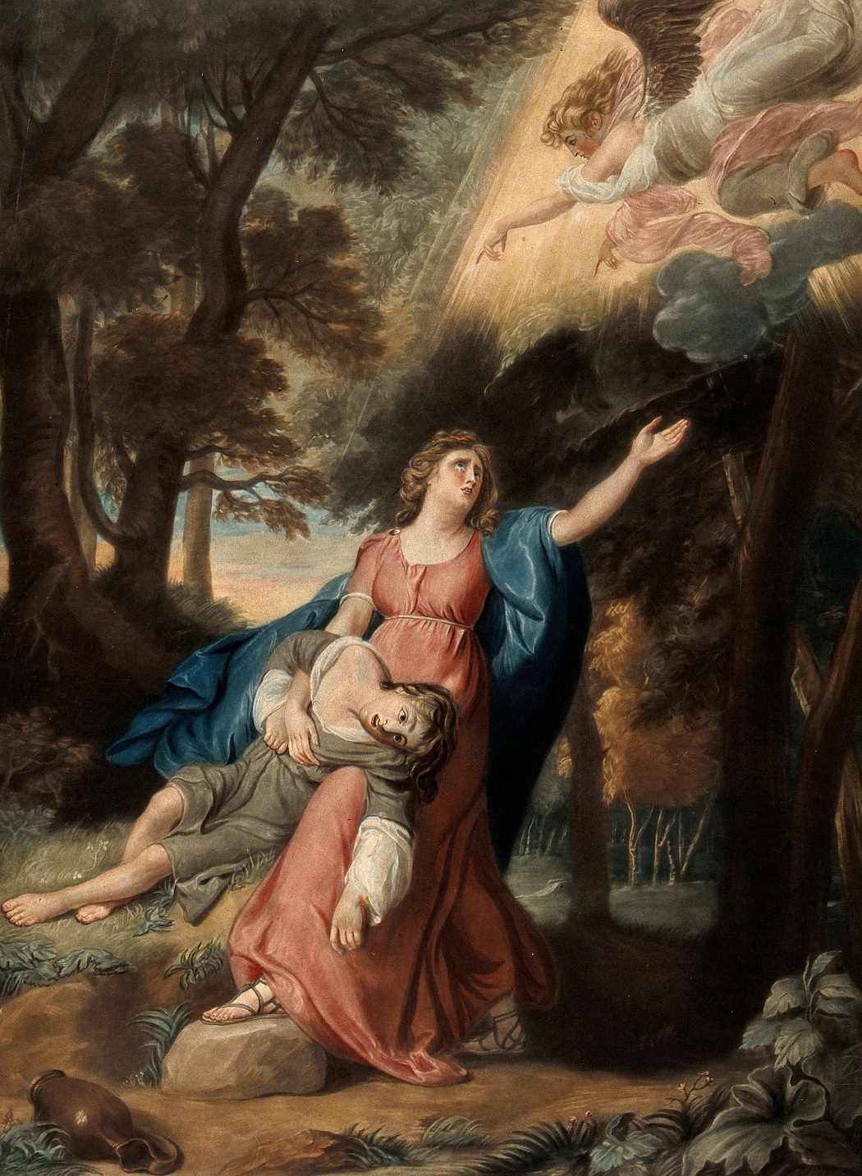
How can a relationship become redemptive?
Hagar and Ishmael saved by an angel - R. Dunkarton and J.S. Copley
Notes:
How can a relationship become redemptive?
Not by seeing people as a project, but genuinely loving and caring for them.
When Sarai sent away her servant and rival, Hagar, into the desert, things looked pretty grim for her and her son. But then an “angel of the LORD” came to her. Now, he had a lot to offer her … but notice what he did first: He called her by name, “Hagar, servant of Sarai.” He then asked two questions: “Where have you come from and where are you going?” The questions opened two horizons for Hagar: her history and her future.
Because we love our friends, we want to see them know the truth about Jesus, but before we “let them have it”, we must treat then as the person they are: made in the image of God and worthy of respect. They have a story that has made them who they are today. They have aspirations for tomorrow. Take the time to get to know people. As the old saying goes, people don’t care how much you know until they know how much you care.
This takes work, but it is doable!

Slide 16
What will you do?
Your colleague tells you they are worried about their rebellious teenager
Your classmate asks you what you did on the weekend
The person sitting beside you on the plane is reading a book on New Age spirituality
A member of your club is taken to the hospital
A family member has significant barriers to belief but is interested in talking
Notes:
In any developing relationship, there comes a time when there’s an invitation to go deeper. What will you do?
…
In these cases, the answer is not necessarily to immediately share the gospel with them, but to take the next step. Maybe it is to share the gospel!

Slide 17
The 1 Degree rule
Notes:
The 1 Degree rule is so helpful in thinking about this. It means that you simply dial up your prayer life / involvement with your friend’s life / understanding of the gospel - whatever - by 1 degree. If your enthusiasm for sharing your faith is a 3 out of 10, you probably won’t instantly go to a 10! But you can ask God to help you move to a 4 or 5. Start with prayer. Ask your small group or a friend to pray with you. [Victoria - always asks us to pray for her dad’s salvation] Simply take that next step. I need to do it too.
And you will find that when you after the first step, the second is not so hard.

Slide 18
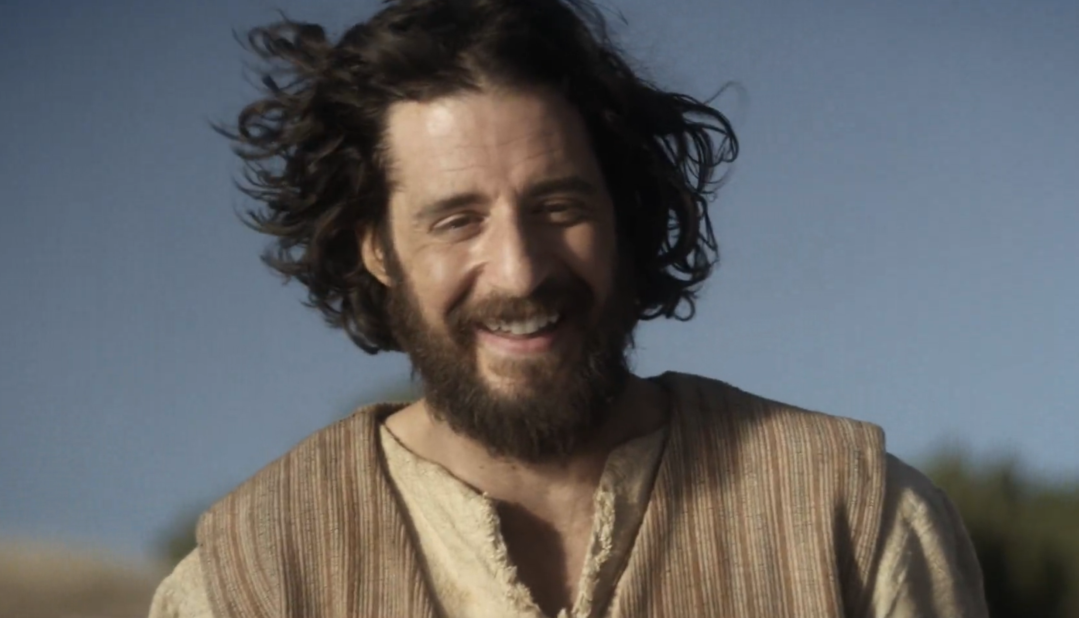
The miraculous catch
Notes:
The early disciples were invited to step our of normal lives but it all began when they encountered Jesus for themselves. Check out this scene from the crowd-funded TV series, The Chosen.
[Show clip: The Miraculous Catch]
So let’s follow Jesus, and allow him to make us fishers of people.

