Slide 1
Philippians 4:10-13
Notes:
This morning we’re talking about contentment. What is contentment and how do we get it?

Slide 2
Notes:
To get the juices flowing, let me ask you a question: describe a scenario in which you feel content. Is it lying on the beach, watching your favourite show, having coffee with friends, completing that DIY project? Have a chat to your neighbour…

Slide 3
Philippians 4:10-13
Paul has learned to be content – whatever the circumstance he faces
“We, my brethren, might well be willing to endure Paul’s infirmities, and share the cold dungeon with him, if we too might by any means attain unto such a degree of contentment.”
Charles Spurgeon
Notes:
Well, this morning we’re going to look at that classic passage on contentment, Philippians 4:10-13.
[Recap of our series – Paul uses his life as an example …]
Philippians 4:10-13
¹⁰ I rejoiced greatly in the Lord that at last you renewed your concern for me. Indeed, you were concerned, but you had no opportunity to show it. ¹¹ I am not saying this because I am in need, for I have learned to be content whatever the circumstances. ¹² I know what it is to be in need, and I know what it is to have plenty. I have learned the secret of being content in any and every situation, whether well fed or hungry, whether living in plenty or in want. ¹³ I can do all this through him who gives me strength.
Paul wants the Philippian church to know that he was very happy to receive the gift they sent. As he roams the empire sharing the gospel and planting churches, he depends on the support of churches like them so he can be set apart for the work of the ministry. But he is also careful to let them know that he did not need the gift or, in verse 17, desire it. Why so circumspect? Why couldn’t he just say, “Your gift came in the nick of the time. It really got me out of a tight spot!” Because he never wanted people to think that he was “in it for the money”. There were plenty of people who were.
One group in Philippi who were well known for asking for money were the charlatan philosophers”, who dressed like philosophers and expected many to give to them, “either out of respect for their cloth or for fear of their abusive language.”
So he says, thanks very much, even though I didn’t need it. You see, I have learned to be content whether my wallet is full or my stomach is empty. This is not Christianity 101, folks. This is the master class! Paul has learned to be content – whatever the circumstance he faced. How do you suppose he did that? Through hard-won experience. Through being chased out of town – quite a lot, through floggings, shipwrecks and imprisonment – he learned to be content.
If we are thinking of taking a shortcut to contentment, we should heed Charles Spurgeon’s words: [quote]
Whatever the circumstances, Paul had learned to be content. So …

Slide 4
What is contentment?
Notes:
A quick google search elicits the definition, “a state of happiness and satisfaction.” The stoic philosophers of Paul’s day saw contentment as “self-sufficiency” – not having to depend on something or someone external to themselves. I’m sure Paul would prefer to talk more about “God-sufficiency” than self-sufficiency, but we’ll get to that soon!

Slide 5
Notes:
The Chinese philosopher, Lao Tzu put it this way: [quote]
I like that, it’s a philosophy which is low on angst and high on acceptance.

Slide 6
Notes:
Mark Twain put it this way: [quote]
That’s not everybody’s idea of the good life. I’m not sure how sporty Mark Twain was for instance, but we can all agree on some of it!

Slide 7
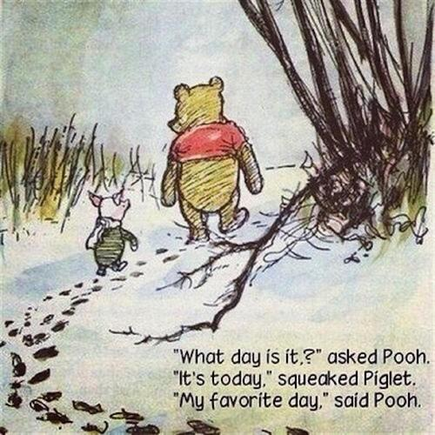
Notes:
How about Winnie the Pooh’s response to Piglet here? [quote]
I like that. The contented bear (or person) is not overly concerned with tomorrow or fussing over what happened yesterday. They are sucking the marrow out of life. They are milking the moment. Such a person can be seen singing in traffic, smelling the freshly cut grass or licking the left over cake mix, even though it is full of sugar!

Slide 8
What works against contentment?
Notes:
What is it that makes contentment so elusive for many of us? Here’s one of the biggies:

Slide 9
Notes:
Comparison
Theodore Roosevelt called comparison “the thief of joy”. That is so true, isn’t it? This is especially true if we perceive that people who are “like us” (similar education, culture, values etc) are doing better than us. Let’s face it, most of us aren’t too envious of Bill Gates, founder of Microsoft, but when the Jones family next door buys a new car and add an extension to their house, we feel like we are missing out if we can’t afford to do the same.
All of this ties into our culture of …

Slide 10
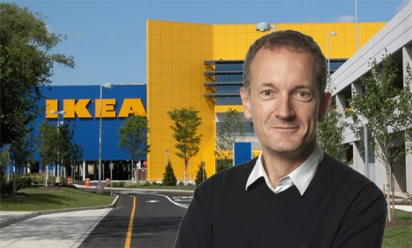
Consumerism
“In the West, we have probably hit “peak stuff.” We talk about peak oil. I’d say we’ve hit peak red meat, peak sugar, peak stuff … peak home furnishings.”
Steve Howard, head of sustainability for IKEA
Notes:
Consumerism
A couple of years ago, Steve Howard the head of sustainability for IKEA, the popular Swedish modular furniture manufacturer, said something very surprising. He said, [quote]
Fascinating! It is unusual for a company to admit we have enough stuff. Why? Because the economy is built on feeding and satisfying people’s appetite for more.

Slide 11
Consumerism
“Last winter …I spent three days at a Christian community devoid of televisions and radios, and removed from billboard-besieged highways. Arriving back at Chicago's O'Hare Airport, I felt assaulted by posters and billboards hyping svelte, suave men and incredibly coiffed, airbrushed women-even though a few days before I had passed them by without a second thought.
Notes:
Rodney Clapp in his excellent article The Devil takes Visa describes his re-entry into the world of consumerism: [quote]

Slide 12
Consumerism
Deprived of these stimuli for half a week, the ads seemed hollow, artificial, even unnatural. I heard myself mutter, "This is not the way things are supposed to be."
Rodney Clapp, The Devil takes Visa
Christianity Today, 40/11 (1996), 19-33
Notes:
Ever felt like that? It’s the water we swim isn’t it? And we don’t even notice it. It can be hard to be content with what we have when the culture screams, “You must have more!” And yet it’s a lie. Sooner or later, we realise we’ve been sold a lie.

Slide 13
So what?
¹⁰ I denied myself nothing my eyes desired; I refused my heart no pleasure. My heart took delight in all my labour, and this was the reward for all my toil. ¹¹ Yet when I surveyed all that my hands had done and what I had toiled to achieve, everything was meaningless, a chasing after the wind; nothing was gained under the sun.
Ecclesiastes 2:10-11
Notes:
As the writer of Ecclesiastes expressed, [quote]\
What was the point of it all?
Now, before we talk about the secret to the contentment, it’s worth mentioning

Slide 14
What contentment is not

Slide 15
Contentment is not complacency
Notes:
[Heading] –an excuse for doing nothing. Just look at Jesus – he’s a good model! What did he do when he saw the crowds - harassed and helpless, like sheep without a shepherd? Did he say, “Thank you Lord that I’m not like them! I am content!” No, obviously not. He had compassion on them. He fed them. He healed them. He taught them. And he trained up a band of men who would minister to them after he was gone. The word compassion has a flash of anger associated with it. Jesus was, frankly, ticked off by the injustice on the world, by the way Satan oppressed people and took away their freedom. He was especially peeved by the religious leaders. To them he said, “Woe to you, teachers of the law and Pharisees, you hypocrites! You travel over land and sea to win a single convert, and when you have succeeded, you make them twice as much a child of hell as you are!” Matthew 23:15. And many other choice words!

Slide 16
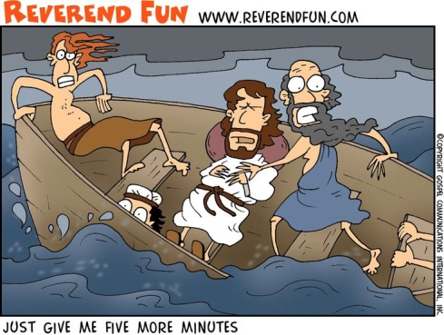
Notes:
No, Jesus was an activist, but he was also content. I love the picture of Jesus in the boat with the disciples during a brutal storm. What is Jesus doing while the wind is howling and the waves are engulfing the little boat and her crew. He’s asleep!
Now, you and I know what happened next. Jesus rebukes them for their lack of faith and calms the storm. But the disciples didn’t know that. They didn’t understand that he wasn’t worried by the storm because he trusted in God in the midst of the storm. He was asleep in his father’s arms, and that’s the safest place to be.

Slide 17
Contentment is not complacency
“I do not consider myself yet to have taken hold of it. But one thing I do: forgetting what is behind and straining towards what is ahead”
Phil 3:13
Don’t be content with what you have attained spiritually
Do be content with what you have materially
Notes:
Just as contentment is not complacency about those around us, it’s also not complacency about our own spiritual health. The kiwi slogan, “she’ll be right” is not a completely helpful recipe for spiritual vitality! Paul is a superb model here. Last week, Ashton told us how he vowed to press on to know Christ more. [verse]
That word, “straining”, means to lean forward, to extend. This was no mere walk in the park. It was an Olympic race! And he was giving it everything he had.
He was not satisfied with where he was. There was so much more to be taken hold of than just “being saved.”
So: [Final two points here]
Does that mean we shouldn’t aim for a better job or ask for a pay rise? No. But in our current situation, we are (somehow) content.
And it’s the “somehow” that I want to turn to now.

Slide 18
How CAN we experience this kind of contentment no matter what?
I can all this through him who gives me strength (verse 13)
There is hope for the helpless, rest for the weary And love for the broken hearts There is grace and forgiveness, mercy and healing He'll meet you wherever you are
Cry out to Jesus Cry out to Jesus
Third Day
Notes:
Paul gives us the answer in verse 13: [verse]
If we were interviewing Paul right now, he would say, “Finally, you’re getting to the point! The secret is him. It’s Christ!
The band, Third Day said it well: [song]
Cry out to Jesus, and he will bring a ridiculous degree of contentment completely unrelated to the situation you find yourself in! Whereas others, like Job’s wife, will say, “Curse God and die”, you will say, along with Job, “The Lord has given and the Lord has taken away. Blessed be the name of the Lord.”
Hey, that’s another good song…
… But I’ve always found it easier to sing than to do. How about you?
“I have learned to be content”, Paul says. What is the curriculum in this school of contentment? How do we unlock the strength of Christ in our lives? I believe Paul gives us four keys in this very chapter: rejoice, pray, thank and dwell.

Slide 19
Choose joy (v. 4)
Notes:
4 Rejoice in the Lord always. I will say it again: rejoice!
Don’t wait for circumstances to change, choose joy right now. When we choose joy, we affirm that this is not all there is. That there is a God who reigns in this world who will one day right all the wrong, and we’ll be laughing in the presence of Jesus.
In the third book of his trilogy about the leper, Thomas Covenant who is transported to another world called, simply “the Land”, our hero faces his nemesis, Lord Foul the Despiser (not a nice guy!) in a final showdown. He is accompanied by his friend and faithful companion, the giant, Saltheart Foamfollower. They are both broken and desperate and all hope seems lost. Covenant realizes that he can’t beat Foul with force alone so he does a weird thing. He asks Foamfollower to laugh.
“With a terrible effort, Saltheart Foamfollower, the last of the Giants, began to laugh. It was a gruesome sound at first; writhing in his fetters, Foamfollower spat out the laugh as if it were a curse… But as Foamfollower fought to laugh, his muscles loosened. The constriction of his throat and chest relaxed, allowing a pure wind of humour to blow the ashes of rage and pain from his lungs. Soon something like joy, something like real mirth, appeared in his voice…Lord Foul cringed at the sound. He strove to sustain his defiance, but could not. With a cry of mingled pain and fury, he covered his face and began to change.”
So Lord Foul becomes younger and younger. His body shrinks and fades with every undone age … For an instant, he is a loud infant, squalling in his ancient frustration. Then he disappears altogether.
It’s a powerful scene. Despair, hopelessness and evil are banished by the defiant laughter of faith. Secondly,

Slide 20
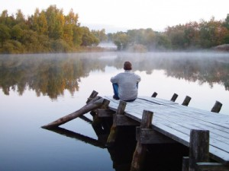
Pray (v. 6)
Notes:
6 Do not be anxious about anything, but in every situation, by prayer and petition, with thanksgiving, present your requests to God.
It’s pretty obvious, isn’t it? But not too obvious that we can overlook this powerful weapon! Do we pray that God will change our circumstances? Maybe? But it seems the mature follower of Jesus tends to pray for strength and courage and peace in the midst of those circumstances. This was the attitude of two Iranian women, Maryam and Marziyeh, imprisoned by the regime for converting to Christianity and sharing their faith with others. That are locked in the notorious Evin prison for eight months, they endured interrogations, and appalling living conditions. But they saw it is an opportunity form the Lord. They shone brightly for Jesus in that dark place. They prayed and cared for the other women in the prison, who were so often unjustly imprisoned. Many were impacted by their faith, including the guards.
What an inspiring story! They personify Paul’s attitude in Philippians 1:20:
20 I eagerly expect and hope that I will in no way be ashamed, but will have sufficient courage so that now as always Christ will be exalted in my body, whether by life or by death.
I heartily recommend their book, “Captive in Iran”, to you. You will be grateful for what we have in NZ, but you will also see that when the need is great, God’s grace is sufficient to meet that need. You are I don’t live in fear of being rounded up by the Revolutionary Guard. We trust that our judicial system has a low level of corruption by world standards. And so, to be honest, we are not that desperate for God’s help. But when we are faced with our own “Evin prison”, whatever that might be, God’s grace is right there. And we can call on his help.
So pray. And along with that …

Slide 21
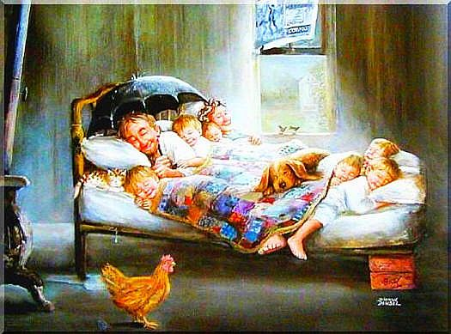
Give thanks (v. 6)
Notes:
for what you have. There are people in this world far worse of.
Dr Seuss wrote,
“When you think things are bad, when you feel sour and blue, when you start to get mad… You should do what I do! Just tell yourself, Duckie, you’re really quite lucky! Some people are much more…Oh, ever so much more…Oh, muchly much-much more unlucky than you!"
Sage advice indeed. And that great sage of daytime TV, Oprah Winfrey agrees.
“Be thankful for what you have; you'll end up having more. If you concentrate on what you don't have, you will never, ever have enough.”
An old woman, living in a cottage, had nothing but a piece of bread and a little water. She lifted up her hands and said, ‘What! All this, and Christ too?’
That’s the attitude that chases away the temptation to be discontent. And then

Slide 22
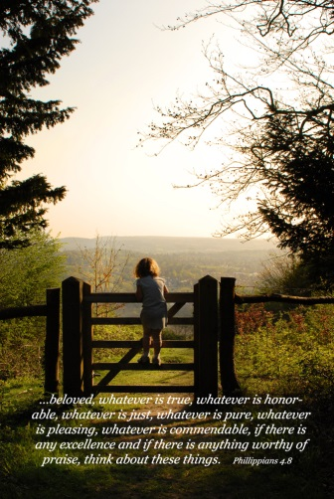
Dwell (v. 8)
Notes:
Dwell on the right stuff.
8 Finally, brothers and sisters, whatever is true, … noble, … right, … pure, … lovely, …admirable – if anything is excellent or praiseworthy – think about such things.
Some people ask, should Christians watch horror movies? Should they listen to heavy metal, or paint nudes?
Or a thousand other questions of morality. The Bible doesn’t prescribe what YouTube video we should watch, or how much Netflix bingeing is too much or when Instagram becomes an addiction, but what it does say, is be careful what you feed your mind. What we dwell on impacts, over time, our hearts.
Above all else, guard your heart, for everything you do flows from it. Proverbs 4:23
Are reading the Word? You say, “Ok, I will.” But you think, “It’s boring.” And it stays on the shelf. But this book is the light saber that will save your life (if you’ll excuse the Star Wars metaphor!) Because this book will lead you to Jesus – again and again. And you will find that you can do ALL things through him who strengthens you. It takes discipline, but there are some things that will help. Find a friend and study together. Use a good tool like the YOU Bible app available on iPhone and Android or the good old SU notes. Or try the Audio Bible if reading is not your thing. David Suchet (who has recently completed his last Hercule Poirot mystery on TV) has just completed a new audio Bible in the NIV version which is wonderful to listen to. Pathways College online courses are a great way to develop your habit and passion for the Word. (I’m even on there!)
So – rejoice, pray, thank and dwell. What then? Verse 7 …

Slide 23
The result?
And the peace of God, which transcends all understanding, will guard your hearts and your minds in Christ Jesus.
Phil 4:7
Notes:
[Verse]
That peace, like a river that floods your soul, will nurture the sweet fruit of contentment.

Slide 24
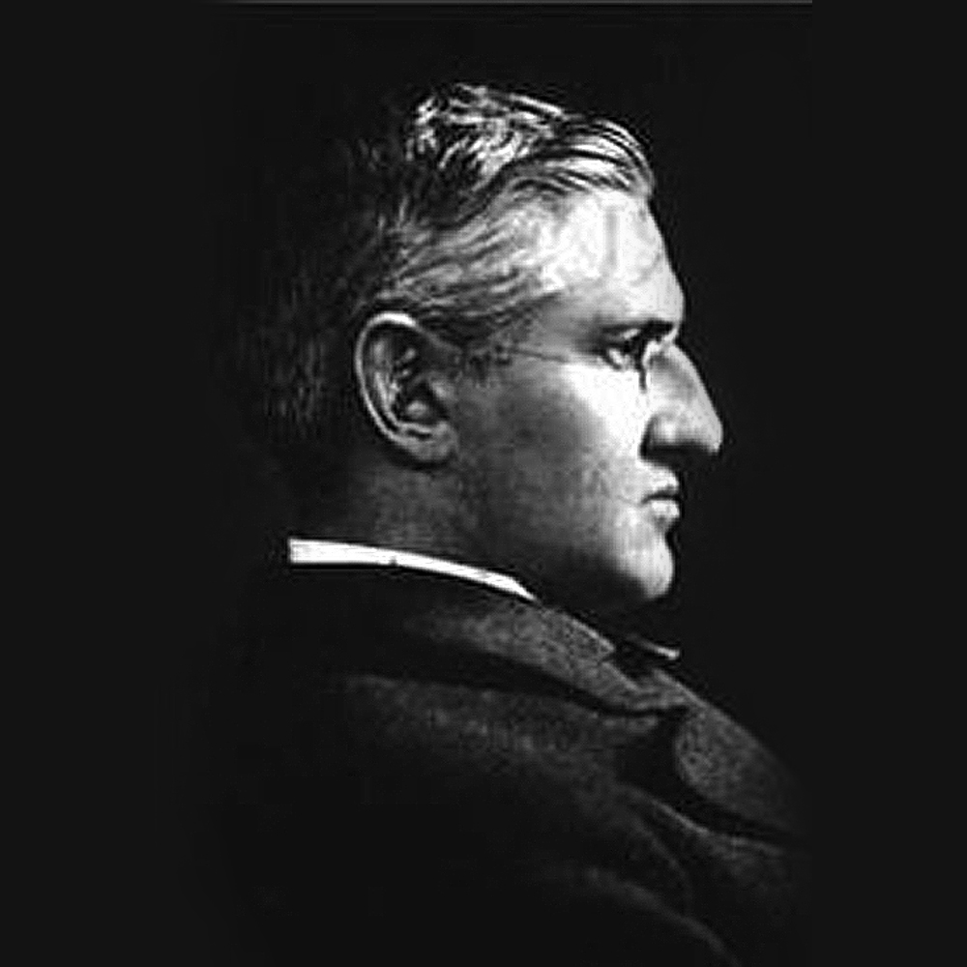
Horatio Spafford
Notes:
Maybe you’ve heard the story of Horatio Spafford, who wrote the hymn, “It is well with my soul.” Spafford was a wealthy Chicago lawyer with a thriving legal practice, a beautiful home, a wife, four daughters and a son. He was also a devout Christian and faithful student of the Scriptures. At the very height of his financial and professional success, Horatio and his wife Anna suffered the tragic loss of their young son. Shortly afterwards, the Great Chicago Fire of 1871 destroyed almost every real estate investment that he had.
In 1873, Spafford scheduled a boat trip to Europe in order to give his wife and daughters a much needed vacation and time to recover from the tragedy. Spafford sent his wife and daughters ahead of him while he remained in Chicago to take care of some business. Several days later he received notice that his family's ship had encountered a collision. All four of his daughters drowned; only his wife had survived.
With a heavy heart, Spafford boarded a boat that would take him to his grieving Anna in England. It was on this trip that he penned those now famous words …

Slide 25
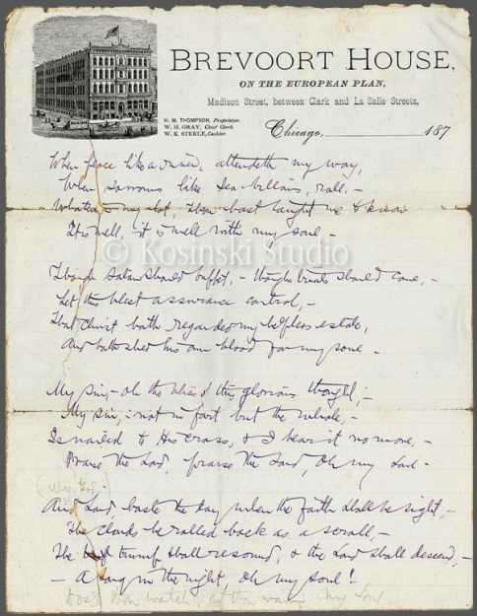
Notes:
When peace like a river, attendeth my way, When sorrows like sea billows roll; Whatever my lot, Thou hast taught me to say, ‘It is well, it is well with my soul.’
May you experience that truth again and again in 2016: ‘It is well, it is well with my soul.’

