Slide 1
The Pharisees and some of the teachers of the law who had come from Jerusalem gathered around Jesus and saw some of his disciples eating food with hands that were defiled, that is, unwashed. (The Pharisees and all the Jews do not eat unless they give their hands a ceremonial washing, holding to the tradition of the elders. When they come from the marketplace they do not eat unless they wash. And they observe many other traditions, such as the washing of cups, pitchers and kettles.)
So the Pharisees and teachers of the law asked Jesus, “Why don’t your disciples live according to the tradition of the elders instead of eating their food with defiled hands?”

Slide 2
... And he continued, “You have a fine way of setting aside the commands of God in order to observe your own traditions! For Moses said, ‘Honor your father and mother,’ and, ‘Anyone who curses their father or mother is to be put to death.’ But you say that if anyone declares that what might have been used to help their father or mother is Corban (that is, devoted to God)— then you no longer let them do anything for their father or mother. Thus you nullify the word of God by your tradition that you have handed down. And you do many things like that.”

Slide 3
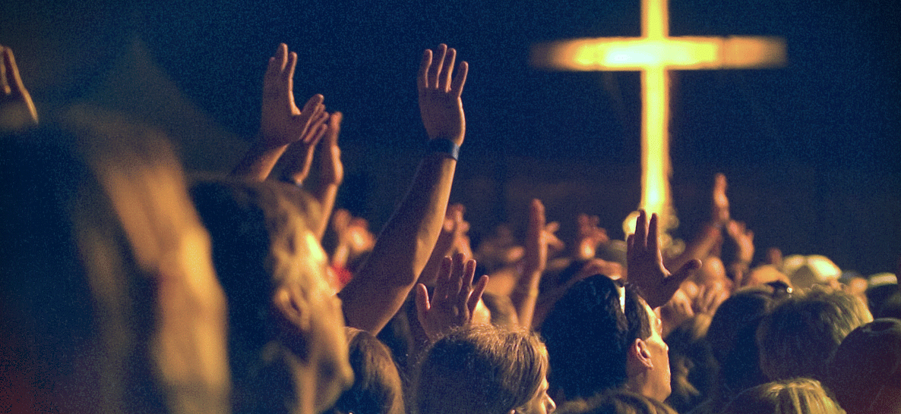

Slide 4
Now John’s disciples and the Pharisees were fasting. Some people came and asked Jesus, “How is it that John’s disciples and the disciples of the Pharisees are fasting, but yours are not?”
Jesus answered, “How can the guests of the bridegroom fast while he is with them? They cannot, so long as they have him with them. But the time will come when the bridegroom will be taken from them, and on that day they will fast.

Slide 5
“No one sews a patch of unshrunk cloth on an old garment. Otherwise, the new piece will pull away from the old, making the tear worse. And no one pours new wine into old wineskins. Otherwise, the wine will burst the skins, and both the wine and the wineskins will be ruined. No, they pour new wine into new wineskins.”

Slide 6
After Jesus and his disciples arrived in Capernaum, the collectors of the two-drachma temple tax came to Peter and asked, “Doesn’t your teacher pay the temple tax?”
“Yes, he does,” he replied.
When Peter came into the house, Jesus was the first to speak. “What do you think, Simon?” he asked. “From whom do the kings of the earth collect duty and taxes—from their own children or from others?”
“From others,” Peter answered.
“Then the children are exempt,” Jesus said to him. “But so that we may not cause offense, go to the lake and throw out your line. Take the first fish you catch; open its mouth and you will find a four-drachma coin. Take it and give it to them for my tax and yours.”

Slide 7
Though I am free and belong to no one, I have made myself a slave to everyone, to win as many as possible. To the Jews I became like a Jew, to win the Jews. To those under the law I became like one under the law (though I myself am not under the law), so as to win those under the law.

Slide 8
Has God commanded this?
No
Is it good?
No
Is it bad?
Yes
Yes
Yes
No
Should I do it anyway out of love and respect?
DO IT
DON’T DO IT
Yes
No

Slide 9
Has God commanded this?
TEACH SOMETHING ELSE
No
Is it good?
No
Yes
Yes
TEACH IT
TEACH IT As a tradition, not a command

Slide 10
HOMEWORK

