Slide 1

Some ABCs of parenting

Slide 2
Accept your children as a gift from God
Let them know you love them no matter what
Discipline and love
⁹ … we have all had human fathers who disciplined us and we respected them for it. How much more should we submit to the Father of spirits and live!
¹¹ No discipline seems pleasant at the time, but painful. Later on, however, it produces a harvest of righteousness and peace for those who have been trained by it.
  Hebrews 12:9 & 11

Slide 3
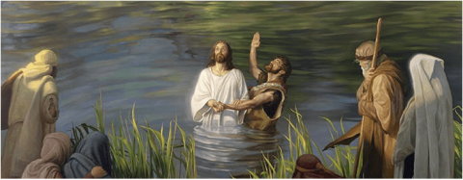
‘This is my Son, whom I love; with him I am well pleased.’

Slide 4
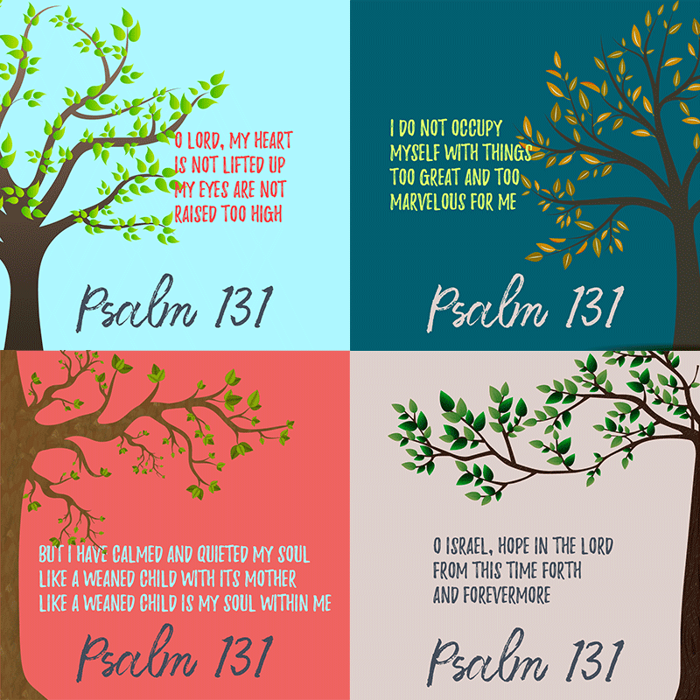

Slide 5
Build your family on Christ
“No matter how big you grow, never grow up so much that you lose your child's heart: full of trust in God.”
"Hear O Israel: The Lord our God is one. Love the Lord your God with all your heart, and with all your soul, and with all your strength… These commandments that I give you today are to be upon your hearts. Impress them on their children. Talk about them when you sit at home and when you walk along the road, when you lie down and when you get up. Tie them as symbols on your hands and bind them on your foreheads. Write them on the doorframes of your houses and on your gates."
  Deuteronomy 6:2,6-9

Slide 6



Good Resources

Slide 7
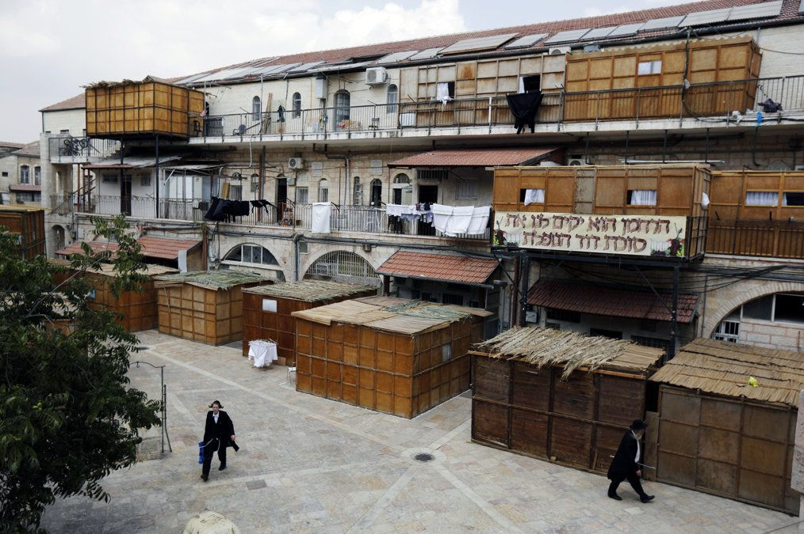
Celebrate often
Feast of Booths

Slide 8
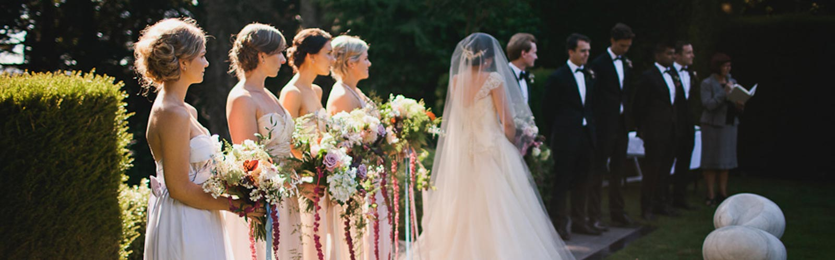

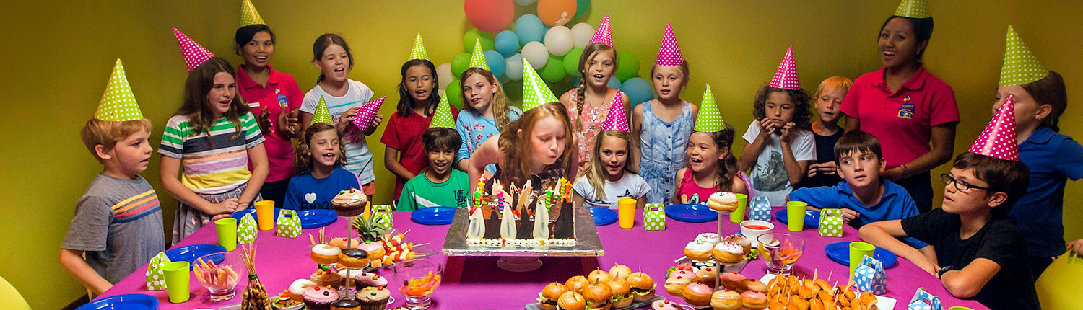
Celebrate often

