Slide 1
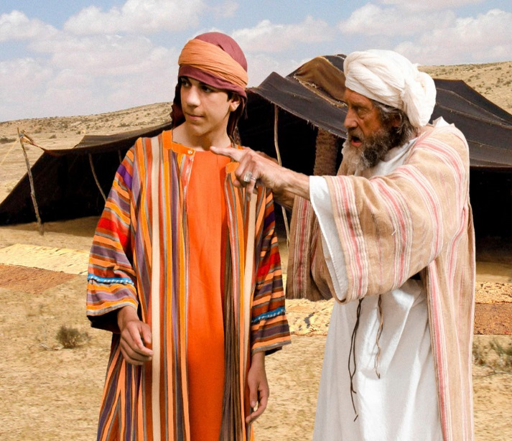
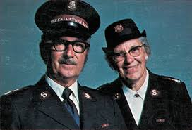
Joseph c 1600-1700BC
Josef and Erna Korbel 1907-2002

Slide 2
THE LORD WAS WITH JOSEPH
Genesis 39: 2, 3, 21, 23
BUT GOD WILL GIVE …. 41:16
GOD HAS REVEALED …. 41:25
GOD HAS SHOWN ……. 41:28
…THE MATTER HAS BEEN FIRMLY DECIDED BY GOD, AND GOD WILL DO IT SOON …. 41:32
GOD SENT ME AHEAD OF YOU ….. 45:5, 7
IT
WAS NOT YOU WHO SENT ME HERE, BUT GOD . 45:8
GOD HAS MADE ME …. 45:9

