Slide 1
2020 Vision: Shining in the City
#1 David’s Dream

Slide 2

Psalm 84
1 How lovely is your dwelling-place,
Lord Almighty!
2 My soul yearns, even faints,
for the courts of the Lord;
my heart and my flesh cry out
for the living God.
3 Even the sparrow has found a home,
and the swallow a nest for herself,
where she may have her young –
a place near your altar,
Lord Almighty, my King and my God.

Slide 3
Psalm 84
⁴ Blessed are those who dwell in your house;
they are ever praising you.
¹⁰ Better is one day in your courts
than a thousand elsewhere;
I would rather be a doorkeeper in the house of my God
than dwell in the tents of the wicked.

Slide 4

Psalm 27
4 One thing I ask from the Lord,
this only do I seek:
that I may dwell in the house of the Lord
all the days of my life,
to gaze on the beauty of the Lord
and to seek him in his temple.
5 For in the day of trouble
he will keep me safe in his dwelling;
he will hide me in the shelter of his sacred tent
and set me high upon a rock.
Notes:
Beautiful words…

Slide 5
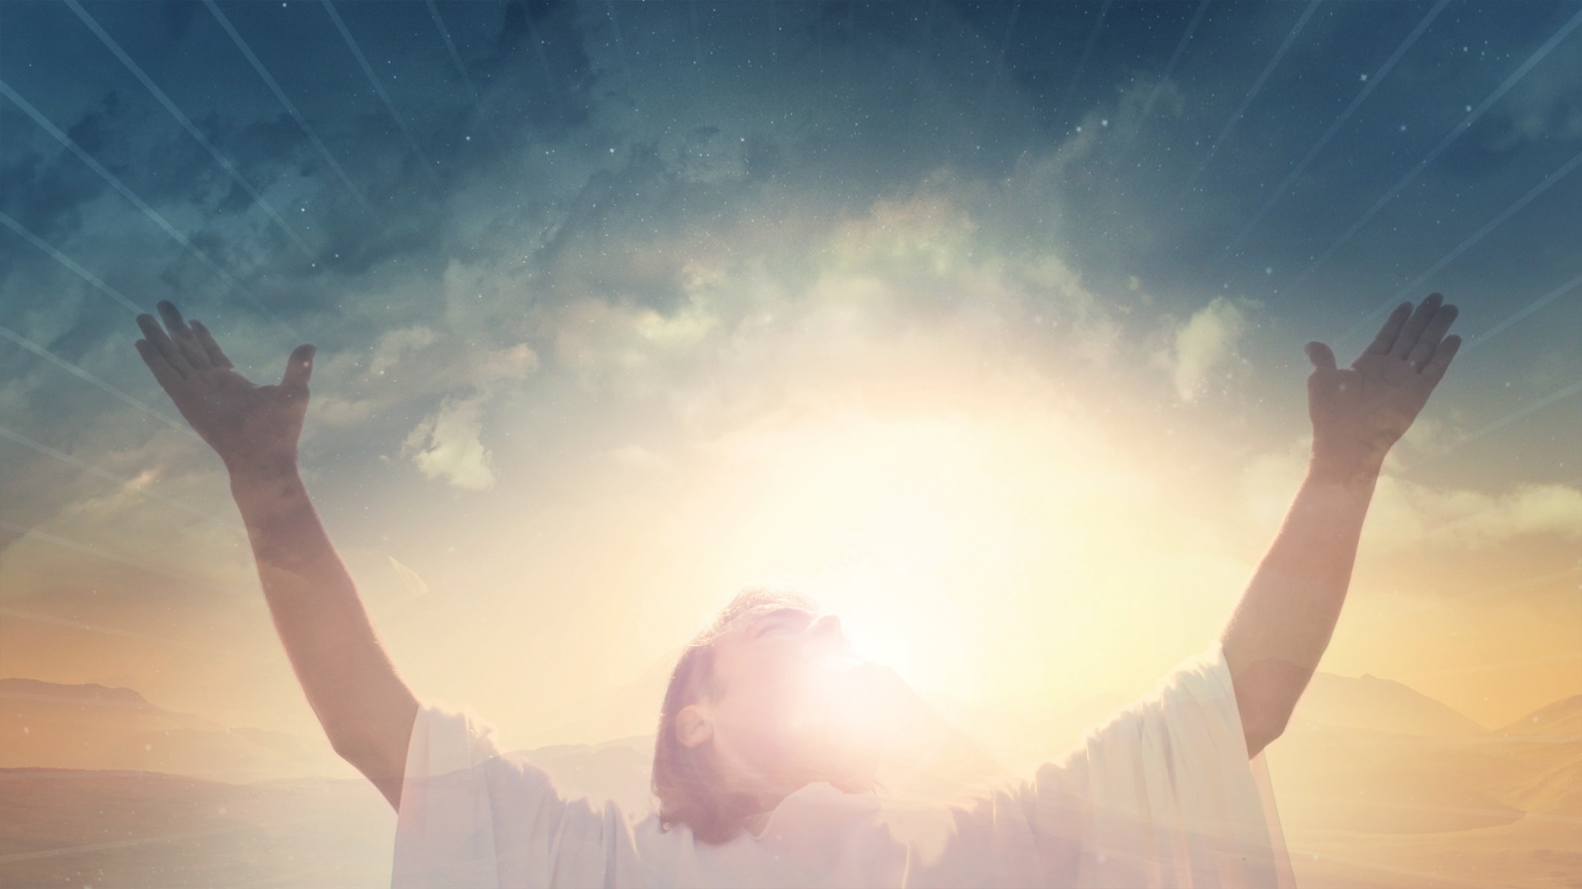
Introduction
David loved to worship!
Have you ever experienced worship that seemed to carry you to the very throne room of God?
Notes:
David loved to worship! From his boyhood when he looked after sheep to becoming an outlaw on the run from murderous King Saul to eventually becoming King himself, David had a heart of worship.
Have you ever …?
The location doesn’t matter. It can be by yourself at the beach or in a crowd of thousands. Often we are distracted, aren’t we? Maybe be something amiss in the music team or our our own thoughts. But occasionally, we feel the presence of God. Wouldn’t it be great if people came to our church and said, long with Jacob, “Surely God is in the place!”

Slide 6
David’s Dream
¹⁷ …he said to Nathan the prophet, ‘Here I am, living in a house of cedar, while the ark of the covenant of the Lord is under a tent.’ (1 Chronicles 17:1)
¹⁴ I will set him [your son] over my house and my kingdom for ever; his throne will be established for ever.”’
¹⁶ … ‘Who am I, Lord God, and what is my family, that you have brought me this far? ¹⁷ And as if this were not enough in your sight, my God, you have spoken about the future of the house of your servant. You, Lord God, have looked on me as though I were the most exalted of men…”
Notes:
David really loved to worship God but much of his career forced him to be more warrior than worshipper. But finally, when he had rest from all enemies, he turned his attention to a long-held dream:
“He said to Nathan …”
Now, the ark of the covenant was the box containing the 10 commandments. It symbolised the presence of God.
Nathan thought this sounded like a good idea, until he went to bed! God spoke to him in a dream. David was not the one to build the temple. God would raise up his son to build it instead.
Now, it would be understandable if David was disappointed. He so wanted to create a structure to honour the God he loved so much. But there is no evidence that he complained. Listen to the promise God made through Nathan the prophet:
“I will set him …”
Wow! That’s some promise!
David didn’t focus on his thwarted ambition. He was overwhelmed by God’s goodness to him:
“Who am I …”
David was a man of humility. He never felt God owed him anything. Everything God gave him was a bonus. Did he get proud and complacent? You bet! Especially when he sinned with Uriah’s wife and and had him killed after she fell pregnant. But when Nathan confronted him with his sin, he admitted it immediately.
You see, God owned David’s heart. Obedience to God was something David treasured above all and he strived to give it and was bitterly disappointed when he failed.

Slide 7

A lesson for us
Perfection vs. Grace
Do we sometimes lose sight of this?
Let’s celebrate the gospel!
Notes:
David’s example speaks to us today. [Perfection vs. grace]
Many people think that to be a Christian is to claim to be perfect, or at least well-behaved and not swearing! I don’t know where they get that idea! Being a Christian is about being a messy, sinful human being, just like everybody else. But a human being who has accepted God’s offer of love and forgiveness and eternal life through Jesus Christ.
Do we sometimes lose sight of this? Yes. Do we begin to think it’s about good works and religious observances? Often.
Religious observances are fine, but not as a means to be saved. They are a response. It’s easy to look to religion as the way of salvation instead of simply the worship of the Saviour.
So let’s celebrate the gospel. It really is Good News!
David accepted that he wasn’t the one to build the temple, but he figured he could get the ball rolling.

Slide 8
David’s Preparations
¹ Then King David said to the entire assembly, "My son Solomon, whom alone God has chosen, is still young and inexperienced and the work is great; for the temple is not for man, but for the LORD God. ² "Now with all my ability I have provided for the house of my God the gold for the things of gold, and the silver for the things of silver, and the bronze for the things of bronze, the iron for the things of iron, and wood for the things of wood, onyx stones and inlaid stones, stones of antimony and stones of various colours, and all kinds of precious stones and alabaster in abundance.

Slide 9
David’s Preparations
³ "Moreover, in my delight in the house of my God, the treasure I have of gold and silver, I give to the house of my God, over and above all that I have already provided for the holy temple, ⁴ namely, 3,000 talents of gold, of the gold of Ophir, and 7,000 talents of refined silver, to overlay the walls of the buildings; ⁵ of gold for the things of gold and of silver for the things of silver, that is, for all the work done by the craftsmen…”
  1 Chronicles 29:1-5
Notes:
Let’s put this in perspective. This was a lot of gold. One talent would be worth about 2 million NZD. That’s the average house price in Herne Bay! Multiply that by 3,000 plus the silver etc. David amassed a huge supply of materials to give Solomon a head start on the building. He also gave him extensive blueprints and spent many hours explaining what he would need to do.

Slide 10
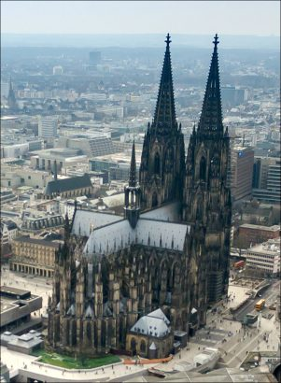
After you’re gone
Have you ever prepared something for someone else to complete after you've gone?
We are also in the building industry. We are building the kingdom of God. With bricks of faith and steel of truth and mortar of love and roads of peace and citizens of joy, God’s reign is being extended on earth as it is in heaven.
Notes:
Have you ever …? Maybe you’ve changed companies and had to leave a project unfinished. Imagine starting work on one of the great cathedrals of Europe in the Middle Ages and knowing you would probably die before it was finished! For example, Cologne Cathedral was completed in 1880, 632 years after the corner stone was laid!
We are also in the building industry. We are building the kingdom of God. With bricks of faith and steel of truth and mortar of love and roads of peace and citizens of joy, God’s reign is being extended on earth as it is in heaven.
This takes a long term perspective, doesn’t it!
We will probably not see its completion in our lifetime, but the goal is actually the most worthwhile goal there is.

Slide 11
David’s Invitation
⁵ ‘Now, who is willing to consecrate themselves to the Lord today?’ ⁶ Then the leaders of families, the officers of the tribes of Israel, the commanders of thousands and commanders of hundreds, and the officials in charge of the king’s work gave willingly. ⁷ They gave towards the work on the temple of God five thousand talents and ten thousand darics [type of coin] of gold, ten thousand talents of silver, eighteen thousand talents of bronze and a hundred thousand talents of iron.
Notes:
So David prepared for the work - then he invited the people to contribute:

Slide 12
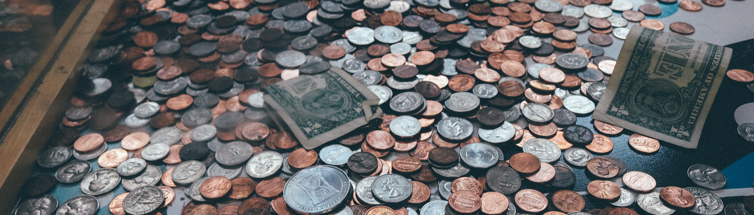
David’s Invitation
⁸ Anyone who had precious stones gave them to the treasury of the temple of the Lord in the custody of Jehiel the Gershonite. ⁹ The people rejoiced at the willing response of their leaders, for they had given freely and wholeheartedly to the Lord. David the king also rejoiced greatly.
  1 Chronicles 29:5-9
Notes:
Wow. Ever been part of something like that? It’s pretty exciting as God’s people respond wholeheartedly to the Lord, When, inspired by God, they unite behind a shared vision. [P.O.P.T.A.R.T.S.] David set the example and the people followed.

Slide 13
Our Dream
2020 Vision: “Shining in the City”
We have purchased a new property and we will be re-purposing the ground floor and first floor to host Sunday services and other programs for CM and EM - and MM
What is the purpose of the church?
  The church is God’s worshipping and witnessing people, chosen by Him to live and tell the Good News about Jesus.
  We have come to the conclusion that we can best do that in a larger facility with more parking and more room for growth.
Notes:
2020 Vision …
It’s not a temple, but we can still learn lessons from David’s temple dream as we stand here at the beginning of 2020
David’s dream was to build a temple so that the people could meet God.
What is the purpose of the church? Is it something to do on Sunday mornings, a group to belong to, an education or community facility, a purveyor of religious goods and services? No - well, maybe partly - but it’s far more.
The church is God’s worshipping and witnessing people, chosen by him to live and tell the Good News about Jesus.
We have come to the conclusion that we can best do that in a larger facility with more parking and more room for growth.

Slide 14
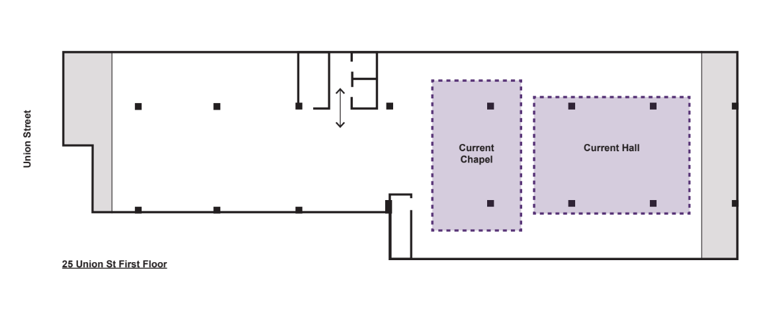
Our Dream
We want to grow. Why?
Notes:
Floor plan
[Notice how the existing facilities fit inside the first floor of 25 Union St.]
We want to grow. Why? Because it looks good on those forms we send to PCANZ? Who cares about the forms? No. Because we long to see people from every culture in Auckland understanding the gospel and being invited to become part of the church. We stand with all Bible-believing, Christ-honouring, gospel-centred churches in Auckland in this. With 60,000 people in the CBD and not many churches, most of them catering for people in the suburbs (!), the harvest is plentiful, folks! And the opportunity of 25 Union St feels to me like church-planting in the city. It is a new day for ACPC.

Slide 15
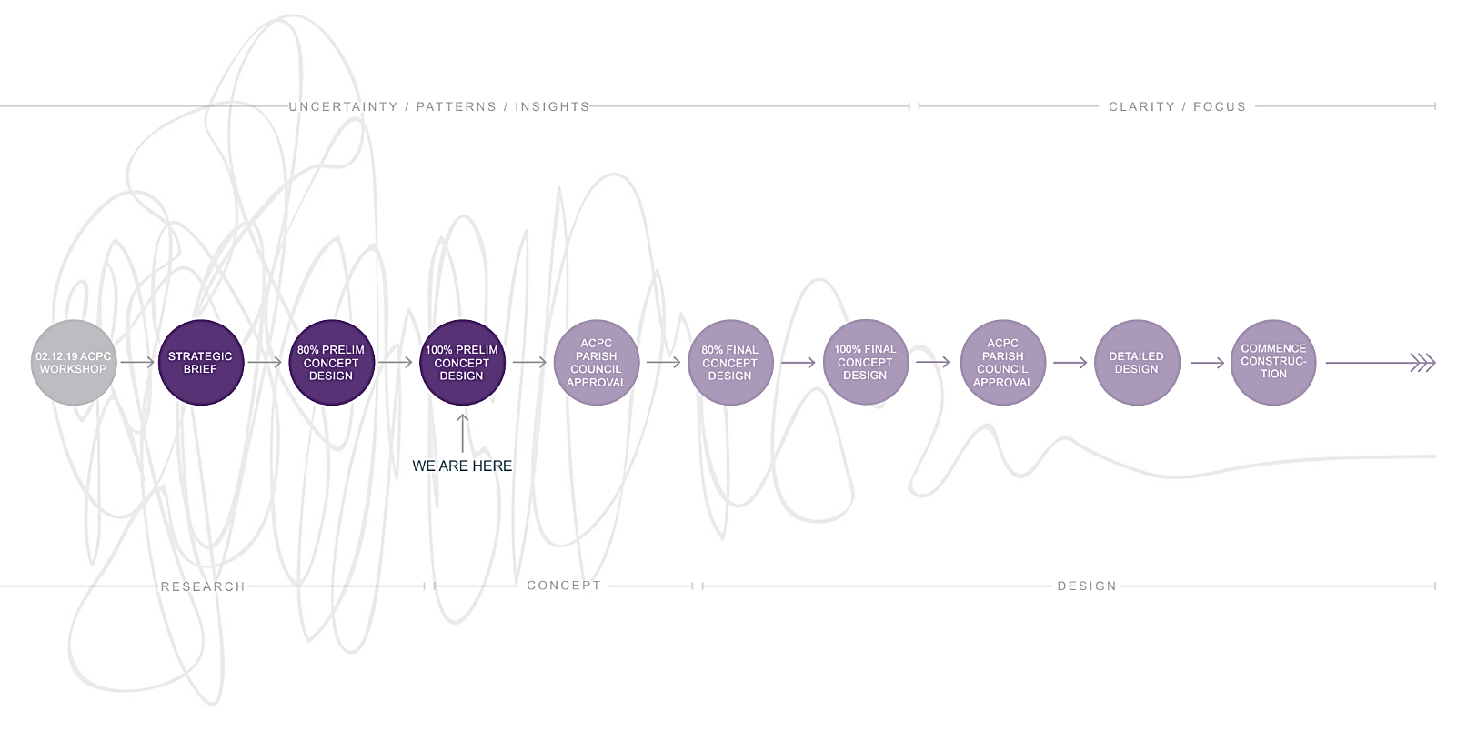
Our Preparations
Notes:
Just as David got things ready, 2020 is the year of preparation for us.
Diagram
Above is the process we are going through with the architects currently. We have seen a preliminary plan which you will hear about soon…
We really need to sell 105 Vincent St! Pray for that.
And we need God to supply what we need to make 25 Union St an effective place from which we as a church can shine brightly in the city.
So we are going to be preparing. Not just raising money, though that comes into it, but preparing our hearts to step out of our comfort zones, to turn up the brightness, to connect with the people of Auckland - Chinese, Kiwi Chinese, Kiwi other and (simply) other. (I think that covers most people!)

Slide 16
Our invitation
Heart
Prayer
Teamwork
Expertise
Funding
Notes:
So the parish council of ACPC want to invite all of us to be part of this 2020 Vision through:
Heart * Prayer …
Prayer is so important. Pray for a real shared vision as we move forward. In the process of building, many spiritual battles will be faced. We must face them with prayer and open communication. Pray for G2 Architects - for inspiration and creativity from God himself. Pray for the people who will be reached for Christ from our new church home.

Slide 17
Our invitation
When the religious leaders wanted to put the apostles to death, a highly respected Pharisee named Gamaliel stood up and addressed them. He mentioned several failed religious movements and their dead leaders.
³⁸“Therefore, in the present case I advise you: leave these men alone! Let them go! For if their purpose or activity is of human origin, it will fail. ³⁹ But if it is from God, you will not be able to stop these men; you will only find yourselves fighting against God.’
  Acts 5:38-39
“God’s work done in God’s way will never lack God’s provision.”
  J. Hudson Taylor
Notes:
I’ve been studying the Book of Acts this month. The apostles were causing a stir - preaching and healing in the name of Jesus. The little sect the religious leaders thought they’d snuffed out seemed to expanding even more now that Jesus was (apparently) out of the picture!
When the religious …
Friends, this is true for us too. If our purpose in moving is of God then he will make it happen. And if it is not, we can raise a million dollars or more and it will still fail.
“God’s work …
As leaders of this church, before the Lord, we believe that this plan is of God. But that doesn’t mean it will be smooth sailing! There will be challenges ahead. But we will face them in the strength that God supplies. At times we will wonder if we’ll ever get there. At those times especially, it is vital that we hold on to our purpose of shining in the city and keep reminding each other of the God that David loved:

Slide 18
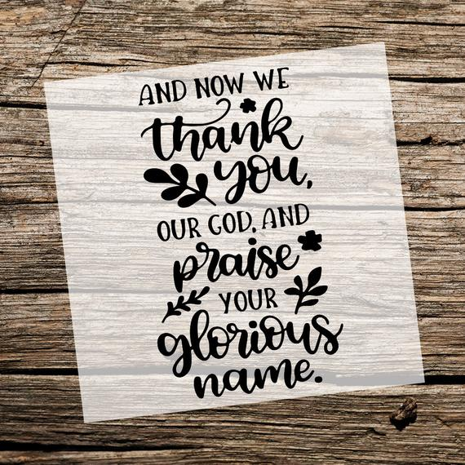
1 Chronicles 29:10-13
¹⁰‘Praise be to you, Lord,
the God of our father Israel,
from everlasting to everlasting.
¹¹ Yours, Lord, is the greatness and the power
and the glory and the majesty and the splendour,
for everything in heaven and earth is yours.
Yours, Lord, is the kingdom;
you are exalted as head over all.

Slide 19
1 Chronicles 29:10-13
¹² Wealth and honour come from you;
you are the ruler of all things.
In your hands are strength and power
to exalt and give strength to all.
¹³ Now, our God, we give you thanks,
and praise your glorious name.
Notes:
May we, God’s people at ACPC, depend on God for all we need to do his will in the world. And let us continually praise his glorious name for the great things he has done in the past and will do in the future!

