Slide 1
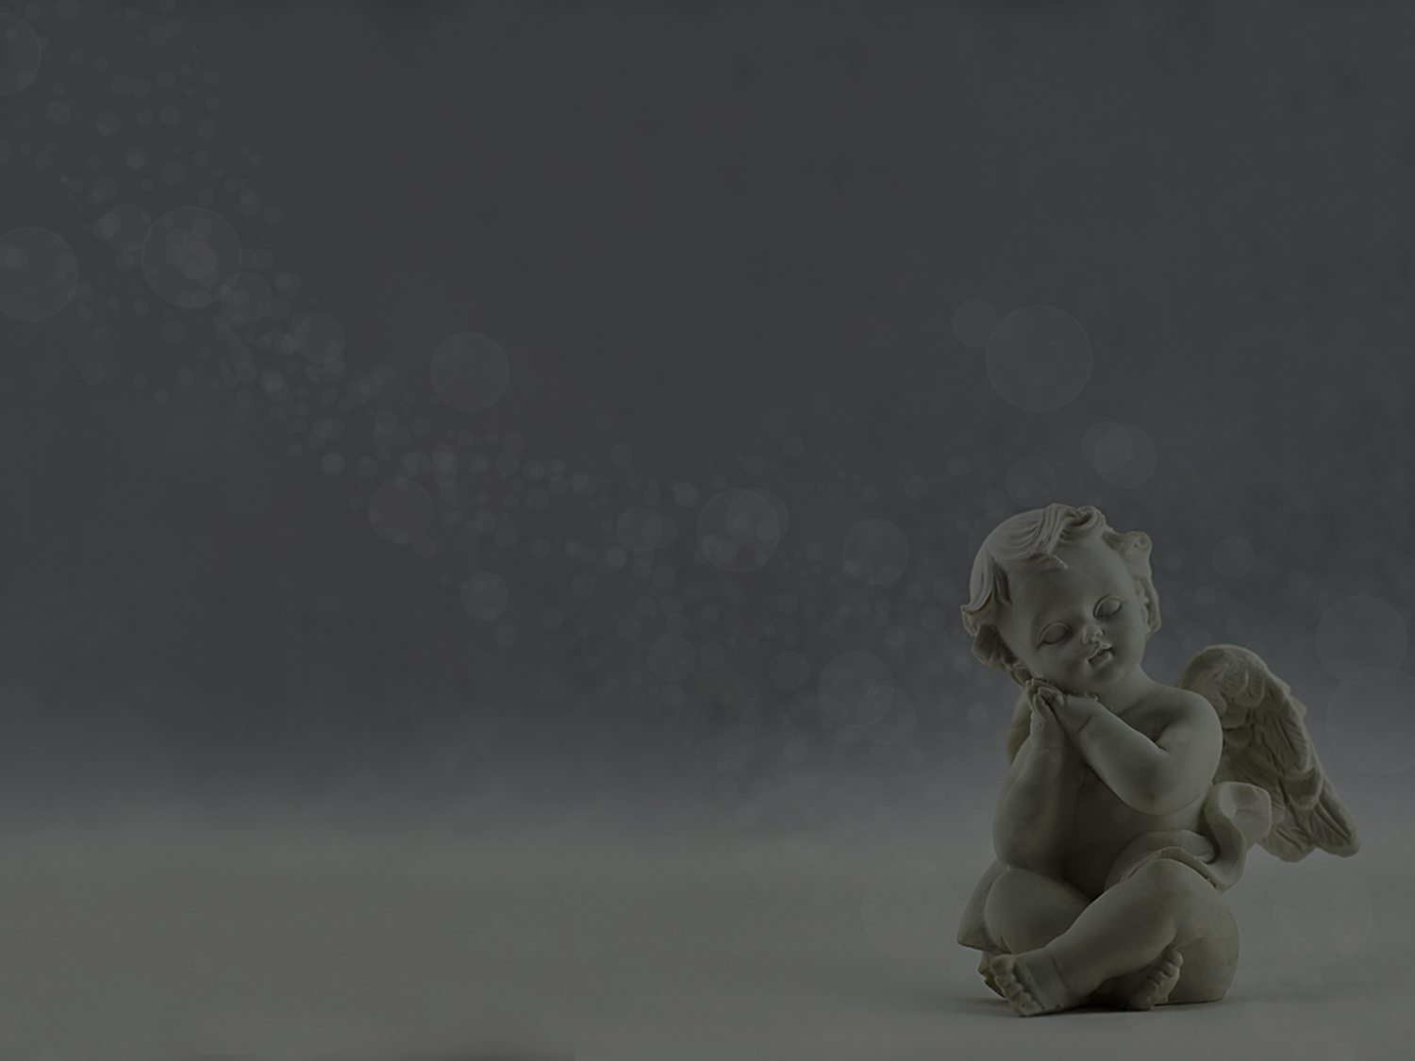
ACPC Sunday School presents…
The Many Names of Jesus
1 December 2019

Slide 2

WORSHIP

Slide 3
MAN OF SORROWS
Man of sorrows, Lamb of God
By His own betrayed
The sin of man and wrath of God
Has been on Jesus laid

Slide 4
MAN OF SORROWS
Silent as He stood accused
Beaten mocked and scorned
Bowing to the Father's will
He took a crown of thorns

Slide 5
MAN OF SORROWS
Oh that rugged cross
My salvation
Where Your love poured out over me
Now my soul cries out
Hallelujah
Praise and honour unto Thee

Slide 6
MAN OF SORROWS
Sent of heaven, God's own Son
To purchase and redeem
And reconcile the very ones
Who nailed Him to that tree

Slide 7
MAN OF SORROWS
Oh that rugged cross
My salvation
Where Your love poured out over me
Now my soul cries out
Hallelujah
Praise and honour unto Thee

Slide 8
MAN OF SORROWS
Now my debt is paid
It is paid in full
By the precious blood
That my Jesus spilled

Slide 9
MAN OF SORROWS
Now the curse of sin
Has no hold on me
Whom the Son sets free
Oh is free indeed!

Slide 10
MAN OF SORROWS
Oh that rugged cross
My salvation
Where Your love poured out over me
Now my soul cries out
Hallelujah
Praise and honour unto Thee

Slide 11
MAN OF SORROWS
See the stone is rolled away
Behold the empty tomb
Hallelujah, God be praised
He's risen from the grave

Slide 12
MAN OF SORROWS
Oh that rugged cross
My salvation
Where Your love poured out over me
Now my soul cries out
Hallelujah
Praise and honour unto Thee
Praise and honour unto Thee

Slide 13
MIGHTY TO SAVE
Everyone needs compassion
A love that’s never failing
Let mercy fall on me
Everyone needs forgiveness
The kindness of a Saviour
The hope of nations

Slide 14
MIGHTY TO SAVE
Saviour, He can move the mountains
My god is mighty to save
He is mighty to save
Forever, author of salvation
He rose and conquered the grave
Jesus conquered the grave

Slide 15
MIGHTY TO SAVE
So take me as you find me
All my fears and failures
Fill my life again
I give my life to follow
everything I believe in
Now I surrender

Slide 16
MIGHTY TO SAVE
Saviour, He can move the mountains
My god is mighty to save
He is mighty to save
Forever, author of salvation
He rose and conquered the grave
Jesus conquered the grave

Slide 17
MIGHTY TO SAVE
Shine your light and
let the whole world see
We're singin’
for the glory of the risen king
Jesus

Slide 18
MIGHTY TO SAVE
Shine your light and
let the whole world see
We're singin’
for the glory of the risen king
Jesus

Slide 19
MIGHTY TO SAVE
Saviour, He can move the mountains
My god is mighty to save
He is mighty to save
Forever, author of salvation
He rose and conquered the grave
Jesus conquered the grave

Slide 20
MIGHTY TO SAVE
Saviour, He can move the mountains
My god is mighty to save
He is mighty to save
Forever, author of salvation
He rose and conquered the grave
Jesus conquered the grave

Slide 21
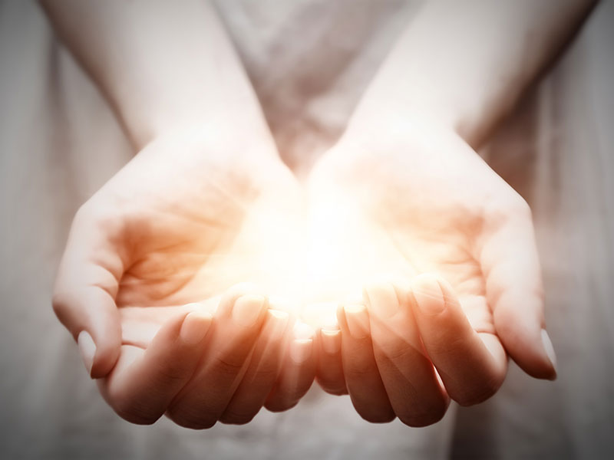
OFFERING

Slide 22
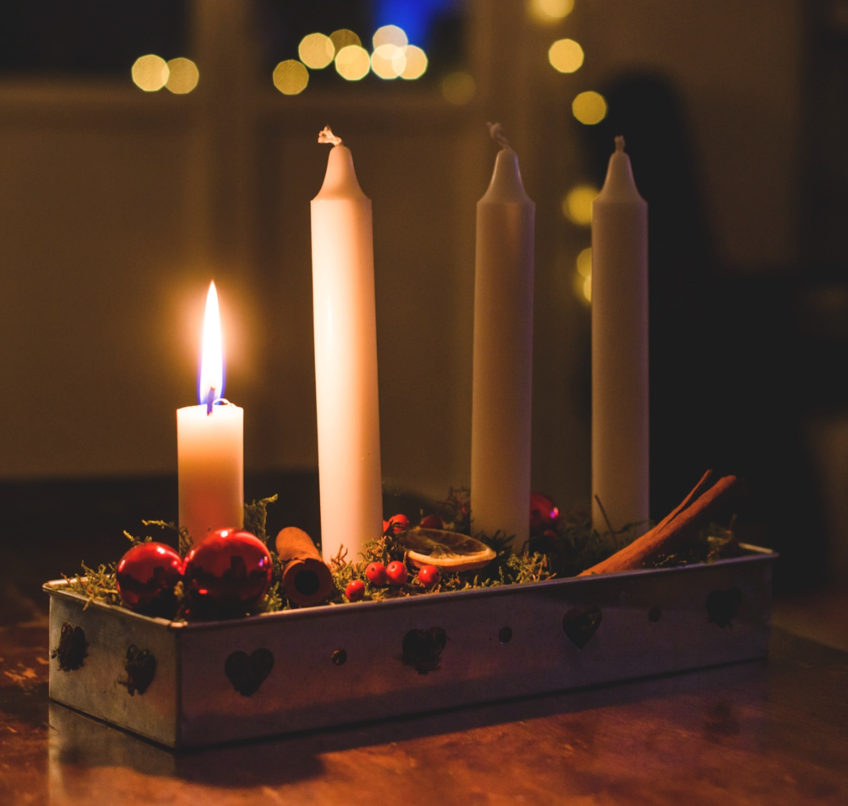
ADVENT

Slide 23
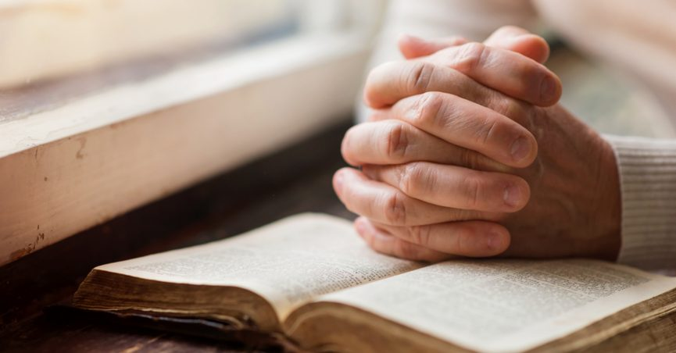
PRAYER

Slide 24
NAMES OF JESUS
Get into four teams
Discuss other names Jesus was known by
Each team takes turns to provide a name not already said (you have 10 seconds)
If you cannot provide a name in the timeframe, your team is eliminated
Last team standing wins!
Ps. Andrew is the judge

Slide 25
WORSHIP

Slide 26
Lord I Lift Your Name on High
Lord I lift your name on high
Lord I love to sing your praises
I'm so glad you're in my life
I'm so glad you came to save us

Slide 27
Lord I Lift Your Name on High
You came from heaven to earth
to show the way
From the earth to the cross
my debt to pay
From the cross to the grave
From the grave to the sky
Lord, I lift your name on high

Slide 28
Lord I Lift Your Name on High
Lord I lift your name on high
Lord I love to sing your praises
I'm so glad you're in my life
I'm so glad you came to save us

Slide 29
Lord I Lift Your Name on High
You came from heaven to earth
to show the way
From the earth to the cross
my debt to pay
From the cross to the grave
From the grave to the sky
Lord, I lift your name on high

Slide 30
King of Kings and Lord of Lords
King of Kings and Lord of Lords
Glory, Hallelujah
King of Kings and Lord of Lords
Glory, Hallelujah

Slide 31
King of Kings and Lord of Lords
Jesus, Prince of Peace
Glory, Hallelujah
Jesus, Prince of Peace
Glory, Hallelujah

Slide 32
King of Kings and Lord of Lords
King of Kings and Lord of Lords
Glory, Hallelujah
King of Kings and Lord of Lords
Glory, Hallelujah

Slide 33
King of Kings and Lord of Lords
Jesus, Prince of Peace
Glory, Hallelujah
Jesus, Prince of Peace
Glory, Hallelujah

Slide 34
King of Kings and Lord of Lords
King of Kings and Lord of Lords
Glory, Hallelujah
King of Kings and Lord of Lords
Glory, Hallelujah

Slide 35
King of Kings and Lord of Lords
Jesus, Prince of Peace
Glory, Hallelujah
Jesus, Prince of Peace
Glory, Hallelujah

Slide 36

BIBLE READING

Slide 37
Isaiah 9:6-7
6 For to us a child is born, to us a son is given, and
The government will be on his shoulders. And he will
be called Wonderful Counselor, Mighty God,
Everlasting Father, Prince of Peace. 7 Of the greatness
of his government and peace there will be no end. He
will reign on David’s throne and over his kingdom,
establishing and upholding it with justice and
righteousness from that time on and forever. The zeal
of the Lord Almighty will accomplish this.

Slide 38
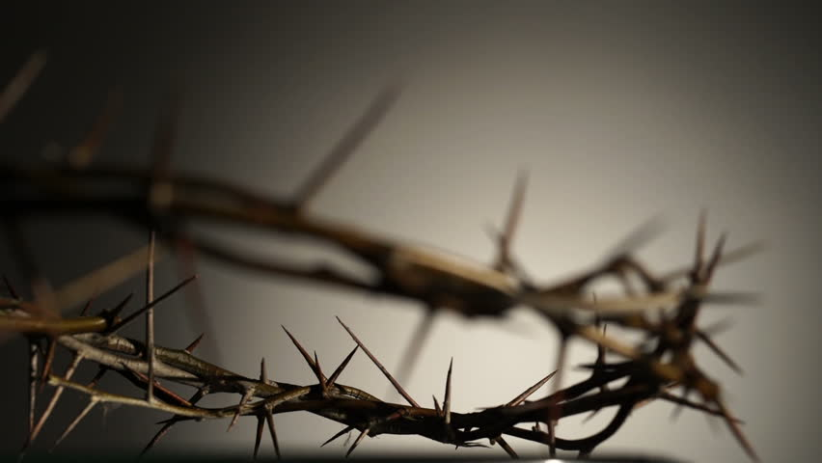
The Many Names of Jesus

Slide 39
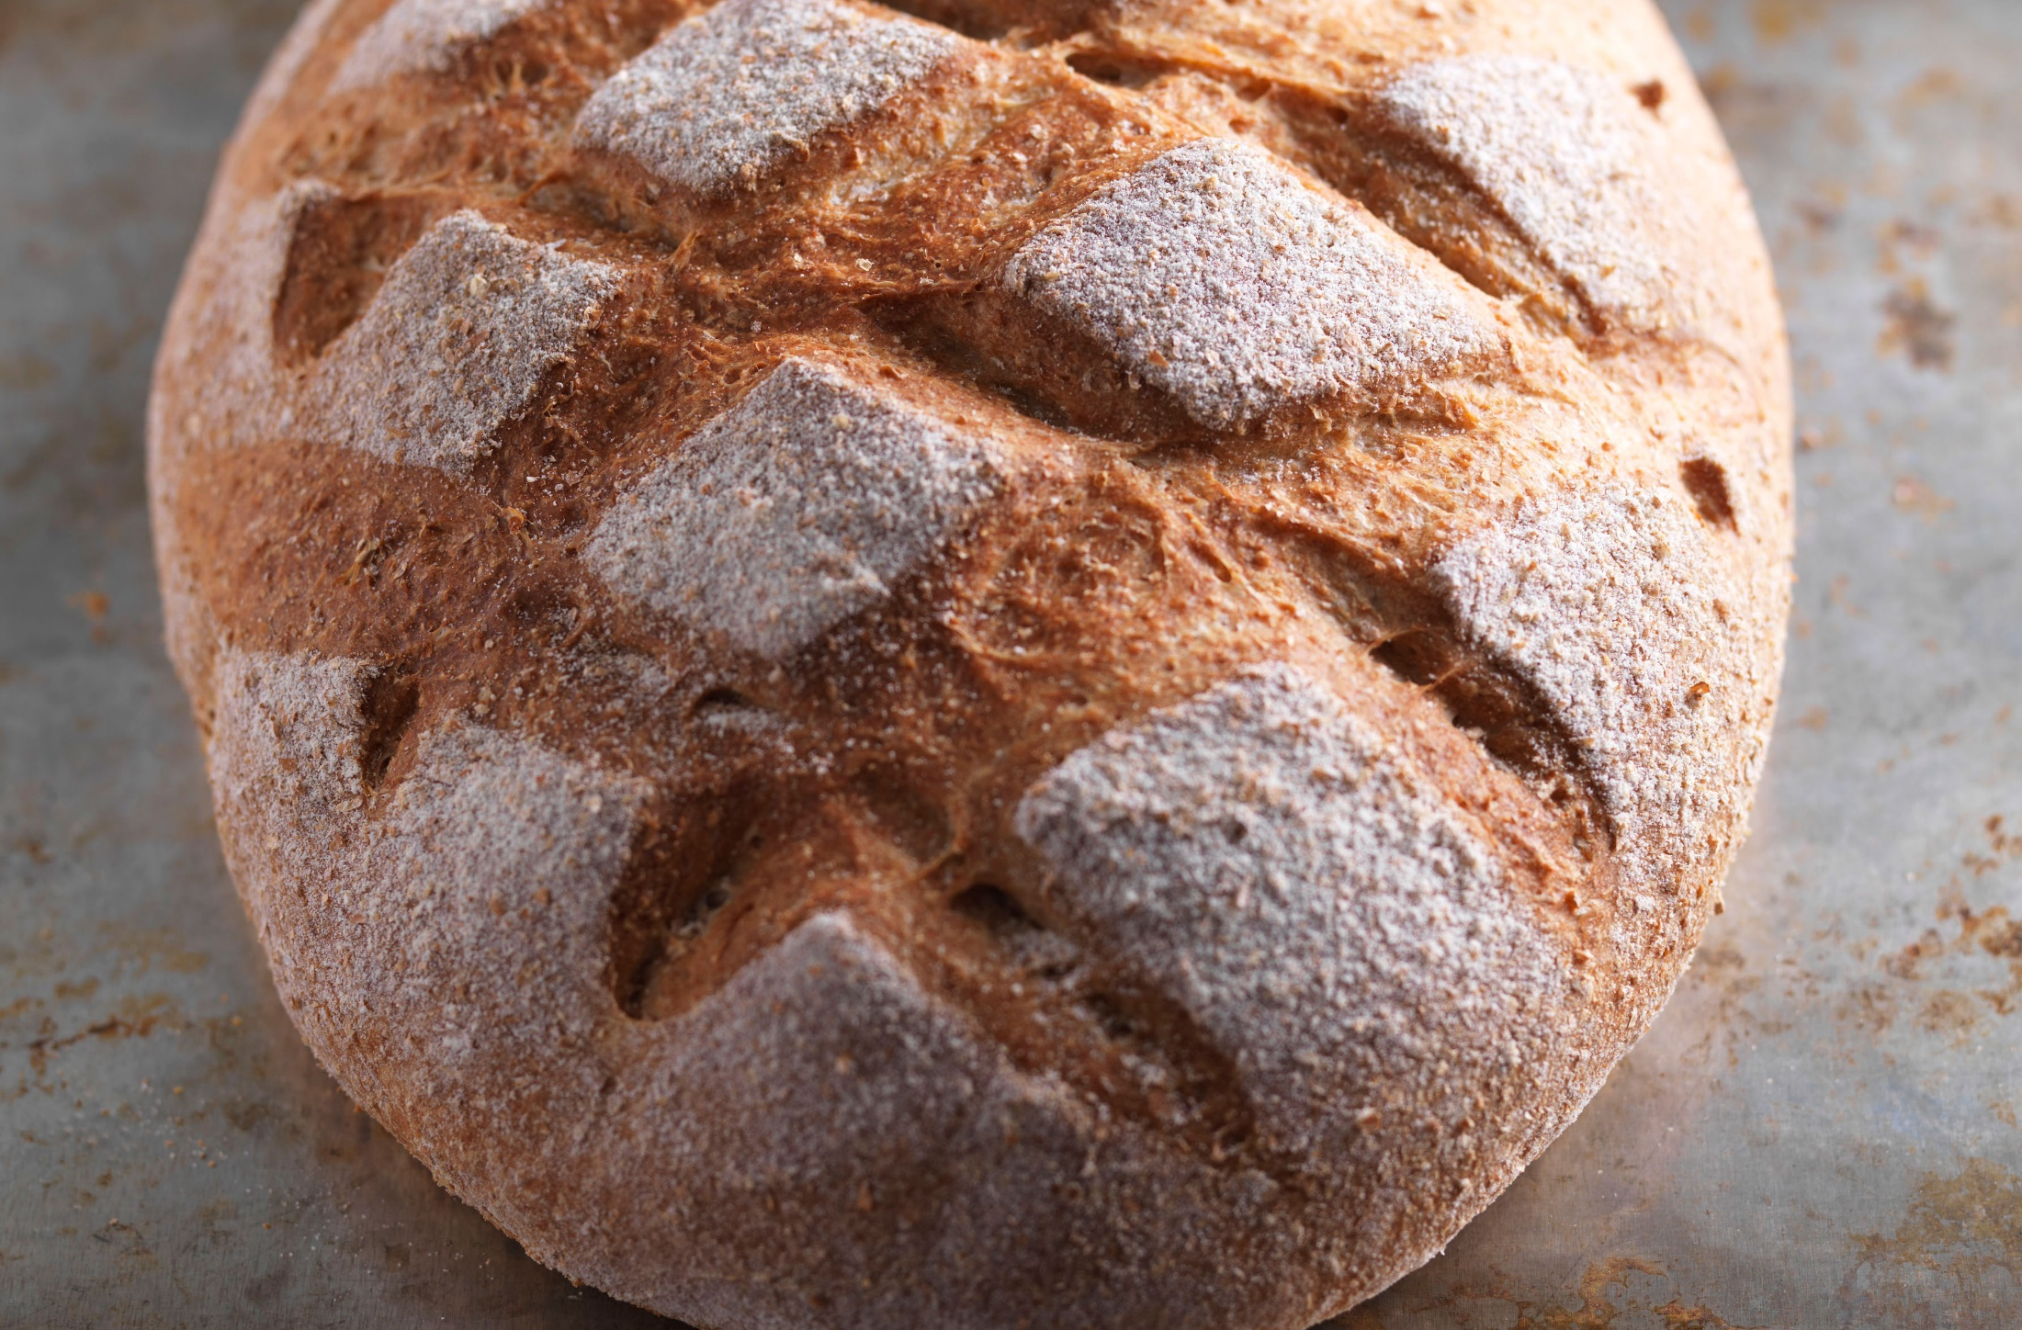

Slide 40
John 6:32-35
32 Jesus said to them, “Very truly I tell you, it is not Moses who has given you the bread
from heaven, but it is my Father who gives
you the true bread from heaven. 33 For the
bread of God is the bread that comes down
from heaven and gives life to the world.”
35 Then Jesus declared, “I am the bread of
life. Whoever comes to me will never go
hungry, and whoever believes in me will
never be thirsty.

Slide 41


Slide 42
John 8:12
12 When Jesus spoke again to the people, he said, “I am the light of the world. Whoever follows me will never walk in darkness, but will have the light of life.”

Slide 43
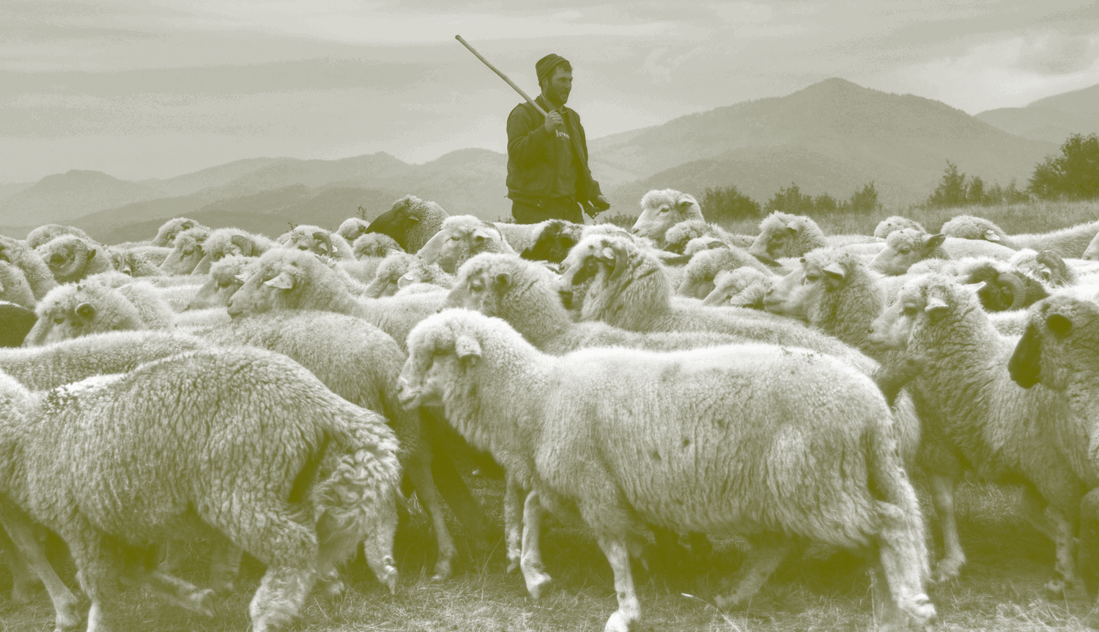

Slide 44
John 10:11-15
11 “I am the good shepherd. The good shepherd lays
down his life for the sheep. 12 The hired hand is not
the shepherd and does not own the sheep. So when
he sees the wolf coming, he abandons the sheep and
runs away. Then the wolf attacks the flock and scatters
it. 13 The man runs away because he is a hired hand
and cares nothing for the sheep.
14 “I am the good shepherd; I know my sheep and my
sheep know me— 15 just as the Father knows me and
I know the Father—and I lay down my life for the
sheep.

Slide 45
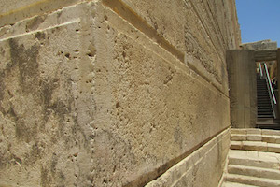

Slide 46
Psalm 118:22-24
22 The stone the builders rejected
has become the cornerstone;
23 the Lord has done this,
and it is marvelous in our eyes.
24 The Lord has done it this very day;
let us rejoice today and be glad.

Slide 47


Slide 48
ACPC Sunday School presents…
The Many Names of Jesus
1 December 2019

Slide 49

SUNDAY SCHOOL PRESENTATIONS

Slide 50
WORSHIP

Slide 51
WHAT A BEAUTIFUL NAME
You were the Word at the beginning
One with God the Lord Most High
Your hidden glory in creation
Now revealed in You our Christ

Slide 52
WHAT A BEAUTIFUL NAME
What a beautiful Name it is
What a beautiful Name it is
The Name of Jesus Christ my King
What a beautiful Name it is
Nothing compares to this
What a beautiful Name it is
The Name of Jesus

Slide 53
WHAT A BEAUTIFUL NAME
You didn't want heaven without us
So Jesus, You brought heaven down
My sin was great, Your love was greater
What could separate us now

Slide 54
WHAT A BEAUTIFUL NAME
What a wonderful Name it is
What a wonderful Name it is
The Name of Jesus Christ my King
What a wonderful Name it is
Nothing compares to this

Slide 55
WHAT A BEAUTIFUL NAME
What a wonderful Name it is
The Name of Jesus
What a wonderful Name it is
The Name of Jesus

Slide 56
WHAT A BEAUTIFUL NAME
Death could not hold You,
the veil tore before You
You silenced the boast of sin and grave
The heavens are roaring,
the praise of Your glory
For You are raised to life again

Slide 57
WHAT A BEAUTIFUL NAME
You have no rival, You have no equal
Now and forever, God, You reign
Yours is the Kingdom, Yours is the glory
Yours is the Name above all names

Slide 58
WHAT A BEAUTIFUL NAME
What a powerful Name it is
What a powerful Name it is
The Name of Jesus Christ my King
What a powerful Name it is
Nothing can stand against
What a powerful Name it is
The Name of Jesus

Slide 59
WHAT A BEAUTIFUL NAME
You have no rival, You have no equal
Now and forever, God, You reign
Yours is the Kingdom, Yours is the glory
Yours is the Name above all names

Slide 60
WHAT A BEAUTIFUL NAME
What a powerful Name it is
What a powerful Name it is
The Name of Jesus Christ my King
What a powerful Name it is
Nothing can stand against
What a powerful Name it is
The Name of Jesus

Slide 61
WHAT A BEAUTIFUL NAME
What a powerful Name it is
The Name of Jesus
What a powerful Name it is
The Name of Jesus

Slide 62

ANNOUNCEMENTS

Slide 63
ACPC Sunday School presents…
The Many Names of Jesus
1 December 2019

