Slide 1

Review - Week 1: Family
Practise hospitality – a welcoming community
Rejoice with those who rejoice, mourn with those who mourn – a caring community
Love your enemies – a radical community

Slide 2
Do the Survey for Week 1: Family
What aspect of our church family life do you most appreciate?
What can we do in our Sunday service to improve our experience of family?
How can we change how we communicate to improve our experience of family?
How can we improve our experience of family by the things we do together?
What else have you been prompted about this week?
+ Continue the Devotional for Week 2: Place

Slide 3
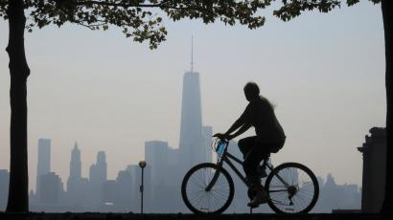
Redemptive Family
Week 2: PLACE
Jeremiah 29:4-14

Slide 4
HOW IMPORTANT IS PLACE?
Essential element of identity to the Maori
During the mihi, you would give your genealogy (whakapapa)
  My mountain is __________ (Ko __________ toku maunga)
  My river is __________ (Ko __________ te awa)
  I am from __________ (Ko __________ ahau)
  My name is __________ (Ko __________toku ingoa)
Have a go yourself!

Slide 5
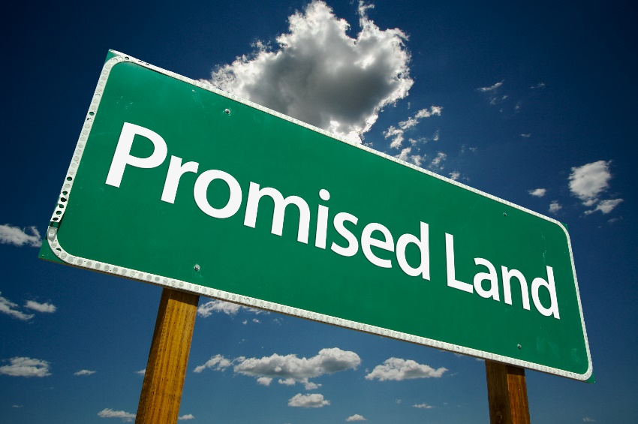
The Promised Land
God’s promise to Abraham (Genesis 12:1-3) “I will give you this land”
Top line / bottom line = BLESSed → BLESSing
Continuing to live in the land was contingent on obedience
“if you do not obey the Lord your God and do not carefully follow all his commands and decrees I am giving you today … ⁶⁴ Then the Lord will scatter you among all nations, from one end of the earth to the other.”
  Deut 28:15, 64

Slide 6
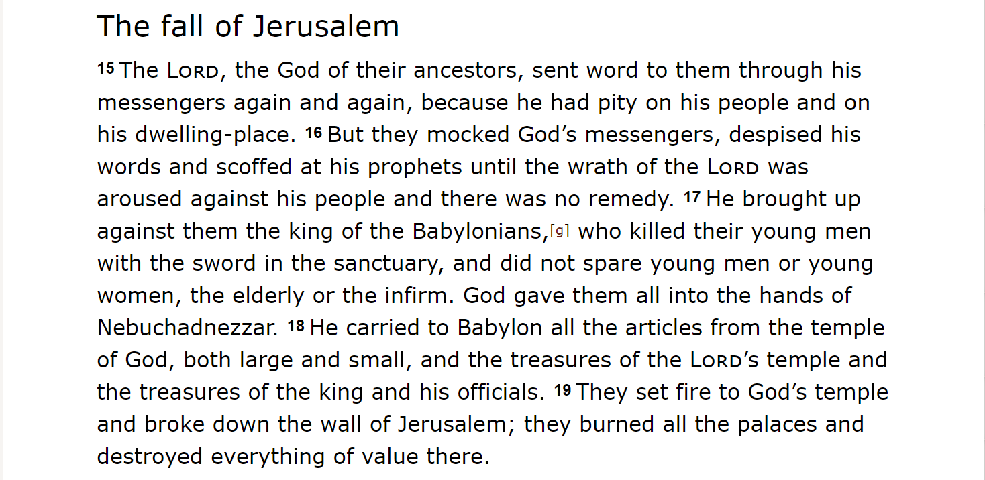
God eventually lost his patience!
Notes:
2 Chronicles 36. God kept sending the prophets to warn them to obey his word and they would for a while, but eventually they would worship idols, ally themselves with pagans kings, forget god’s Sabbaths, take advantage of the poor, etc., etc. Eventually he lost his patience and sent ehm to Babylon, after a very nasty siege by King (who?) Nebuchadnezzar.

Slide 7
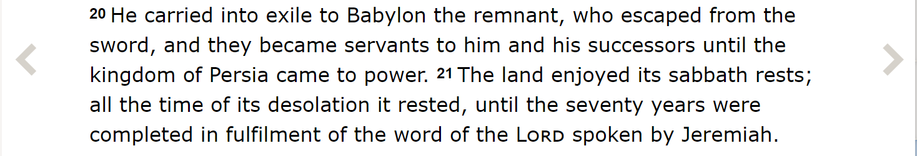
God eventually lost his patience!
  2 Chronicles 36

Slide 8
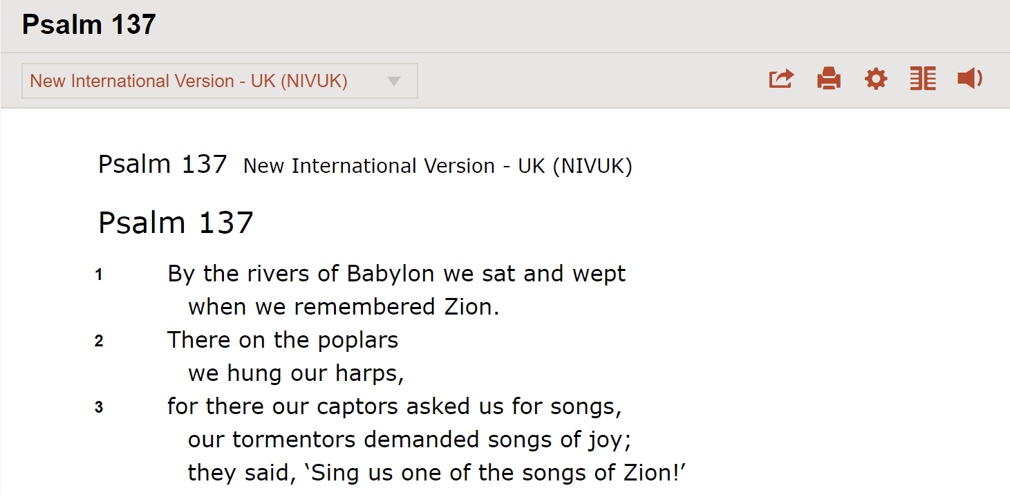
A Devastating Situation
Notes:
Babylonian captivity: God had promised his people their own land and now they were kicked out of it!

Slide 9
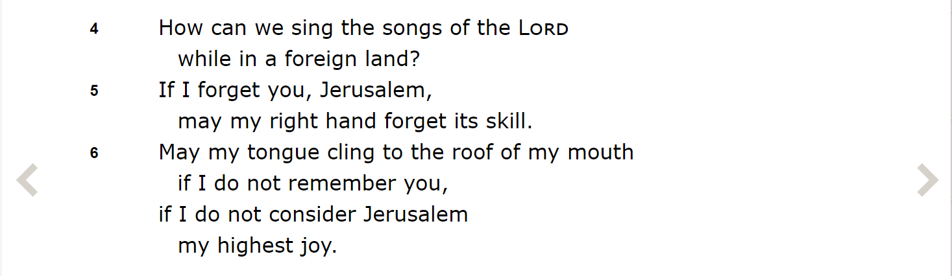
A Devastating Situation

Slide 10
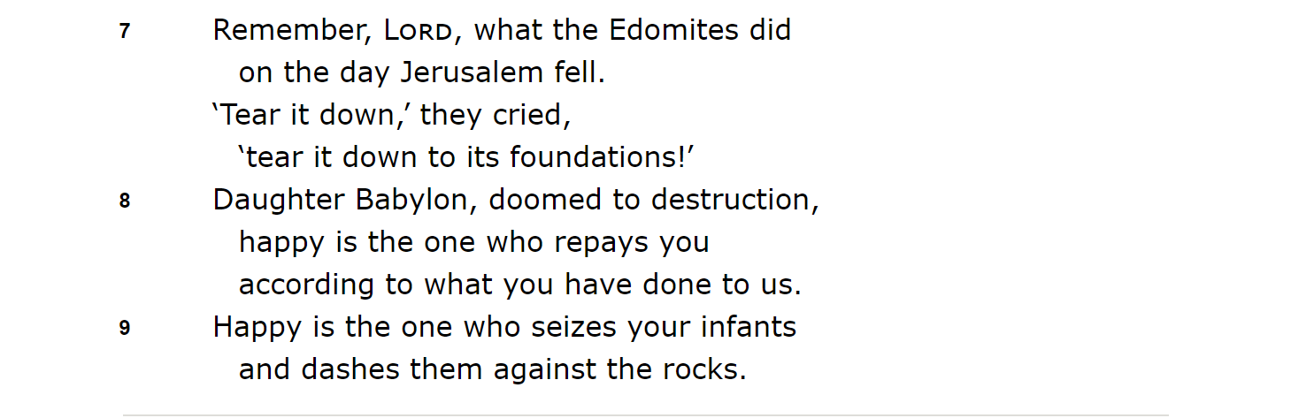
A Devastating Situation
Notes:
Do you hear the passion and pain of a vanquished people?

Slide 11
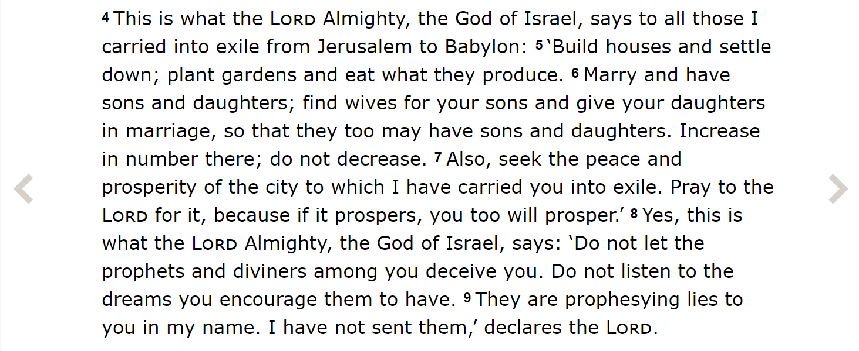
Jeremiah 29:4-14
Notes:
Don’t sit there and mope – flourish in the place where God has placed you. Sure – you want to be some place else, I get that, but you are still my people – I haven’t forgotten you

Slide 12
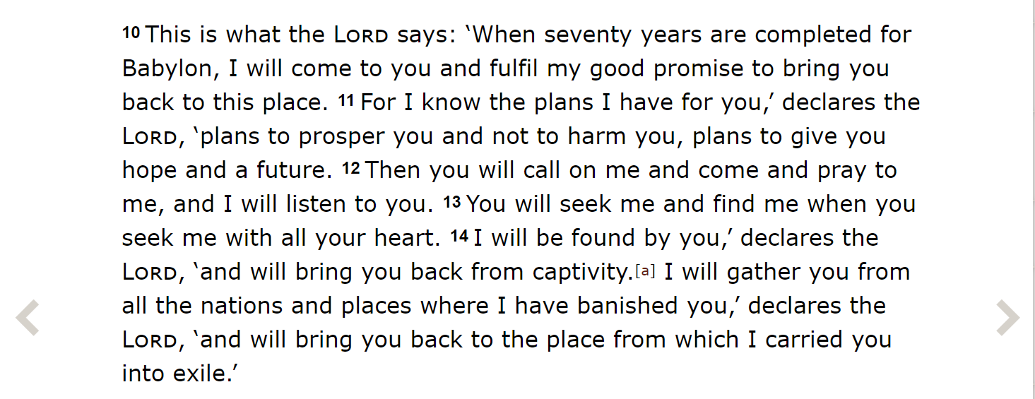
Jeremiah 29:4-14
Notes:
Anyone ever taken Jeremiah 29:11 out of context? Great verse – but it applies first to God’s covenant promise to Israel.
Jeremiah reminds them that they are still God’s people and he will bring them home again. They can depend on him – even when things look grim – especially when things look grim. In the meantime, they are to THRIVE!
So what’s the lesson for us?

Slide 13
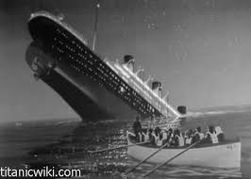
A Theology of Place
“I look upon this world as a wrecked vessel. God has given me a lifeboat and said to me, “Moody, save all you can.”
  D.L. Moody
Notes:
[Titanic sank on 14 April 1912, 107 years ago]
Is the world a wrecked vessel?
Is there any use looking after it if it’s going to be destroyed?
This question is so relevant for Christians. Are we going to engage with topics like pollution, climate change or species extinction?
Or are we only going to focus on “spiritual matters.”

Slide 14
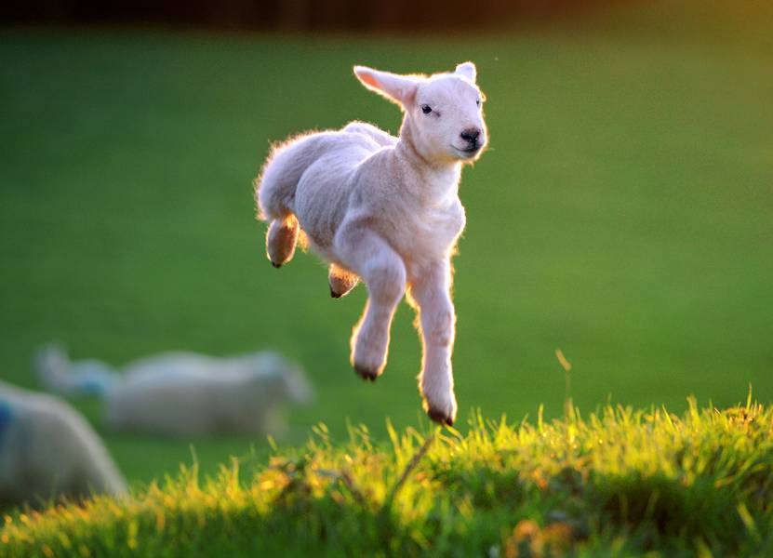
A Theology of Place
The Fall impacted our relationship with God, others and all of creation
The gospel does the same – Christ is God’s “Shalom” (peace) who repairs these damaged relationships
Ultimately all creation will be renewed in the kingdom of God
So living out the gospel includes evangelism,
building bridges in our communities (including praying for our city) and caring for creation
This is the BIG GOSPEL STORY!
Notes:
God – alienation and condemnation
Others – competition and conflict
Creation – abuse and neglect
Evangelism – relationship with God
Building bridges – relationships with others
Caring for creation – speaks for itself
This gives even the most ordinary of jobs new meaning and purpose.
What we do and where are placed matters to God.

Slide 15
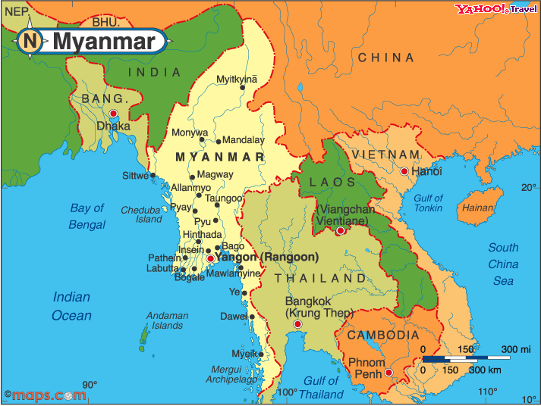
John and Rebecca De Jong
God’s call is key – not a place to have a crisis of faith
Language learning essential to understanding the culture - 20 hours a week for three years
Turn off your air-con - acclimatise and have an open door
Holiday in the place (country) you live

Slide 16
John and Rebecca De Jong
Immerse yourself - don’t live in two worlds - live fully - be fully present - in your context - e.g. hanging around with expats and connecting through the email a lot
People can tell if you genuinely love them
Process of figuring out what you are going to do: what do THEY want to you to do? What are their needs?
Accept the ministry you are given - do it to the best of your ability
Consistent ministry over a period of time to a smaller number is of great value
Have hobbies!
Notes:
They panted themselves in that (not easy) place and they and those around them flourished – but they had a very specific mindset

Slide 17
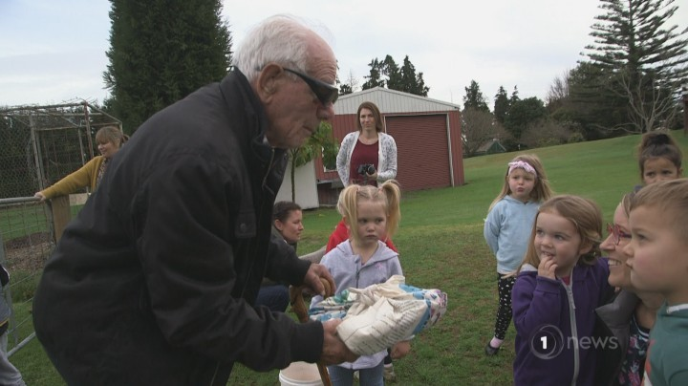
Gordon Burr
Notes:
[Show video from Good Sorts segment]
Gordon embraced his place!

Slide 18
What about us?
How do we embrace the places where we live, work, worship and play?
If our church disappeared in say, a year or so, would the community notice?
We’re involved in some great community-facing stuff! Table tennis, YWCA, pot luck, Tea ‘n’ Talk, fund-raising events, etc.
But relatively few people make these happen. Can we better support these things and / or add others that we are passionate about?

Slide 19
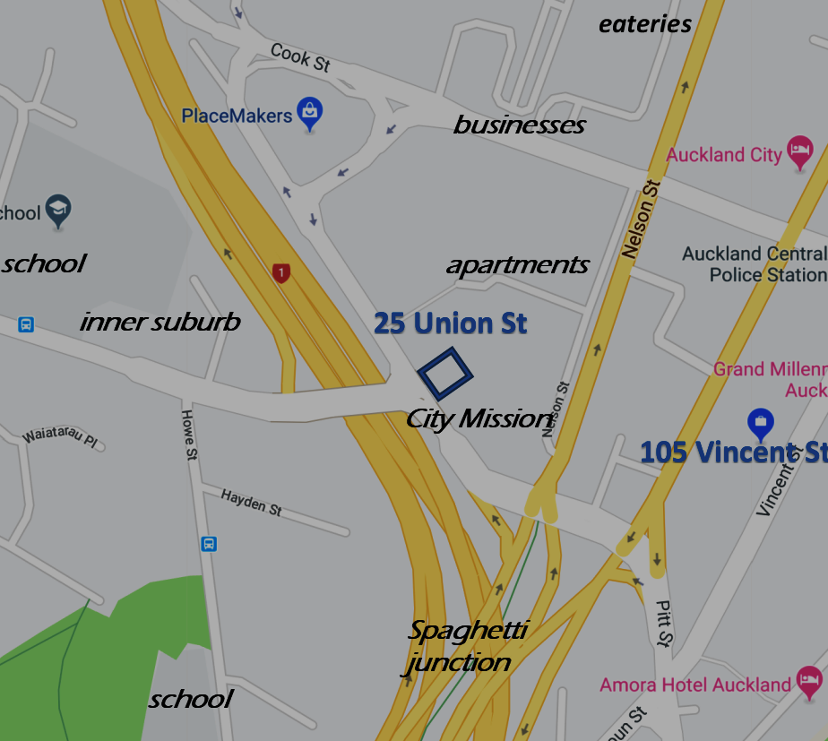
Notes:
How can we engage with the schools? The apartments? The businesses? Could we provide a place for people to meet in the local community?
Just confirmed this week: we will take possession of the ground floor soon so we can do strengthening work on floor one without disrupting the ground floor tenant. This provides an exciting opportunity for a real community-facing presence!
Let’s embrace our place at 105 Vincent St for the next year or so and prepare for “the big move” to 25 Union St – not just by picking out furniture!

Slide 20
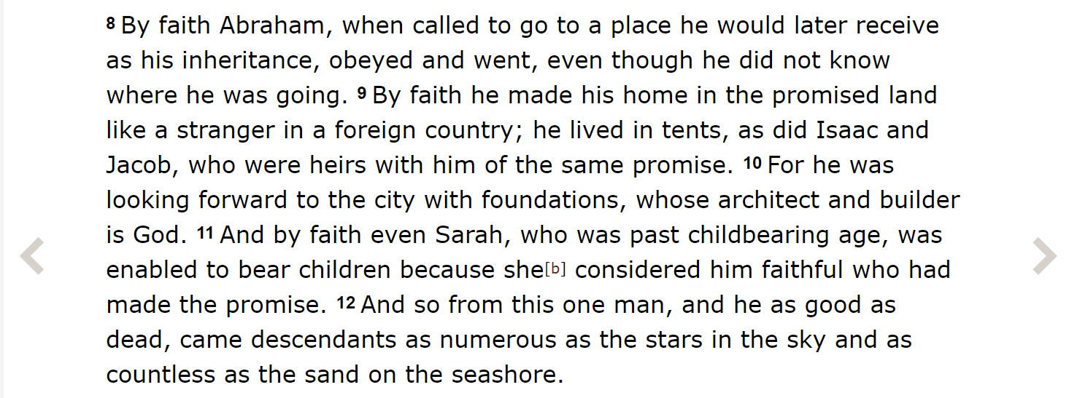
A Place to call home
  Hebrews 11:8-12
Notes:
Abraham was promised a place of his own and God kept that promise – after he died. But ultimately it wasn’t about a narrow little slice of real estate in the Middle East. God wanted to give him the whole world (See Romans 8:13)! That was fulfilled by his descendent, Jesus the Messiah. So all God’s promises are yes in Jesus Christ (2 Cor. 1:20).
As we work in our corner of the world, sowing the seed of the Gospel, connecting people, praying for the city and looking after the planet, we are helping build the kingdom of the God. But this world as it is will not be fully redeemed until the chief architect and builder steps on to the job site himself once more.
That’s what we are looking forward to. We are looking forward to Jesus’ return not by sitting on our hands and waiting passively, but actively working on his kingdom vision in the places where we live, work, worship and play. What an exciting calling we have! So let’s get to work!

