Slide 1
Woven Together for Mission
“I want you woven into a tapestry of love, in touch with everything there is to know of God. Then you will have minds confident and at rest, focused on Christ” Colossians 2:2 MSG
Notes:
Introduce theme
Penguin clip
What did we see?

Slide 2
Acts 2: 42-47 The Fellowship of the Believers
⁴² They devoted themselves to the apostles’ teaching and to fellowship, to the breaking of bread and to prayer. ⁴³ Everyone was filled with awe at the many wonders and signs performed by the apostles. ⁴⁴ All the believers were together and had everything in common. ⁴⁵ They sold property and possessions to give to anyone who had need. ⁴⁶ Every day they continued to meet together in the temple courts. They broke bread in their homes and ate together with glad and sincere hearts, ⁴⁷ praising God and enjoying the favour of all the people. And the Lord added to their number daily those who were being saved.

Slide 3
It begins with the transforming work of God…
…that weaves us together as family…
…from which we reach out and include others…
…and see them transformed too!

Slide 4
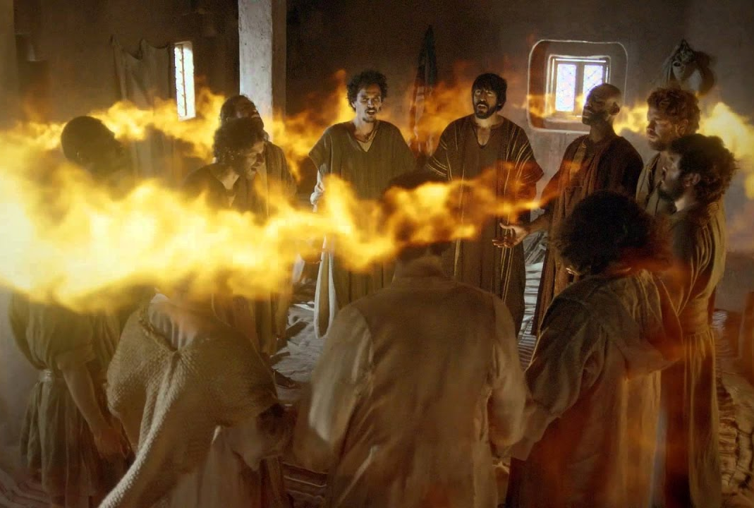
It begins with the transforming work of God…
Notes:
We cannot live authentically in our own strength – it is too hard!
Pentecost was not a ‘spiritual’ box separate to everyday life
Rather, everyday life became centred around Kingdom-growing

Slide 5
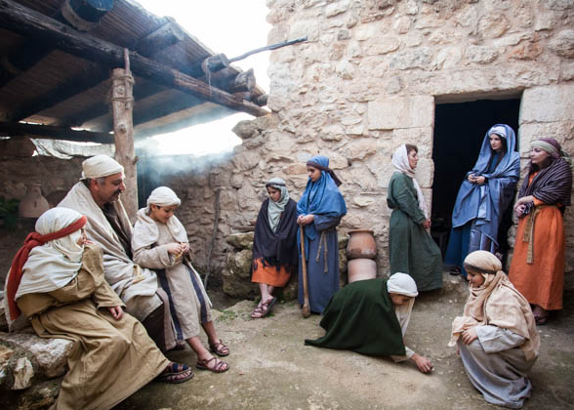
…that weaves us together as family…
Notes:
Jesus called his followers family:
Matthew 12:50 ⁵⁰ For whoever does the will of my Father in heaven is my brother and sister and mother.”
At the last supper he says to his disciples, ‘whenever you guys eat this bread and drink this cup, remember me until I come back.’. They have had many meals together, and Jesus anticipates many more.
Elsewhere he says, ‘when people see you guys together they are going to marvel at your love and your unity’. He knows that together they are going to be a witness to a watching world.
The early church understood that they were family:
We read in this passage that ‘all the believers were together and had everything in common.’ Those early believers sold up and moved in together where they could. That is taking family seriously!
That we as believers are meant to be family for each other is a constant theme throughout the NT. There are literally hundreds of references to us being family, and they occur in every book of the NT.
This series has been focused on our mission, which is vitally important. But for mission to be effective we have to begin with family. Here is why.

Slide 6
We are better woven together
We are STRONGER together
We fill each other’s GAPS
We are our best WITNESS together
Notes:
We are stronger together (canvas analogy)
We best fulfil our God-given purpose together. Our weakness makes room for other people’s strengths (Sylvester Stallone as Rocky Balboa in Rocky 1976: ‘I got gaps, she got gaps, together we fill gaps’)
We are our best witness together (Jesus said the world looking in would marvel at our love and our unity)

Slide 7
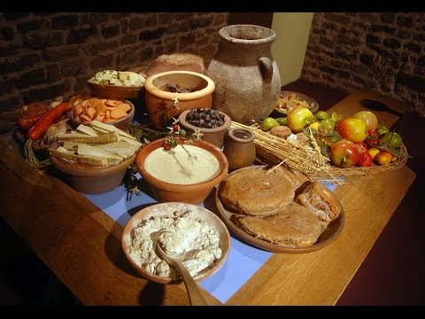
…from which we reach out and include others…
Notes:
This is what they did. They had a rhythm, moving between public spaces (the temple and markets) and their homes. They pulled in people from the temple and marketplace and took them home and fed them and let their joy and passion and zeal and the power of the Holy Spirit leak all over them! Theirs was the biggest party in town. There was no method box and no time box.
Imagine passing by in the street past a house where Christians were gathered. What do you see? What you hear? How does it make you feel?
And if you found yourself peeking through the doorway at the party inside, what might happen next?

Slide 8
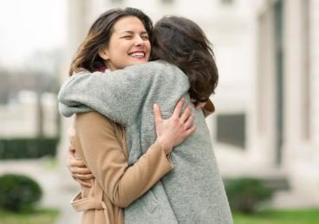
…and see them transformed too!
“And the Lord added to their number daily those who were being saved”
Notes:
The passage tells us in detail what the early church members did together, and ends with ‘and the Lord added to their number daily those who were being saved’.
The clear implication of this passage is that it was by doing these things that Luke lists that people were being saved.
It would be strange if Luke went to such trouble to describe the rhythms of the early church if they bore no relation to others coming to faith, and kept the means of them coming to faith a complete mystery.
Outreach was through inclusion. They pulled up another seat at the table and just did what the family of God does together . And people got saved.
Let me ask you a question. Here we are gathered together as church family. Who is watching? Who is marvelling at our love and our unity together?
I hope there may at least be one or two here for the first time. But if there are not, why not? Because we didn’t invite them. Because we are not the biggest party in town. Maybe we have made church a comfortable place for us, and now outsiders don’t belong.

Slide 9
The 5 thresholds to conversion
From distrust to trust
From complacent to curious
From being closed to change to becoming open
From meandering to seeking
Making a decision for Christ
Notes:
From distrust to trust – they learn to trust a Christian
From complacent to curious – Through the work of the HS and their association with Christian friends they become curious
From being closed to change to becoming open - Through the work of the HS and their association with Christian friends they become open to examining their own lives
From meandering to seeking - Through the work of the HS and their association with Christian friends they move from asking questions to seeking answers
Making a decision for Christ – they jump from their present net into your net. This is risky. It is commitment. It is made possible by knowing that they have a new network of friends that they know and trust who are ready and waiting to embrace them.
This shift across the 5 thresholds is because of a fourfold witness:
Personal witness
Witness of authentic community
Witness of spiritual reality
The witness of the Holy Spirit in their hearts leads them to conversion

Slide 10
Encounters in my world
Befriending
My Christian circle
Church family
Notes:
Practise the 3 D’s personally
Develop friendships – establishing common ground
Discover stories –sharing our life stories
Discern next steps – in helping them find faith in Christ
Wrap other Christian relationships around seekers and practice the 3 D’s together.
This increases their circle of Christian friends and allows them to catch a glimpse of the society of Christians.
Relationships deepen faster when, instead of safeguarding our time, we invite them to share private space in our lives

Slide 11
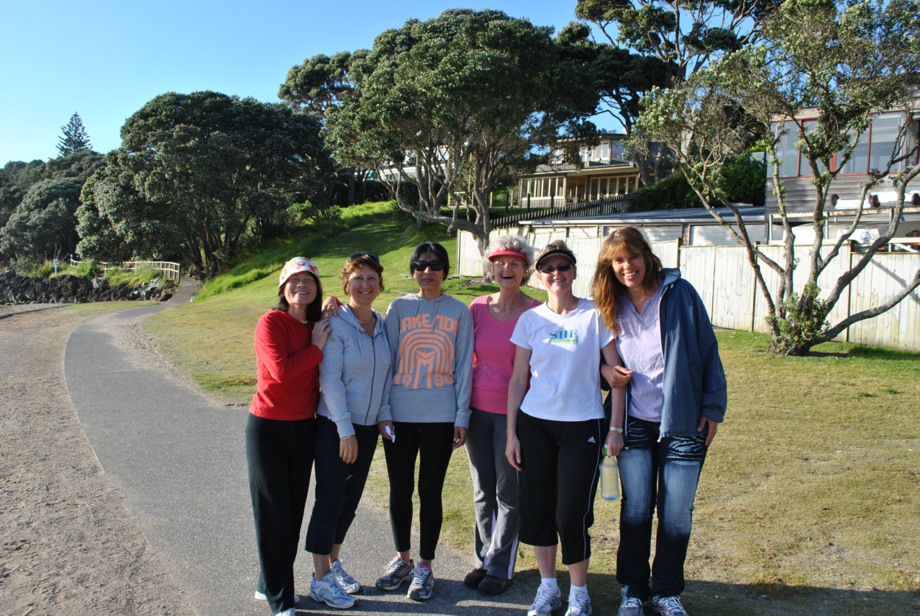
Our mission is weaving people together
Notes:
Whether we are looking at life inside the church or at our influence outside the church, it is all about relationships. Our mission is to grow the Kingdom, which means growing the church. You can’t become part of God’s kingdom without becoming part of God’s family.
We grow God’s church 2 ways - by building up those that are already here, and by adding people who are presently outsiders. Here is a story that demonstrates the power of relationships in doing these two things.
Jacqui’s story
Some years ago, Jacqui decided to walk to keep fit instead of going to the gym. After a few days she had the thought, ‘Why not invite others to go walking with me?’ She did a simple letterbox drop and numbers grew each day, until a large number were involved, even if they didn’t walk every day. The morning walk was known as ' The March of the Penguins' because it started on Penguin Drive on the North Shore and progressed to the beach.
Jacqui quickly drew other Christians around her to intentionally take time to chat with other residents on the walk. ‘We share the stories of our lives, we tell of answered prayer, and we pray out loud for each other. The ladies who are not Christians are welcomed and included, but the Christians openly live out their faith,’ Jacqui told us at the time.
Walking companions became good friends and social time together grew. They began spending time in each other’s homes. These walking friends attended baby showers, watched movies together in the home theatre of a member of their group, and even went round to celebrate the purchase of a new coffee machine.
Thanks to Jacqui and her Christian friends, a number of the walking group came to faith. Jacqui felt especially privileged to lead the baptism of a Thai Buddhist friend who came walking with her. After Jacqui had used her as an interpreter to explain the gospel to another woman, she had told Jacqui that she wanted to receive Jesus too!
How are we going to add people to this family? It is only through relationships. People may visit because of our sign, (although most will come because of an invitation); but they will only stay and become part of this family if they become woven in with us through relationships.

Slide 12
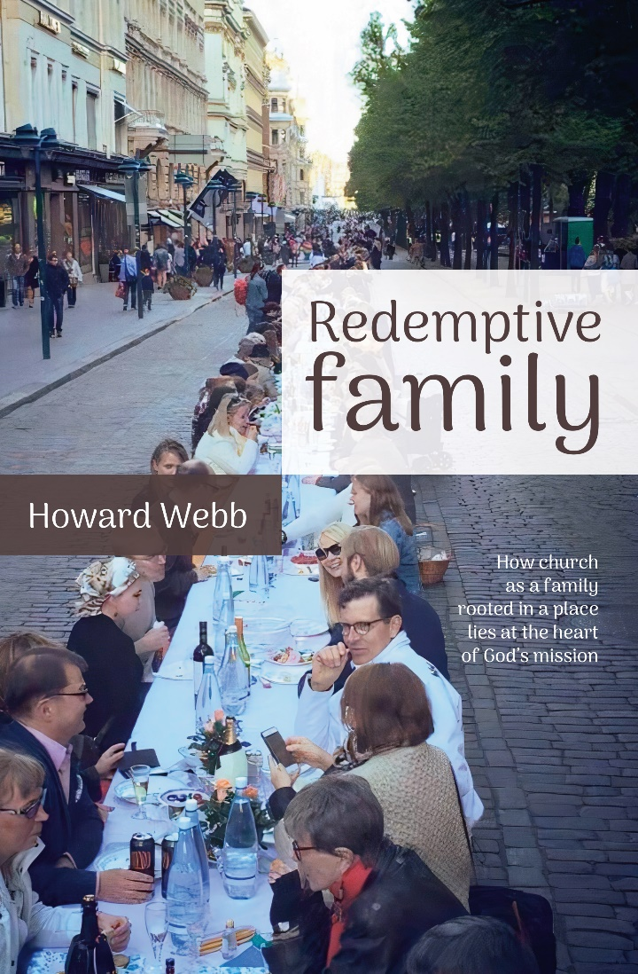
Book table

