Slide 1
Marriage and Singleness
1 Corinthians 7:25-40

Slide 2
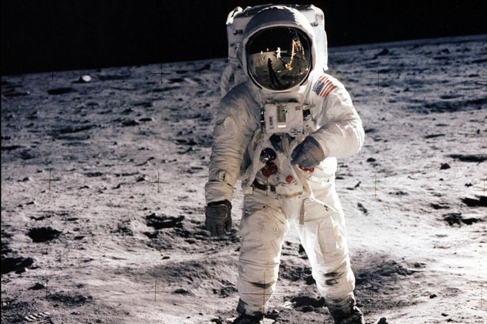
Get the facts straight ..
Notes:
Part 1: The Text
With the 50th anniversary of the first moon landing, I thought it would be appropriate to start with a space story. Have you heard about NASA’s quest to invent a pen that could function in space? They spent years and millions of taxpayer dollars to develop a pen that could put ink to paper without gravity. But their crafty Soviet counterparts, so the story goes, simply handed their cosmonauts pencils.
Now, the problem with this story is that it’s not true. But people like to believe it because it’s a good story! Both astronauts and cosmonauts used pencils at first, but pencils tended to flake off bits of graphite which floated around and got stuck in the instruments. And pencils were flammable, so a safer alternative was invented.
So the moral of the story is we should get the facts straight as much as possible. Two “facts” about Paul that are consistently told is that he was anti-sex (1 Cor. 6) and anti-marriage (chapter 7).

Slide 3
Two Clues:
“Now for the matters you wrote about” (1)
“Because of the present crisis” (26)
Persecution
Unhealthy ideas about sex (“everything is permissible” vs. “It is good for a man not to touch a woman”)

Slide 4
The 30 Second Version of 1 Cor. 7
To married people: mutual satisfaction - enjoy one another!
To single people: undistracted focus - the Lord’s work
To those in mixed marriages: remain together if possible
To those who are separated: attempt reconciliation
To the widowed: freedom to remarry or remain single

Slide 5
Key Principle
Make the most of the situation you are in at the moment
… but don’t remain in an abusive relationship

Slide 6
Singleness
We often don’t talk much about singleness in the church
The gift of celibacy
Undistracted focus
Missionary work and ministry
Same sex relationships

Slide 8
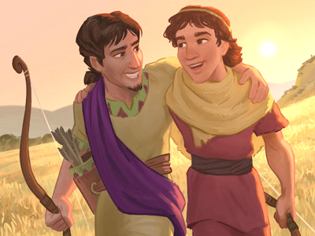
Singleness
Healthy same-sex non-romantic friendships
E.g. David and Jonathan

Slide 9
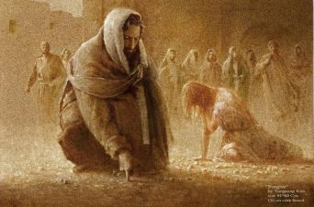
Between the Rock and the Wabi-Sabi
John 8:2-11

Slide 10
Between the Rock and the Wabi-Sabi
… do you not know that wrongdoers will not inherit the kingdom of God? … 1 Cor. 6:9-10
¹¹ And that is what some of you were [sinners]. But you were washed, you were sanctified, you were justified in the name of the Lord Jesus Christ and by the Spirit of our God.

Slide 11
The kind of people God accepts
The flunk-outs and drop-outs and burned-outs. The broke and the broken. The drug heads and the divorced. The HIV-positive and herpes-ridden. The brain-damaged, the incurably ill. The barren and and the pregnant too many times or at the wrong time.

Slide 12
The kind of people God accepts
The over-employed, the underemployed, the unemployed. The unemployable. The swindled, the shoved aside, the replaced. The parents with children living on the street, the children with parents not dying in the “rest” home…

Slide 13
The kind of people God accepts
The lonely, the incompetent, the stupid. The emotionally starved or emotionally dead. .. Murderers and child-molesters. The brutal and the bigoted. Drug lords and pornographers. War criminals and sadists. Terrorists. The perverted and the filthy and the filthy rich.
Dallas Willard, The Divine Conspiracy

Slide 14
Between the Rock and the Wabi-Sabi

