Slide 1
Why can’t we be friends? Unity in the Body of Christ
Philippians 1:12-30

Slide 2
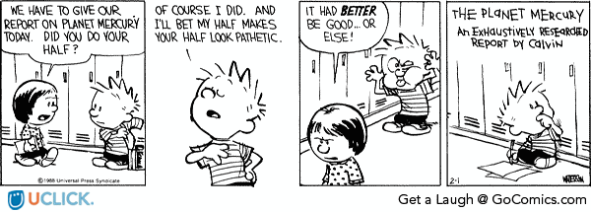
Teamwork

Slide 3
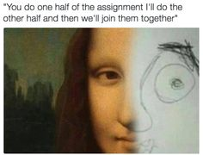
Teamwork

Slide 5
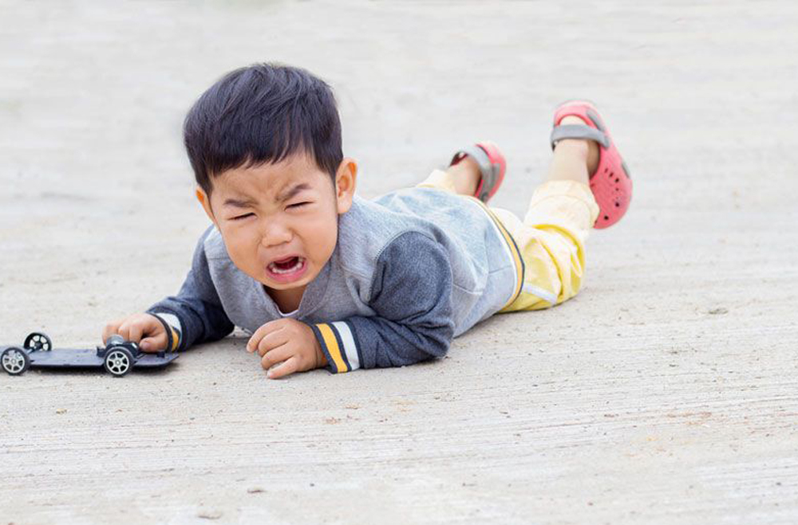
“When inwardly-focused, self-serving members do not get their way in worship styles, pastoral attention, music choices, and carpet colours, they pitch holy temper tantrums and begin to ask what the church is doing for them. A divided church is inevitably an inwardly focused church.”
Thom Rainer, “Breakout churches”

Slide 6
Philippians 1:27
“Whatever happens conduct yourselves in a manner worthy of the gospel of Christ.”
Paul looked straight at the Sanhedrin and said, ‘My brothers, I have fulfilled my duty to God in all good conscience to this day.’ (Acts 23:1)
“whether I come and see you or only hear about you in my absence…”
“... I will know that you stand firm in the one Spirit striving together as one for the faith of the gospel.”

Slide 7
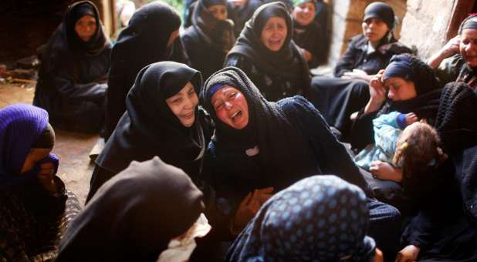
Philippians 1:28
Without being frightened in any way by those who oppose you.
20 I eagerly expect and hope that I will in no way be ashamed, but will have sufficient courage so that now as always Christ will be exalted in my body, whether by life or by death. 21 For to me, to live is Christ and to die is gain.
For the creation waits in eager expectation for the children of God to be revealed. Romans 8:19

Slide 8
So what is the context of Paul's plea for Unity?
Conduct yourselves in a manner worthy of the gospel. Unity expresses the very character of God and the reconciliation of the gospel
If they are going to stand firm against those who oppose them, they must do it together.

Slide 9
How to Build Unity
Agree on the non-negotiables
In the beginning God created the heavens and the earth
The magnificence and faithfulness of God
The fatherhood of God
The authority of God’s Word
The identity and mission of Jesus including his death and resurrection from the dead
The person and work of the Holy Spirit
Assurance of Salvation in Christ Alone by faith alone

Slide 10
How to Build Unity
Agree on the non-negotiables
Grace not works
Freedom to obey not the duty of legalism
Holiness not sinning it up
The sanctity of life
The importance of Christian marriage
Living out and preaching the gospel of the kingdom of God as his church in the world

Slide 11
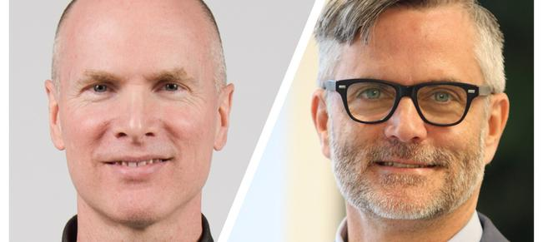
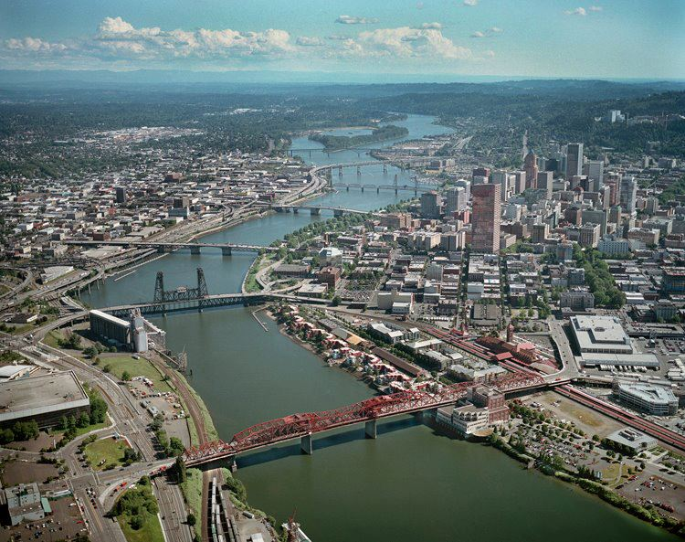
How to Build Unity
We can work with people with whom we share a common goal

Slide 12
How to Build Unity
Purposeful
Organised
People
Together
Achieving
Remarkable
Targets

Slide 13
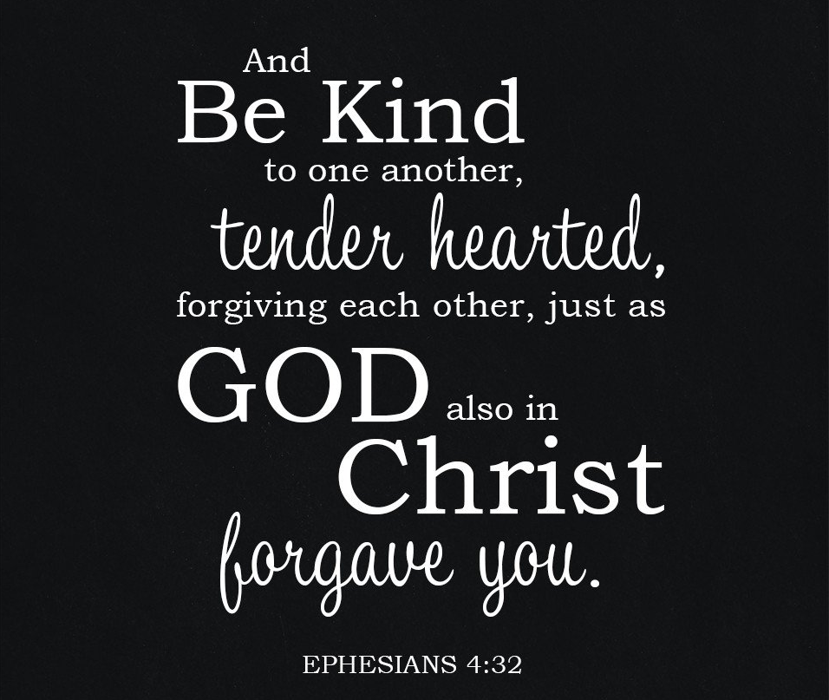
How to Build Unity

Slide 14
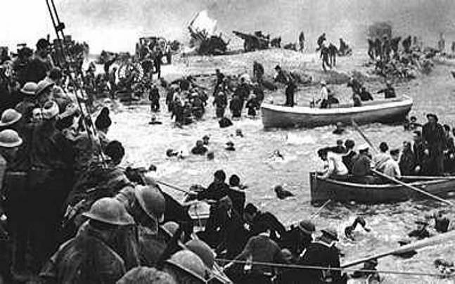
A united effort

Slide 15
Unity – with purpose
The task was worth it. Jesus was worth it.
And he would be exalted in Paul’s life or in his death.
He couldn’t lose – and neither can we
As we strive together as one for the faith of the gospel.

