Slide 1
God Causes the Growth
1 Corinthians 3:1-23

Slide 2
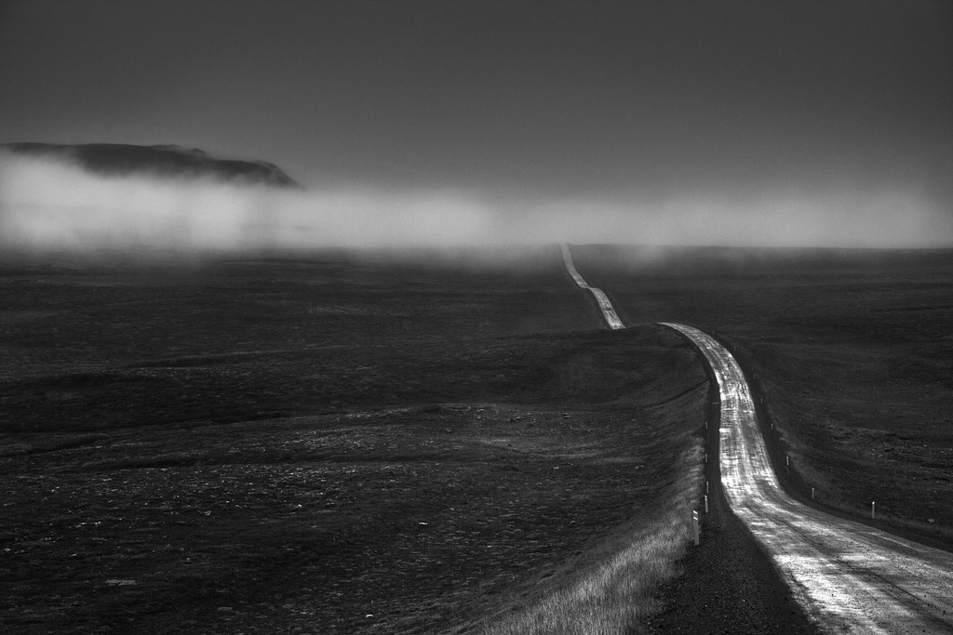
We're on a road to nowhere -Talking Heads
We're on a road to nowhere Come on inside Takin' that ride to nowhere We'll take that ride
Notes:
You’ve probably heard the conversation, one person says to another: “Where are we going?” The other person replies: “I don’t know, but we’re making excellent progress!”
<CLICK>
{Song from 1985}
The question of the direction and meaning in life has haunted philosophers and teenagers from millennia. Walt Whitman expressed the question well in this poem:

Slide 3
Walt Whitman
Oh me! Oh life! of the questions of these recurring,
Of the endless trains of the faithless, of cities fill’d with the foolish …
The question, O me! so sad, recurring—What good amidst these, O me, O life?
Answer:
That you are here—that life exists and identity,
That the powerful play goes on, and you may contribute a verse.

Slide 4
Why bother?
… Why do we endanger ourselves every hour? ³¹ I face death every day – yes, just as surely as I boast about you in Christ Jesus our Lord. ³² If I fought wild beasts in Ephesus with no more than human hopes, what have I gained? If the dead are not raised, ‘Let us eat and drink, for tomorrow we die.’
1 Corinthians 15:30-32
Notes:
Paul’s goal in life was fuelled by his confidence in Christ and his hope in the resurrection Chapter 15:30-32 In chapter 15 he passionately argues that if Christ is not raised, their faith is in vain and his preaching is useless. Listen to his words:
(Verse)
He is saying - if there is no real purpose to his life, then he might as well relax and enjoy the party! Kind of like Nathan Peterson …

Slide 5
Faith Without Works Incredibly Relaxing - Babylon Bee, February 20th, 2019
Notes:
Faith Without Works Incredibly Relaxing - Babylon Bee, February 20th, 2019
VALDOSTA, GA—After spending several years wallowing in sin and not bothering to allow the Holy Spirit to change his life in any way, local Christian man Nathan Peterson confirmed his findings Wednesday that having faith without works is in fact "incredibly relaxing."
"Faith alone saves," he told reporters. "But after you're saved, it's important not to do anything at all to contribute to your sanctification. Can you imagine the kind of work I'd have to put into that? I'd have no time for the latest battle royale game, or idly browsing Facebook on my smartphone."
Peterson pointed out that faith without works allows for a much easier life. "If I allowed my saving faith to be shown through my works, I'd have to be, like, a lot more disciplined. Like a disciple or something. Dying to myself? That just sounds like a whole lot of work."
The man has also torn the book of James out of his Bible as he found it "offensive" and "problematic." "Yeah, James was really harshing my mellow," he said. "All that stuff about faith without works being dead? It was a total bummer."
At publishing time, Peterson was binge-watching Breaking Bad a third time.
Peterson (not a real person) is a guy lacking purpose.
But here’s the (not so) secret: [quietly say this] the gospel is true. Jesus DID rise from the dead and so our lives are infused with purpose - in fact the whole creation is saturated with it!

Slide 6
Paul’s life’s mission
²⁸ He is the one we proclaim, admonishing and teaching everyone with all wisdom, so that we may present everyone fully mature in Christ. ²⁹ To this end I strenuously contend with all the energy Christ so powerfully works in me. Colossians 1:28-29
Full maturity
²⁸ And we know that in all things God works for the good of those who love him, who have been called according to his purpose….
Notes:
So what was Paul’s life’s mission?
(Verse 1)
<CLICK>
Full maturity - nothing less that vital, healthy disciples of Jesus.
So, we’re on a road to nowhere maturity!
Listen to this:
<CLICK>
(Verse 2)

Slide 7
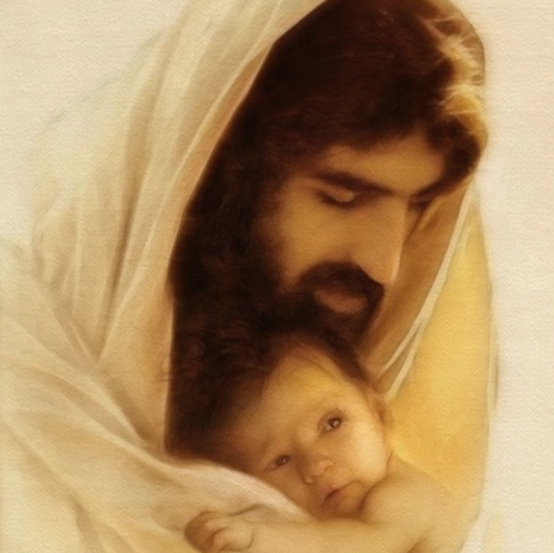
Paul’s life’s mission
²⁹ For those God foreknew he also predestined to be conformed to the image of his Son, that he might be the firstborn among many brothers and sisters. ³⁰ And those he predestined, he also called; those he called, he also justified; those he justified, he also glorified.
Romans 8:28-30
Notes:
(Verse)
Another way of describing maturity is becoming like Jesus.

Slide 8
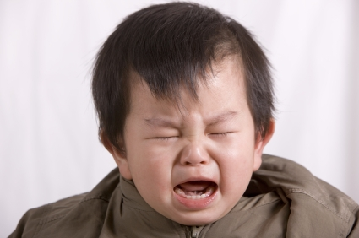
How were the Corinthians doing?
3 Brothers and sisters, I could not address you as people who live by the Spirit but as people who are still worldly – mere infants in Christ.
Notes:
(Slide)
How were they doing?
Not so good.
“I could not address you as people who live by the Spirit.”
See 2:6-16. The Spirit comes to live in us and teach us the wisdom and ways of God. When the Spirit comes, our lives change! Well, that’s what supposed to happen. But their lives didn’t look much different to those around them.

Slide 9
What are the marks of a mature disciples of Jesus?
Pursues unity
² Brothers and sisters, I could not address you as people who live by the Spirit but as people who are still worldly – mere infants in Christ. ² I gave you milk, not solid food, for you were not yet ready for it. Indeed, you are still not ready. ³ You are still worldly. For since there is jealousy and quarrelling among you, are you not worldly? Are you not acting like mere humans? ⁴ For when one says, ‘I follow Paul,’ and another, ‘I follow Apollos,’ are you not mere human beings? 1 Cor. 3:1-4
Notes:
Today I want us to focus on this purpose of becoming mature, or complete in Christ. What are the marks of a mature disciples of Jesus? What are the distinguishing features? Because if we know what a mature disciple looks like, we can seek to build those qualities into ur own lives. Because if we aim at nothing …. [we’re sure to hit it.]
ONE: [A MATURE BELIEVER IS ONE WHO ] PURSUES UNITY
A negative example …
<CLICK>
(Verse)

Slide 10
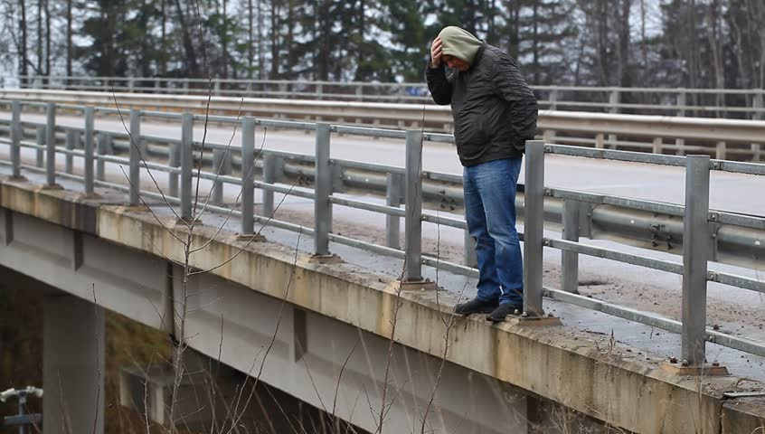
1. Pursues Unity
Notes:
Sadly, the world seems to be becoming ever more tribal.
An old joke goes like this:
Once I saw this guy on a bridge about to jump. I said, "Don't do it!" He said, "Nobody loves me." I said, "God loves you. Do you believe in God?"
He said, "Yes." I said, "Are you a Christian or a Jew?" He said, "A Christian." I said, "Me, too! Protestant or Catholic?" He said, "Protestant." I said, "Me, too! What franchise?" He said, "Baptist." I said, "Me, too! Northern Baptist or Southern Baptist?" He said, "Northern Baptist." I said, "Me, too! Northern Conservative Baptist or Northern Liberal Baptist?"
He said, "Northern Conservative Baptist." I said, "Me, too! Northern Conservative Baptist Great Lakes Region, or Northern Conservative Baptist Eastern Region?" He said, "Northern Conservative Baptist Great Lakes Region." I said, "Me, too!"
Northern Conservative†Baptist Great Lakes Region Council of 1879, or Northern Conservative Baptist Great Lakes Region Council of 1912?" He said, "Northern Conservative Baptist Great Lakes Region Council of 1912." I said, "Die, heretic!" And I pushed him over.
Silly, but with a point. The church keeps splintering and segregating along theological (and other) lines - but our Lord prayed for unity.

Slide 11
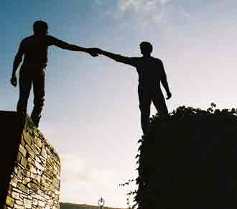
1. Pursues Unity
¹⁸ If it is possible, as far as it depends on you, live at peace with everyone. Romans 12:18
Make every effort to keep the unity of the Spirit through the bond of peace. Ephesian 4:3
Notes:
The mature believer doesn’t place doctrinal purity over relationship. He or she stays at the table as long as possible. Paul writes,
(Verse)

Slide 12
Question
Am I making every effort to keep the bond of peace - with family, friendship group, colleagues and church members?

Slide 13
What are the marks of a mature disciples of Jesus?
Pursues unity
Keeps growing
⁵ What, after all, is Apollos? And what is Paul? Only servants, through whom you came to believe – as the Lord has assigned to each his task. ⁶ I planted the seed, Apollos watered it, but God has been making it grow. ⁷ So neither the one who plants nor the one who waters is anything, but only God, who makes things grow. 3:5-7
Notes:
TWO: [A MATURE BELIEVER IS ONE WHO IS ] GROWING
(Verse)

Slide 14
2. Keeps growing
The seed is the the gospel
"A walloping great congregation is fine and fun, but what most communities really need is a couple of saints. The tragedy is that they may well be there in embryo, waiting to be discovered, waiting for sound training, waiting to be emancipated from the cult of the mediocre."
Martin Thornton
Notes:
The seed is the the gospel - the plant is the person who responds. Remember the parable of the soils? 4 responses, according to the quality of the soil and the presence of some very strangly weeds! But when the conditions are right. The plants sprouts up. That’s what they are made for. So are disciples. Disciples grow - or do they?
<CLICK>
Martin Thornton writes:
"A walloping great congregation is fine and fun, but what most communities really need is a couple of saints. The tragedy is that they may well be there in embryo, waiting to be discovered, waiting for sound training, waiting to be emancipated from the cult of the mediocre."
Are we growing or are we stagnating?
[Share Bianca’s story]. Bianca has been in a hot house environment for the past few years. She’s grown heaps and she’s ready to take the next step.
Her story shouldn’t be unusual. It should be the norm.

Slide 15
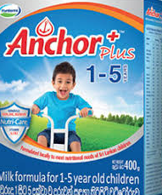
How do we grow?
² I gave you milk, not solid food, for you were not yet ready for it.
1 Cor. 3:2
… the lust of the flesh, the lust of the eyes, and the pride of life …
1 John 2:16
Notes:
How do we grow? Verse 2 gives us a clue. ² I gave you milk, not solid food, for you were not yet ready for it. Solid food and exercise are the keys to a balanced lifestyle!
In the spiritual realm, we feed on the Word of God and we do the Works of God in the power of the Holy Spirit. Simple! Yes, on one level it is.
<CLICK>
But 1 John 2:16 reminds us that the lust of the flesh, the lust of the eyes, and the pride of life are all waiting to trip us up. Therefore we cannot be complacent. We must have a strategy for our own growth. Yes, God causes the growth but we must keep opening our lives up to his Spirit.

Slide 16
Questions
Am I making every effort to keep the bond of peace - with family, friendship group, colleagues and church members?
What do I need to do more / less of to help me grow?
Notes:
Question 2

Slide 17
What are the marks of a mature disciples of Jesus?
Pursues unity
Keeps growing
Passes the test
⁸ The one who plants and the one who waters have one purpose, and they will each be rewarded according to their own labour. ⁹ For we are fellow workers in God’s service; you are God’s field, God’s building.
Notes:
THREE: [A MATURE BELIEVER IS ONE WHO ] PASSES THE TEST
In this chapter Paul moves from one metaphor to another:
<CLICK>
(Verse)

Slide 18
3. Passes the Test
¹⁰ By the grace God has given me, I laid a foundation as a wise builder, and someone else is building on it. But each one should build with care. ¹¹ For no one can lay any foundation other than the one already laid, which is Jesus Christ.
¹² If anyone builds on this foundation using gold, silver, costly stones, wood, hay or straw, ¹³ their work will be shown for what it is, because the Day will bring it to light. It will be revealed with fire, and the fire will test the quality of each person’s work.

Slide 19
3. Passes the Test
The foundation is Christ alone
There is a choice of building materials
There is a testing fire
Notes:
Notice that the foundation is Christ alone.
Notice there is a choice of building materials. Now, much ink has been spilled over what these building materials represent. But the most important thing we need to know about them is this: will they pass the test? Will the people’s faith be proved genuine? Will OUR faith be proved genuine?
Notice the testing fire. What is the fire?

Slide 20
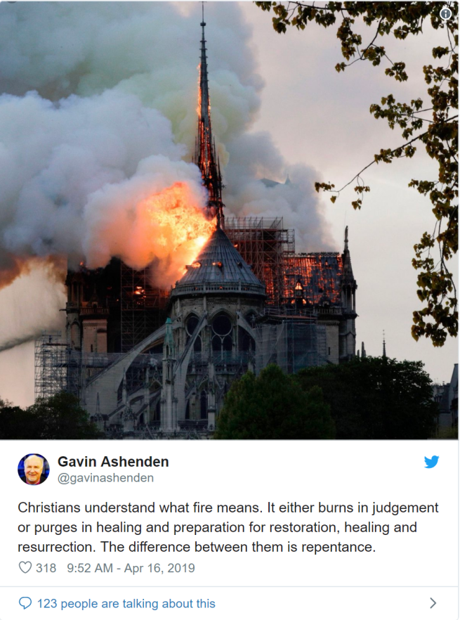
Notes:
An Anglican bishop tweeted after the notre Dame fire:
“Christians understand what fire means. It either burns in judgement or purges in healing and preparation for restoration, healing and resurrection. The difference between them is repentance.”
Gavin is talking about the fires in this life, which come to test our faith.

Slide 21
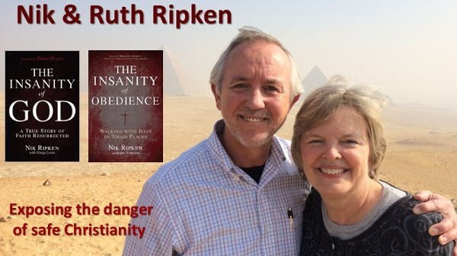
3. Passes the Test
Notes:
In his book, The Insanity of God, Nick Ripkin meets up with leaders in the house church movement in China.
One of the younger men in the room, perhaps twenty-five years old, was already anxious to set a time for an individual interview appointment. He and I set a time for later that night. After we were out of earshot from that young house-church leader, my host leaned toward me and whispered: “He’s going to be someone God can use in a powerful way someday. But you cannot trust what he says now; he hasn’t been to prison yet.” This was an attitude that I would encounter often in China.
Personal trust and respect for spiritual maturity were often in direct proportion to the amount of suffering that had been endured for the faith. If someone had not yet experienced personal persecution and suffering, trust was withheld until that happened.
It seemed that most of the house-church leaders in the room had served at least one three-year prison term for their faith.
When they went to prison, small groups of believers would band together for fellowship and study. They encouraged each other to share their faith, to win converts among their fellow prisoners, and to plant other small churches in various parts of the prison. Amazingly, there was a huge church-planting movement within China’s prisons!
They come out of the experience with a much stronger relationship with the Lord. One of the house-church leaders actually asked me, “Do you know what prison is for us? It is how we get our theological education. Prison in China is for us like seminary is for training church leaders in your country.”

Slide 22
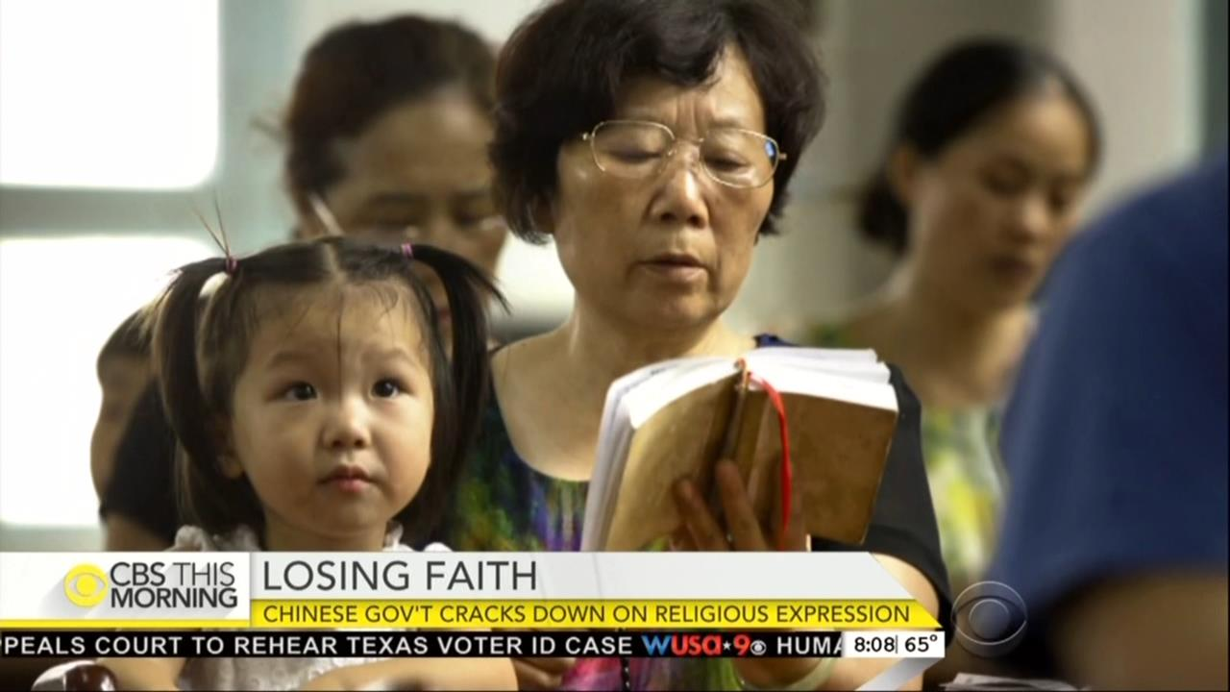
3. Passes the Test
The fires of persecution have fanned the flames of faith in China and around the world
All of us will face a testing which will determine our future rewards in God’s kingdom
How do we know if our lives will pass the test?
Notes:
So …
(Points 1 and 2)
<CLICK>
How …?

Slide 23
3. Passes the Test
All our works accomplished with the help of the Spirit of God will be proved genuine and in some sense eternal. All our works accomplished with merely human effort and wisdom, will be like ash in the fire or autumn leaves on Vincent Street, they will all blow away.
Notes:
Here’s the thing …

Slide 24
3. Passes the Test
“The idea that our eternal happiness is at all contingent on performance in this life should be fundamentally depressing for all who are honest about their level of maturity or growth in the faith.”
Craig L. Blomberg
“fundamentally depressing challenging and inspiring”
Notes:
Bible scholar, Craig L. Blomberg writes,
(Quote)
<CLICK>
Woah. What a challenge! But I react to his words, “fundamentally depressing”. I would prefer the words, “challenging and inspiring”. Because if we have the Spirit of God in our lives, which we do, then he will help us build a strong character and a lasting legacy.

Slide 25
Questions
Am I making every effort to keep the bond of peace - with family, friendship group, colleagues and church members?
What do I need to do more / less of to help me grow?
What am I “building” with? Spirit-led obedience or something else?
Notes:
QUESTION 3

Slide 26
What are the marks of a mature disciples of Jesus?
Pursues unity
Keeps growing
Passes the test
Is humble
¹⁸ Do not deceive yourselves. If any of you think you are wise by the standards of this age, you should become ‘fools’ so that you may become wise. ¹⁹ For the wisdom of this world is foolishness in God’s sight.
Notes:
FOUR: [A MATURE BELIEVER IS ONE WHO IS:] HUMBLE

Slide 27
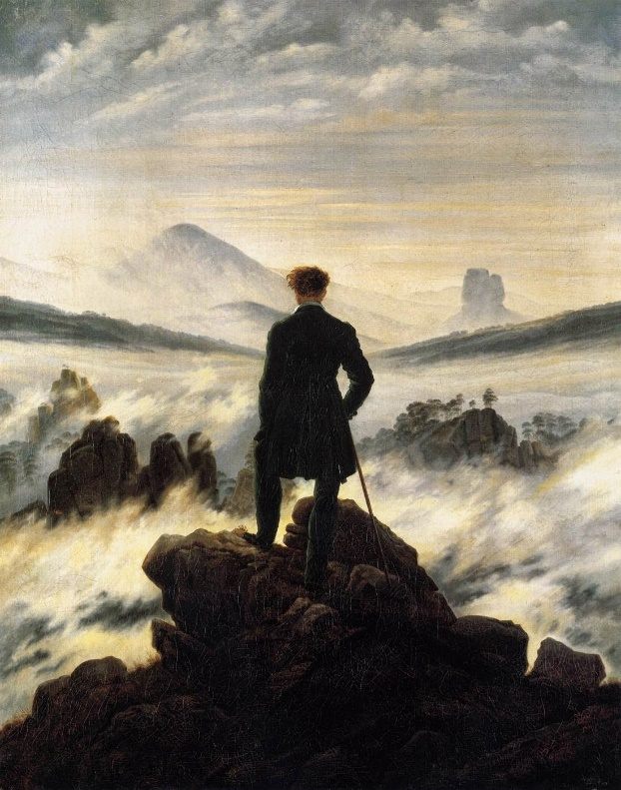
4. Is Humble
As it is written: ‘He catches the wise in their craftiness’; ²⁰ and again, ‘The Lord knows that the thoughts of the wise are futile.’ ²¹ So then, no more boasting about human leaders! All things are yours, ²² whether Paul or Apollos or Cephas or the world or life or death or the present or the future – all are yours, ²³ and you are of Christ, and Christ is of God.
Notes:
(Verses)
[Share my story from Wellington 1987 - God doesn’t want to hurt your pride …]
So then, no more boasting … All things are yours, including the world and life and death and the present and the future – all are yours, ²³ and you are of Christ, and Christ is of God.

Slide 28
4. Is Humble
²⁵⁻²⁶ Since this is the kind of life we have chosen, the life of the Spirit, let us make sure that we do not just hold it as an idea in our heads or a sentiment in our hearts, but work out its implications in every detail of our lives. That means we will not compare ourselves with each other as if one of us were better and another worse. We have far more interesting things to do with our lives. Each of us is an original.
Galatians 5:25-26(MSG)
Notes:
I love how Eugene Peterson explains Galatians 5:25-26
(Verses)

Slide 29
Questions
Am I making every effort to keep the bond of peace - with family, friendship group, colleagues and church members?
What do I need to do more / less of to help me grow?
What am I “building” with? Spirit-led obedience or something else?
Do I feel the urge to impress other people or compare myself with them?
Notes:
QUESTION 4
Then to paraphrase the Apostle Paul, “Stop it!”
So we’ve looked at some qualifies of mature believers. They are not exhaustive but they are challenging and inspiring (rather than fundamentally depressing)! Remember we need to have a strategy for our own development but it is God who causes the growth. Keep remaining open to Him and allow Him to work in your life - then you will pass the test with flying colours.
[Pray]

