Slide 1
Don't be Benign, Shine!
Philippians 2:14-16

Slide 3
The Good News is sooo good
It answers our yearning for a better world.
Human beings were made with incredible worth and dignity.
The bad news is really bad - we all stand condemned before a holy God.
The incomparable life and ministry of Jesus Christ
We’re on a magnificent quest to bring hope and healing to the world; and
The grace of God in Christ brings us forgiveness, eternal life and the power of the Spirit

Slide 4
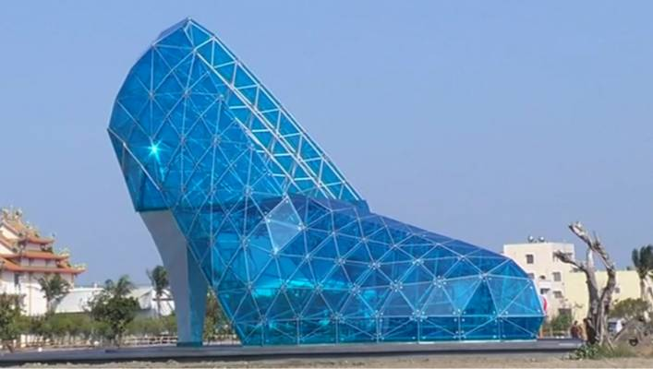
High-Heeled Shoe Church, Taiwan

Slide 5
Philippians 2:14-16
¹⁴ Do everything without complaining or arguing, ¹⁵ so that you may become blameless and pure, children of God without fault in a crooked and depraved generation, in which you shine like stars in the universe ¹⁶ as you hold out (or hold on to) the word of life—in order that i may boast on the day of Christ that I did not run or labour for nothing.

Slide 6
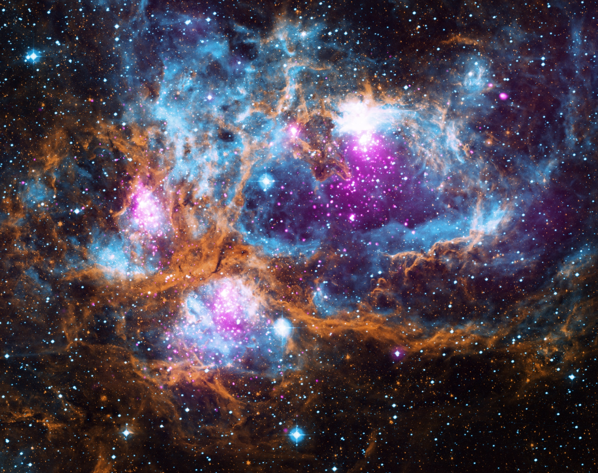

Slide 7
1. Watch what you say
"How long will this wicked community grumble against me? In this wilderness your bodies will fall, every one of you who has grumbled against me."
Numbers 14:27,29

Slide 8
1. Watch what you say
²⁰ I have no one else like him, who will show genuine concern for your welfare. ²¹ For everyone looks out for their own interests, not those of Jesus Christ.
Don’t entertain gossip
Have sufficient witnesses
Complain to God

Slide 9
1. Watch what you say
Why, Lord, do you stand far off? Why do you hide yourself in times of trouble?
Psalm 10:1
Awake, Lord! Why do you sleep? Rouse yourself! Do not reject us for ever.
Psalm 44:23
Why do you hold back your hand, your right hand? Take it from the folds of your garment and destroy them!
Psalm 74:11

Slide 10
2. Hold on to what God says

Slide 11
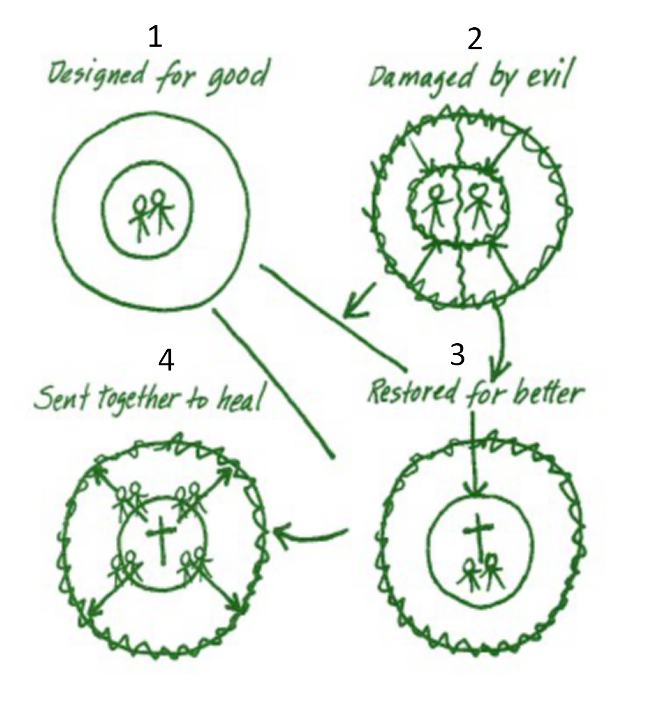
The Big Story
It talks about sin in terms of our relationship with God, each other and the created world
It doesn’t stop with the death and resurrection of Christ or even belief in Him - it includes the Great Commission to make disciples and build God’s kingdom
It emphasises grace - it is not possible to go straight to “Circle 4” without first going through “Circle 3”, Christ.

Slide 12
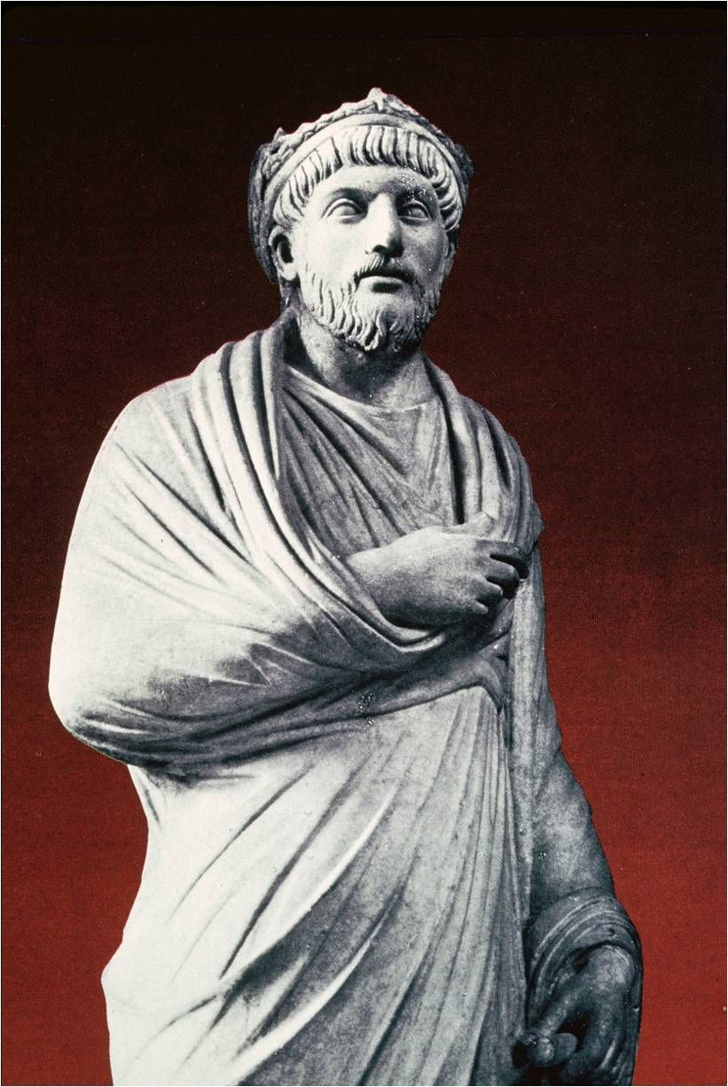
Secret of the Christians
“The recent Christian growth was caused by their “moral character, even if pretended and by their benevolence toward strangers and care for the graves of the dead."
The Emperor Julian, 362 AD

Slide 13
All about Jesus
It’s all about You, Jesus
And all this is for You
For Your glory and Your fame
It’s not about me
As if You should do things my way
You alone are God and I surrender
To Your ways
Paul Oakley

Slide 14
Imagine …
“…a ragtag collection of surrendered and transformed people who love God and others. They are mesmerised by the idea that this is not about them； but all about Jesus. They are transfixed by His story and His heart for the city.
They are seed-sowers and fire-starters, hope peddlers and grace-givers, risk- takers and dreamers, young and old. They link arms with anyone who tells the story of Jesus. They empower the poor, strengthen the weak, embrace the outcast, seek the lost. They serve together, pi ay together^ worship together, live life together.
Their city will change because God sent them. They are us. We believe that small things done with great love will change the world.”
Vineyard Church, Cincinnati

