Slide 1
Why the Good News is sooo Good!
Psalm 14 etc

Slide 2
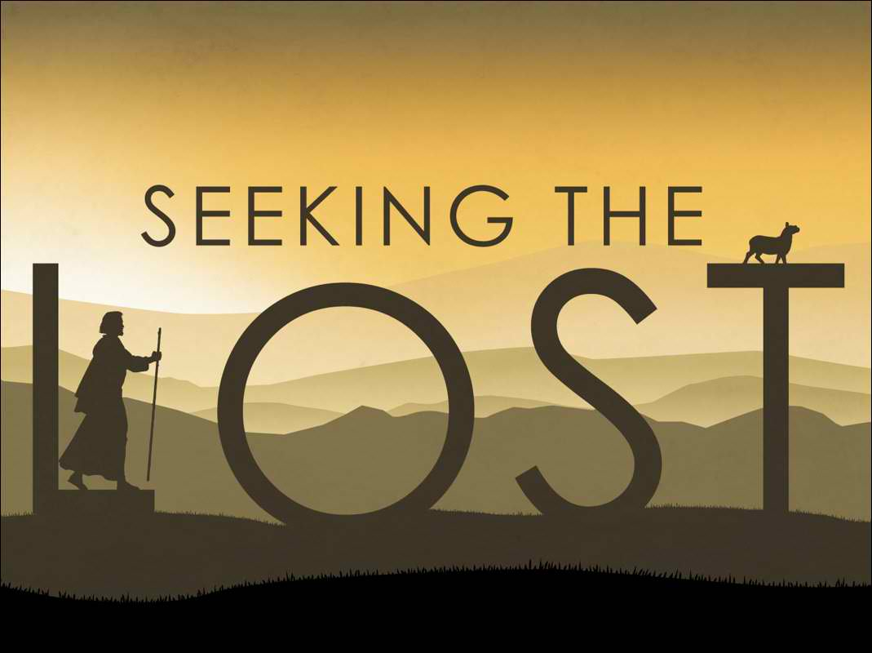

Slide 3
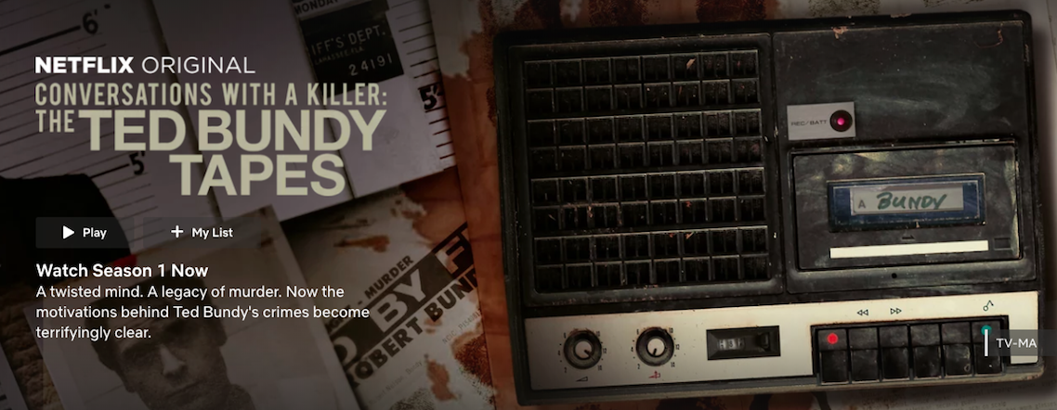
The Good News is sooo good because it answers our yearning for a better world
The fool says in his heart there is no God - Psalm 14:1a
"Will somebody please do something about this?"

Slide 4
The Good News is sooo good because human beings were made with incredible worth and dignity
The Lord looks down from heaven on all mankind to see if there are any who understand, any who seek God.
Psalm 14:2
Human beings have the capacity to seek God. Because we - both male and female - reflect His image.
Today we have a crisis of identity

Slide 5
They are corrupt, their deeds are vile; there is no one who does good.
All have turned away, all have become corrupt; there is no one who does good, not even one.
Psalms 14:1b, 3
For all have sinned and fallen short of the glory of God – Romans 3:23
Instead of fulfilling the mandate to manage the planet, care for each other and love God, we have despised God, abused our neighbours, and vandalized the Earth.

Slide 6
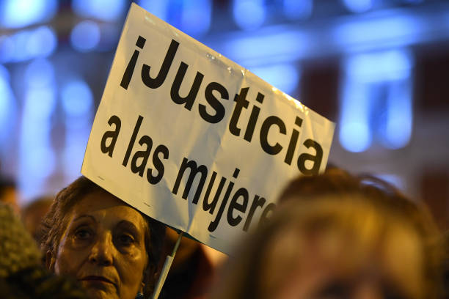
The Good News is sooo good because the bad news is so bad. We - and all of humanity - stand condemned before a holy God.
The result: we face death and eternal separation from God.
In our heart of hearts we have a deep hunger for justice

Slide 7
Oh, that salvation for Israel would come out of Zion! When the Lord restores his people, let Jacob rejoice and Israel be glad!
Psalm 14:8

Slide 8
The Messiah turned out to be quite different from what they expected
He came not in a blaze of glory but as a baby in a manger.
He wasn’t cushioned from the hardships of this world but was a man of suffering, and familiar with pain
He came not to be served but to serve and to give his life a ransom for many.
He came not as an untouchable deity though deity he was - but as a human man who touched and cried and raged and slept.
He touched the lepers, welcomed the children, talked with women, dined with sinners, trained his disciples, criticised the religious leaders.

Slide 9
His Greatest Work
“Absorbing the worst that human beings can offer—crooked religiosity, petty political systems, individual betrayal, physical torture with whip and thorn and nail and hammer and spear—Jesus enters into the centre of the thunderstorm of human evil and takes its full shock on the cross. Our evil is brutally, unmistakably exposed, drawn into broad daylight, and judged—named and shown for what it is. Then, having felt its agony and evil firsthand, in person, Jesus pronounces forgiveness and demonstrates that the grace of God is more powerful and expansive than the evil of humanity. Justice and mercy kiss; judgment and forgiveness embrace. From their marriage a new future is conceived.”
Brian McLaren, Generous Orthodoxy

Slide 10
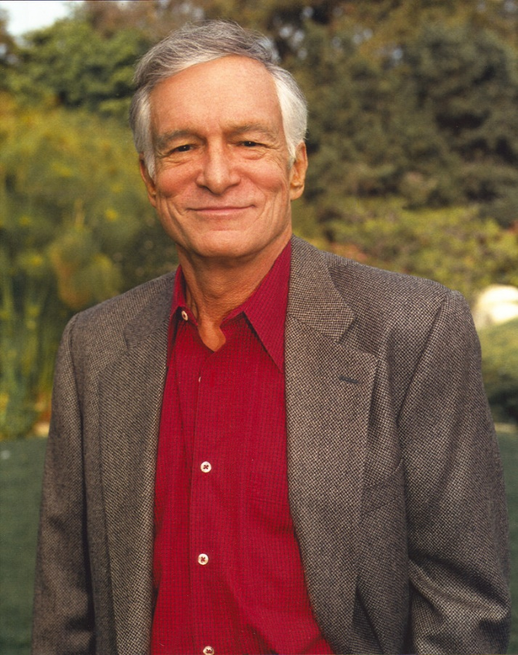
The Good News is sooo Good because of the incomparable life and ministry of Jesus Christ
“The God of Christianity is a little too childlike for me. But If one had any real evidence that, indeed, Jesus did return from the dead, then that is the beginning of a dropping of a series of dominoes that takes us to all kinds of wonderful things. It assures an afterlife and all kinds of things that we would all hope are true."
Hugh Hefner

Slide 11
Jesus has now sent us - his church - into the world to proclaim this Good News to everyone
We must take the whole message
If we don’t care about putting the world right
… then we won’t be representing the whole gospel
We’ve been sent to announce a new world that is coming
Let’s do our every day work with a renewed sense of mission and ask God - what is the kingdom response in this situation?

Slide 12
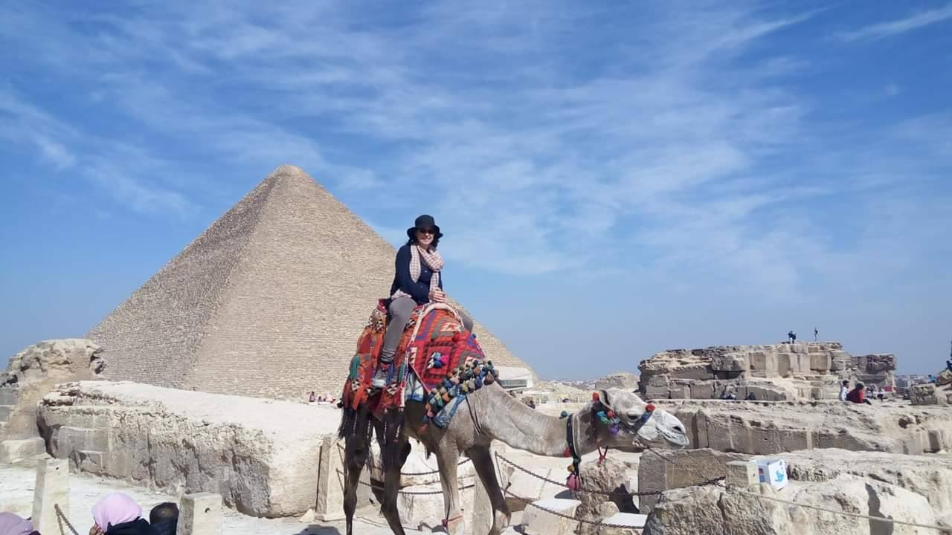
The Good News is sooo Good because we’re on a magnificent quest to bring hope and healing to the world

Slide 13
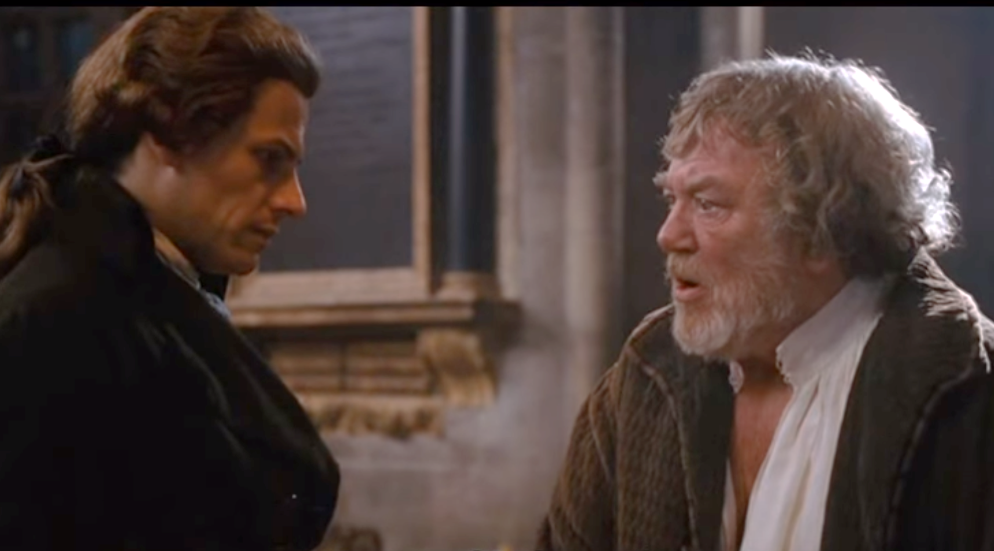
“Why can’t I just do that without Christ - why do I need Him?”
Because it won't work.
We, and the world, are damaged and need healing before we can help heal those around us.
We need grace.

Slide 14
The Good News is sooo Good because …
It answers our yearning for a better world.
Human beings were made with incredible worth and dignity.
The bad news is really bad - we all stand condemned before a holy God.
The incomparable life and ministry of Jesus Christ
We’re on a magnificent quest to bring hope and healing to the world
The grace of God in Christ brings us forgiveness, eternal life and the power of the Spirit

